Slide 2
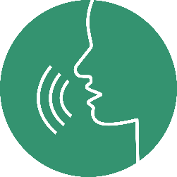
PRONUNCIATION
LESSON 6
SPEAKING

Slide 4
Pronunciation
Sound changes
b. Listen . Notice the sound changes of the underlined words.
Do you get enough sleep?
Do you eat a lot of fast food?
c. Listen and cross out the sentences that doesn’t follow the note in “a”.
Do you do exercise?
Do you eat fresh fruit?
d. Read the sentences with the sound changes noted in “a” to a partner.

Slide 5
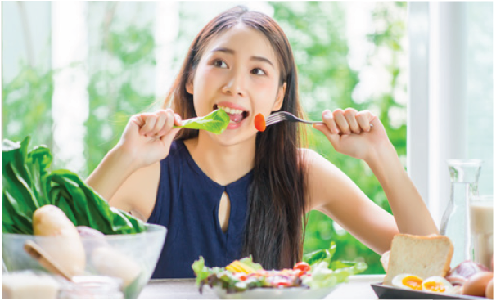
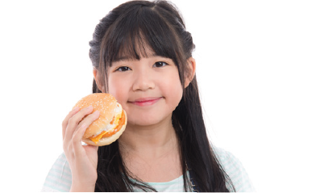
Pair-work: Look at the following photos and make questions with DO YOU /dju:/. Then, take turns to ask and answer.
Do you eat fruit and vegetables every day?
Do you often drink soda?
Do you usually eat fast food?
Do you play games every night?

Slide 6
Practice the conversation with your partner. Swap roles and repeat.

Slide 7
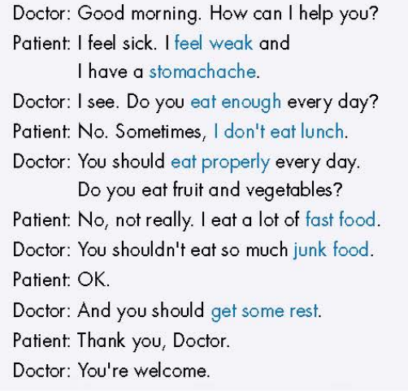
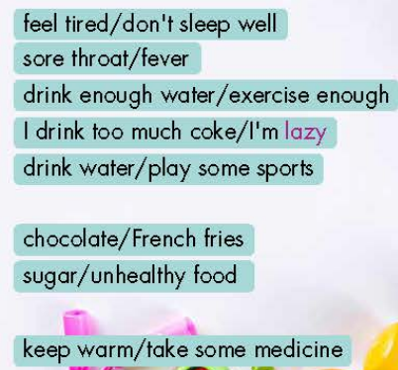
Practice with your own idea.

Slide 8
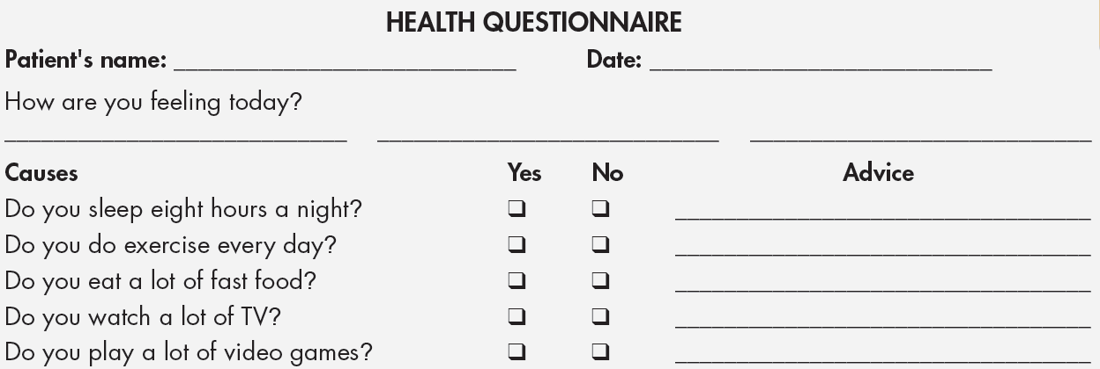
a. In pairs: Student B, p.118 File 2 . Student A, you're a doctor giving advice to a sick patient. Ask your patient questions, complete the questionnaire, and give advice if you need to for each question.

Slide 9
b. Swap roles. Student A, now you're the patient. Student B, the doctor, changes the questionnaire based on the patient’s problems. The patient answers the doctor's questions and write down the advice.
You have a cough, a headache, and you feel weak. You eat a lot of fast food and you always watch TV until midnight.
Doctor’s advice
You should __________________
You shouldn’t _________________

Slide 10
Unit 2: HEALTH
Lesson 6: Pronunciation + Speaking
Practice sound change with DO YOU /dju:/.
- Practice giving advice and persuading someone to have a healthy lifestyle with SHOULD

Slide 11
HOMEWORK
- Make 2 questions with the phrase “Do you…?”and practice reading them.
- Complete the questionnaire for those who haven’t finished it in class.
- Prepare: Lesson 3 – Listening and Reading (page 18– SB).
- Review the vocabulary and grammar notes in Tiếng Anh 7 i-Learn Smart World Notebook
(pages 12 & 13).

