Slide 2
WARM-UP
Ms Phương
Zalo: 0966765064

Slide 3
NEW WORDS
LESSON 1
READING

Slide 4
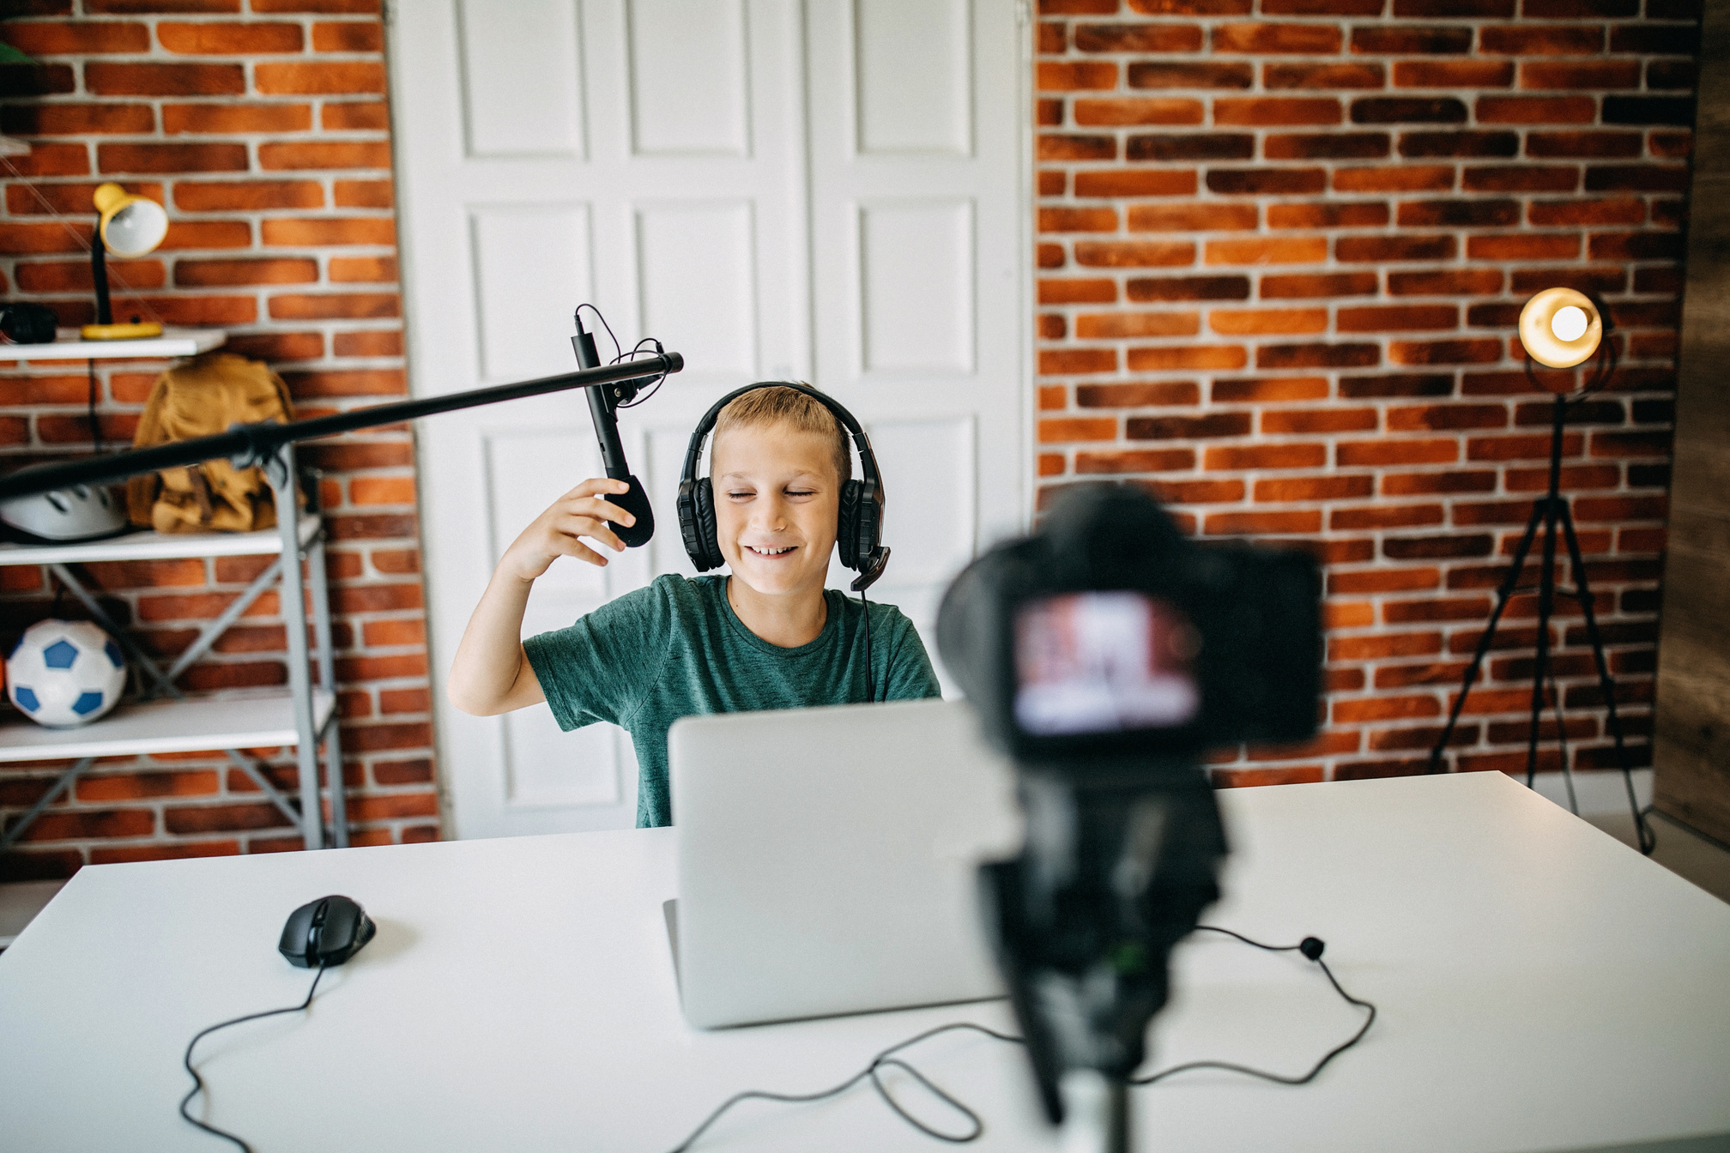
make vlogs
/meɪk vlogs/
Ms Phương
Zalo: 0966765064
Làm vlog
My brother often makes vlogs in his free time.
Anh trai tôi thường làm vlog trong thời gian rảnh rỗi.

Slide 5
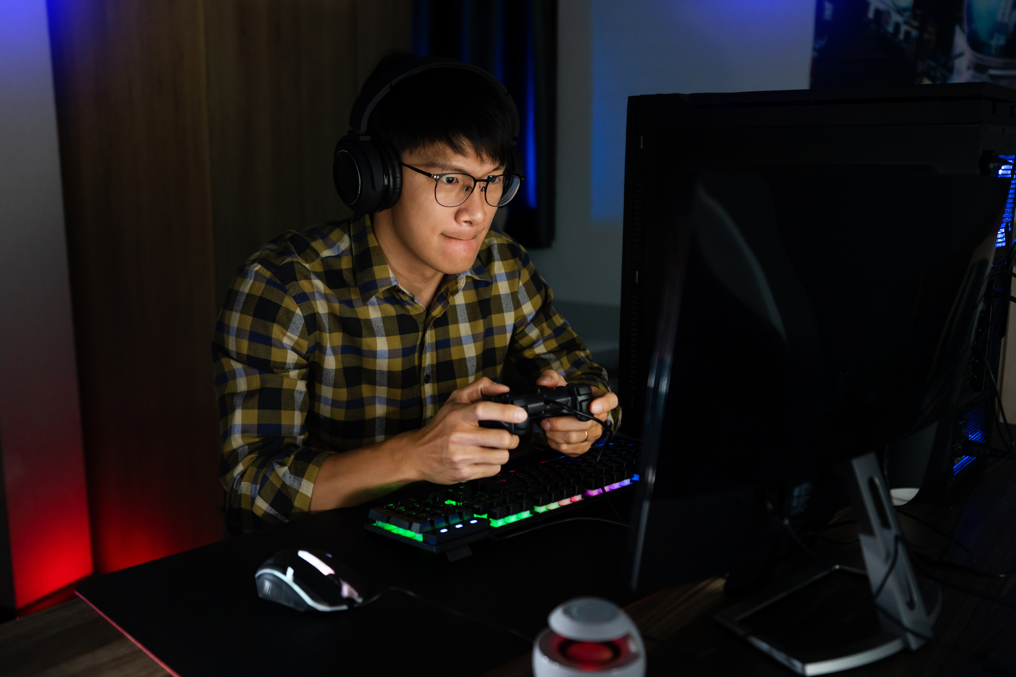
play online games
/pleɪ ˈɒnˌlaɪn geɪmz/
Ms Phương
Zalo: 0966765064
Chơi trò chơi điện tử.
Playing too much online games is very bad for your health.
Chơi nhiều trò chơi điện tử thì rất không tốt cho sức khoẻ.

Slide 6
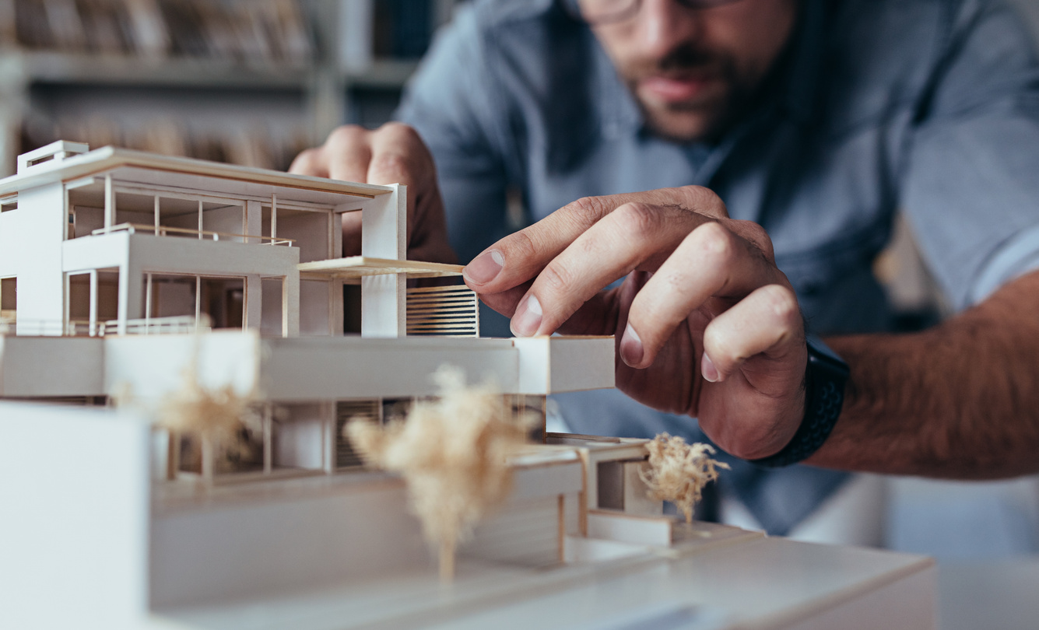
build models
/ˈterəbl/
Ms Phương
Zalo: 0966765064
Làm mô hình
Building models is one of my favorite activities.
Làm mô hình là một trong các hoạt động yêu thích của tôi.

Slide 7
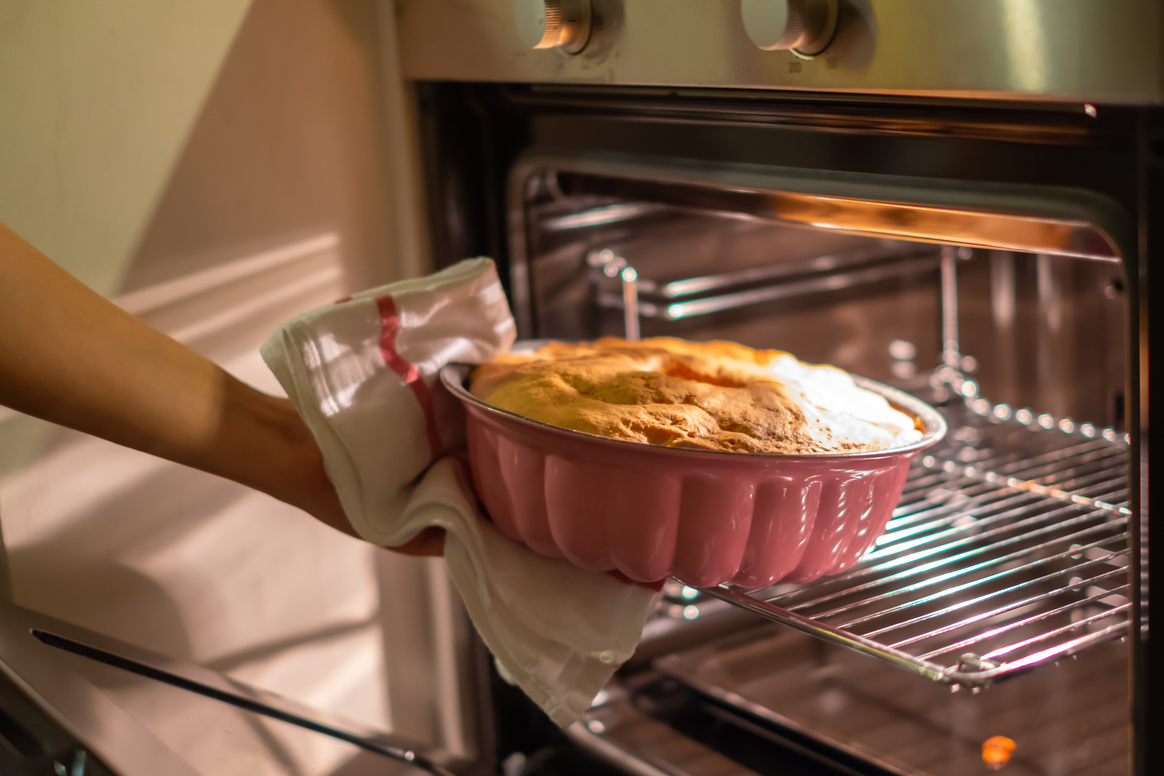
bake cakes
/beɪk keɪks/
Ms Phương
Zalo: 0966765064
Nướng bánh
My mother enjoys baking cakes at the weekend.
Mẹ tôi thích nướng bánh vào cuối tuần.

Slide 8
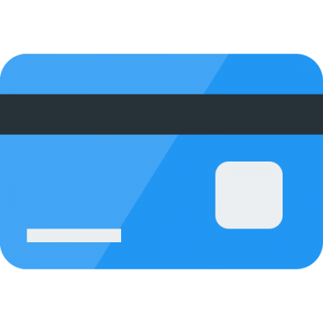
BÀI GIẢNG THUỘC QUYỀN SỞ HỮU TRÍ TUỆ CỦA E-TEACHERS. NGHIÊM CẤM MỌI HÀNH VI SAO CHÉP, PHÁT TÁN CHIA SẺ , MUA ĐI BÁN LẠI KHI CHƯA ĐƯỢC SỰ ĐỒNG Ý CỦA E-TEACHERS
ỦNG HỘ CHẤT XÁM CỦA ĐỒNG NGHIỆP LÀ ĐANG TẠO NHÂN QUẢ TỐT CHO BẢN THÂN VÀ GIA ĐÌNH CỦA CHÍNH MÌNH. E-TEACHERS CẢM ƠN VÌ BẠN ĐÃ ĐỒNG HÀNH.
PHONE /ZALO: 0966765064
https://www.facebook.com/maiphuongdo.dhnn/
SỬ DỤNG TÀI LIỆU CHÍNH CHỦ BẠN SẼ NHẬN ĐƯỢC SỰ TẬN TÂM VÀ CHÚNG TÔI SẼ PHỤC VỤ CÁC BẠN TẬN TÌNH.
TÀI LIỆU ĐƯỢC UPDATE VÀO MAIL CÁ NHÂN NGAY KHI UPDATE VÀ ĐƯỢC GIẢI ĐÁP MỌI THẮC MẮC VỀ KỸ THUẬT HOẶC CHUYÊN MÔN MỘT CÁCH KỊP THỜI NHẤT
TK: 3614689 ĐỖ MAI PHƯƠNG
NGÂN HÀNG VPBAK VIÊT NAM THỊNH VƯỢNG CHI NHÁNH HÀ NỘI.

Slide 9
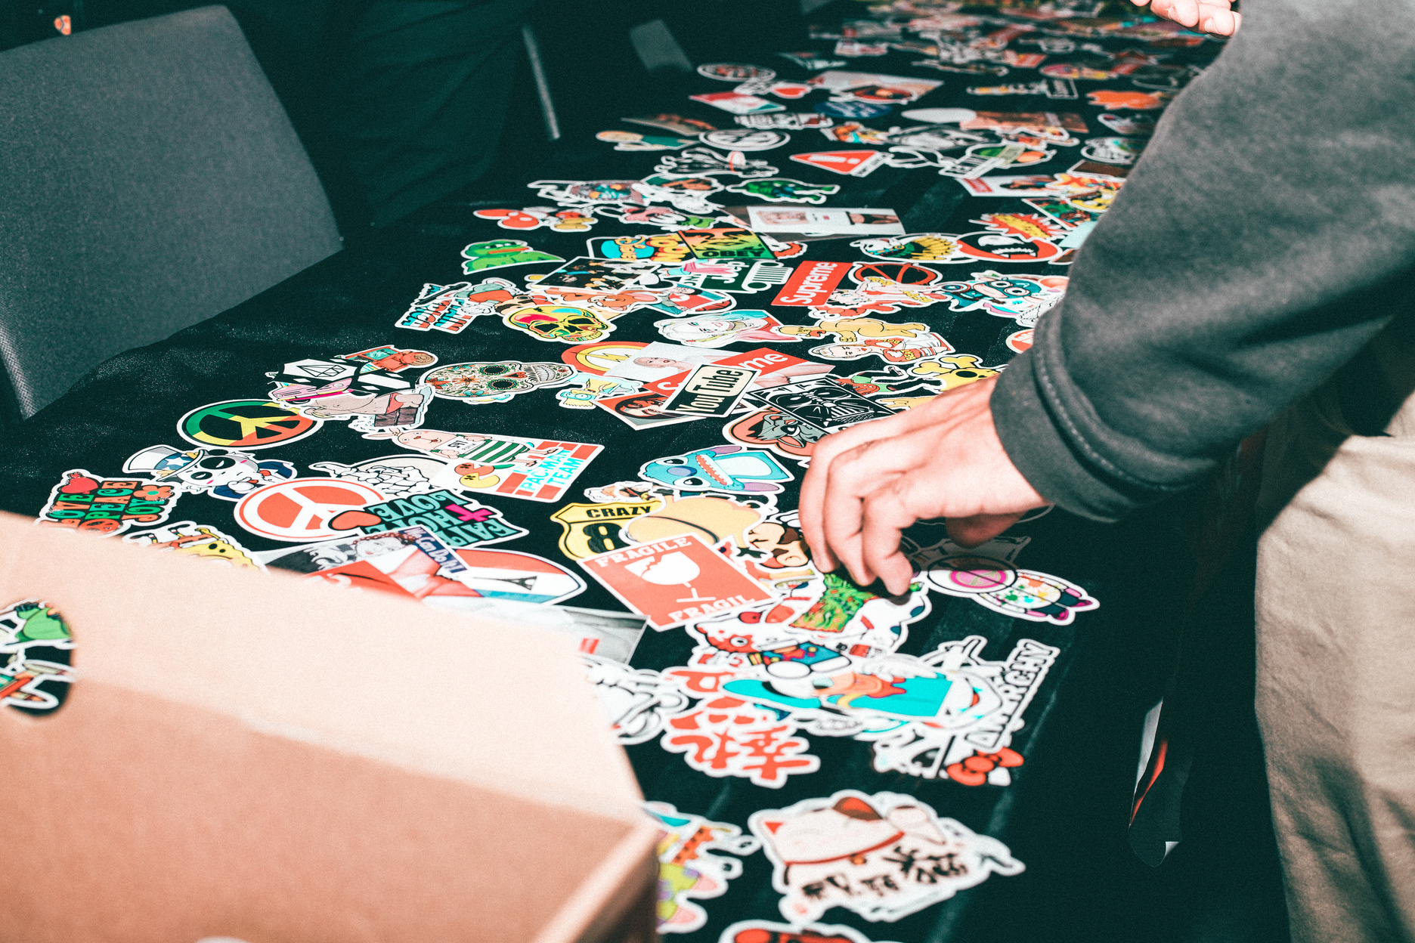
collect soccer stickers
/kəˈlɛkt ˈsɒkə ˈstɪkəz/
Ms Phương
Zalo: 0966765064
Sưu tầm hình dán bóng đá
My brother likes sports, so he often collects soccer stickers.
Em trai tôi thích thể thao vì thế cậu ấy thường sưu tầm hình dán bóng đá.

Slide 10
read comics
/riːd ˈkɒmɪks/
Ms Phương
Zalo: 0966765064
đọc truyện tranh
He is interested in reading comics on Sundays.
Cậu ấy thích thú đọc truyện tranh vào những ngày chủ nhật.

Slide 11
make vlog
play online games
build models
bake cakes
collect soccer stickers
read comics

Slide 12
New Words
a. Number the pictures. Listen and repeat.

Slide 13
B. Work in pair and add three more hobbies you know.
Hobbies

Slide 14
Yes, I do
Do you like………..?
No, I don’t
Do you like…………………….?
Do you like…………………….?
Do you like…………………….?
Do you like…………………….?
Do you like…………………….?
Do you like…………………….?

Slide 15
Complete the blanks with more hobbies and ask your partner.
1.Do you like…………………….?
4. Do you like…………………….?
2. Do you like…………………….?
5. Do you like…………………..?
3. Do you like…………………….?
6. Do you like……………………?

Slide 16
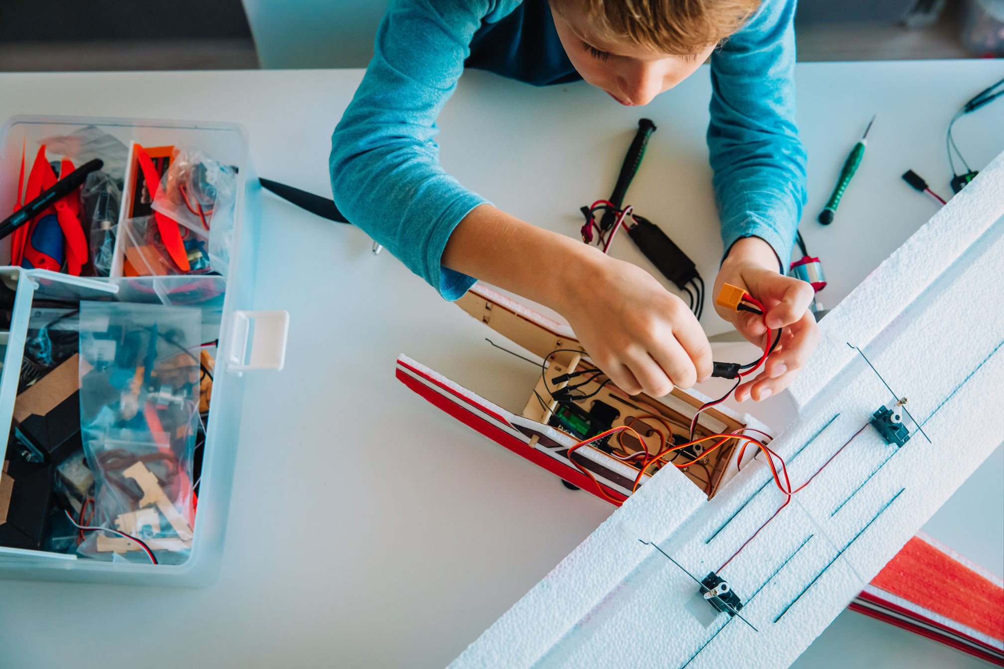
Look at the picture and guess what are they doing?
He is making models.
He is writing his blog.

Slide 17
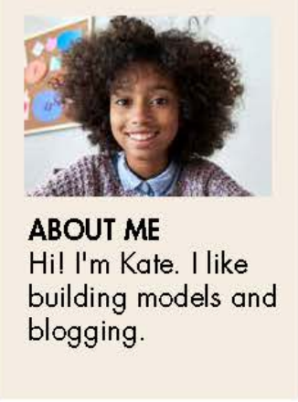
Look at the picture and answer the questions.
What’s her name?
What does she like?
I build models in my free time. I have fifteen models. Some of them were gifts from my friends and family, but I bough most of them. I mostly build planes and cars, but I have a few ship models, too. My favorite one is my MGA car model. The real MGA was a cool sports car from England. I think it’s very cute.
I often spend one hour or two hours a day building my models. Sometime my sister Alice does it with me and films us building models for her vlogs. She makes vlogs every week and it helps her make new friends.
What about you? What do you do in your free time? Leave a comment and tell me.

Slide 18
a. Read Kate’s blog and choose the best title.
1. My Model Collection
2. Building Model Cars is fun
I build models in my free time. I have fifteen models. Some of them were gifts from my friends and family, but I bough most of them. I mostly build planes and cars, but I have a few ship models, too. My favorite one is my MGA car model. The real MGA was a cool sports car from England. I think it’s very cute.
I often spend one hour or two hours a day building my models. Sometime my sister Alice does it with me and films us building models for her vlogs. She makes vlogs every week and it helps her make new friends.
What about you? What do you do in your free time? Leave a comment and tell me.

Slide 19
1. How did Kate get most for her model?
c. She found them.
b. She bought them.
They were gifts.
2. What is her favorite model?
a car
a ship
a plane
3. Who does Kate build her models with?
her friend
b. her teacher
c. her sister
4. Why does Alice film them to building models?
for school
b. for her vlogs
b. for her friends

Slide 20
C. In pair. What cool things can you make?
1. What do you do in your free time?
2. What cool things can you make?

Slide 21
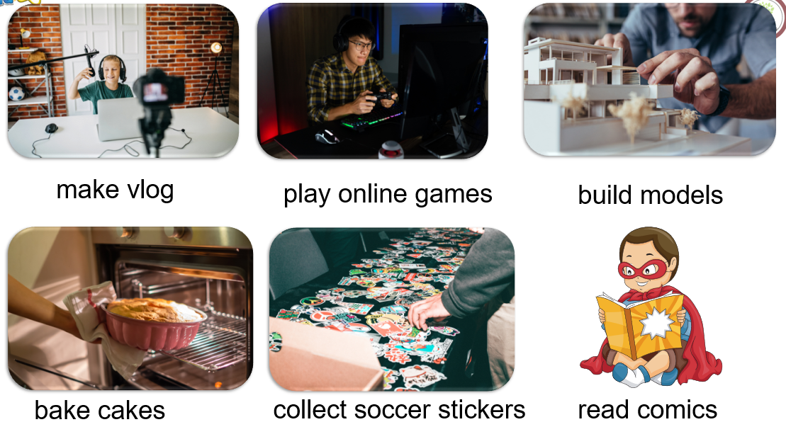
WARP-UP
Unit 1
Free time
Lesson 1: New words + reading
Ms Phương
Zalo: 0966765064

Slide 22
CHECKING MEMORY
v.phr
làm vlog
1. make vlogs
Ms Phương
Zalo: 0966765064
v.phr
Chơi trò chơi qua mạng
2.play online games
3. build models
v.phr
dựng mô hình
4. bake cakes
v.phr
nướng bánh
5. collect soccer stickers
v.phr
sưu tầm hình dán bóng đá.
v.phr
đọc truyện tranh
6.read comics

Slide 23
https://wordwall.net/resource/33946321

Slide 24
HOMEWORK
Learn the new words by heart.
01
- Practice talking about your hobby.
02
- Do the exercises in Workbook: Lesson 1 - New words (page 2).
03
- Prepare: Lesson 1 – Grammar (page 5 – SB).
04

