Slide 1
Unit 2: Life in the past
Lesson 3.2: Speaking & Writing
Page 23

Slide 2
Lesson Outline
Warm-up
Writing
Speaking
Consolidation
Wrap-up

Slide 3
By the end of this lesson, students will be able to…
talk about the life of the family member.
learn how to use time connectors (Writing skills)
write a passage about the life of the family member you talked about.

Slide 4
WARM-UP

Slide 5
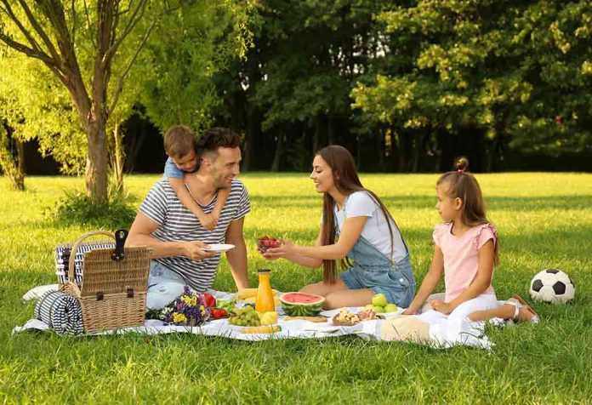
Work in pairs and answer these questions:
1.What activities would you regularly do with your mother when you were younger?
2.How do your family members contribute to the household?
3.What are your siblings’ hobbies?
4.What sports or games would you play with your siblings in your neighborhood?

Slide 6
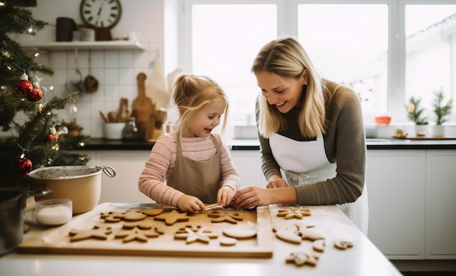
Suggested
answer
1.What activities would you regularly do with your mother when you were younger?
We would often bake cookies together or go for walks in the park.

Slide 7
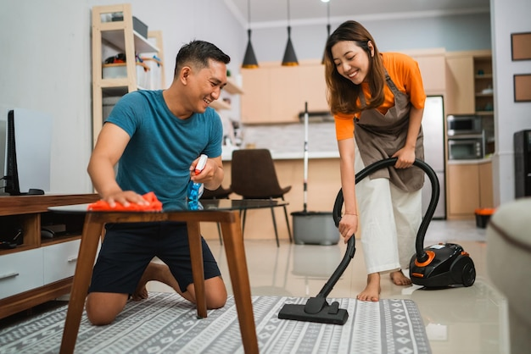
Suggested
answer
2.How do your family members contribute to the household?
Both my father and mother manage the household chores.

Slide 8
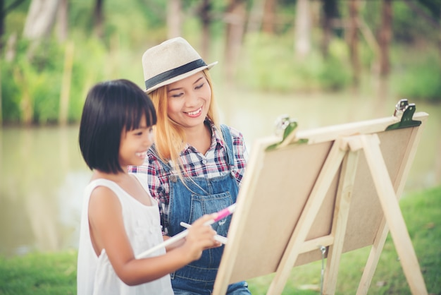
Suggested
answer
My sister enjoys painting pictures.
3.What are your siblings’ hobbies?

Slide 9
Suggested
answer
4.What sports or games would you play with your siblings in your neighborhood?
We used to play soccer and hide-and-seek.

Slide 10
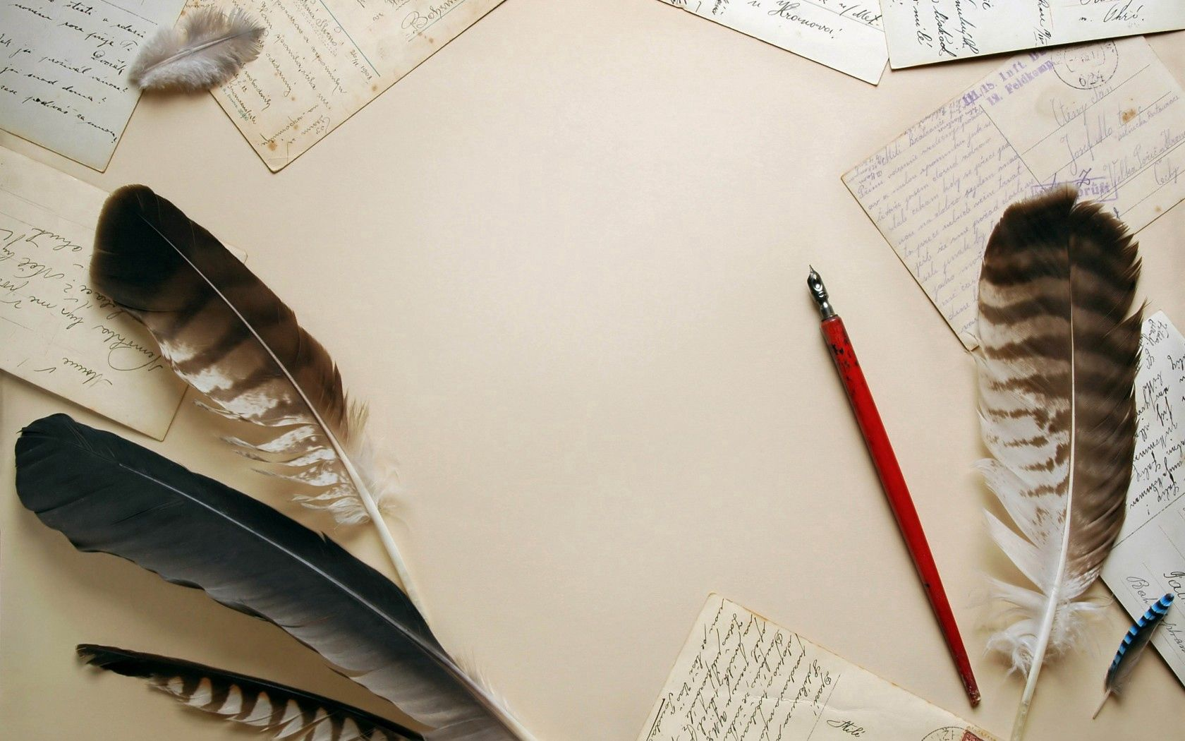
WRITING

Slide 11
Pre-writing

Slide 12
Read the sentences and match the “time connectors” with their meaning
1.Leave the cake to cool completely. Meanwhile, make the topping.
A. at a later time
2.He took his family to supper at a restaurant. Afterward, he fell ill.
B. in the end, after a long time
3.Although she had been ill for a long time, it still came as a shock when she eventually died.
C. At the same time something else is happening

Slide 13
Look at the example and fill in the blanks.
Her husband fought in the war. Meanwhile, she had to raise five kids on her own.
Her husband fought in the war. She meanwhile had to raise five kids on her own.
To show when an event happened in relation to another event, we can use afterward, meanwhile, and eventually. We often use them at the (1)_____________ of a sentence (with a comma after) or (2)__________ the main verb*.
beginning
before

Slide 14
Task a. Read about using time connectors, then read Lan's passage again and underline the connectors she used.
USING TIME CONNECTORS
To show when an event happened in relation to another event, we can use afterward, meanwhile, and eventually. We often use them at the beginning of a sentence (with a comma after) or before the main verb*.

Slide 15
USING TIME CONNECTORS
• Afterward: at a later time
He worked at the store for several years. Afterward, he opened his own store.
• Meanwhile**: at the same time something else is happening
Her husband fought in the war. She meanwhile had to raise five kids on her own.
• Eventually: in the end, after a long time
He walked to work for years to save money. Eventually, he got enough money to buy a bicycle.

Slide 16
USING TIME CONNECTORS
*Using afterward before the main verb is only common in formal language. **We can also use a comma before and after meanwhile if we want to contrast two things or people.
His family was rich. She, meanwhile, came from a poor family.

Slide 17
Task a. Read about using time connectors, then read Lan's passage again and underline the connectors she used.
Answer
When I was a kid, I used to stay with my grandmother after school. She'd often tell me stories about her life in the past, and I found them very interesting.
Her childhood was different from mine. She grew up in a large, extended family. Her family was poor, and she only finished elementary school. When she was thirteen, she started working. Her uncle cooked for wedding parties, and she'd go with him to those parties to help him.

Slide 18
Task a. Read about using time connectors, then read Lan's passage again and underline the connectors she used.
Answer
Afterward, she worked at a pottery place. She was good at making pottery and proud of the things she made. My grandfather also started working there. They fell in love and got married two years later.
My grandparents worked hard to build a family together. After they had their first child, my grandfather continued to work at the pottery place. Meanwhile, my grandmother sold groceries at home. They eventually saved enough money to buy a house of their own and raised three children.

Slide 19
Task a. Read about using time connectors, then read Lan's passage again and underline the connectors she used.
Answer
I sometimes think about the stories my grandmother told me and feel thankful for her and my grandfather. Whenever I have a difficult problem, I think about those stories and tell myself to continue to work hard.

Slide 20
Task b. Write sentences using the prompts.
He/dream of/be doctor/since little kid/and study hard. Eventually/he/get into/ medical school.
______________________________________________________
______________________________________________________
2. My grandmother/want/get job first. Meanwhile/her parents/want her/get married
He dreamed of being a doctor since he was a little kid and studied hard. Eventually, he got into medical school.

Slide 21
Task b. Write sentences using the prompts.
3. He/sell food/at small stall/at market. Afterward/he/find job/at factory
4. My mother/continue/work/a couple of years. Afterward/she/become/housewife
5. His father/be away from home/years/because of war. It/eventually/end, / and he/return home

Slide 22
Task b. Write sentences using the prompts.
Answer
2. My grandmother/want/get job first. Meanwhile/her parents/want her/get married
______________________________________________________
______________________________________________________
3. He/sell food/at small stall/at market. Afterward/he/find job/at factory
______________________________________________________
______________________________________________________
My grandmother wanted to get a job first. Meanwhile, her parents wanted her to get married.
He sold food at a small stall at the market. Afterward, he found a job at a factory.

Slide 23
Task b. Write sentences using the prompts.
Answer
4. My mother/continue/work/a couple of years. Afterward/she/become/housewife
______________________________________________________
______________________________________________________
5. His father/be away from home/years/because of war. It/eventually/end, / and he/return home
______________________________________________________
______________________________________________________
My mother continued to work for a couple of years. Afterward, she became a housewife.
His father was away from home for years because of the war. It eventually ended, and he returned home.

Slide 24
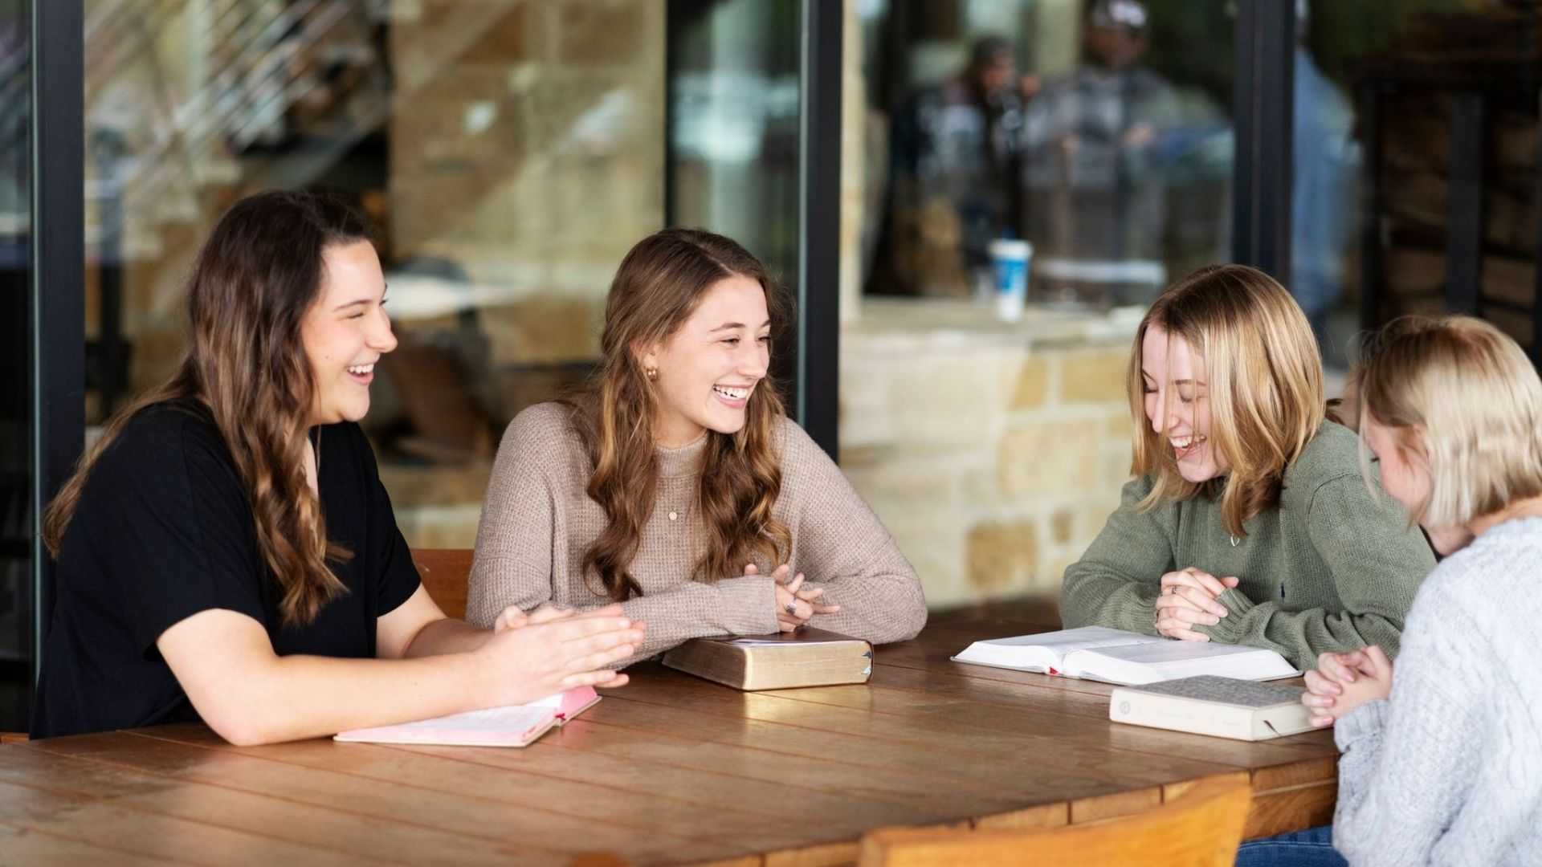
SPEAKING

Slide 25
The Life of My Family Member
Task a. In pairs: Tell your partner about the life of a family member. You can use the questions below to help you.
• What do you know about his/her childhood and younger years?
• What memory do you have about him/her?
• What can you learn from his/her story?

Slide 26
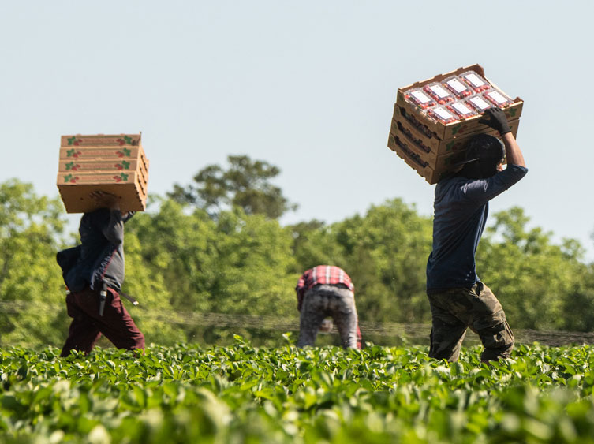
Suggested answer
What do you know about his/her childhood and younger years?
My grandmother grew up in the countryside with her older brothers. They were close and helped each other at school and on the farm. She later moved to Hanoi for university.

Slide 27
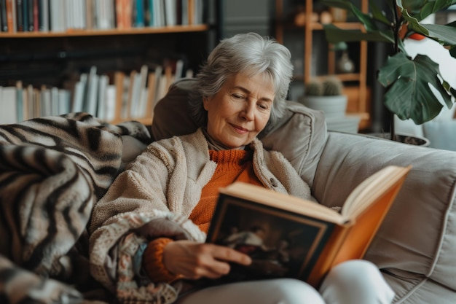
Suggested answer
What memory do you have about him/her?
I remember spending time with her after school. She often told me stories about her childhood on the farm and her adventures in Hanoi.

Slide 28
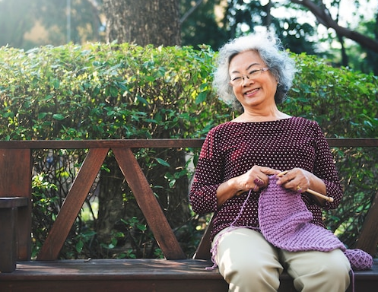
Suggested answer
What can you learn from his/her story?
From her story, I learn the importance of family and hard work. Her journey from the countryside to university teaches me the value of education and determination in pursuing my goals.

Slide 29
Task b. Choose two or three events or memories and complete the table with information about what, how, and when they happened.
Family member:
Event/Memory 1:
Event/Memory 2:
Event/Memory 3:
What you learned:

Slide 30
Task b. Choose two or three events or memories and complete the table with information about what, how, and when they happened.
Suggested answer
Family member: | Grandmother
Event/Memory 1: | A. What:Memories of family members B. How: grew up in a big family in the country, had six older brothers, played lots of games together and helped each other C. When: during childhood.

Slide 31
Task b. Choose two or three events or memories and complete the table with information about what, how, and when they happened.
Suggested answer
Event/Memory 2: | A. What: work and education B. How: worked at the farm, moved to Hanoi to go to university C. When: during adulthood.

Slide 32
Task b. Choose two or three events or memories and complete the table with information about what, how, and when they happened.
Suggested answer
Event/Memory 3: | A. What: Marriage B. How: met my grandfather in her math class, helped him a lot => fell in love. C. When: During marriage period.
What you learned: | The significance of family unity, hard work, and support.

Slide 33
While-writing

Slide 34
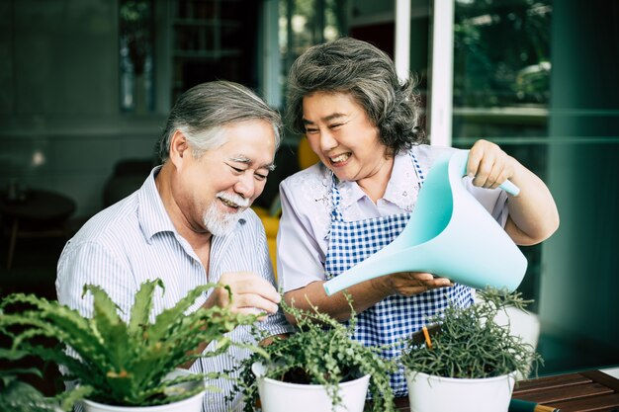
Now, write a passage about the life of the family member you talked about. Use the Writing Skill box, the reading model, and your speaking notes to help you. Write 100 to 120 words.

Slide 35
Sample answer
When I was a kid, I used to stay with my grandmother after school. She told me a lot about her life.
She came from a big family in the country. She had six older brothers. They were all very close and played lots of games together and helped each other at school. They all worked at the farm until they finished high school. Afterward, my grandmother moved to Hanoi to go to university. She met my grandfather in her math class. She had to help him a lot, and eventually they fell in love.
I often think about how my grandmother always helps her family. It teaches me that I should always help my family, too.

Slide 36
Extra
Practice
Presentation

Slide 37
WB-p13. Write sentences using the prompts.
He/sell fruit/market stall./Eventually/make enough money/buy/car.
______________________________________________________
______________________________________________________
2. My grandpa/work/a plumber. /Meanwhile/my grandma/work/a receptionist
He sold fruit at a market stall. Eventually, he made enough money to buy a car.

Slide 38
WB-p13. Write sentences using the prompts.
3. She/go to university/and study/ medicine./ Afterward/work as/doctor.
4. My dad/work/in Thailand./Eventually/he/come home/and work/in/office.
5. She/be housewife/raise two children./Meanwhile/he work in/factory.

Slide 39
WB-p13. Write sentences using the prompts.
Answer
2. My grandpa/work/a plumber. /Meanwhile/my grandma/work/a receptionist
______________________________________________________
______________________________________________________
3. She/go to university/and study/ medicine./ Afterward/work as/doctor.
______________________________________________________
______________________________________________________
My grandpa worked as a plumber. Meanwhile, my grandma worked as a receptionist.
She went to university and studied medicine. Afterward, she worked as a doctor.

Slide 40
WB-p13. Write sentences using the prompts.
Answer
4. My dad/work/in Thailand./Eventually/he/come home/and work/in/office.
______________________________________________________
______________________________________________________
5. She/be housewife/raise two children./Meanwhile/he work in/factory.
______________________________________________________
______________________________________________________
My dad worked in Thailand. Eventually, he came home and worked in an office.
She was a housewife and raised two children. Meanwhile, he worked in a factory.

Slide 41
WB-p13. Choose a family member you know a lot about. Complete the table with events from their life.
Family member:
Event/Memory 1:
Event/Memory 2:
Event/Memory 3:
What you learned:

Slide 42
WB-p13. Choose two or three events or memories and complete the table with information about what, how, and when they happened.
Suggested answer
Family member: | Grandfather
Event/Memory 1: | A. What: efforts to save money for a bicycle. B. How: worked really hard for it. C. When: during childhood

Slide 43
WB-p13. Choose two or three events or memories and complete the table with information about what, how, and when they happened.
Suggested answer
Event/Memory 2: | A. What: Vacation by the lake B. How: went swimming for hours , ate with his family by the lake C. When: during summer

Slide 44
WB-p13. Choose two or three events or memories and complete the table with information about what, how, and when they happened.
Suggested answer
Event/Memory 3: | A. What: University, banking career, and love B. How: went to university and met my grandma, studied to be a banker=> worked at a bank for many years C. When: During adulthood
What you learned: | My grandpa's hard work, determination, and love for his family.

Slide 45
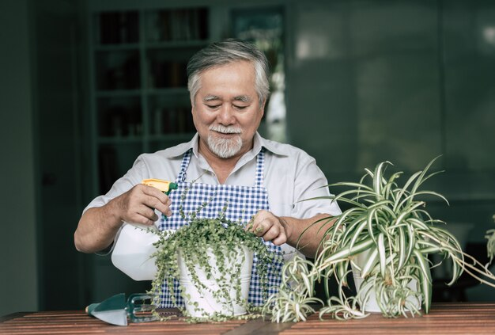
WB-p13. Now, write a passage about the life of the family member you planned about. Use the Writing Skill box, the reading model, and your planning notes to help you. Write 100 to 120 words..

Slide 46
Sample answer
My grandpa had a really interesting life. He told me lots of stories.
He used to walk to school to save money. Eventually, he saved enough money to buy a bicycle. He worked really hard for it.
He used to go on vacation by a lake in the summer. He would go swimming for hours. Afterward, his mom would make him delicious food, and he would eat with his family by the lake. It sounded lovely.
Later, he went to university and met my grandma. He studied to be a banker. Afterward, he worked at a bank for many years. He loved his job.
I think my grandpa is really interesting and a great man. I want to be like him when I'm older.

Slide 47
Post writing

Slide 48
Swap the writing texts in pairs and check each other’s work according to the feedback form.

Slide 49
CONSOLIDATION

Slide 50
Ask and answer the question below with your partner about a family member in the past
What did you use to do with your favorite family member when you were a child?

Slide 51
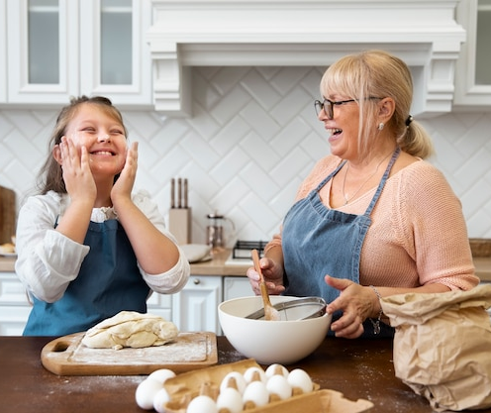
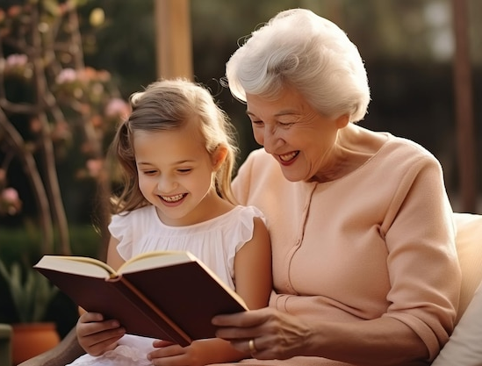
Suggested answer
Presentation
Production
When I was a child, I used to spend a lot of time with my favorite family member, usually my grandmother. We would often bake cookies together or read books.

Slide 52
WRAP-UP

Slide 53
Today’s lesson
Speaking:
Talk about the life of the family member.
Writing:
Learn how to use time connectors
Write a passage about the life of the family member you talked about.

Slide 54
Homework
Review vocabulary related to the life of the family member.
Make sentences using the vocabulary in SB.
Prepare for the next lesson (Review 1 - Pages 87 & 88 - SB).
Play the consolidation games on www.eduhome.com.vn

Slide 55
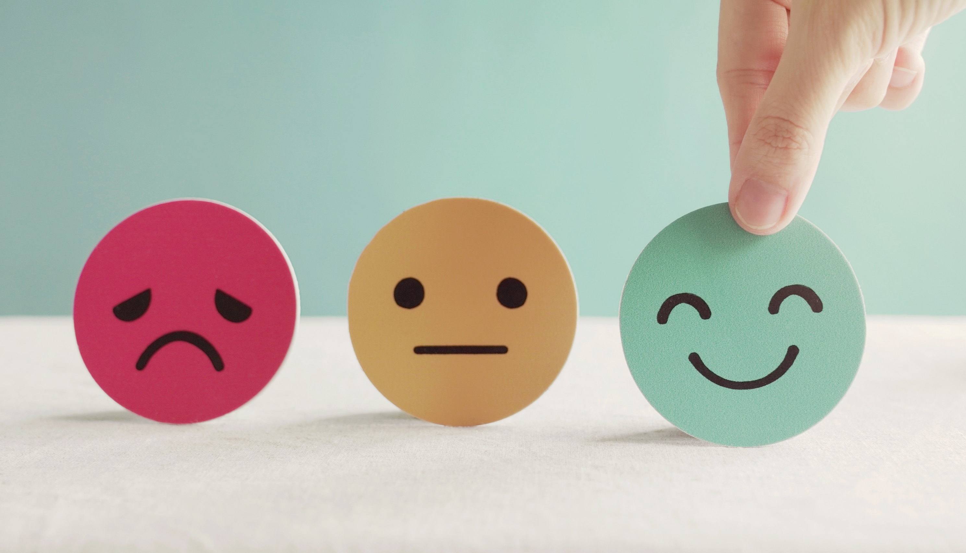
Lesson 3
Stay positive and have a nice day!

