Slide 1

Unit 2: Life in the past
Lesson 2.2: Grammar
Pages 19 & 20

Slide 2
Lesson Outline
Warm-up
Presentation
Practice
Production
Consolidation
Wrap-up

Slide 3

By the end of this lesson, students will be able to…
- learn, practice, and use “used to”.
- Talk about things they used to do after school, on the weekends, and during holidays when they were younger.

Slide 4
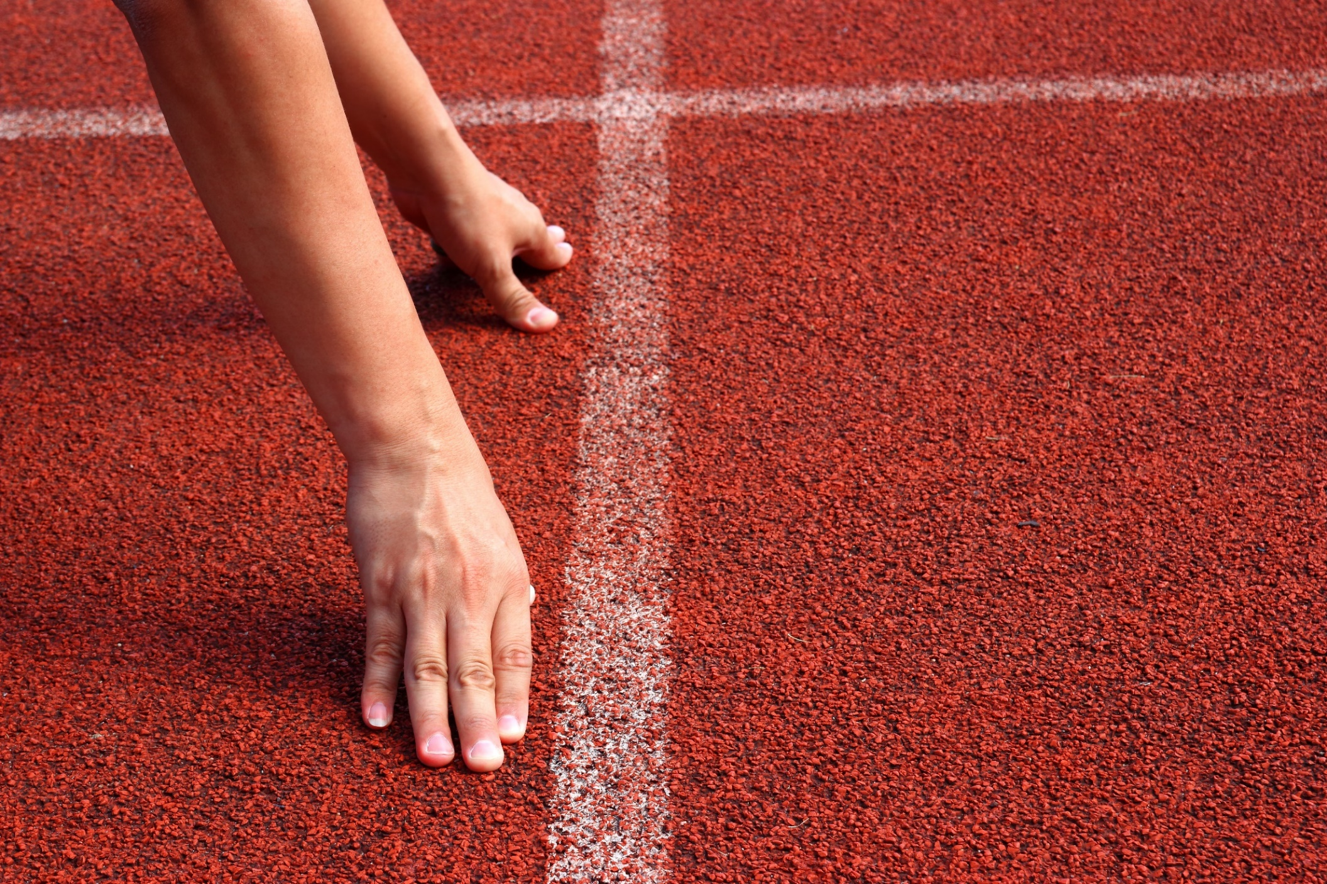
WARM-UP

Slide 5

COMPETITION TIME:
Create groups/teams of 5 students.
You will be given some sentences but in the wrong order. You have to unscramble the sentences.
The team(s) with the most correct answers win (s).
Time limit: 5 minutes

Slide 6
Example:
I used to /a child,/ I was/ like /chocolate./ When
Answer:
When I was a child, I used to like chocolate.

Slide 7
Unscramble the sentences.
very long. /short hair now, / Liz has got /but it used to be
she was a child./Helen / a piano / used to have /when /
When /I didn't use to/I was younger, /like tomatoes.
I used to eat/ I was a kid./broccoli /when
I don't read / read a lot of books, /but /much these days./ I used to

Slide 8
ANSWERS:
1.Liz has got short hair now, but it used to be very long.
2.Helen used to have a piano when she was a child.
3.When I was younger, I didn't use to like tomatoes.
4.I used to eat broccoli when I was a kid.
5.I used to read a lot of books, but I don't read much these days.

Slide 9

Lead-in

Slide 10

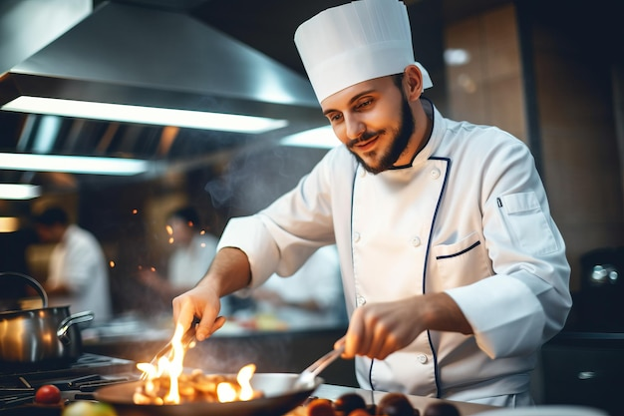
Look at the pictures and answer the questions:
1.Where did David use to work a few years ago?
2. Where does David work today?
David
A few years ago
David
Today

Slide 11
Suggested answers
David
A few years ago
David
Today
David used to work in a hospital.
Now he works in a restaurant.

Slide 12
David
A few years ago
David
Today
David used to work in a hospital= He worked in a hospital before,
but he doesn’t work there now.
He used to work | He works
Past | Now

Slide 13
A few years ago
Work in groups and fill in the blanks
Today
David used to work in a hospital.
Now he works in a restaurant.
bare infinitive
FORM: Subject + used to + ____________________
past
USE: We can use used to to express a ___________ situation or state (but _________existing)
no longer

Slide 14
Presentation

Slide 15


FORM: Subject + used to + bare infinitive (+ object)
USE: We can use used to to express:
• a past situation or state (but no longer existing)
She used to have long hair. (Now it's short.)
• a repeated past action (but no longer continuing)
I used to play tennis every weekend. (Now I don't.)

Slide 16
FORM:
Affirmative: Subiect + used to + bare infinitive (+ object)
1.I used to go to the beach in the summer.
2.My mom used to bake a pie on the weekends.
Presentation

Slide 17
FORM:
Negative: Subject + didn't use to + bare infinitive (+ object)
1.We didn't use to travel in the holidays.
2.She didn't use to see her friends after school.
Presentation

Slide 18
FORM:
Questions: (Wh-word + Did + subiect + use to + bare infinitive (+ obiect)?
1.Did he use to take lunch to school?
2.Where did they use to go on vacation?
Presentation

Slide 19
• When we talk about past states, we use used to, not would
I used to live in London. (NOT: I would live in London.)
• When we use them both together, used to usually comes first to set the context for the past actions.
Presentation
When I was a kid, I used to visit my uncle every year. We'd play in the woods, and we'd go fishing in the river.

Slide 20
• We don't need to mention a past time with used to.
I used to go fishing with my grandpa. (We can also say: When I was young, I used to go fishing with my grandpa.)
• However, we need to mention a past time with would.
(e.g. "When I was young, ...")
Presentation
When I was young, I would go fishing with my grandpa.
(NOT: I would go fishing with my grandpa.)

Slide 21
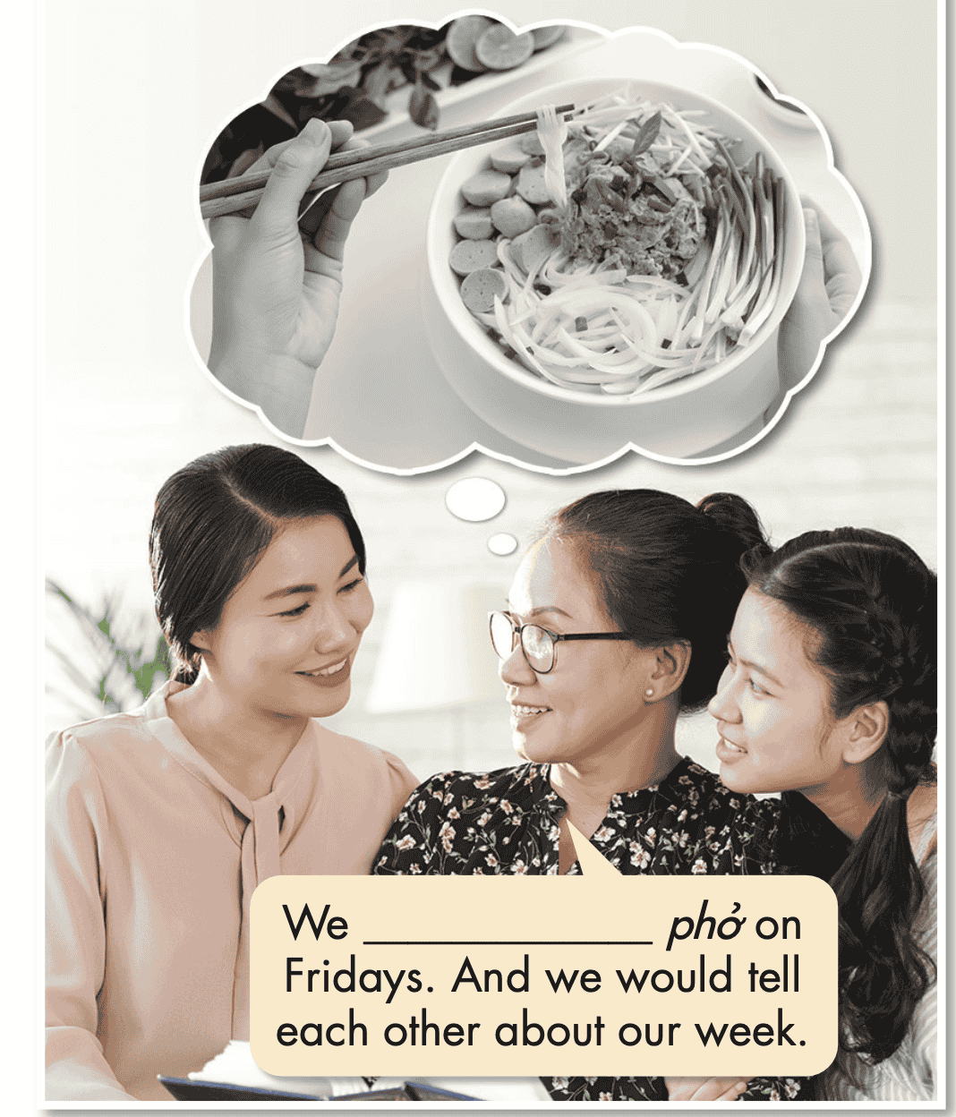
Task a. Read about “used to”, then fill in the blank.

Slide 22


Task b. Listen and check. Listen again and repeat.
used to eat

Slide 23
Presentation
Practice

Slide 24
Task c. Underline the mistakes and write the correct words on the lines.
used to
1. My mother to used sweep the floor in the morning. | _______
2. Did your nephew used to sketch after school? | _______
3. We used to traveled around on a tuk-tuk. | _______
4. I used live in London with my brother. | _______
5. Where did she use to went on the weekends? | _______
6. We use to loved walking to my aunt's cottage. | _______

Slide 25
Task c. Underline the mistakes and write the correct words on the lines.
Answers
1. My mother to used sweep the floor in the morning. | __________
2. Did your nephew used to sketch after school? | __________
3. We used to traveled around on a tuk-tuk. | __________
used to
use
travel

Slide 26
Task c. Underline the mistakes and write the correct words on the lines.
Answers
4. I used live in London with my brother. | __________
5. Where did she use to went on the weekends? | __________
6. We use to loved walking to my aunt's cottage. | __________
used to
go
used to love

Slide 27
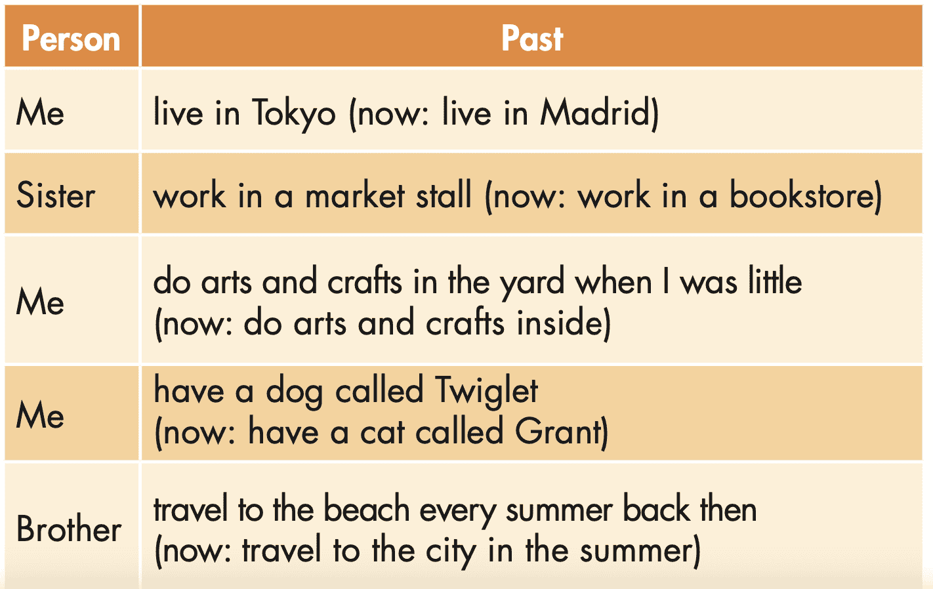
Task d. Write sentences using the information in the table with either used to (if there's no past time phrase) or would (if there's a past time phrase).

Slide 28
Task d. Write sentences using the information in the table with either used to (if there's no past time phrase) or would (if there's a past time phrase).
1. _________________________________________________
_________________________________________________
2. _________________________________________________
_________________________________________________
3. _________________________________________________
_________________________________________________
4. _________________________________________________
_________________________________________________
5. _________________________________________________
_________________________________________________
I used to live in Tokyo.

Slide 29
Task d. Write sentences using the information in the table with either used to (if there's no past time phrase) or would (if there's a past time phrase).
Answers
1. ______________________________________________________
______________________________________________________
2. ______________________________________________________
______________________________________________________
3. ______________________________________________________
______________________________________________________
4. ______________________________________________________
______________________________________________________
5. ______________________________________________________
______________________________________________________
I used to live in Tokyo.
My sister used to work in a market stall.
I would do arts and crafts in the yard when I was little.
I used to have a dog called Twiglet.
My brother would travel to the beach every summer back then.

Slide 30
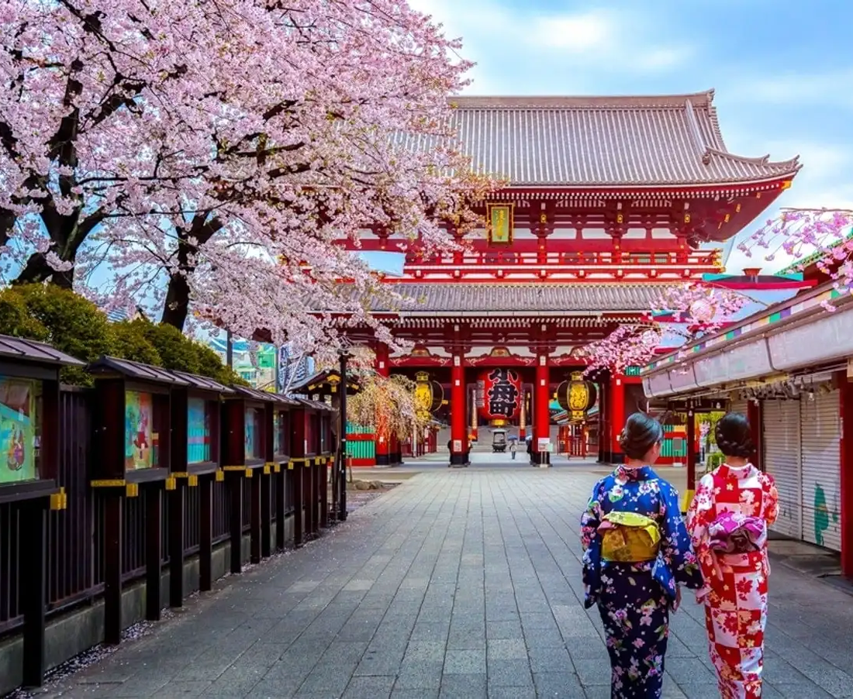
Share your ideas with a partner and record his or hers.
1. ___________________________________
___________________________________
2. ___________________________________
___________________________________
3. ___________________________________
___________________________________
4. ___________________________________
___________________________________
5. ___________________________________
___________________________________
I used to live in Tokyo.

Slide 31
Report what your partner has just shared with you to the class.
1. ___________________________________
___________________________________
2. ___________________________________
___________________________________
3. ___________________________________
___________________________________
4. ___________________________________
___________________________________
5. ___________________________________
___________________________________
I used to live in Tokyo.

Slide 32
Extra
Practice
Presentation

Slide 33

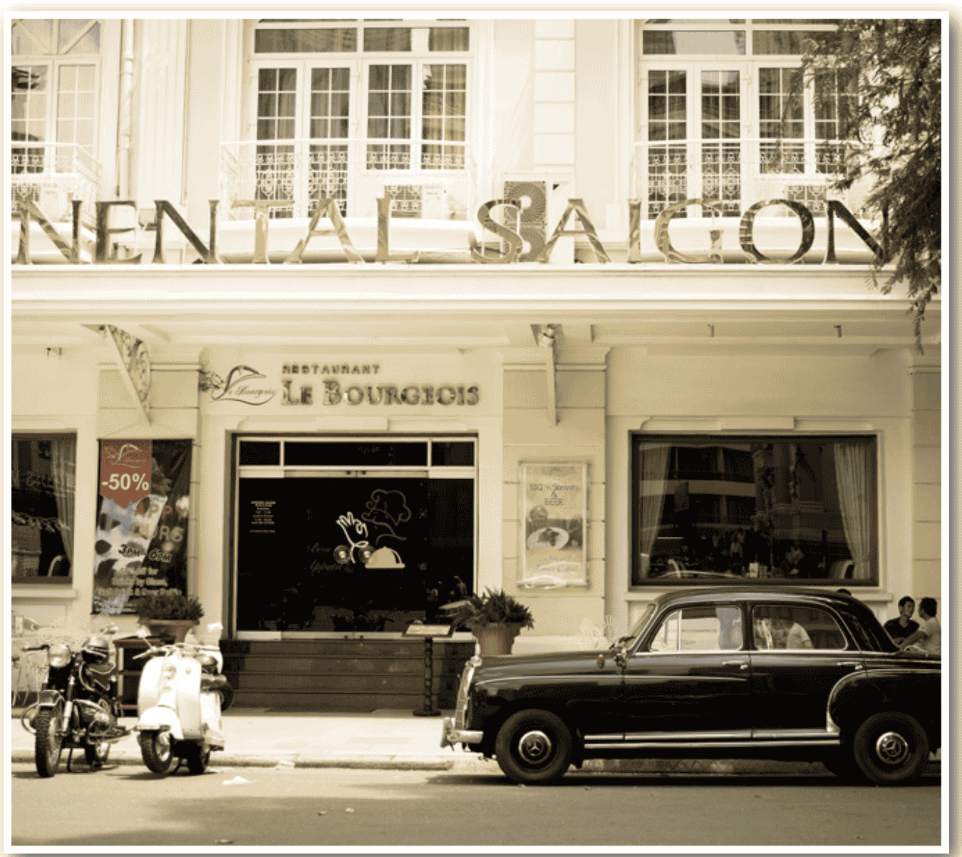
Extra Practice – WB, P 11
Underline the mistakes and write the correct words on the lines.
listen
1. People used to listening to the radio more. | __________
2. I didn't to used like drinking coffee. | __________
3. My grandma use to walk to school. | __________
use to
used

Slide 34
Extra Practice – WB, P 11
Underline the mistakes and write the correct words on the lines.
Men
4. Man used to wear hats outside in public. | __________
5. Where did you used to go on the weekends? | __________
6. My grandpa don't use to have a TV. | __________
use
didn’t

Slide 35
Presentation
Production

Slide 36
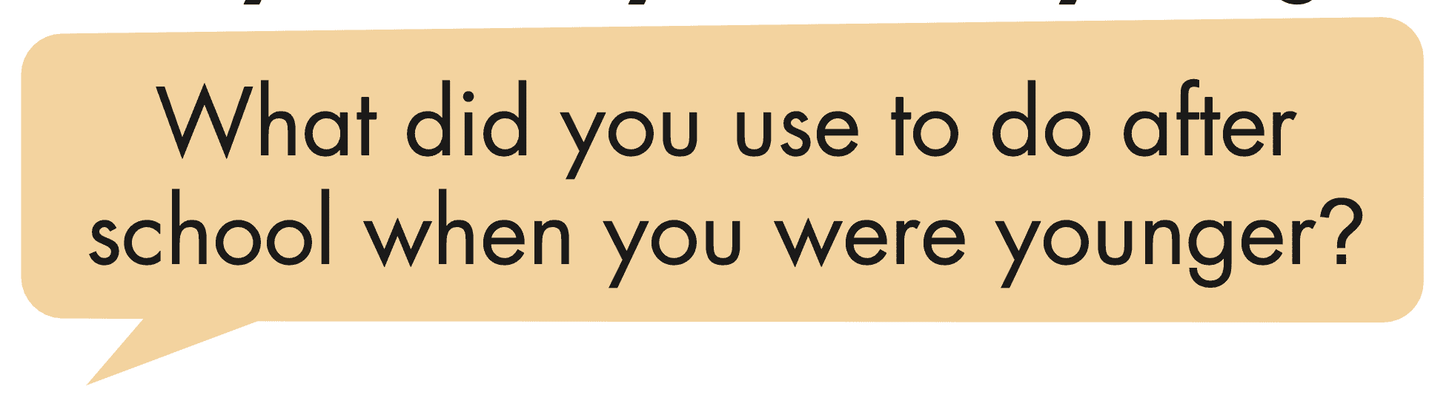
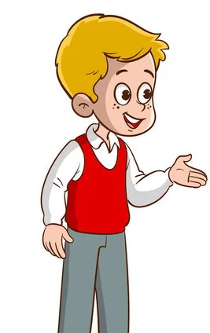
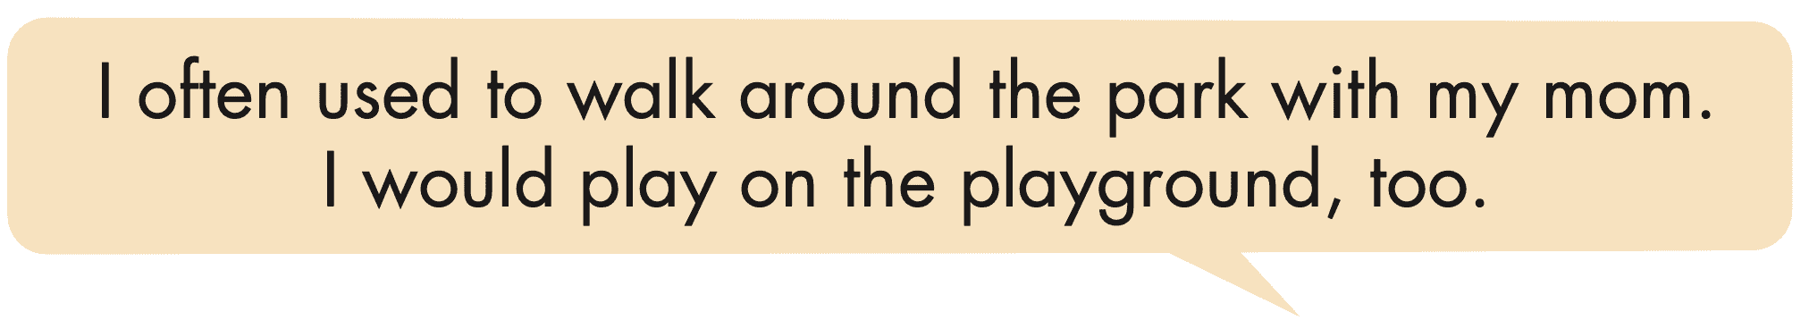
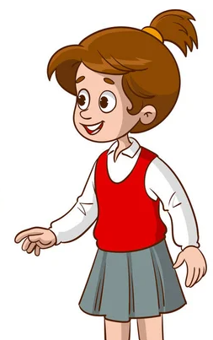
Task e. In pairs: Ask and answer questions about things you used to do after school, on the weekends, and during holidays when you were younger, then use would to give additional information.

Slide 37
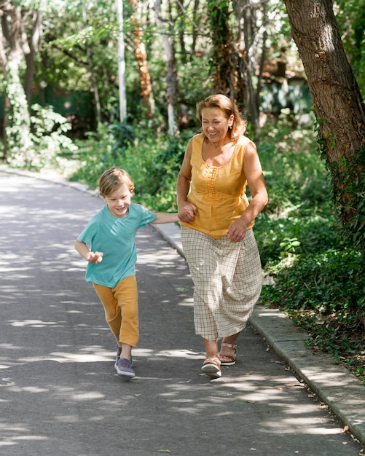
Suggested answer
I often used to walk around the park with my mom. I would play on the playgrounds too.
1. What did you use to do after school when you were younger?

Slide 38
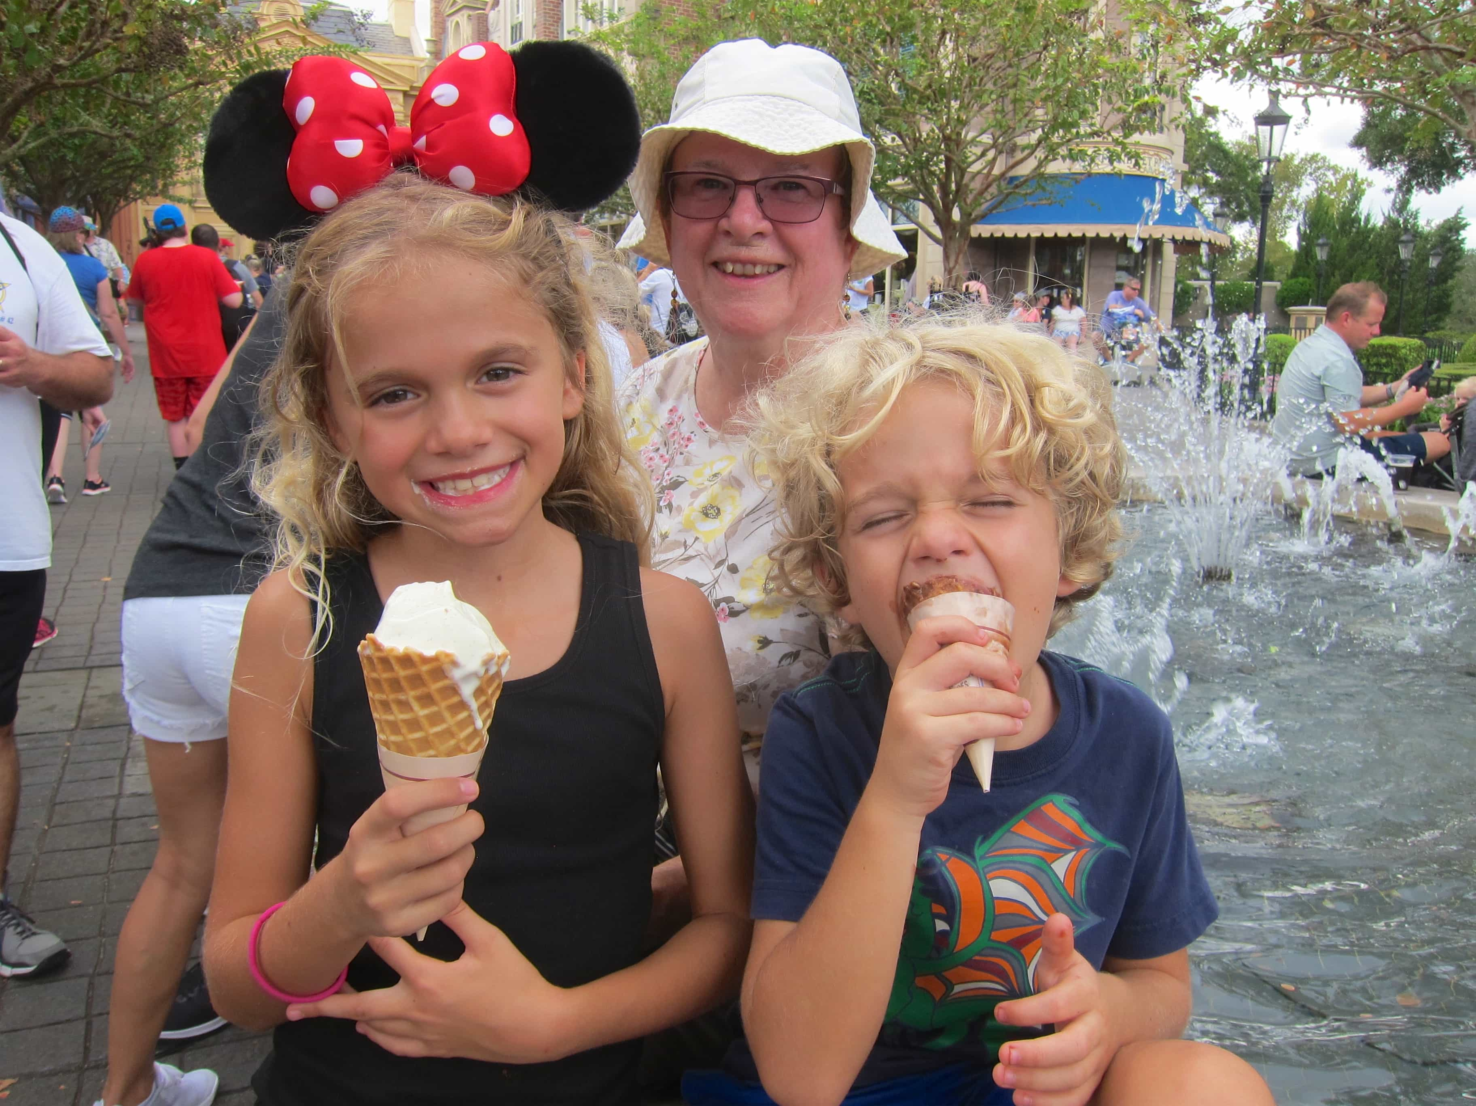
Suggested answer
I used to stay at my grandma's. She would sometimes buy me ice cream.
2. What did you use to do on the weekends when you were younger?

Slide 39
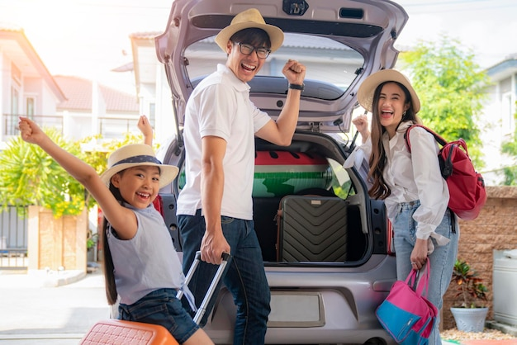
Suggested answer
I used to go on trips with my cousins. We would sing and play games.
3. What did you use to do during holidays when you were younger?

Slide 40

CONSOLIDATION

Slide 41

Ask and answer the question below with your partner, using “used to”
What did you use to eat on your birthday when you were younger?

Slide 42
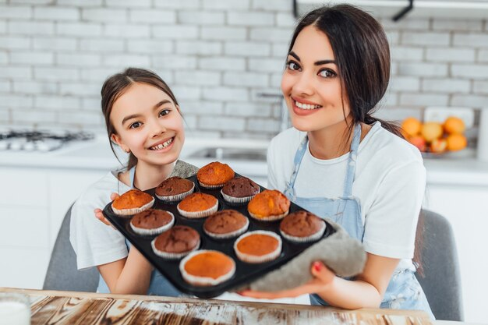
Suggested answer
Presentation
Production
When I was younger, I used to eat chocolate cupcakes on my birthday.

Slide 43

WRAP-UP

Slide 44
Today’s lesson
Grammar:
learn, practice, and use “used to”.
Speaking:
Talk about things they used to do after school, on the weekends, and during holidays when they were younger.

Slide 45
Homework
Review “used to” for past situations
Prepare for the next lesson (Pronunciation & Speaking - pages 20 & 21 - SB).
Play the consolidation games on www.eduhome.com.vn

Slide 46

Lesson 3
Stay positive and have a nice day!

