Slide 1
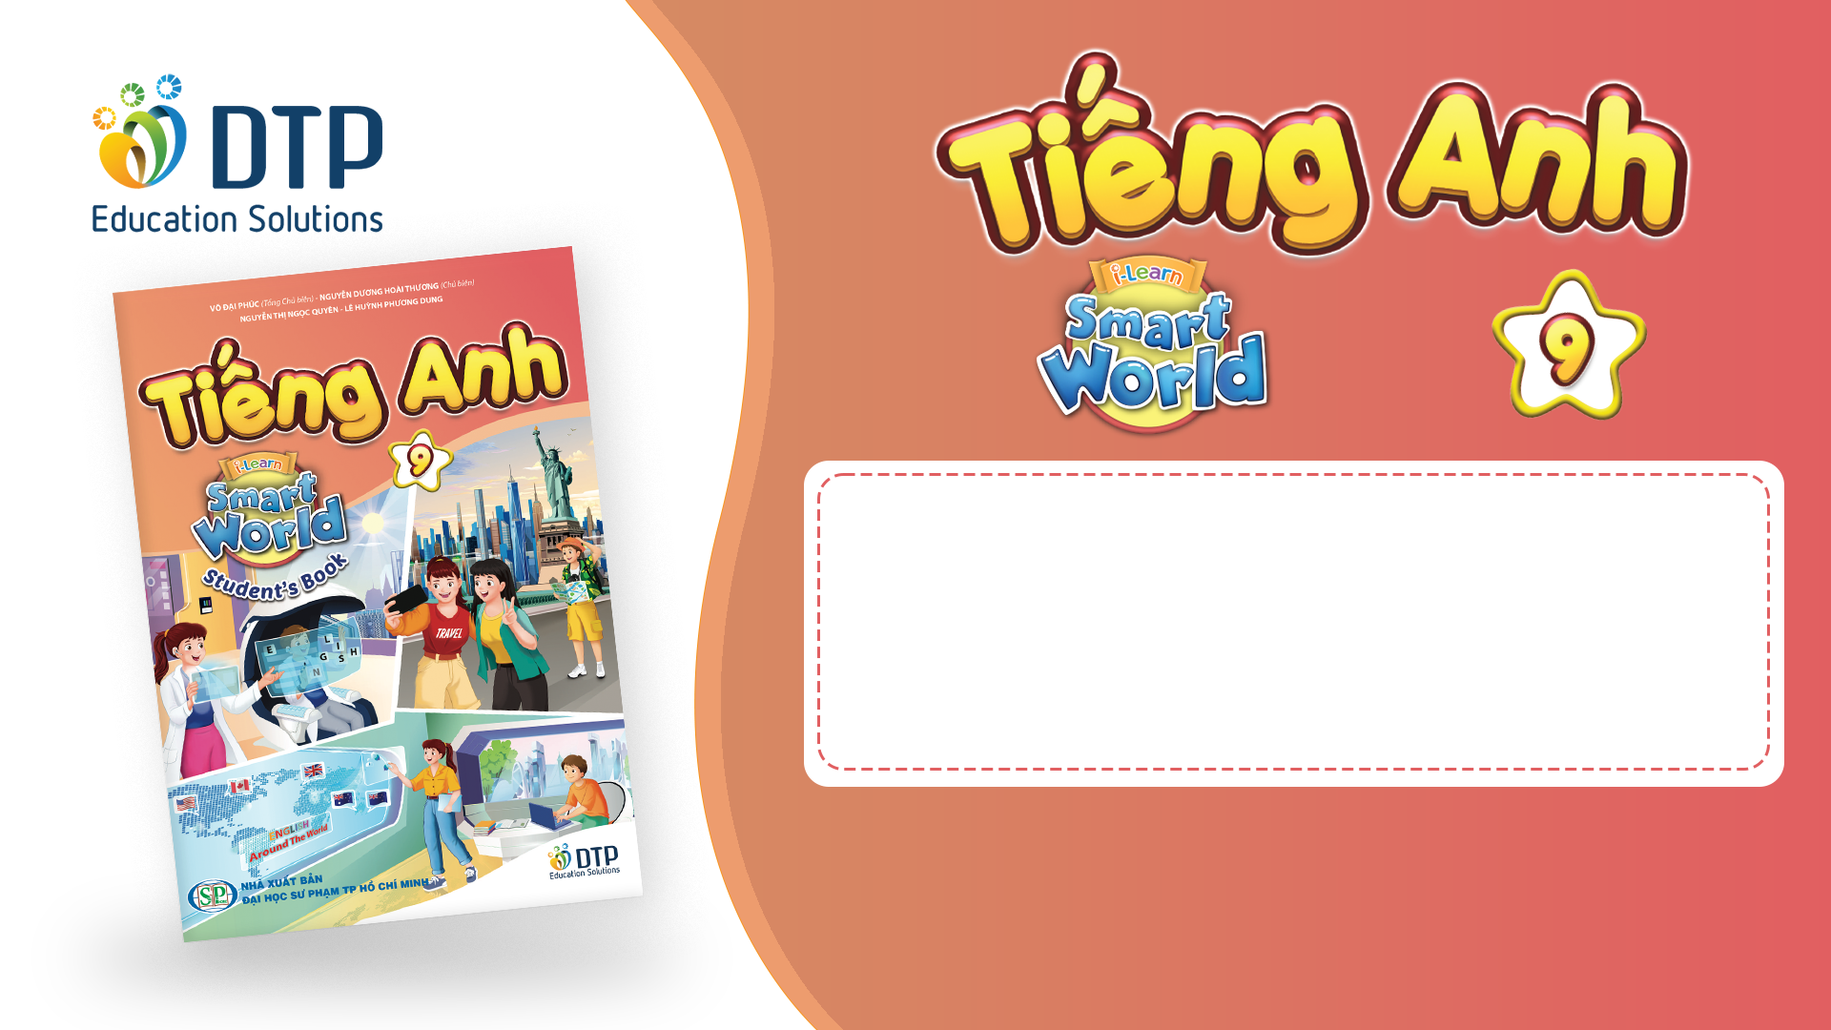
Unit 2: Life in the past
Lesson 2.1: Vocab & Listening
Pages 18 & 19

Slide 2
Lesson Outline
Warm-up
Vocabulary
Listening
Consolidation
Wrap-up

Slide 3
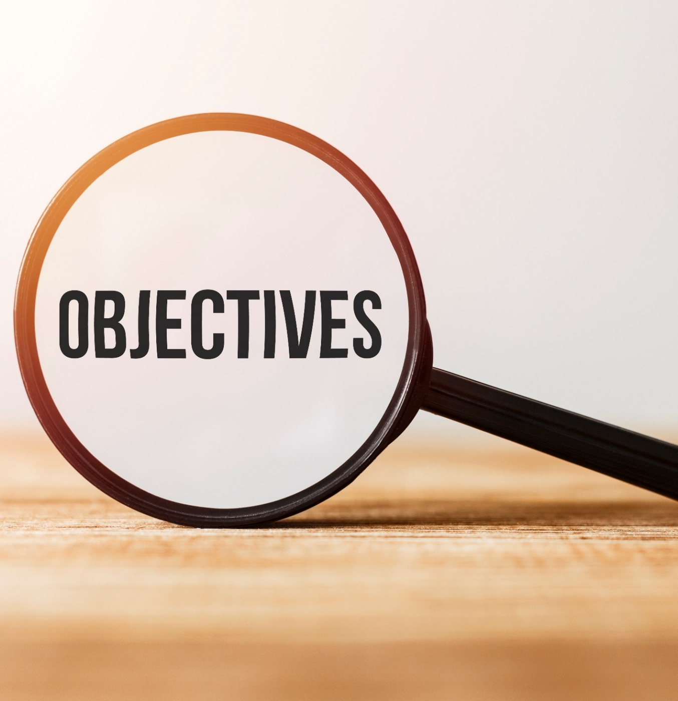
By the end of this lesson, students will be able to…
- learn and use vocabularies related to life in the past.
- practice listening for gist and details
- practice functional English and how to show interest.

Slide 4
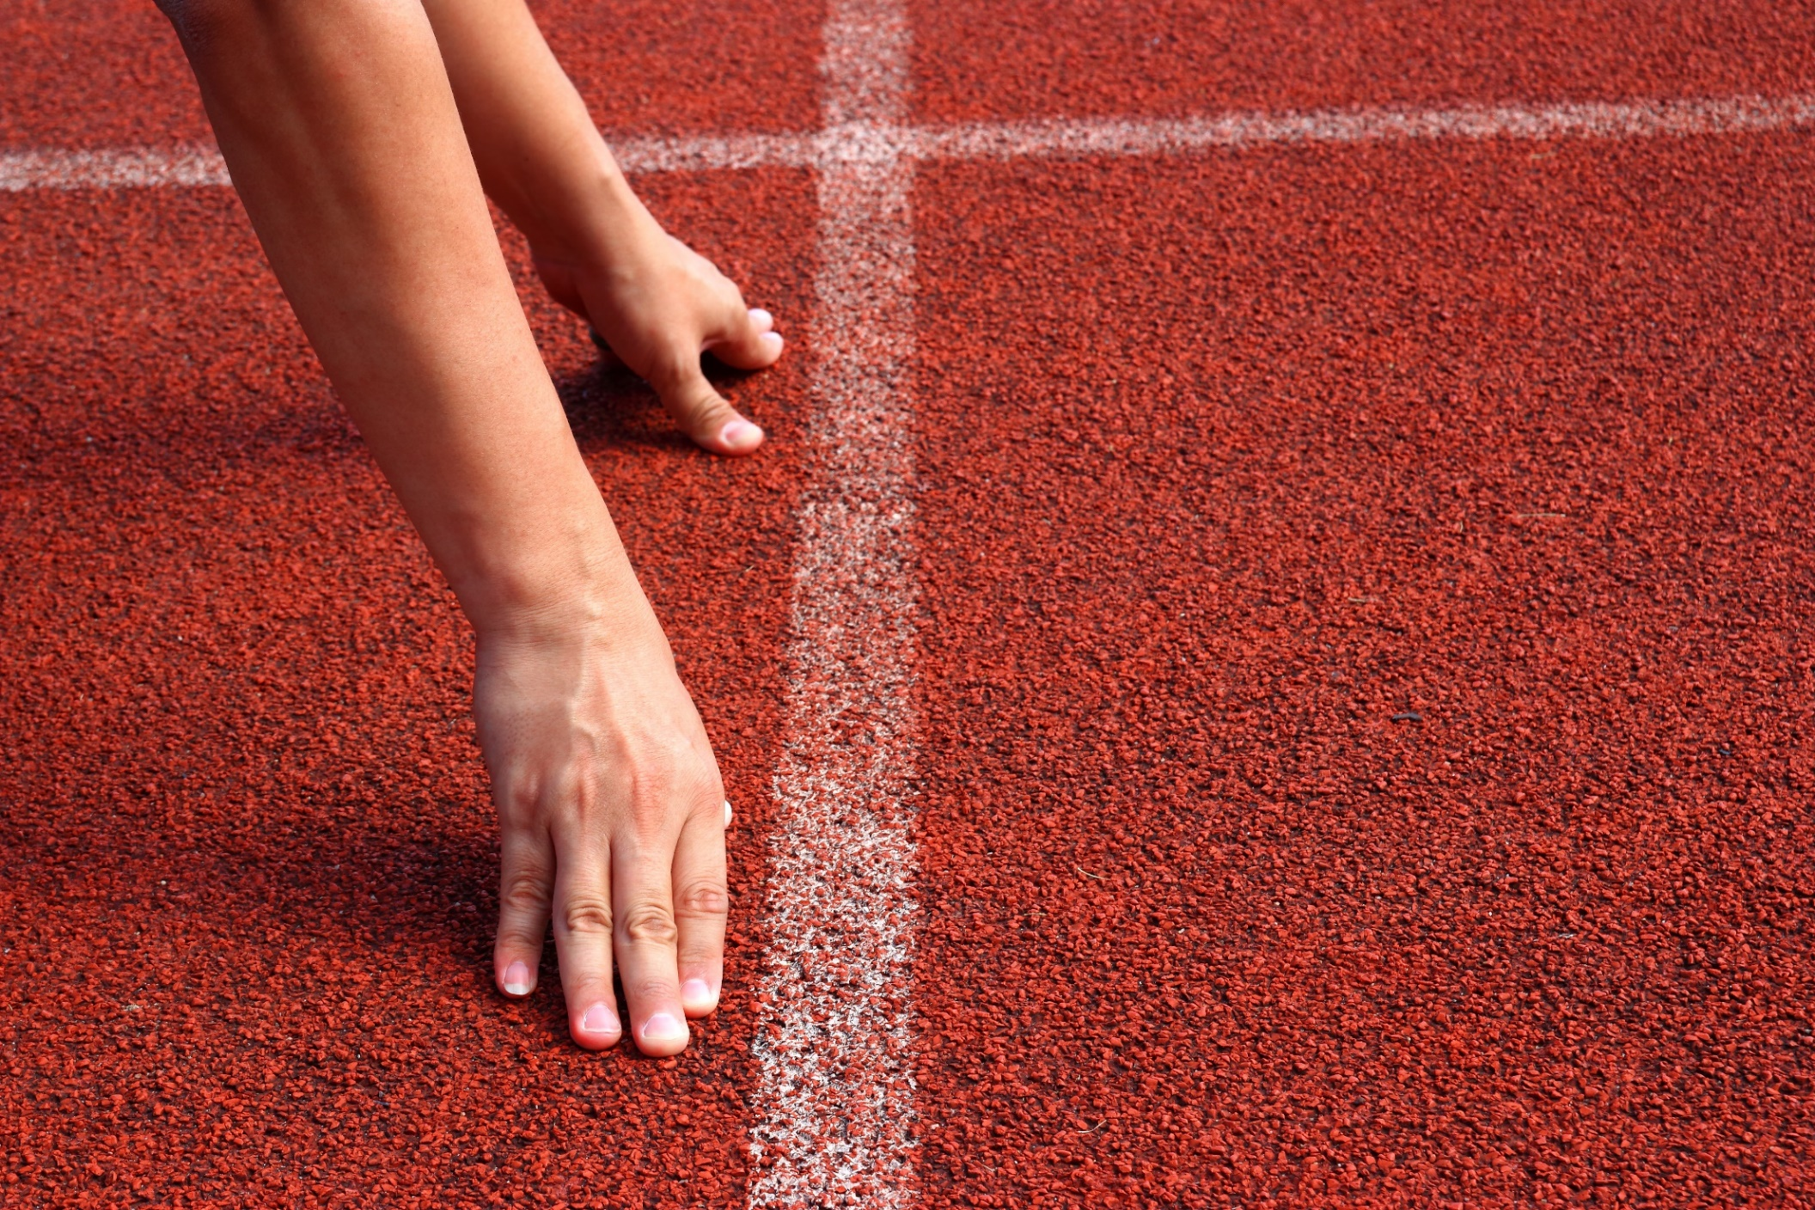
WARM-UP

Slide 5

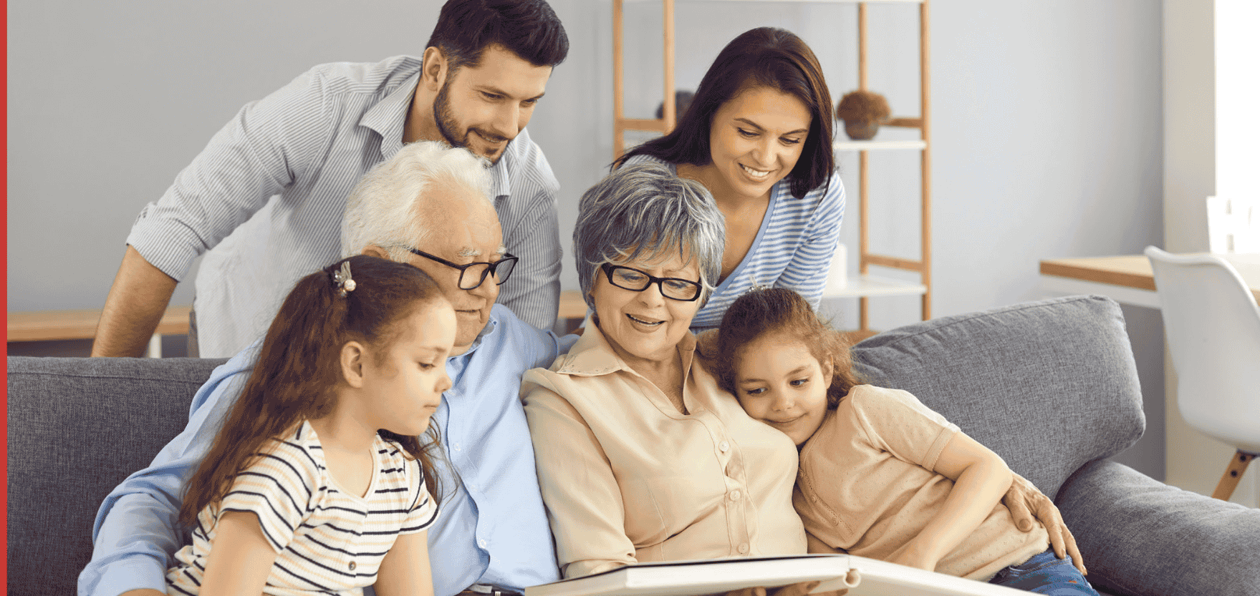
Work in pairs. Look at the pictures:
What can you see?
What kind of things do parents and grandparents often have photos of?
What photos do your parents or grandparents have?

Slide 6
Suggested answers
1.A: What can you see?
B: I can see a family including grandparents, parents and children.

Slide 7
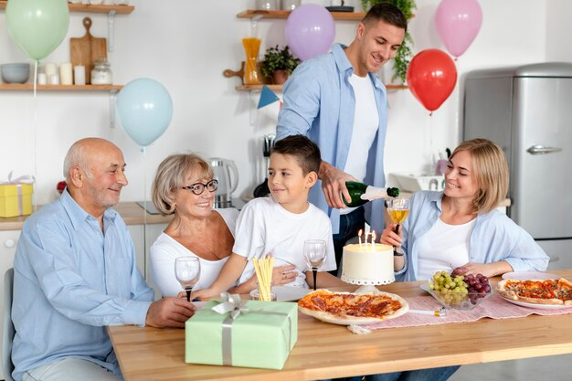
Suggested answers
2.A: What kind of things do parents and grandparents often have photos of?
B: They often have photos of family gatherings, special occasions like weddings or birthdays, vacations, and memorable moments with their children or grandchildren.

Slide 8
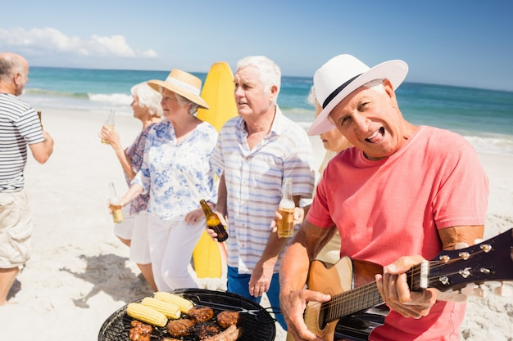
Suggested answers
3.A: What photos do your parents or grandparents have?
B: My parents or grandparents often have photos of family gatherings during Tet holidays, summer vacations, and other special occasions.

Slide 9

Pre-listening

Slide 10



Slide 11
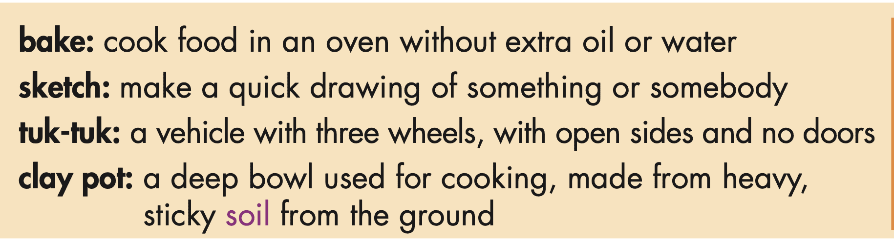
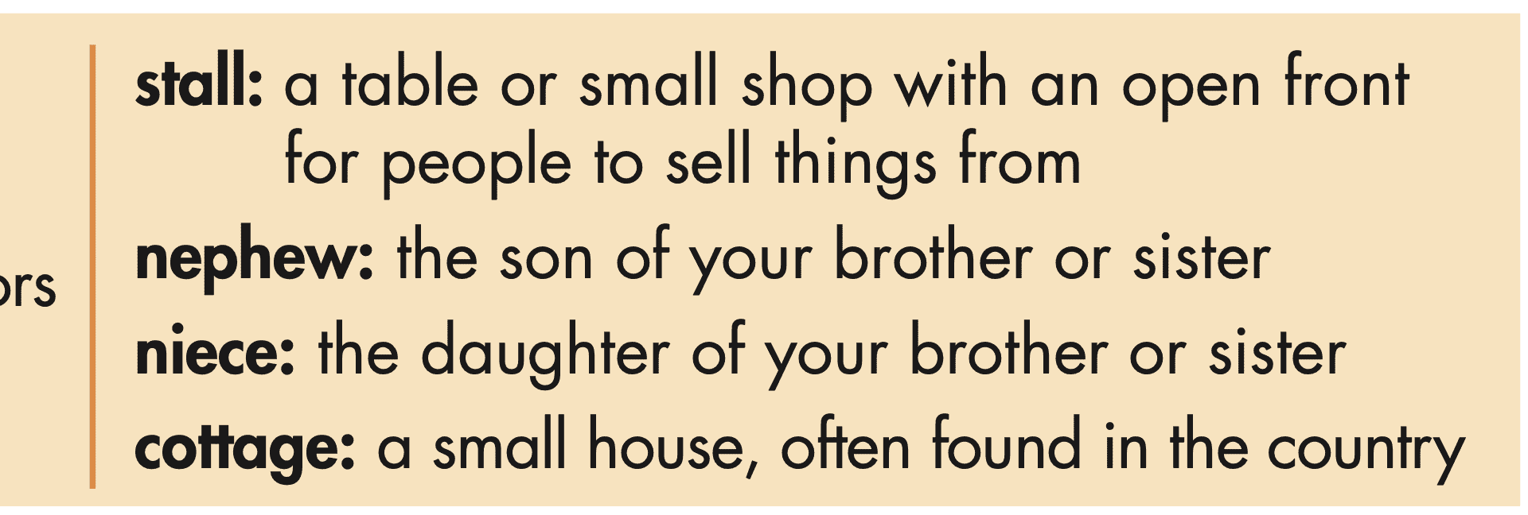
Task a. Read the words and definitions, then match the words with the pictures.

Slide 12
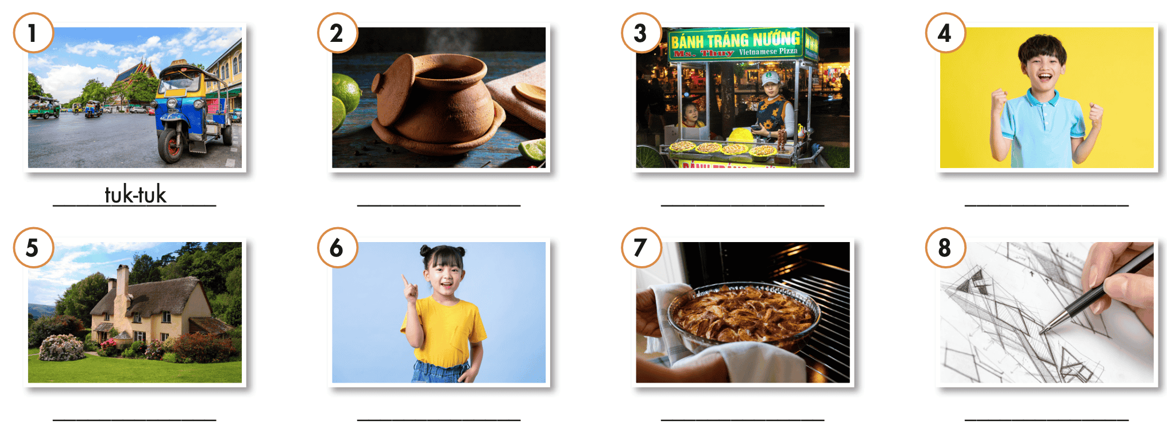
Task a. Read the words and definitions, then match the words with the pictures.

Slide 13
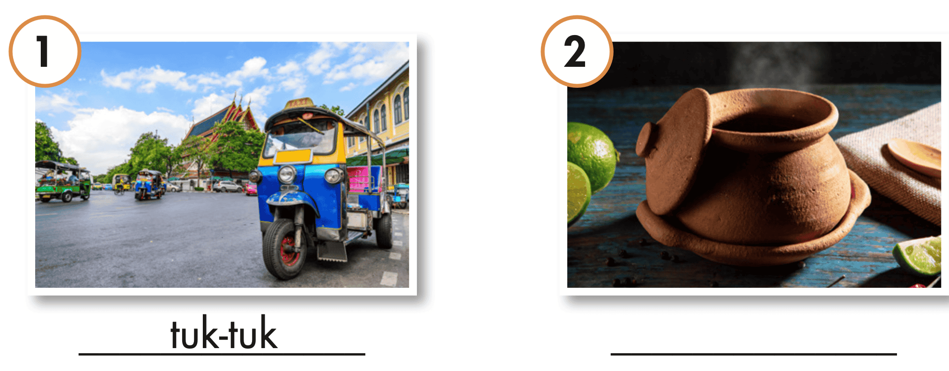
Task a. Read the words and definitions, then match the words with the pictures.
ANSWERS
clay pot

Slide 14
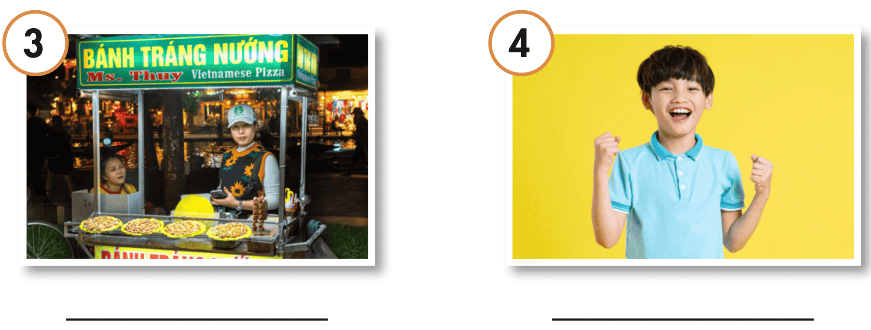
Task a. Read the words and definitions, then match the words with the pictures.
ANSWERS
stall
nephew

Slide 15
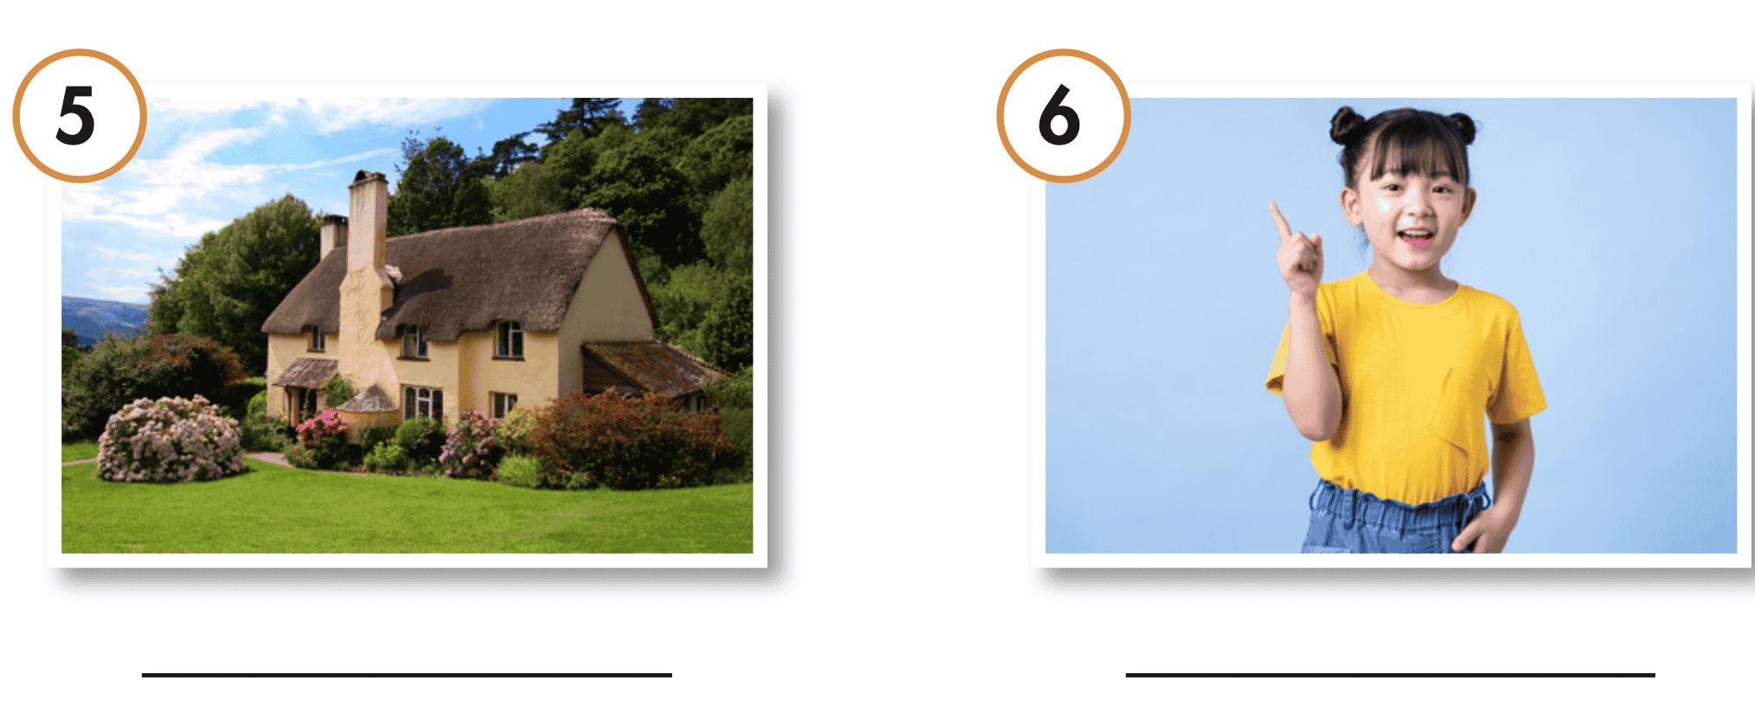
Task a. Read the words and definitions, then match the words with the pictures.
ANSWERS
cottage
niece

Slide 16
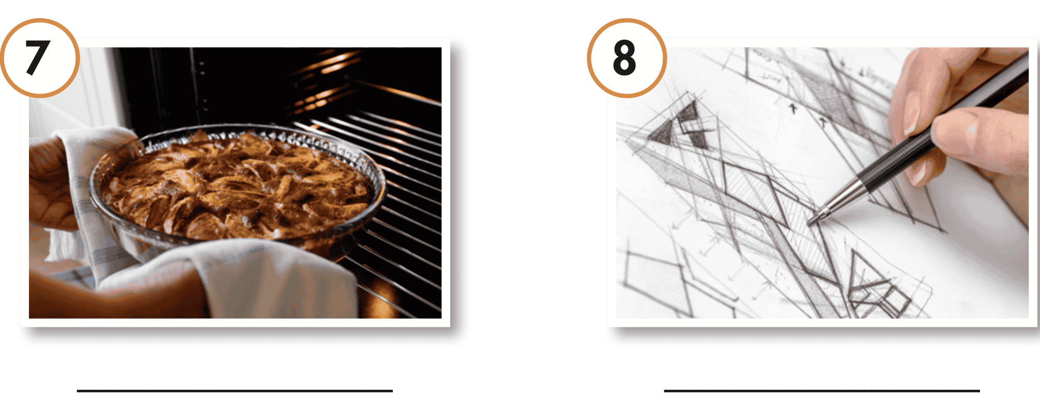
Task a. Read the words and definitions, then match the words with the pictures.
ANSWERS
bake
sketch

Slide 17


Task a. Listen and repeat.
clay pot
stall
nephew
cottage
niece
bake
sketch

Slide 18
Listen and repeat. Click each phrase to hear the sound.
 | 1 | tuk- tuk | (n) | /ˈtʊk tʊk/ | xe lam
 | 2 | clay pot | (n phr) | /kleɪ pɑːt/ | nồi đất
 | 3 | stall | (n) | /stɑːl/ | quầy hàng
 | 4 | nephew | (n) | /ˈnefjuː/ | cháu trai (con của anh, chị, em)
•

Slide 19
Listen and repeat. Click each phrase to hear the sound.
 | 5 | cottage | (n) | /ˈkɑːtɪdʒ/ | ngôi nhà nhỏ (thường ở vùng quê)
 | 6 | niece | (n) | /niːs/ | cháu gái (con của anh, chị, em)
 | 7 | bake | (v) | /beɪk/ | nướng
 | 8 | sketch | (v) | /sketʃ/ | vẽ phác thảo
•

Slide 20
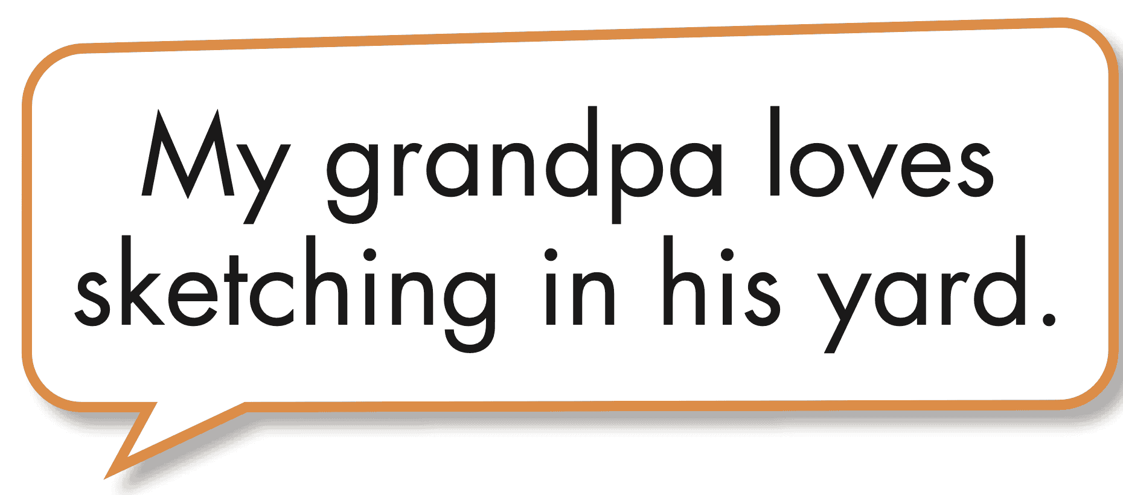
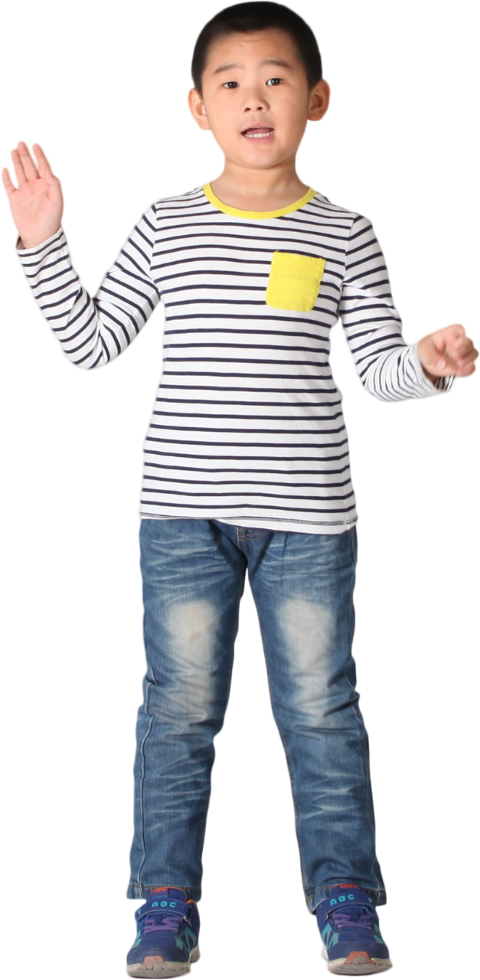
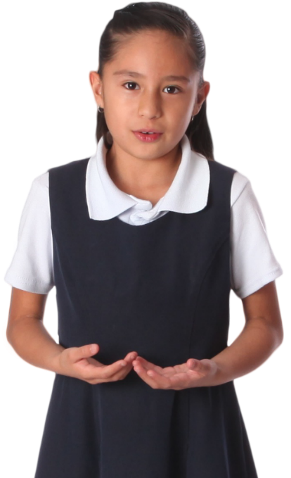

Task b. In pairs: Use the new words to talk about things your parents and grandparents like doing.

Slide 21
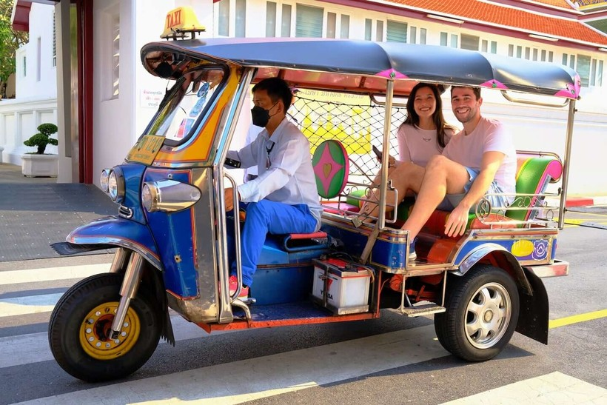
Suggested answer
When visiting my family in Thailand, my parents love to take a tuk-tuk to explore the bustling city streets.

Slide 22
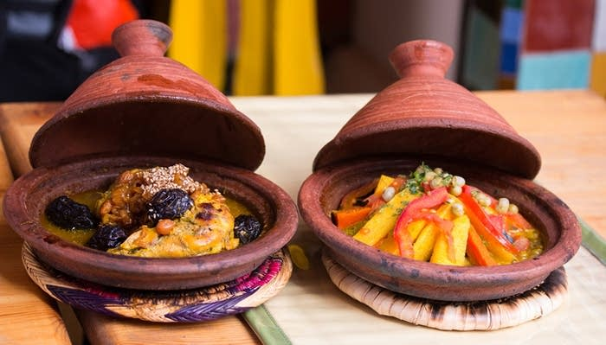
Suggested answer
2.My grandma loves cooking in her clay pots.

Slide 23
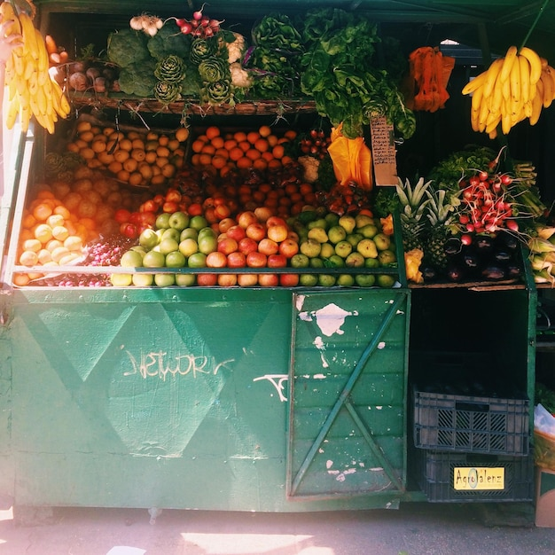
Suggested answer
3. My grandparents like buying food from a woman's stall near their house.

Slide 24
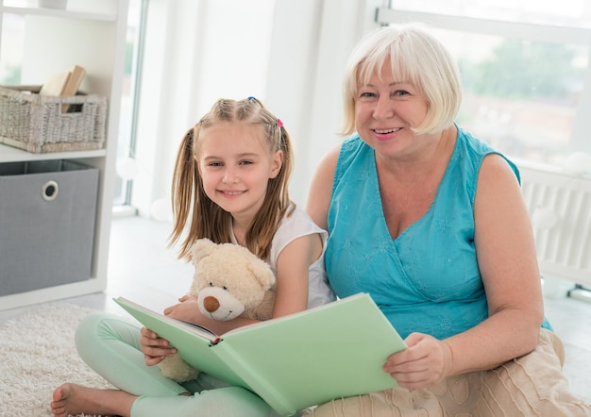
Suggested answer
4. My grandmother likes to read books to my nephew.

Slide 25
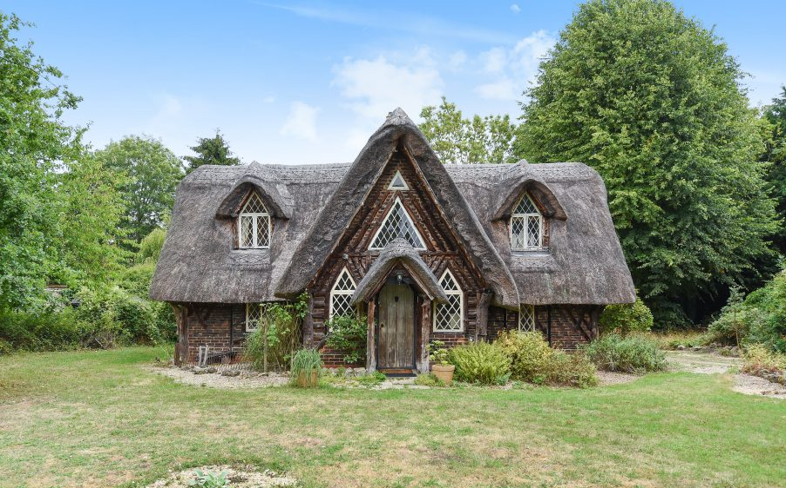
Suggested answer
5. My parents love to rent a cozy cottage for a peaceful getaway.

Slide 26
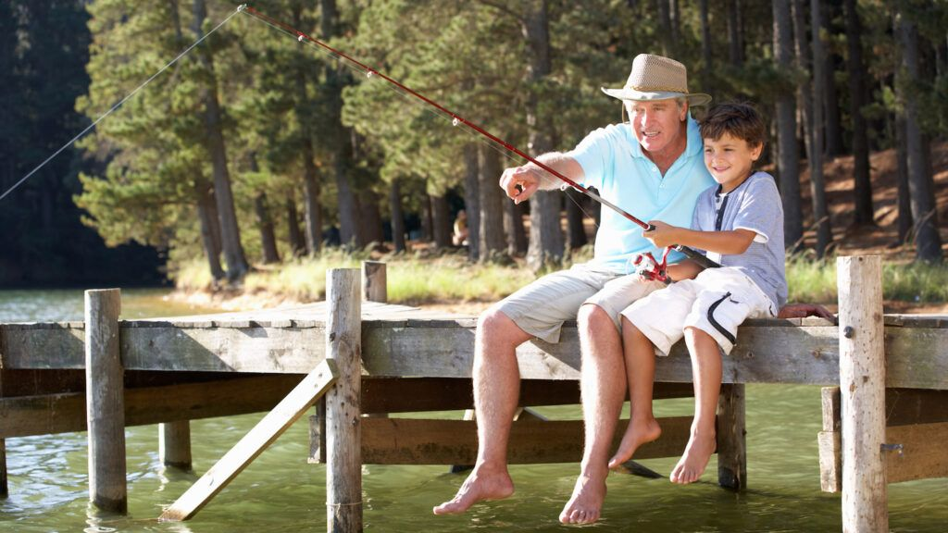
Suggested
answer
6. My father loves to go fishing with my nephew.

Slide 27
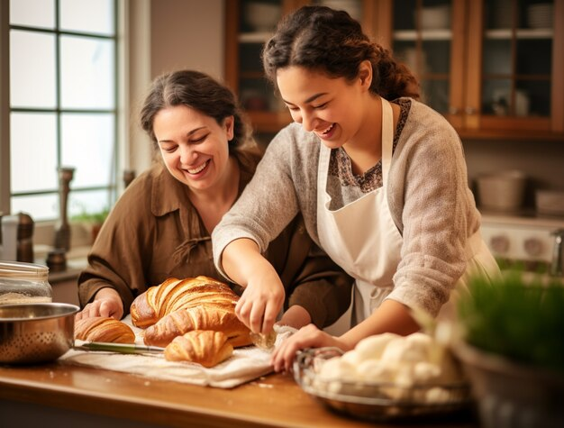
Suggested answer
7. Every Sunday morning, my mom bakes homemade bread for the whole family to enjoy.

Slide 28
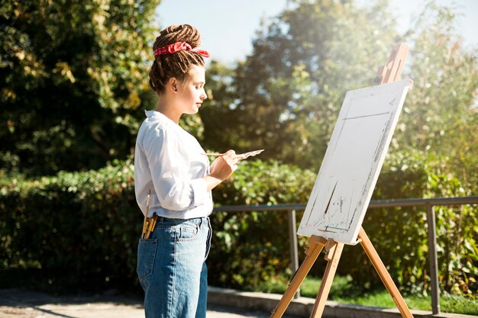
Suggested answer
8. My mother loves sketching in her garden.

Slide 29

Task a. Listen to a grandfather talking to his granddaughter about some memories. How does he feel about them?
Underline the key words
1. good, happy memories
2. nice, but boring memories
3. one happy memory and one sad memory

Slide 30

Task a. Listen to a grandfather talking to his granddaughter about some memories. How does he feel about them?
1. good, happy memories
2. nice, but boring memories
3. one happy memory and one sad memory

Slide 31
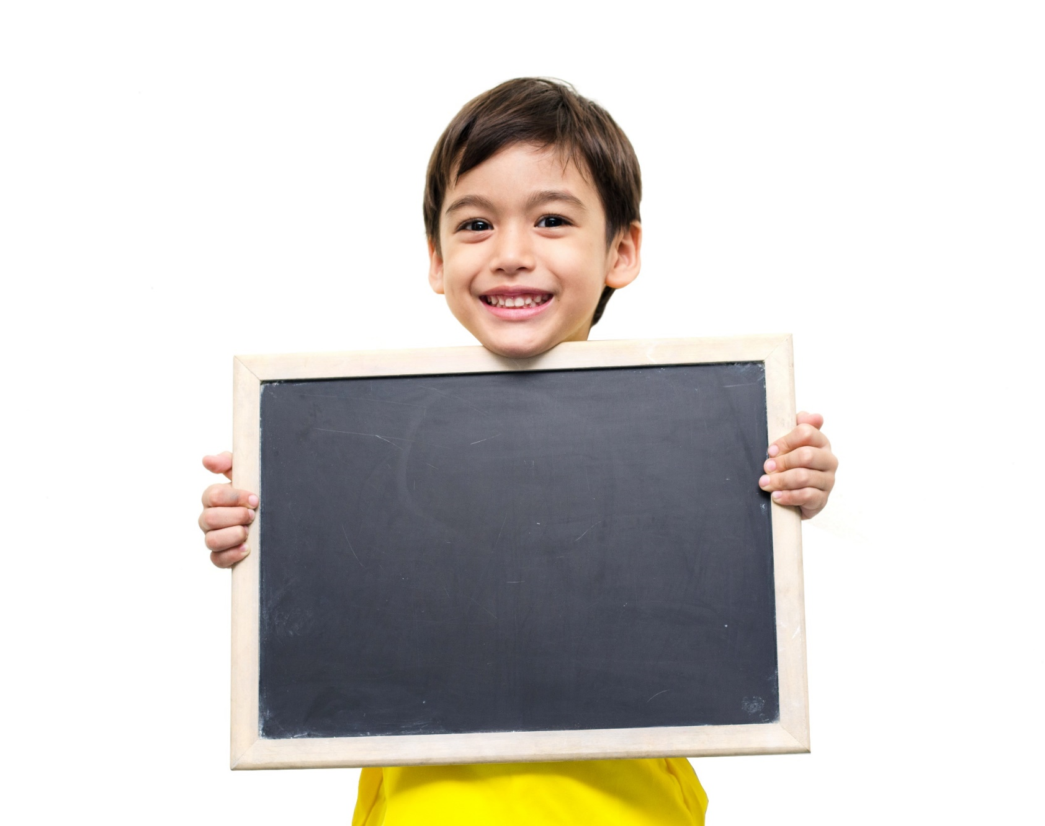
While-listening

Slide 32
Task a. Listen to a grandfather talking to his granddaughter about some memories. How does he feel about them?
ANSWERS
1. good, happy memories
2. nice, but boring memories
3. one happy memory and one sad memory
G: Where's this, Grandpa?
M: That's a beach that your dad and I used to go to in the summer.
G: I love the beach. What would you do?
M: I'd throw a ball with your dad. We used to have so much fun.

Slide 33
Pre-reading

Slide 34
Task b. Now, listen and fill in the blanks.
Underline the key words and guess the type of missing words
1. Grandpa used to visit a cottage in the ____________.
2. Grandpa's wife, children, ____________ and ____________ used to go to the cottage.
3. Grandma used to bake ____________
4. Grandpa and his parents would look at the ____________ at the market.
5. Grandpa would ____________ at the beach.
(season)
(person)
(person)
(food)
(place)
(Verb bare)

Slide 35
Task b. Now, listen and fill in the blanks.
1. Grandpa used to visit a cottage in the ____________.
2. Grandpa's wife, children, ____________ and ____________ used to go to the cottage.
3. Grandma used to bake ____________
4. Grandpa and his parents would look at the ____________ at the market.
5. Grandpa would ____________ at the beach.

Slide 36
Task b. Now, listen and fill in the blanks.
ANSWERS
G: Grandpa. Come and look at these photos with me.
M: OK, sweetie.
G: Look at this one.
M: Oh, that's a good photo.
G: Where were you?
M: That's a cottage we used to visit in the spring.
1. Grandpa used to visit a cottage in the ____________.
spring

Slide 37
Task b. Now, listen and fill in the blanks.
ANSWERS
G: Cool. Who used to go there?
M: We used to go with lots of people. Me, Grandma, your dad, your aunts and uncles, and our nieces and nephews. We'd cook amazing meals there.
2. Grandpa's wife, children, ____________ and ____________ used to go to the cottage.
nieces
nephews

Slide 38
Task b. Now, listen and fill in the blanks.
ANSWERS
3. Grandma used to bake _______________
G: Lucky you! What did you use to cook?
M: Grandma often used to bake fish in a clay pot.
fish in a clay pot.

Slide 39
Task b. Now, listen and fill in the blanks.
ANSWERS
4. Grandpa and his parents would look at the _______________________ at the market.
G: Oh, I'd love to hear more about it!
M: My parents and I would walk around the market and look at all the food and clothes stalls.
food and clothes stalls

Slide 40
Task b. Now, listen and fill in the blanks.
ANSWERS
G: Where's this, Grandpa?
M: That's a beach that your dad and I used to go to in the summer.
G: I love the beach. What would you do?
M: I'd throw a ball with your dad. We used to have so much fun.
5.Grandpa would __________________ at the beach.
throw a ball

Slide 41
SCRIPT- CD1-Track 20
G: Grandpa. Come and look at these photos with me.
M: OK, sweetie.
G: Look at this one.
M: Oh, that's a good photo.
G: Where were you?
M: That's a cottage we used to visit in the spring.
G: Cool. Who used to go there?
M: We used to go with lots of people. Me, Grandma, your dad, your aunts and uncles, and our nieces and nephews. We'd cook amazing meals there.

Slide 42
SCRIPT- CD1-Track 20
G: Lucky you! What did you use to cook?
M: Grandma often used to bake fish in a clay pot.
G: That sounds awesome. What about this photo?
M: That's a market we used to go to on the weekends.
G: Oh, I'd love to hear more about it!
M: My parents and I would walk around the market and look at all the food and clothes stalls.

Slide 43
SCRIPT- CD1-Track 20
G: Did you buy much?
M: No. We didn't have very much money then.
G: I see.
M: But we used to always get ice cream. I used to love doing that.
G: Where's this, Grandpa?
M: That's a beach that your dad and I used to go to in the summer.
G: I love the beach. What would you do?
M: I'd throw a ball with your dad. We used to have so much fun.

Slide 44

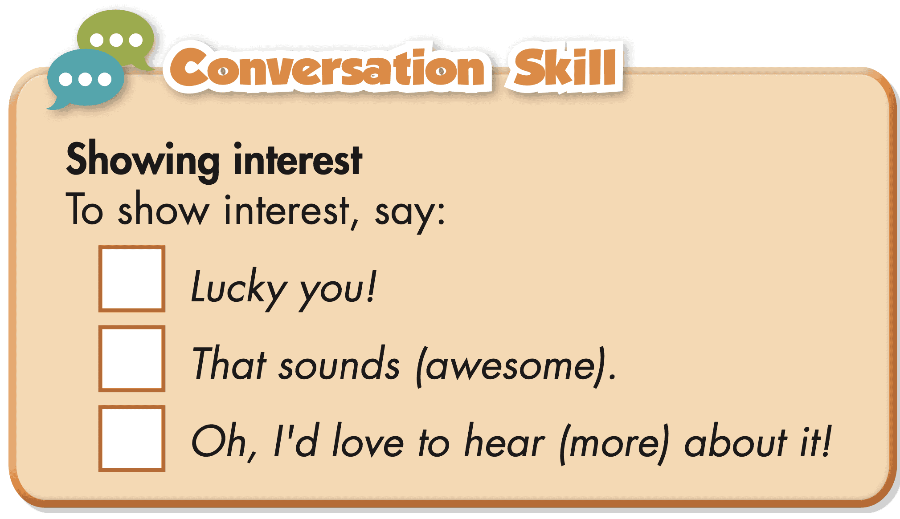
Task c. Read the Conversation Skill box, then listen and repeat

Slide 45
Task d. Now, listen to the conversation again and number the phrases in the correct order
1

Slide 46
Task d. Now, listen to the conversation again and number the phrases in the correct order
ANSWERS
G: Lucky you! What did you use to cook?
M: Grandma often used to bake fish in a clay pot.
G: That sounds awesome. What about this photo?
M: That's a market we used to go to on the weekends.
G: Oh, I'd love to hear more about it!
1
2
3

Slide 47

Post-listening

Slide 48
Task d. In pairs: Take turns telling your partner about things you would do in the summer but don't do anymore.
Suggested answer
When I was little, my family would go to the water park every summer. It was a lot of fun.

Slide 49
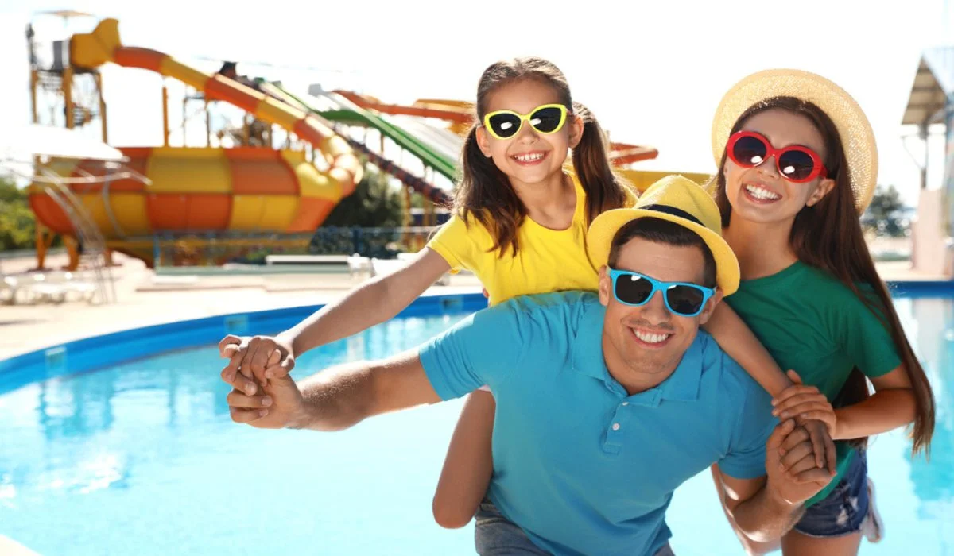
Suggested answer
When I was little, my family would go to the water park every summer. It was a lot of fun.

Slide 50
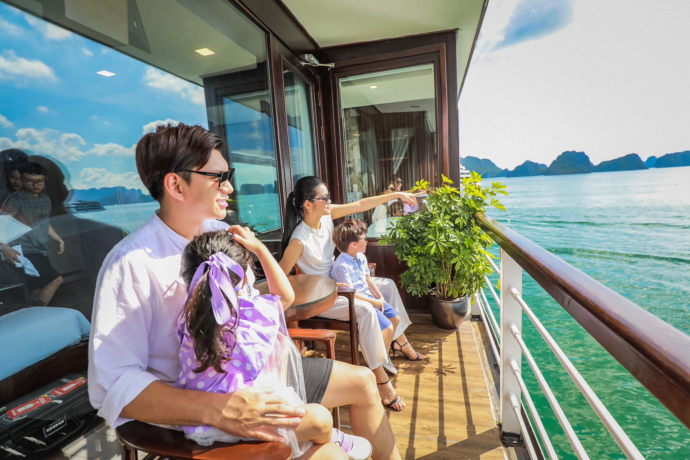
Suggested answer
When I was little, my family would go on a cruise in Ha Long Bay every summer. It was a lot of fun.

Slide 51
Extra
Practice
Workbook
Presentation

Slide 52

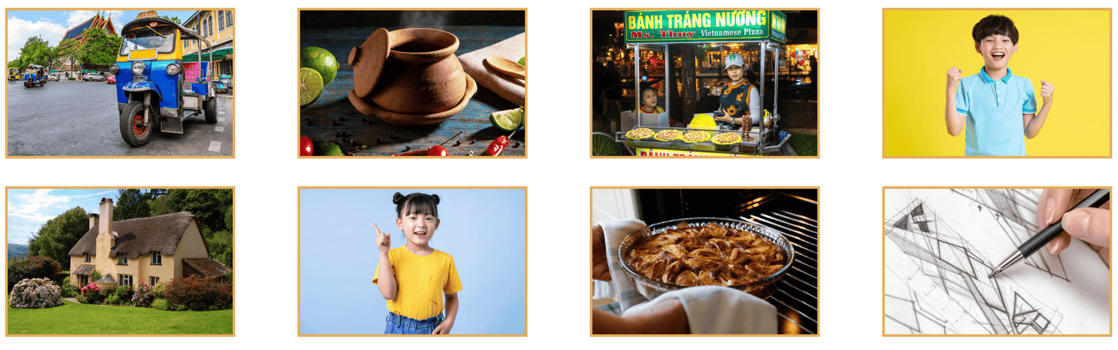
WB - p10 - Task a. Look at the pictures and find the words in the word search.

Slide 53
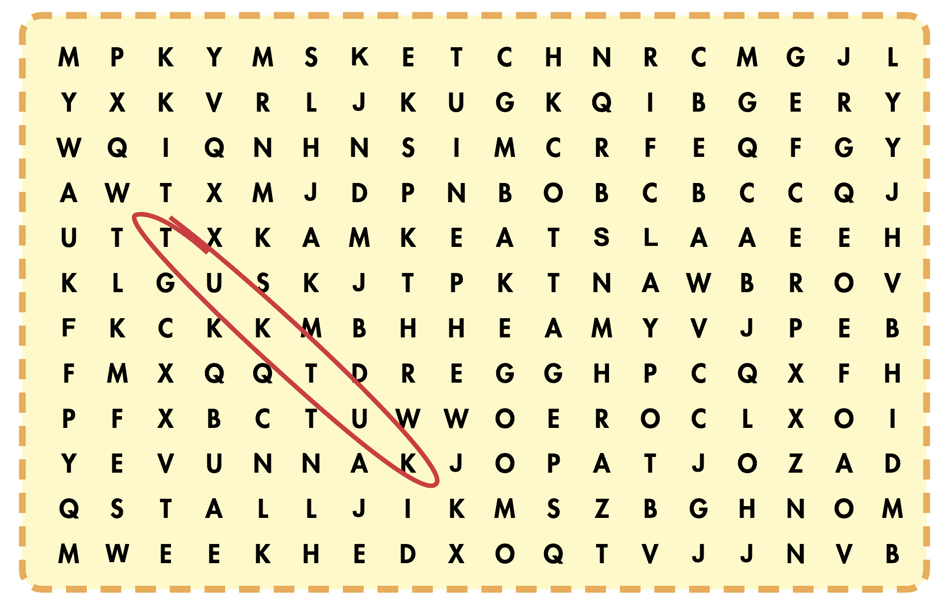
WB-p10-Task a. Look at the pictures and find the words in the word search.

Slide 54
WB - p10 - Task a. Look at the pictures and find the words in the word search.
ANSWERS
clay pot
stall
nephew
cottage
niece
bake
sketch

Slide 55
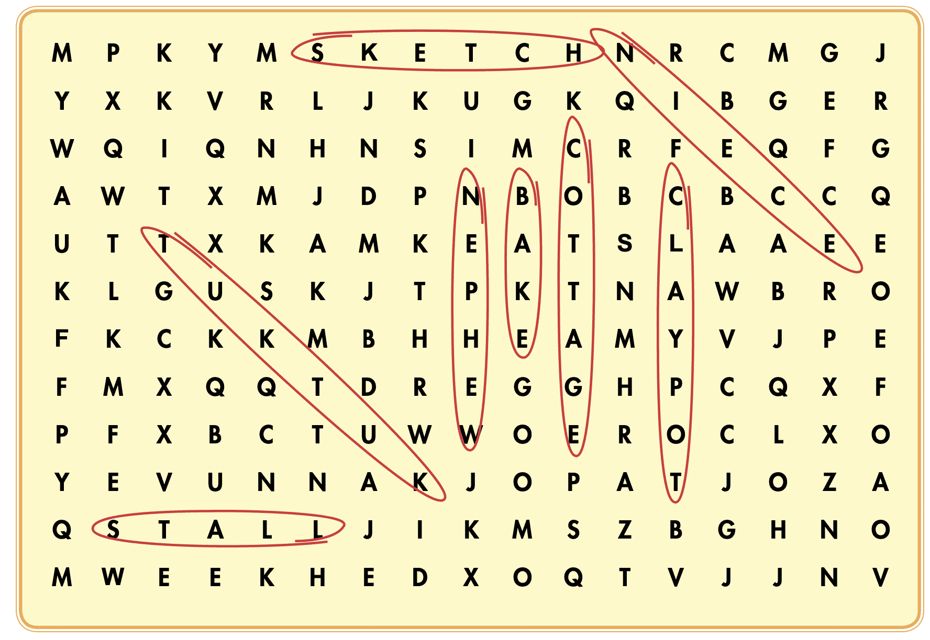
WB - p10 - Task a. Look at the pictures and find the words in the word search.
ANSWERS

Slide 56
WB - p10 - Task b. Fill in the blanks using the words from Task a.
ANSWERS
1. My brother's son is a very polite boy. I'm proud to have a ____________like that.
2. My sister just had a baby girl. I'm so happy. Now, I have a ________.
3. In some countries, people cook food in a ____________ on a fire.
4. If you visit Thailand, the taxis are often ____________s, not cars or motorbikes.
5. The fruit ____________ at the market sells really fresh pineapples.
nephew
niece
clay pot
tuk-tuk
stall

Slide 57
WB - p10 - Task b. Fill in the blanks using the words from Task a.
ANSWERS
6. On my birthday, my mom always ____________s me a cake. She never buys one from a store.
7. My grandparents live in a little ____________ in the country. It's only has four rooms.
8. I love to ____________ pictures when I visit my grandparents in the country.
bake
cottage
sketch

Slide 58
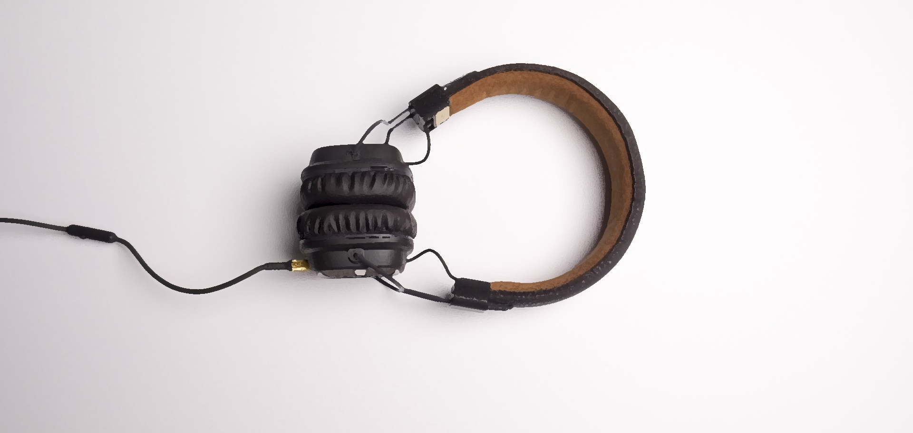
LISTENING

Slide 59
WB - p11 - Task a. Listen to a boy asking his grandma about a memorable day. How did Grandma feel on that day?
Underline the key words
1. annoyed about the car being late
2. happy about the wedding being simple

Slide 60

WB - p11 - Task a. Listen to a boy asking his grandma about a memorable day. How did Grandma feel on that day?
1. annoyed about the car being late
2. happy about the wedding being simple

Slide 61
WB - p11 - Task a.
Grandma: It was a simple wedding. We ate fish in a clay pot. We didn't use to have an oven, you know.
Bob: You couldn't even bake cakes?
Grandma: No, we used to do all our cooking on a small fire.
Bob: Wow. That sounds fun.
Grandma: It was hard work, but yes, life was fun. Your grandpa used to work at a pottery stall at the local market, so he made all the clay pots for the wedding. He brought them to our cottage in his tuk-tuk. It was so romantic.
ANSWERS
1. annoyed about the car being late
2. happy about the wedding being simple

Slide 62
WB - p11 - Task b. Now, listen and circle
Underline the key words
1. Grandma/Grandpa liked driving three-wheeled cars.
2. Grandma lived in a cottage in the country/on a hill.
3. She cooked/didn't cook with an oven.
4. She used to make/didn't use to make cake.
5. Grandpa worked at a pottery stall/fruit and vegetable stall.

Slide 63
ANSWERS
WB - p11 - Task b. Now, listen and circle
Bob: Grandma, is this you and Grandpa in this old photo?
Grandma: Oh, yes! Gosh, that was our wedding day.
Bob: What's this funny-looking car?
Grandma: That's a tuk-tuk, a car with three wheels. We were leaving our wedding. Your grandpa used to love driving those cars.
1. Grandma/Grandpa liked driving three-wheeled cars.

Slide 64
ANSWERS
WB - p11 - Task b. Now, listen and circle
2. Grandma lived in a cottage in the country/on a hill.
Bob: Was this photo taken in the country?
Grandma: Yes. I used to live with my parents in a small cottage in the country. We had the wedding there, and all our relatives came. Uncles, aunts, nephews, nieces, everyone!

Slide 65
ANSWERS
WB - p11 - Task b. Now, listen and circle
3. She cooked/didn't cook with an oven.
Bob: How was it?
Grandma: It was a simple wedding. We ate fish in a clay pot. We didn't use to have an oven, you know.

Slide 66
ANSWERS
WB - p11 - Task b. Now, listen and circle
4. She used to make/didn't use to make cake.
Bob: You couldn't even bake cakes?
Grandma: No, we used to do all our cooking on a small fire.

Slide 67
ANSWERS
WB - p11 - Task b. Now, listen and circle
Grandma: It was hard work, but yes, life was fun. Your grandpa used to work at a pottery stall at the local market, so he made all the clay pots for the wedding. He brought them to our cottage in his tuk-tuk. It was so romantic.
Bob: Tell me more, Grandma! Grandma: Well, on the day of the...
5. Grandpa worked at a pottery stall/fruit and vegetable stall.

Slide 68
SCRIPT- WB-Track 04
Bob: Grandma, is this you and Grandpa in this old photo?
Grandma: Oh, yes! Gosh, that was our wedding day.
Bob: What's this funny-looking car?
Grandma: That's a tuk-tuk, a car with three wheels. We were leaving our wedding. Your grandpa used to love driving those cars.
Bob: Was this photo taken in the country?
Grandma: Yes. I used to live with my parents in a small cottage in the country. We had the wedding there, and all our relatives came. Uncles, aunts, nephews, nieces, everyone!
Bob: How was it?

Slide 69
SCRIPT- WB-Track 04
Grandma: It was a simple wedding. We ate fish in a clay pot. We didn't use to have an oven, you know.
Bob: You couldn't even bake cakes?
Grandma: No, we used to do all our cooking on a small fire.
Bob: Wow. That sounds fun.
Grandma: It was hard work, but yes, life was fun. Your grandpa used to work at a pottery stall at the local market, so he made all the clay pots for the wedding. He brought them to our cottage in his tuk-tuk. It was so romantic.
Bob: Tell me more, Grandma! Grandma: Well, on the day of the...

Slide 70

CONSOLIDATION

Slide 71

Ask and answer the question below with your partner about things you would do in the spring but don't do anymore.
What are things you would do in the spring but don't do anymore?

Slide 72
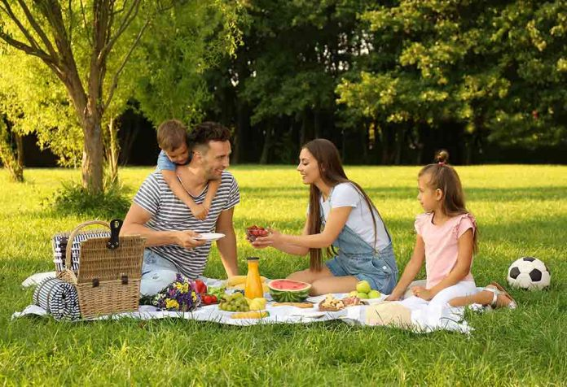
Suggested answer
Presentation
Production
When I was younger, my family would have picnics in the park every spring. It was always a nice way to enjoy the weather and spend time together.

Slide 73

WRAP-UP

Slide 74

Today’s lesson
Vocabularies
bake
sketch
tuk-tuk
clay pot
stall
nephew
niece
cottage

Slide 75
Today’s lesson
Vocabulary:
- learn and use vocabularies related to life in the past. Listening:
- practice listening for gist and details
- practice functional English and how to show interest.

Slide 76
Homework
Review vocabularies related to life in the past.
Make sentences using the vocabularies in SB
Prepare for the next lesson (Grammar - pages 19 & 20 - SB)
Play the consolidation games on www.eduhome.com.vn

Slide 77

Lesson 3
Stay positive and have a nice day!

