Slide 1
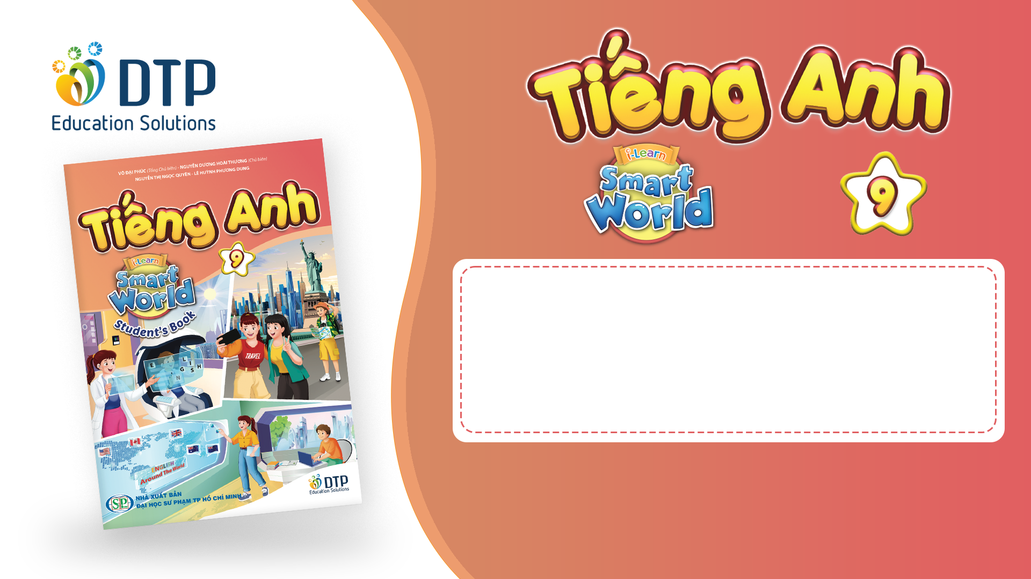
Unit 2: Life in the past
Lesson 1.3: Pronunciation. & Speaking
Pages 16 & 17

Slide 2
Lesson Outline
Warm-up
Pronunciation
Speaking
Consolidation
Wrap-up

Slide 3

By the end of this lesson, students will be able to…
Focus on /ɪ/ and /iː/ sounds.
Talk about family now and then.

Slide 4

WARM-UP

Slide 5
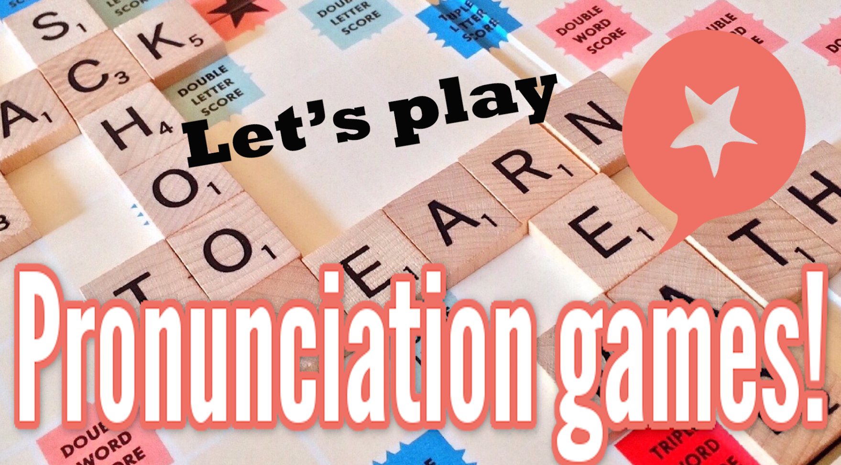
COMPETITION TIME:
Create groups/teams of 5 students.
You will be given some English words
You have to put the words into the correct column (/ɪ/ and /iː/ sounds).
The team(s) with the most correct answers win(s).
Time limit: 5 minutes

Slide 6

Example:
Trapeze
Answer:
/ɪ/ | /iː/
 | Trapeze /trəˈpiːz/

Slide 7
pizza
police
busy
field
building
business
system
dinner
key
magazine
Put the words into the correct column
/ɪ/ | /iː/

Slide 8

Answers
Put the words into the correct column
/ɪ/ |  |  | /iː/
busy | /ˈbɪz.i/ |  | field | /fiːld/
business | /ˈbɪz.nɪs/ |  | pizza | /ˈpiːt.sə/
building | /ˈbɪl.dɪŋ/ |  | key | /kiː/
system | /ˈsɪs.təm/ |  | police | /pəˈliːs/
dinner | /ˈdɪn.ɚ/ |  | magazine | /ˌmæɡ.əˈziːn/

Slide 9

Presentation
Presentation

Slide 10
Pronunciation

Slide 11
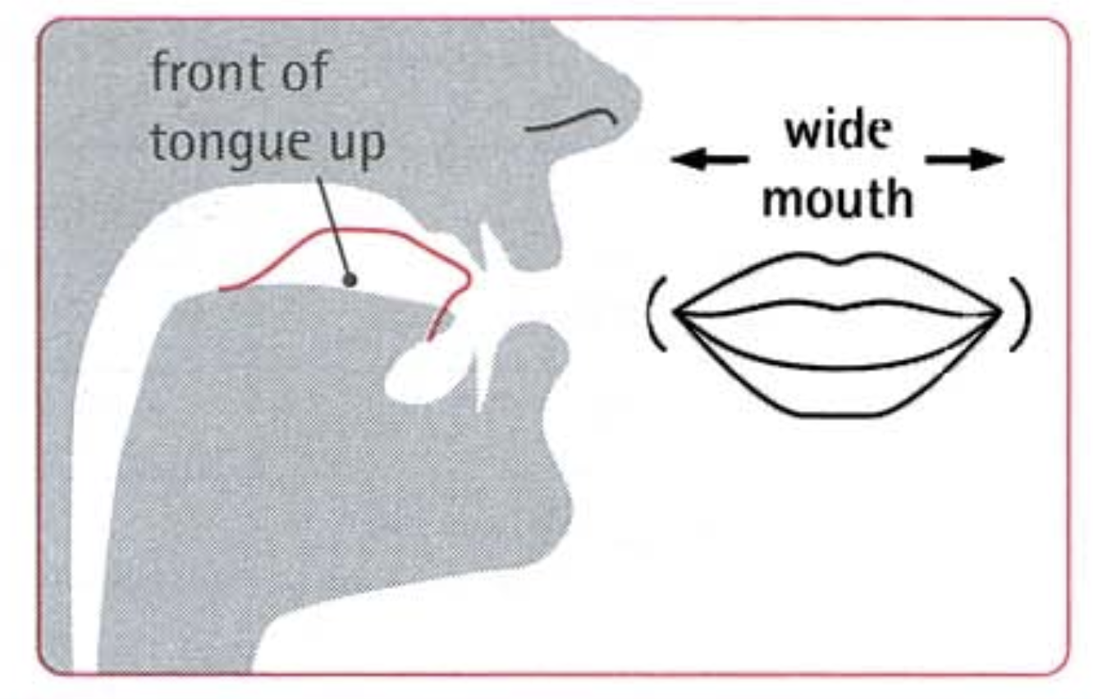
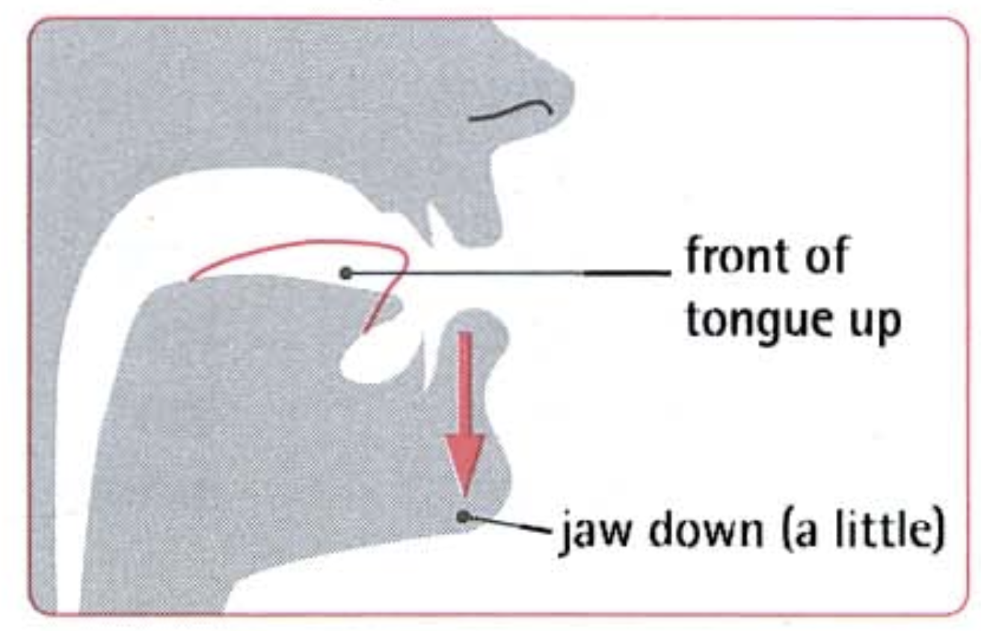
SB - p.16 - Task a. Focus on the /ɪ/ and /iː/ sounds.
NOTES
1./iː/ is a long sound. Make your mouth wide, like a smile. Ensure your tongue touches the sides of your teeth.
2./ɪ/ is a short sound. Make your mouth a bit less wide than for /iː/. Position your tongue a bit towards the back of your mouth.

Slide 12

SB - p.16 - Task b:
Listen. Notice the sounds of the underlined letters.
relative, single, breadwinner
thirteen, Vietnamese, families

Slide 13

SB - p.16 - Task c.
Listen and circle the words you hear.
1. sit seat
2. feel fill
3. His he's

Slide 14
SB - p.16 - Task c.
Listen and circle the words you hear.
Answers
1.sit | seat
/sɪt/ | /siːt/
2.feel | fill
/fiːl/ | /fɪl/
3.His | he’s
/hɪz/ | /hiːz/

Slide 15
SB - p.16 - Task d. Take turns saying the words in Task c. while your partner points to them.
1. sit seat
2. feel fill
3. His he's

Slide 16
Presentation
Practice

Slide 17
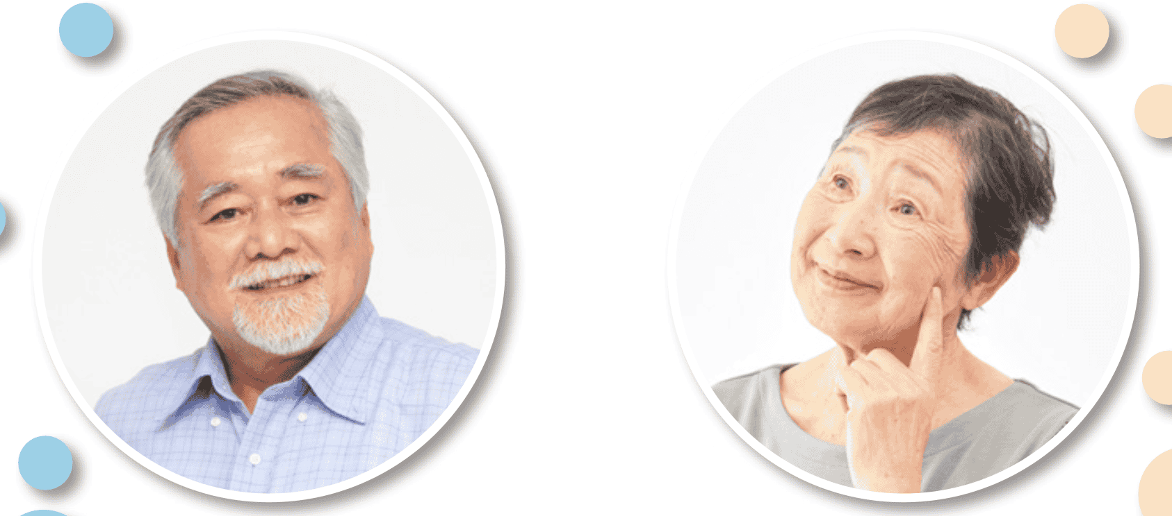
SB - p.17 - Task a. In pairs: Take turns talking about memories of family life in the past and compare them with family life now

Slide 18
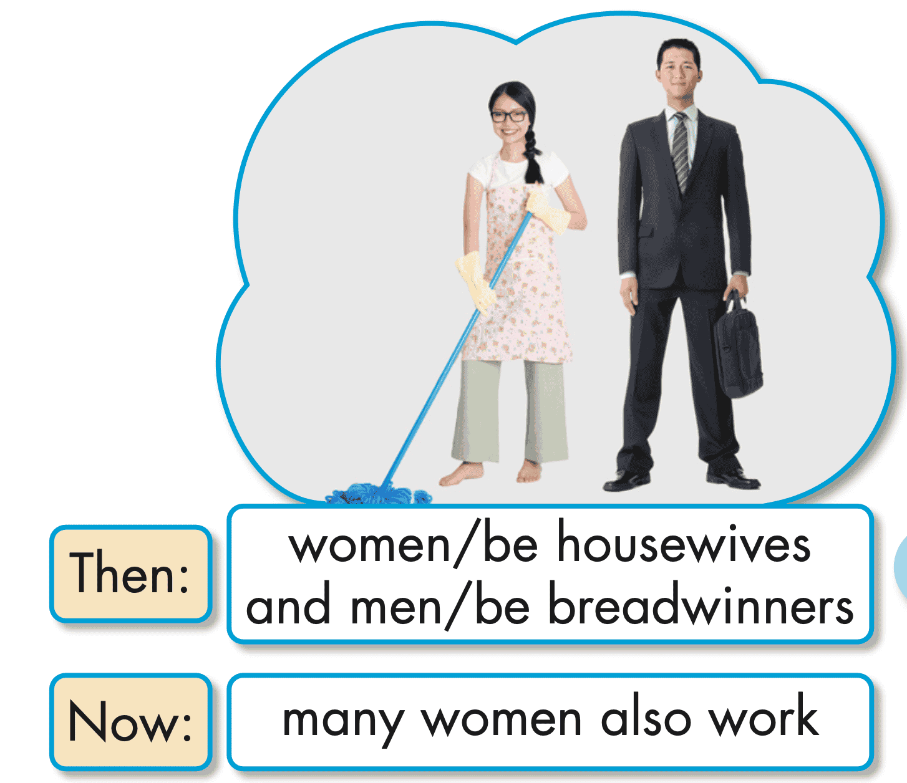
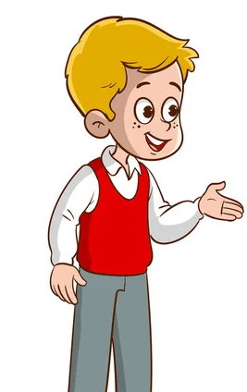
What do you remember about family life in the past, Grandpa?
Back then, women would be housewives, and men would be breadwinners.
Many women also work now.
EXAMPLE

Slide 19
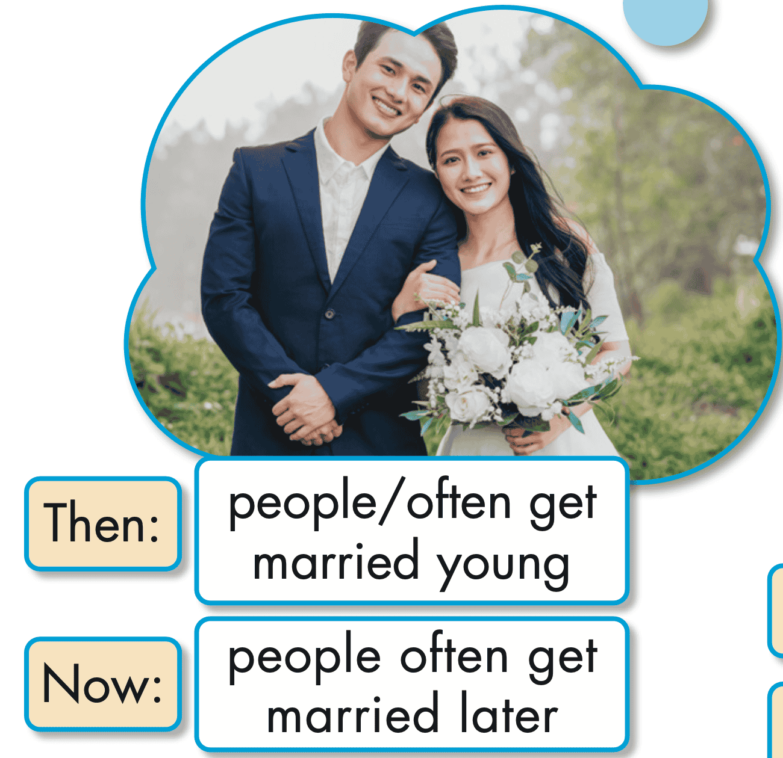
Suggested answer
What do you remember about family life in the past, Grandpa?
Back then, people would often get married young.
People often get married later now.

Slide 20
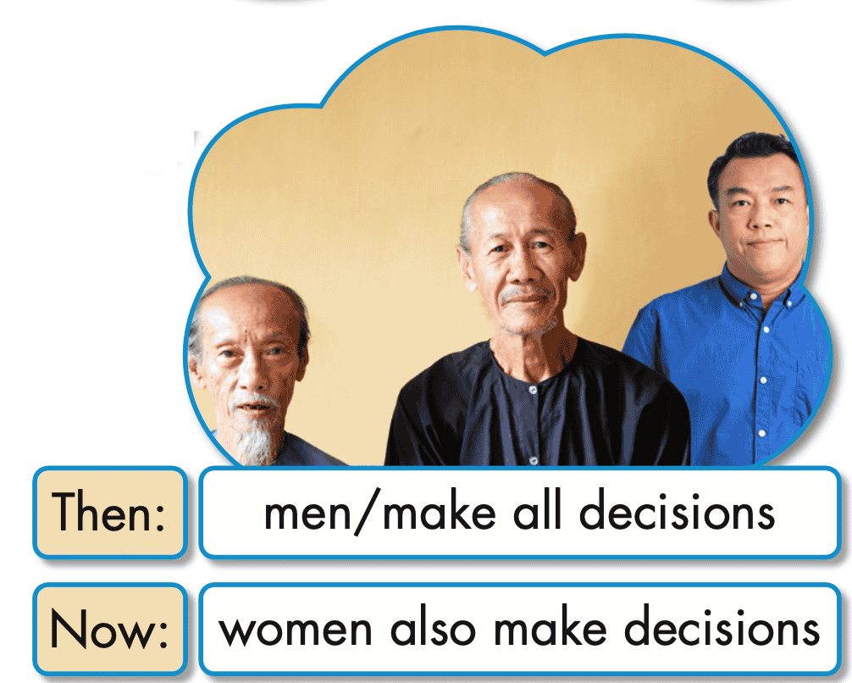
Suggested answer
What do you remember about family life in the past, Grandpa?
Back then, men would make all decisions.
Women also make decisions now.

Slide 21
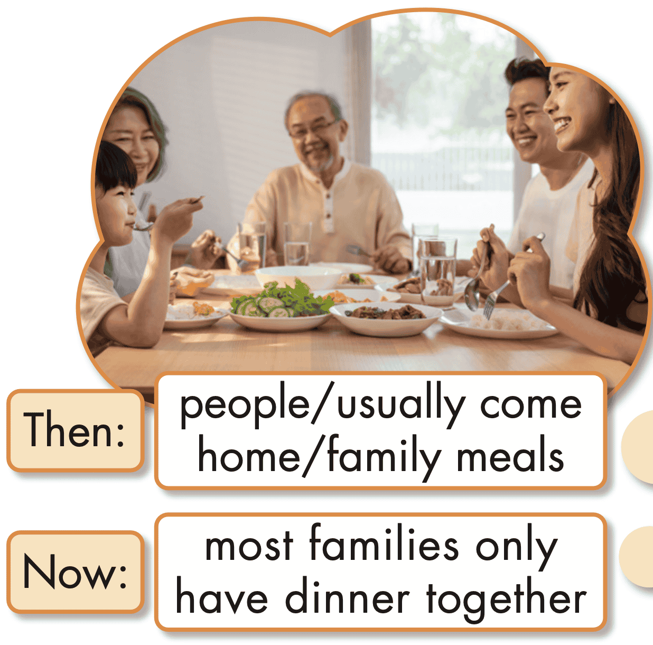
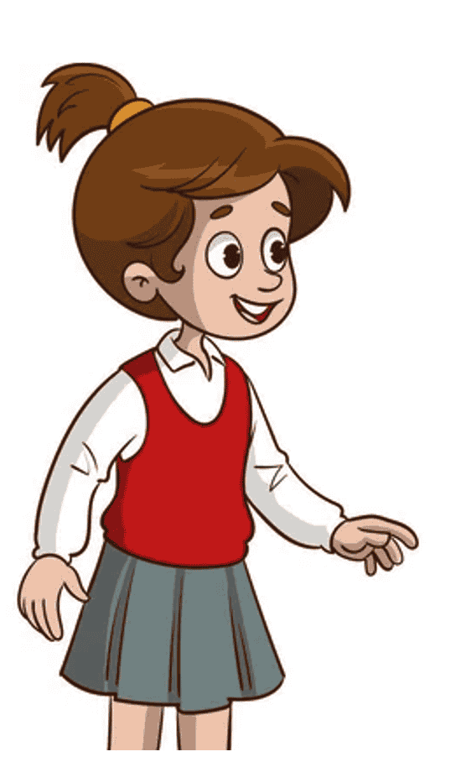
Suggested answer
What do you remember about family life in the past, Grandpa?
Back then, people would usually come home for family meals.
Most families only have dinner together now.

Slide 22
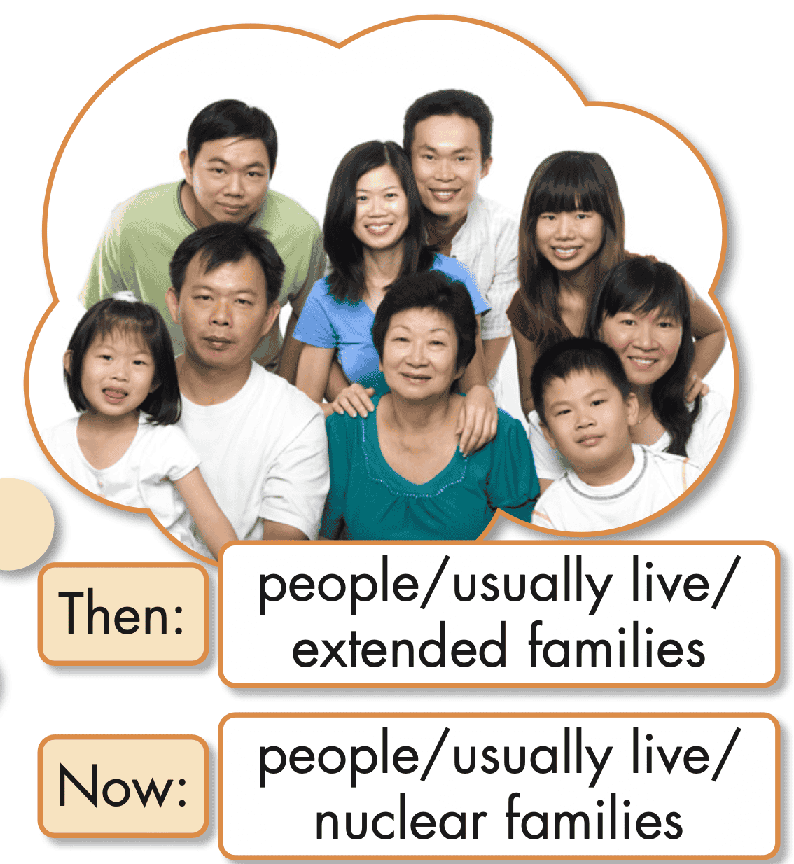
Suggested answer
What do you remember about family life in the past, Grandpa?
Back then, people would usually live in extended families.
People usually live in nuclear families now.

Slide 23
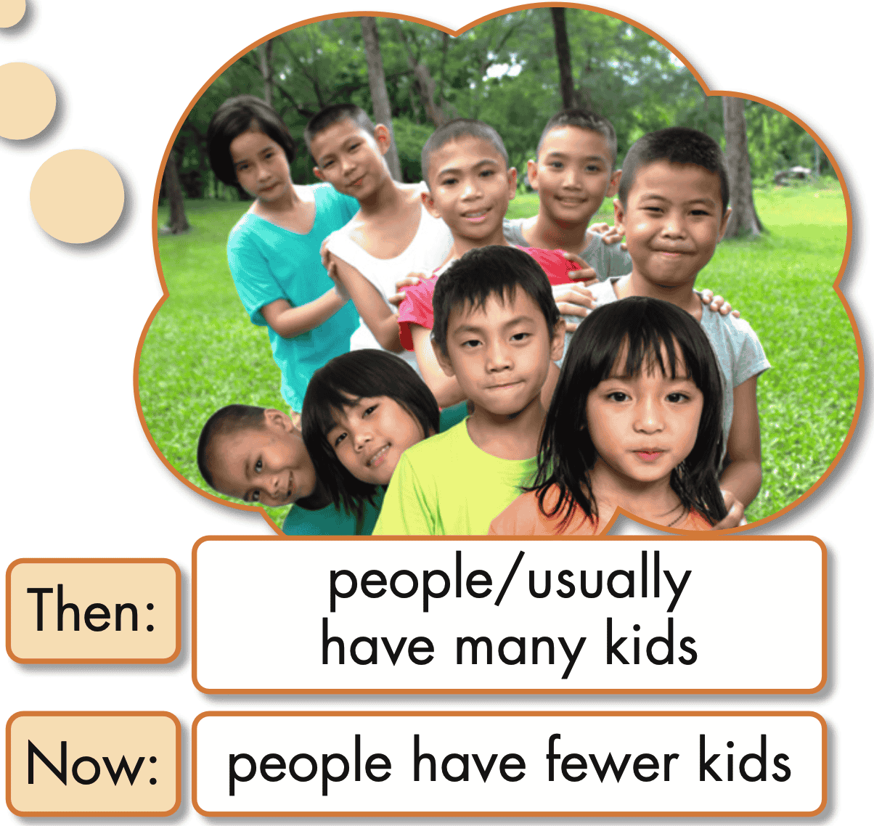
Suggested answer
What do you remember about family life in the past, Grandpa?
Back then, people would usually have many kids.
People have fewer kids now.

Slide 24

SB-p.17-Task b: Practice again with your own ideas for the information in blue.
Suggested answer
A: What do you remember about family life in the past, Grandpa?
B: Back then, people would often communicate through letters, phone calls, or face-to-face interactions.
A: People often communicate through video calls, social media, and instant messaging now.

Slide 25
Presentation
Production

Slide 26
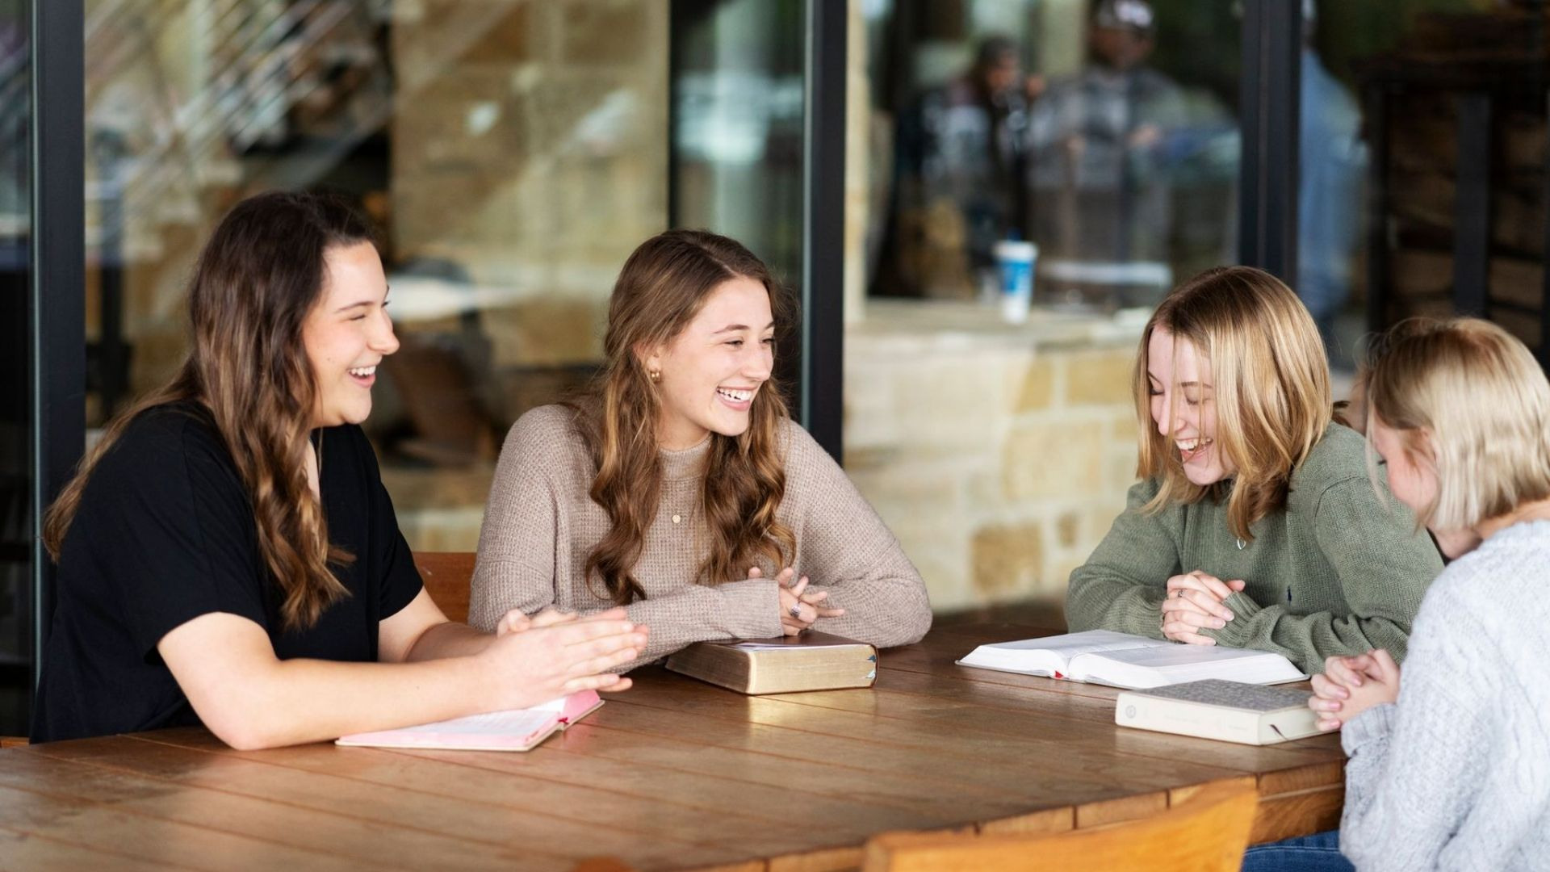
SPEAKING

Slide 27

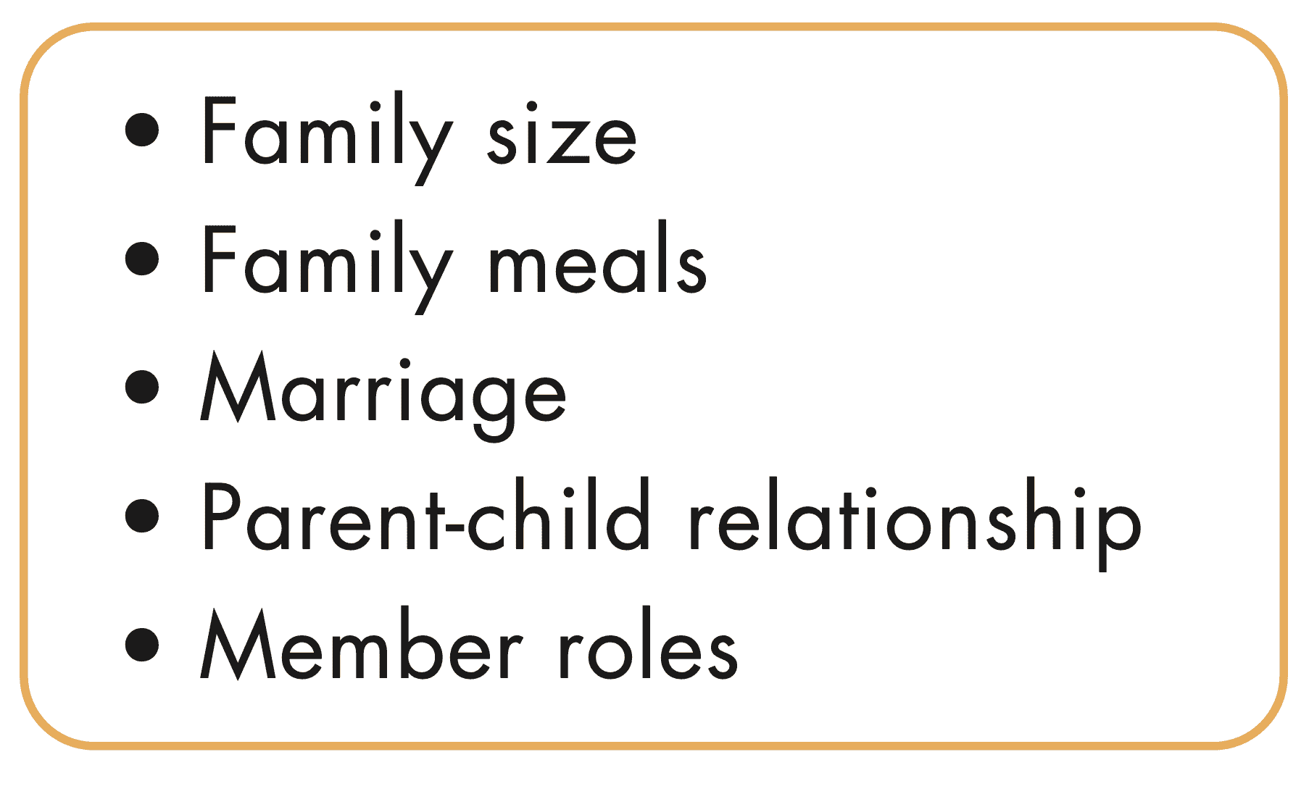
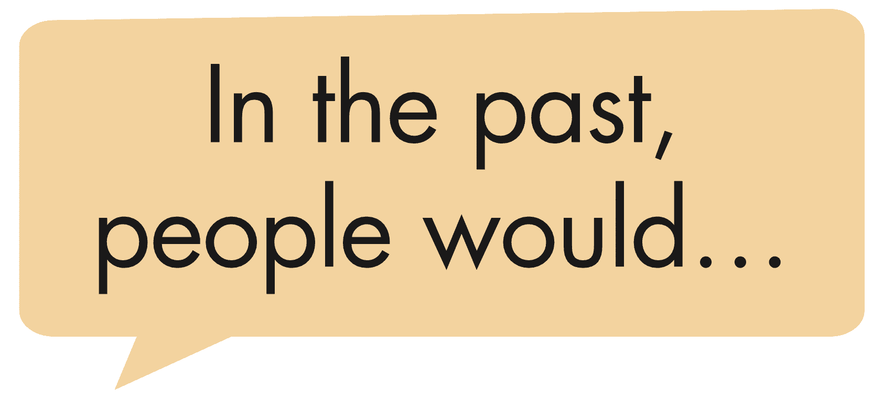

Family Now and Then
SB - p.17 - Task a. In pairs: Discuss family traditions and customs in the past and compare them to today. Discuss the points below.

Slide 28
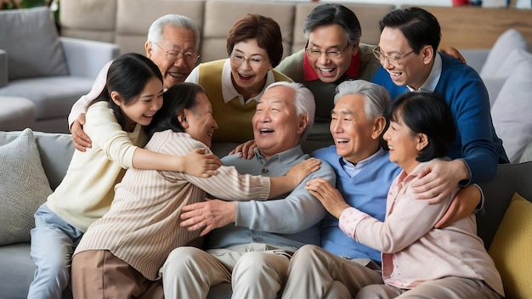

Suggested answer
1.Family size
In the past, people would often have larger families with many children.
Now, people tend to have smaller families, with fewer children or sometimes even just one child.

Slide 29
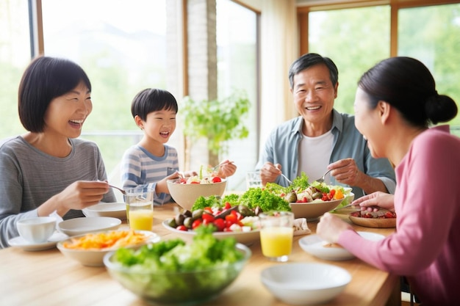
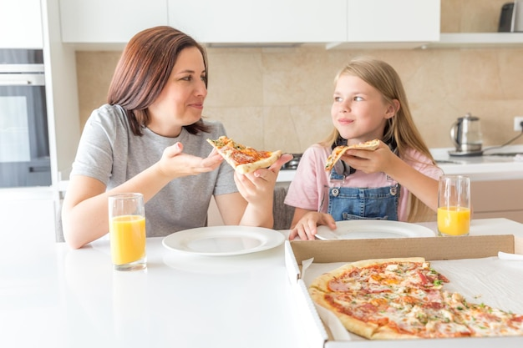
Suggested answer
2.Family meals
In the past, people would gather together for family meals every day.
Now, people often have more hectic schedules, so they may not always eat together as a family.

Slide 30
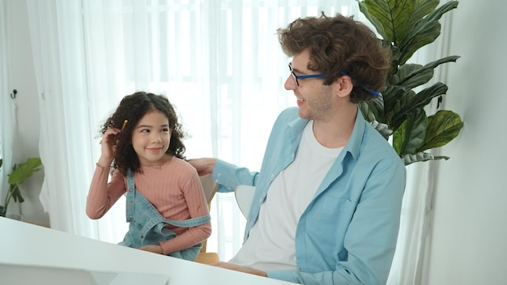
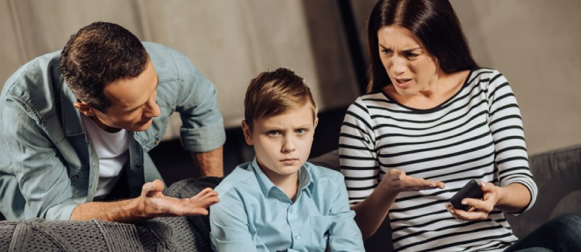
Suggested answer
4.Parent-child relationship
In the past, parents would usually have a stricter approach to parenting.
Now, parents often have a more communicative relationship with their children.

Slide 31
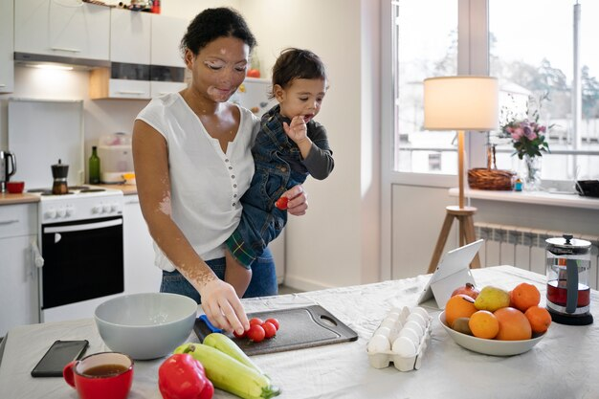

Suggested answer
5.Member roles
In the past, the husband was the breadwinner, and the wife would stay at home.
Now, people tend to have more equal roles within the family and everyone shares responsibilities.

Slide 32
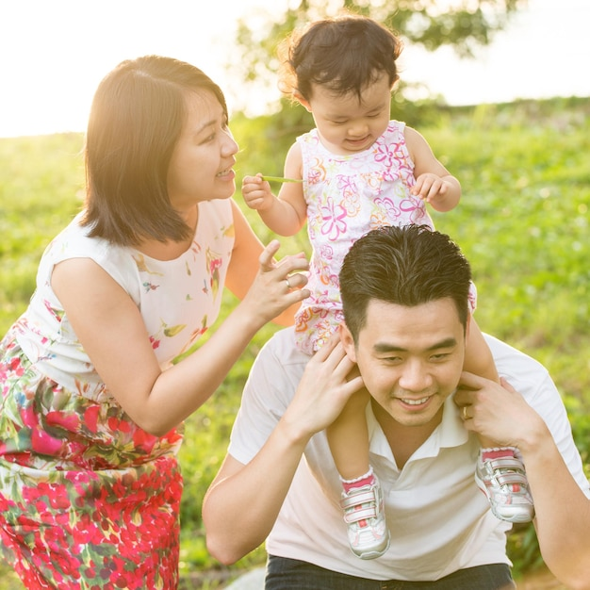

SB - p.17 - Task b. Do you think the changes are better or worse? Why?
Example
I think the change in family size is better. Living with many people can be uncomfortable.

Slide 33
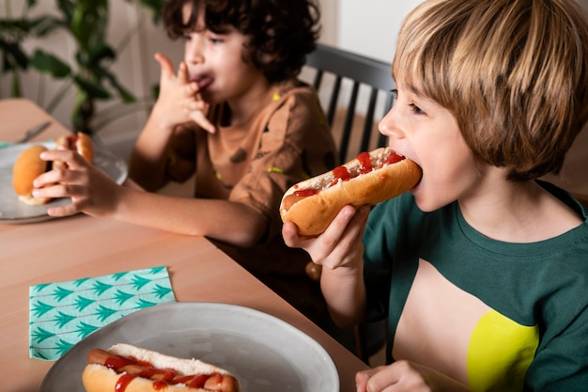
Suggested answer
Presentation
Production
I believe the change in family mealtime is worse. Nowadays, families might not always eat together, which means they miss out on bonding time.

Slide 34
Extra
Practice
Presentation

Slide 35


WB - p.9. Write a short article about what family traditions and customs were like in the past and what they're like now. Write 100 to 120 words.

Slide 36
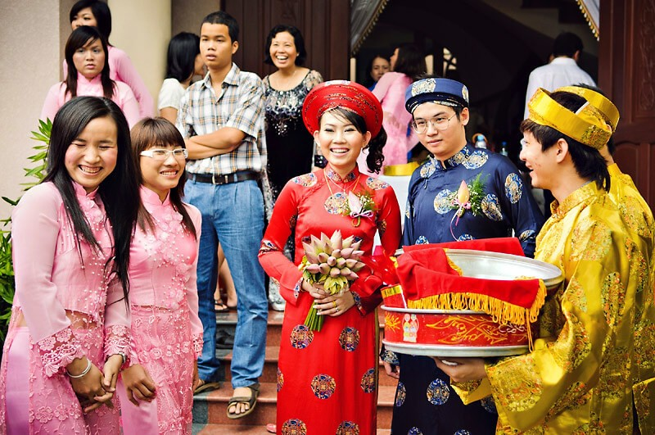
Sample answer
Family traditions were very different in the past. In this article, I will talk about some differences between then and now. In the past, people would get married and stay together forever. People didn't want to stay single. Now, many people stay single, and it's not such a big deal. These days, some people don't find marriage as important as it was.

Slide 37
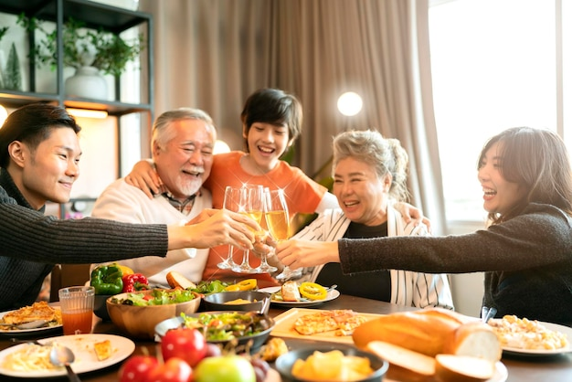
Sample answer
In the past, many generations would live together in one house. There would be lots of relatives living together. Now, most people live in smaller families, and their relatives live in separate houses.
Change in family traditions is normal. In the future, there will be more changes to what we think a family should be like.

Slide 38

CONSOLIDATION

Slide 39

Ask and answer the question below with your partner about family traditions in the past
What would you often do with your family during the Lunar New Year holiday when you were a child?

Slide 40
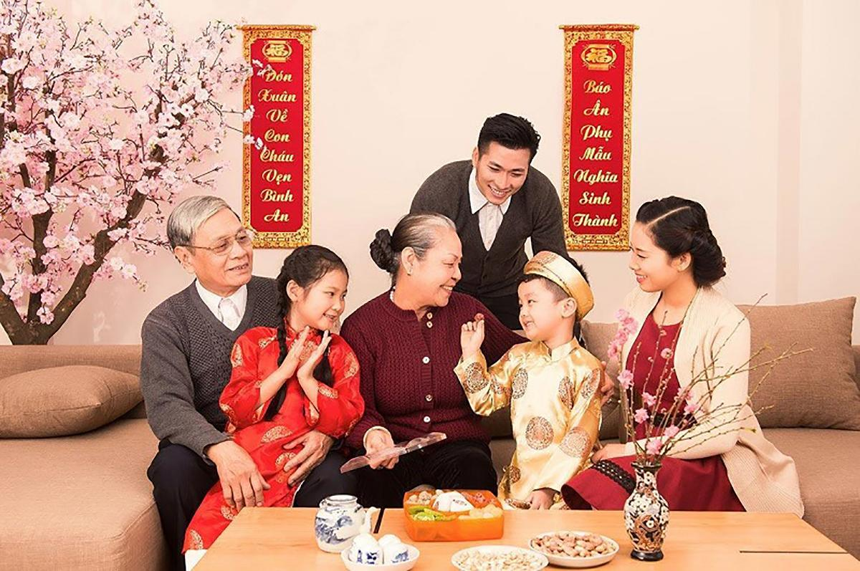
Suggested answer
Presentation
Production
During the Lunar New Year holiday when I was a child, my family and I would often gather for big feasts and visit relatives to exchange greetings and gifts.

Slide 41

WRAP-UP

Slide 42
Today’s lesson
Pronunciation:
Focus on /ɪ/ and /iː/ sounds.
Speaking:
Talk about family now and then.

Slide 43
Homework
Practice sounds: /ɪ/ and /iː/.
Prepare for the next lesson (Vocabulary & Listening - pages 18 & 19 - SB).
Play the consolidation games on www.eduhome.com.vn

Slide 44

Lesson 3
Stay positive and have a nice day!

