Slide 1
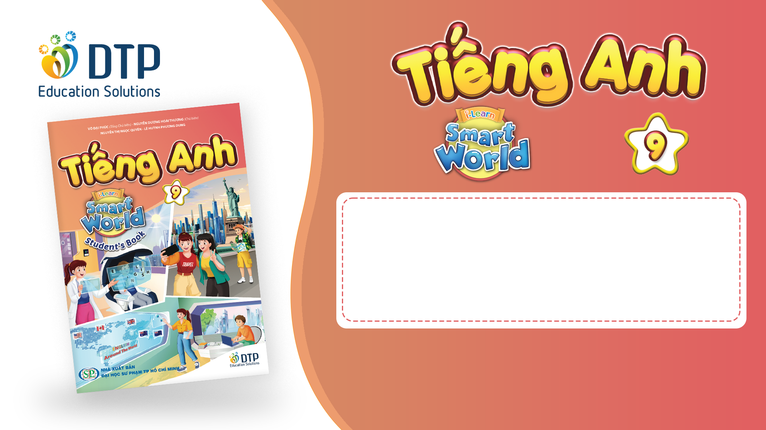
Unit 2: Life in the past
Lesson 1.2: Grammar
Pages 15 & 16

Slide 2
Lesson Outline
Warm-up
Presentation
Practice
Production
Consolidation
Wrap-up

Slide 3

By the end of this lesson, students will be able to…
Learn how to use “would” for repeated past actions
Talk about things that happened regularly when they were kids.

Slide 4

WARM-UP

Slide 5
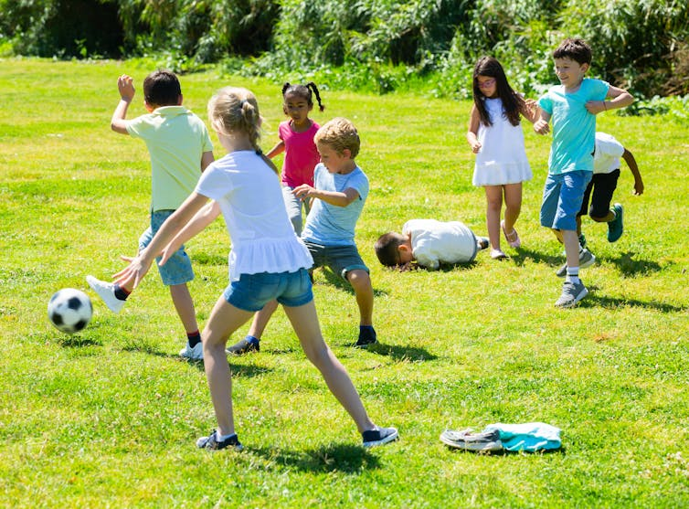
Work in pairs and answer these questions:
What activities would you regularly do with your friends when you were younger?
What special routines would you have before going to bed as a child?
What sports or games would you play with friends in your neighborhood?
What foods or snacks would you always eat when you were a child?

Slide 6
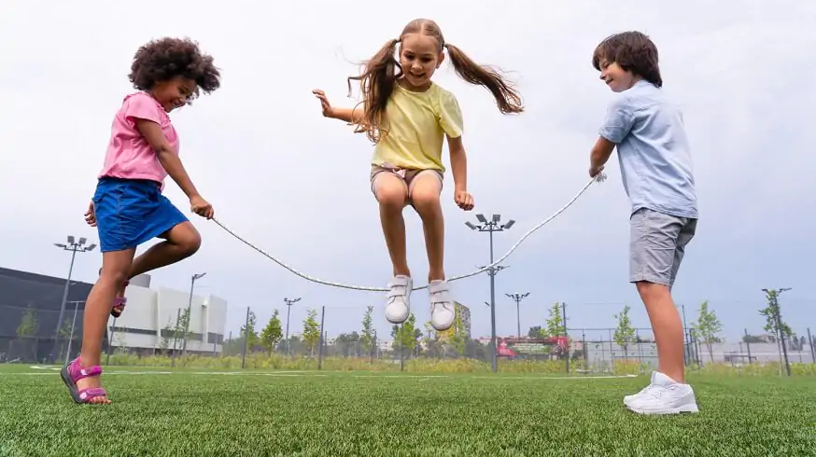
Suggested answer
1.What activities would you regularly do with your friends when you were younger?
1.When I was younger, I would regularly play jump rope with my friends.

Slide 7

Suggested answer
2. What special routines would you have before going to bed as a child?
Before going to bed, I would brush my teeth and put on my pajamas.

Slide 8
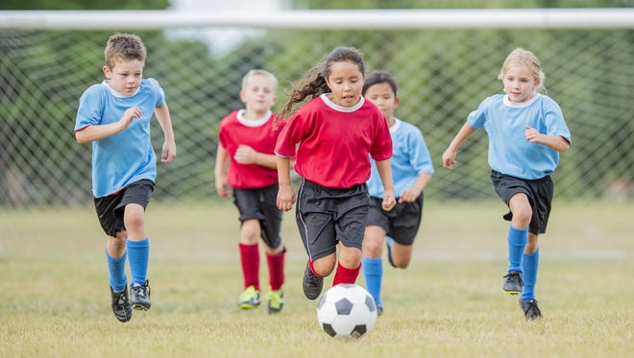
Suggested answer
3.What sports or games would you play with friends in your neighborhood?
In my neighborhood, we would often play soccer.

Slide 9

Suggested answer
4.What foods or snacks would you always eat when you were a child?
When I was a child, I would always eat ice cream.

Slide 10

Lead-in

Slide 11
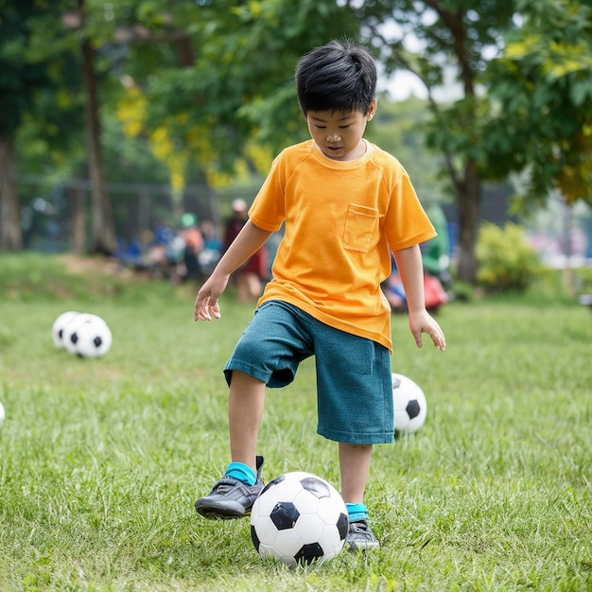
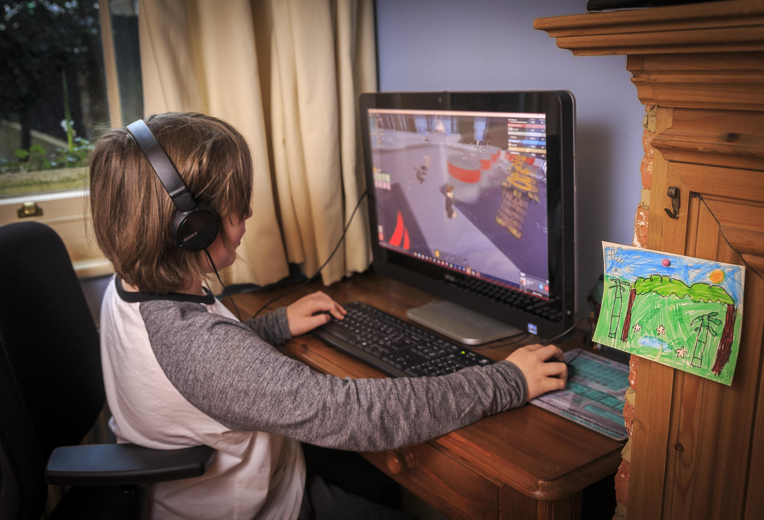
Look at the pictures and answer the questions:
1.What would David regularly play when he was a child?
2. What does David play these days?
When he was a child
These days

Slide 12
Suggested answers
When he was a child
These days
David would regularly play soccer when he was a child.
David plays computer games these days.

Slide 13
David would regularly play soccer when he was a child.
= He regularly played soccer before, but he doesn’t play soccer these days.
He would regularly play | He plays
Past | Now

Slide 14
Work in groups and fill in the blanks
David would regularly play soccer when he was a child.
David plays computer games these days.
bare infinitive
FORM: Subject + would + adverb of frequency + ____________+ object
repeated
USE: We can use would to talk about _______ past actions that don't happen anymore. We need to give a specific time or occasion before or after the repeated action.

Slide 15
Presentation

Slide 16


FORM: Past time phrase, subject + would + bare infinitive + object
USE: We can use would to talk about repeated past actions that don't happen anymore. We need to give a specific time or occasion before or after the repeated action.
Presentation
When I was a kid, I would walk home with my mom.

Slide 17
FORM: Subject + would + bare infinitive + object + past time phrase
USE: We can use would to talk about repeated past actions that don't happen anymore. We need to give a specific time or occasion before or after the repeated action.
Presentation
Men would make the big decisions in those days.

Slide 18
FORM: Subject + would + adverb of frequency + bare infinitive + object
USE: We can use adverbs of frequency (usually, often, sometimes, never) after would.
Presentation
1.Back then, we would often help cook and clean.
2.Children would usually play outside in the past.

Slide 19
USE: We don't use would to talk about facts, states, or things people did most of the time, at a particular time, or only once. In these cases, we use the Past Simple.
1.He was a farmer. (This was a past state.)
2.When I was a kid, I went to bed at 7:30 p.m. (I always did this.)
3.In 1970, my father won an art competition. (He won only once.)
Presentation

Slide 20
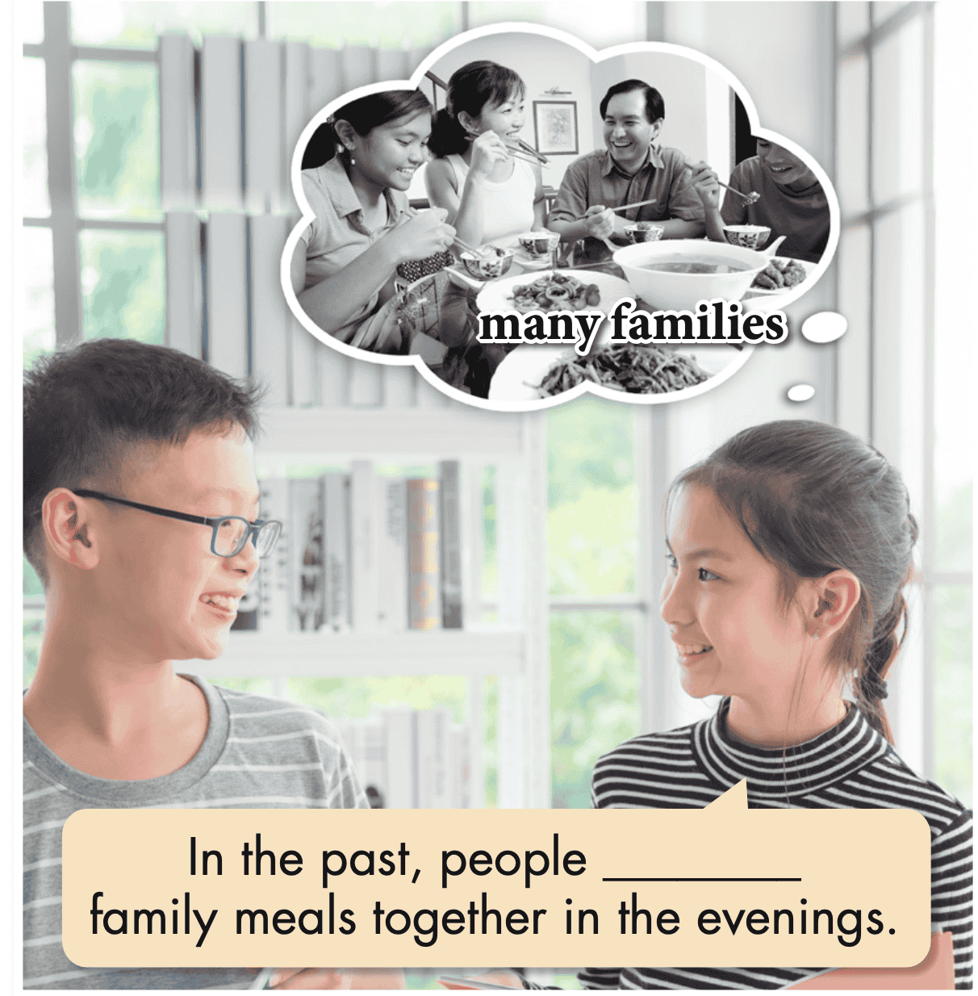
Task a. Read about would, then fill in the blank.

Slide 21


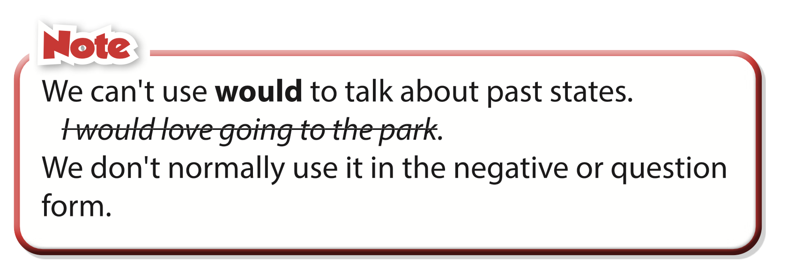
Task b. Listen and check. Listen again and repeat.
would eat

Slide 22
Presentation
Practice

Slide 23
Task c. Unscramble the sentences.
1.family meals./In the past,/for/people/be home/would usually
____________________________________________________
2. people/five to ten/have/Back then,/would/ usually/ children.
3. in extended families./Fifty years ago,/people/live/would often
4. the husband/be/A hundred years ago,/the breadwinner./would often
5. Back then,/after getting married./women/would become/ housewives
6. the whole family./cook for/the mother/In the past,/would
In the past, people would usually be home for family meals.

Slide 24
Task c. Unscramble the sentences.
Answers
2. people/five to ten/have/Back then,/would/ usually/ children.
_______________________________________________________
3. in extended families./Fifty years ago,/people/live/would often
_______________________________________________________
4. the husband/be/A hundred years ago,/the breadwinner./would often
_______________________________________________________
Back then, people would usually have five to ten children.
Fifty years ago, people would often live in extended families.
A hundred years ago, the husband would often be the breadwinner.

Slide 25
Task c. Unscramble the sentences.
Answers
5. Back then,/after getting married./women/would become/ housewives
____________________________________________________
____________________________________________________
Back then, women would become housewives after getting married.
6. the whole family./cook for/the mother/In the past,/would
____________________________________________________
____________________________________________________
In the past, the mother would cook for the whole family.

Slide 26
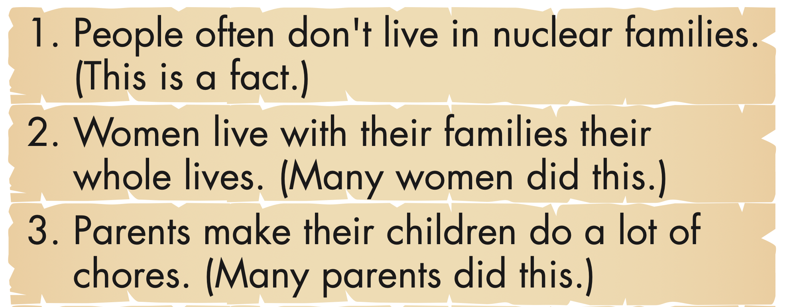
Task d. Read the statements about life in the past and complete the sentences below using would or the Past Simple.

Slide 27
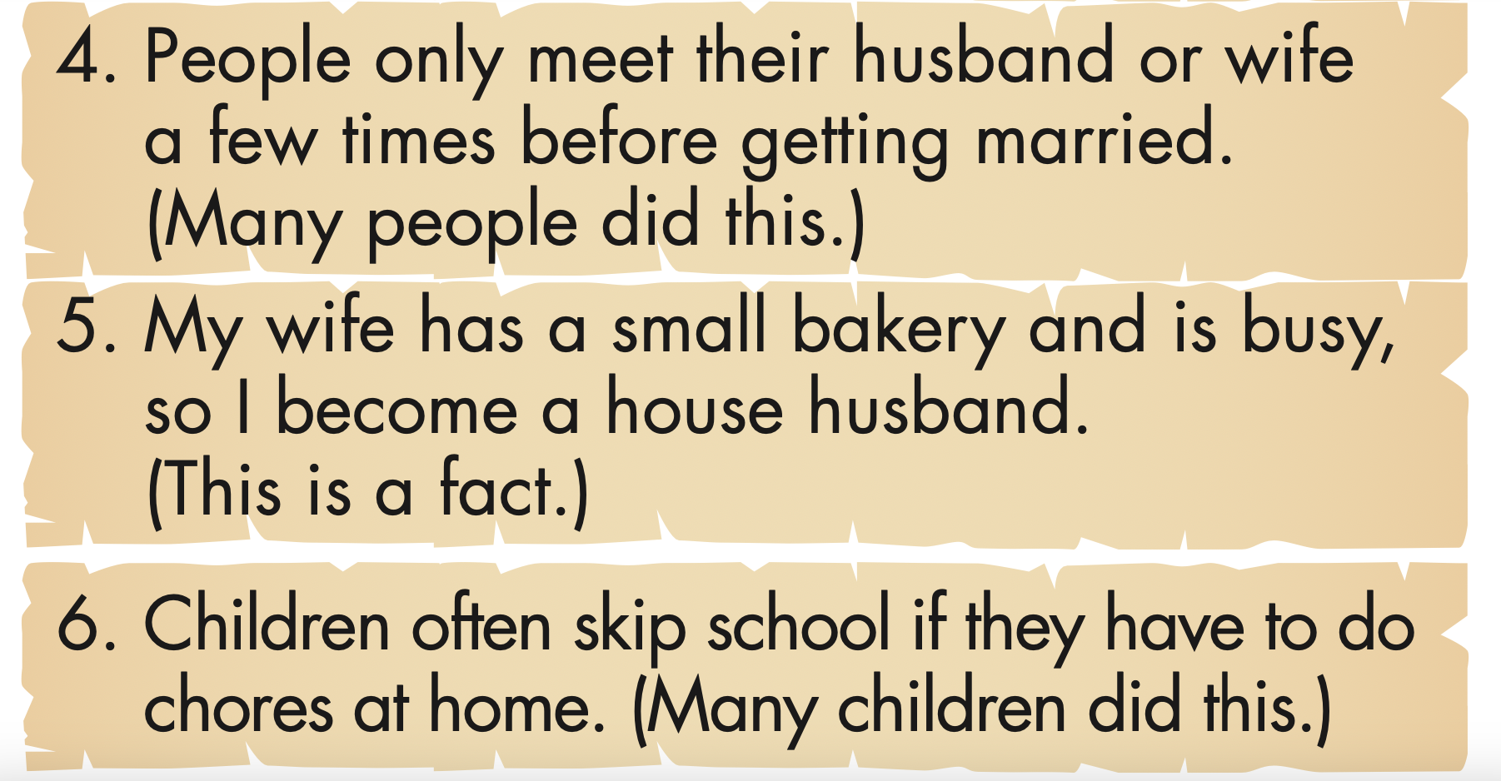
Task d. Read the statements about life in the past and complete the sentences below using would or the Past Simple.

Slide 28
Task d. Read the statements about life in the past and complete the sentences below using would or the Past Simple.
1. In the past, people often didn't live in nuclear families.
2. In the past, ______________________________________.
3. _________________________________________ back then.
4. _________________________________________ in the past.
5. Back then, _________________________________________.
6. Back then, _________________________________________.

Slide 29
Task d. Read the statements about life in the past and complete the sentences below using would or the Past Simple.
Answers
1. People often don't live in nuclear families.(This is a fact.)
In the past, people often didn't live in nuclear families.
2. Women live with their families their whole lives.
(Many women did this.)
In the past, women would live with their families their whole lives.

Slide 30
Task d. Read the statements about life in the past and complete the sentences below using would or the Past Simple.
Answers
3. Parents make their children do a lot of chores.
(Many parents did this.)
Parents would make their children do a lot of chores back then.
4. Children often skip school if they have to do chores at home. (Many children did this.)
People would only meet their husband or wife a few times before getting married in the past.

Slide 31
Task d. Read the statements about life in the past and complete the sentences below using would or the Past Simple.
Answers
5. My wife has a small bakery and is busy, so I become a house husband. (This is a fact.)
Back then, my wife had a small bakery and was busy, so I became a house husband.
6. People only meet their husband or wife a few times before getting married. (Many people did this.)
Back then, children would often skip school if they had to do chores at home.

Slide 32
Share your ideas about life in the past with a partner.
1. In the past, people often didn't live in nuclear families.
2. In the past, ______________________________________.
3. _________________________________________ back then.
4. _________________________________________ in the past.
5. Back then, _________________________________________.
6. Back then, _________________________________________.

Slide 33
Report what your partner has just shared with you about life in the past to your class.
1. In the past, people often didn't live in nuclear families.
2. In the past, ______________________________________.
3. _________________________________________ back then.
4. _________________________________________ in the past.
5. Back then, _________________________________________.
6. Back then, _________________________________________.

Slide 34
Extra
Practice
Presentation

Slide 35

Extra Practice – WB, P 9
Unscramble the sentences.
1. people/extended families./In the past, /lived in In the past, people lived in extended families.
2. the breadwinner./ the husband/Back then,/ would usually be
3. Many years ago, / so easily./ people didn't/get divorced
Presentation
Production

Slide 36
Extra Practice – WB, P 9
Unscramble the sentences.
4. housewives and/the children. /look after /often be/In the past /women would
5. same house. /live together/Back then,/ generations would often/many different/in the
Presentation
Production

Slide 37
Extra Practice – WB, P 9
ANSWERS:
1. In the past, people lived in extended families.
2. Back then, the husband would usually be the
breadwinner.
3. Many years ago, people didn't get divorced so easily.
Presentation
Production

Slide 38
Extra Practice – WB, P 9
ANSWERS:
4. In the past, women would often be housewives and look after the children.
5. Back then, many different generations would often live together in the same house.
Presentation
Production

Slide 39
Presentation
Production

Slide 40
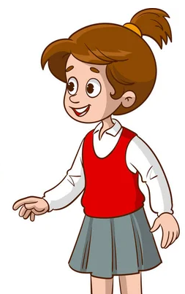
Task e. In pairs: Use the topics below to talk about things that happened regularly when you were a kid.
Topics
• going to school • after school • on holidays
• at school • on the weekends • in the summer
My mom would walk me to school every morning when I was a kid.

Slide 41
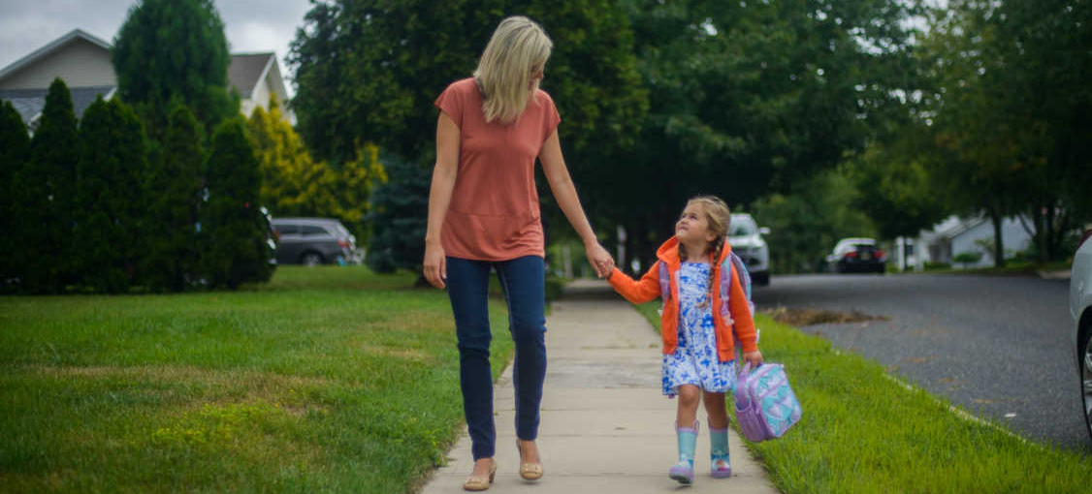
Suggested answer
Presentation
Production
1. My mom would walk me to school every morning when I was a kid.

Slide 42
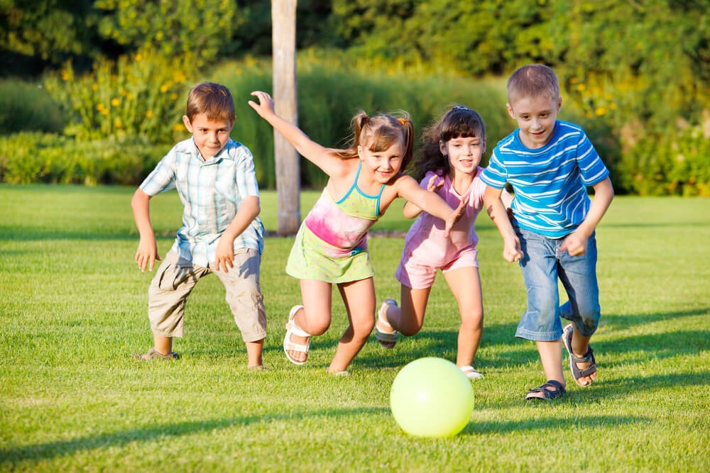
Suggested answer
Presentation
Production
2. Back then, I would play with my friends after school.

Slide 43
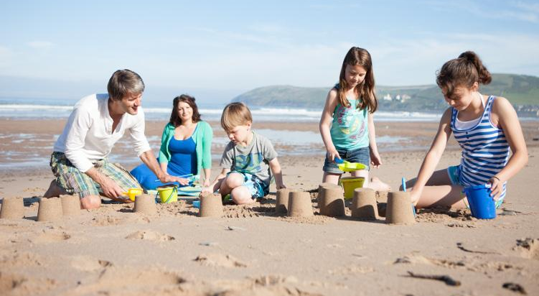
Suggested answer
Presentation
Production
3. In the past, my family would sometimes go to Vũng Tàu
on holidays.

Slide 44
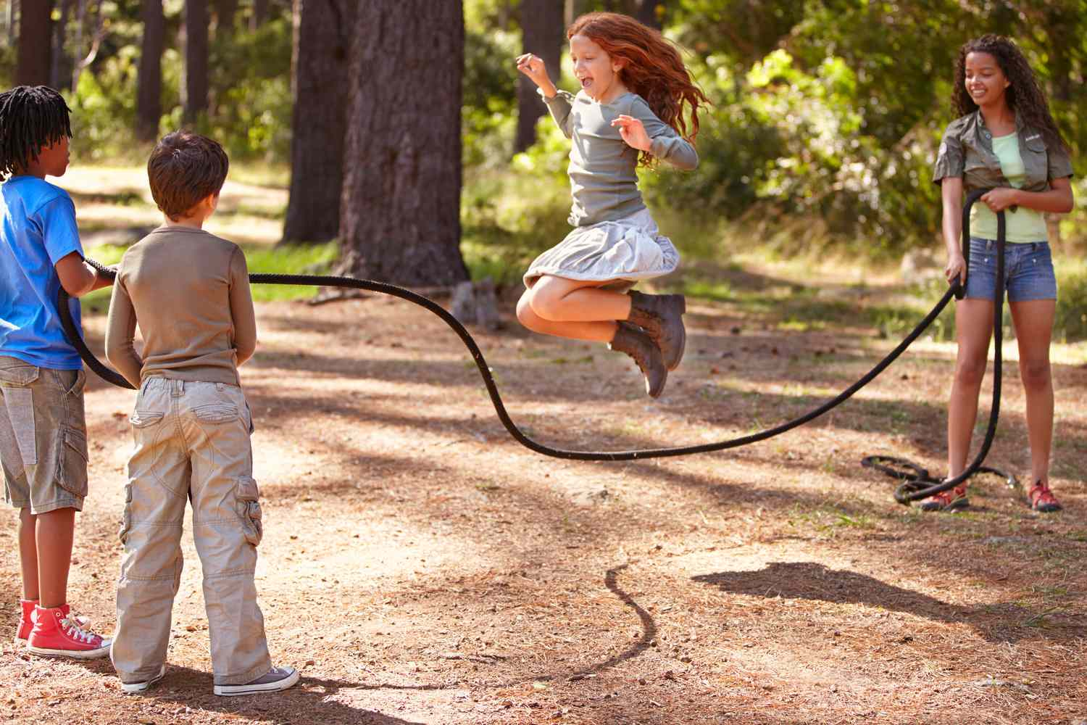
Suggested answer
Presentation
Production
4. When I was little, my classmates and I would often play jump rope during break time at school.

Slide 45
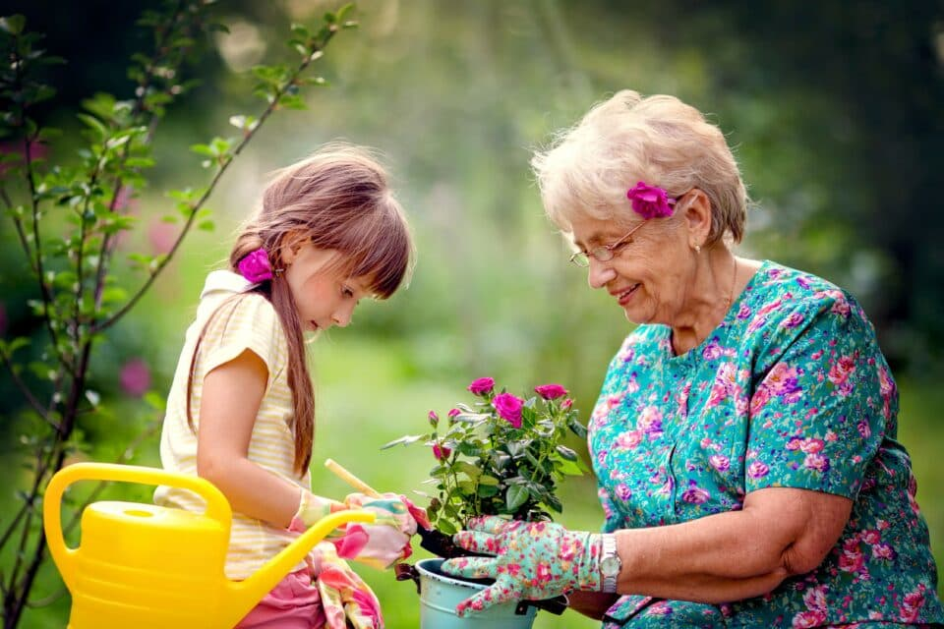
Suggested answer
Presentation
Production
5. I would stay at my grandmother's house on the weekends when I was younger.

Slide 46
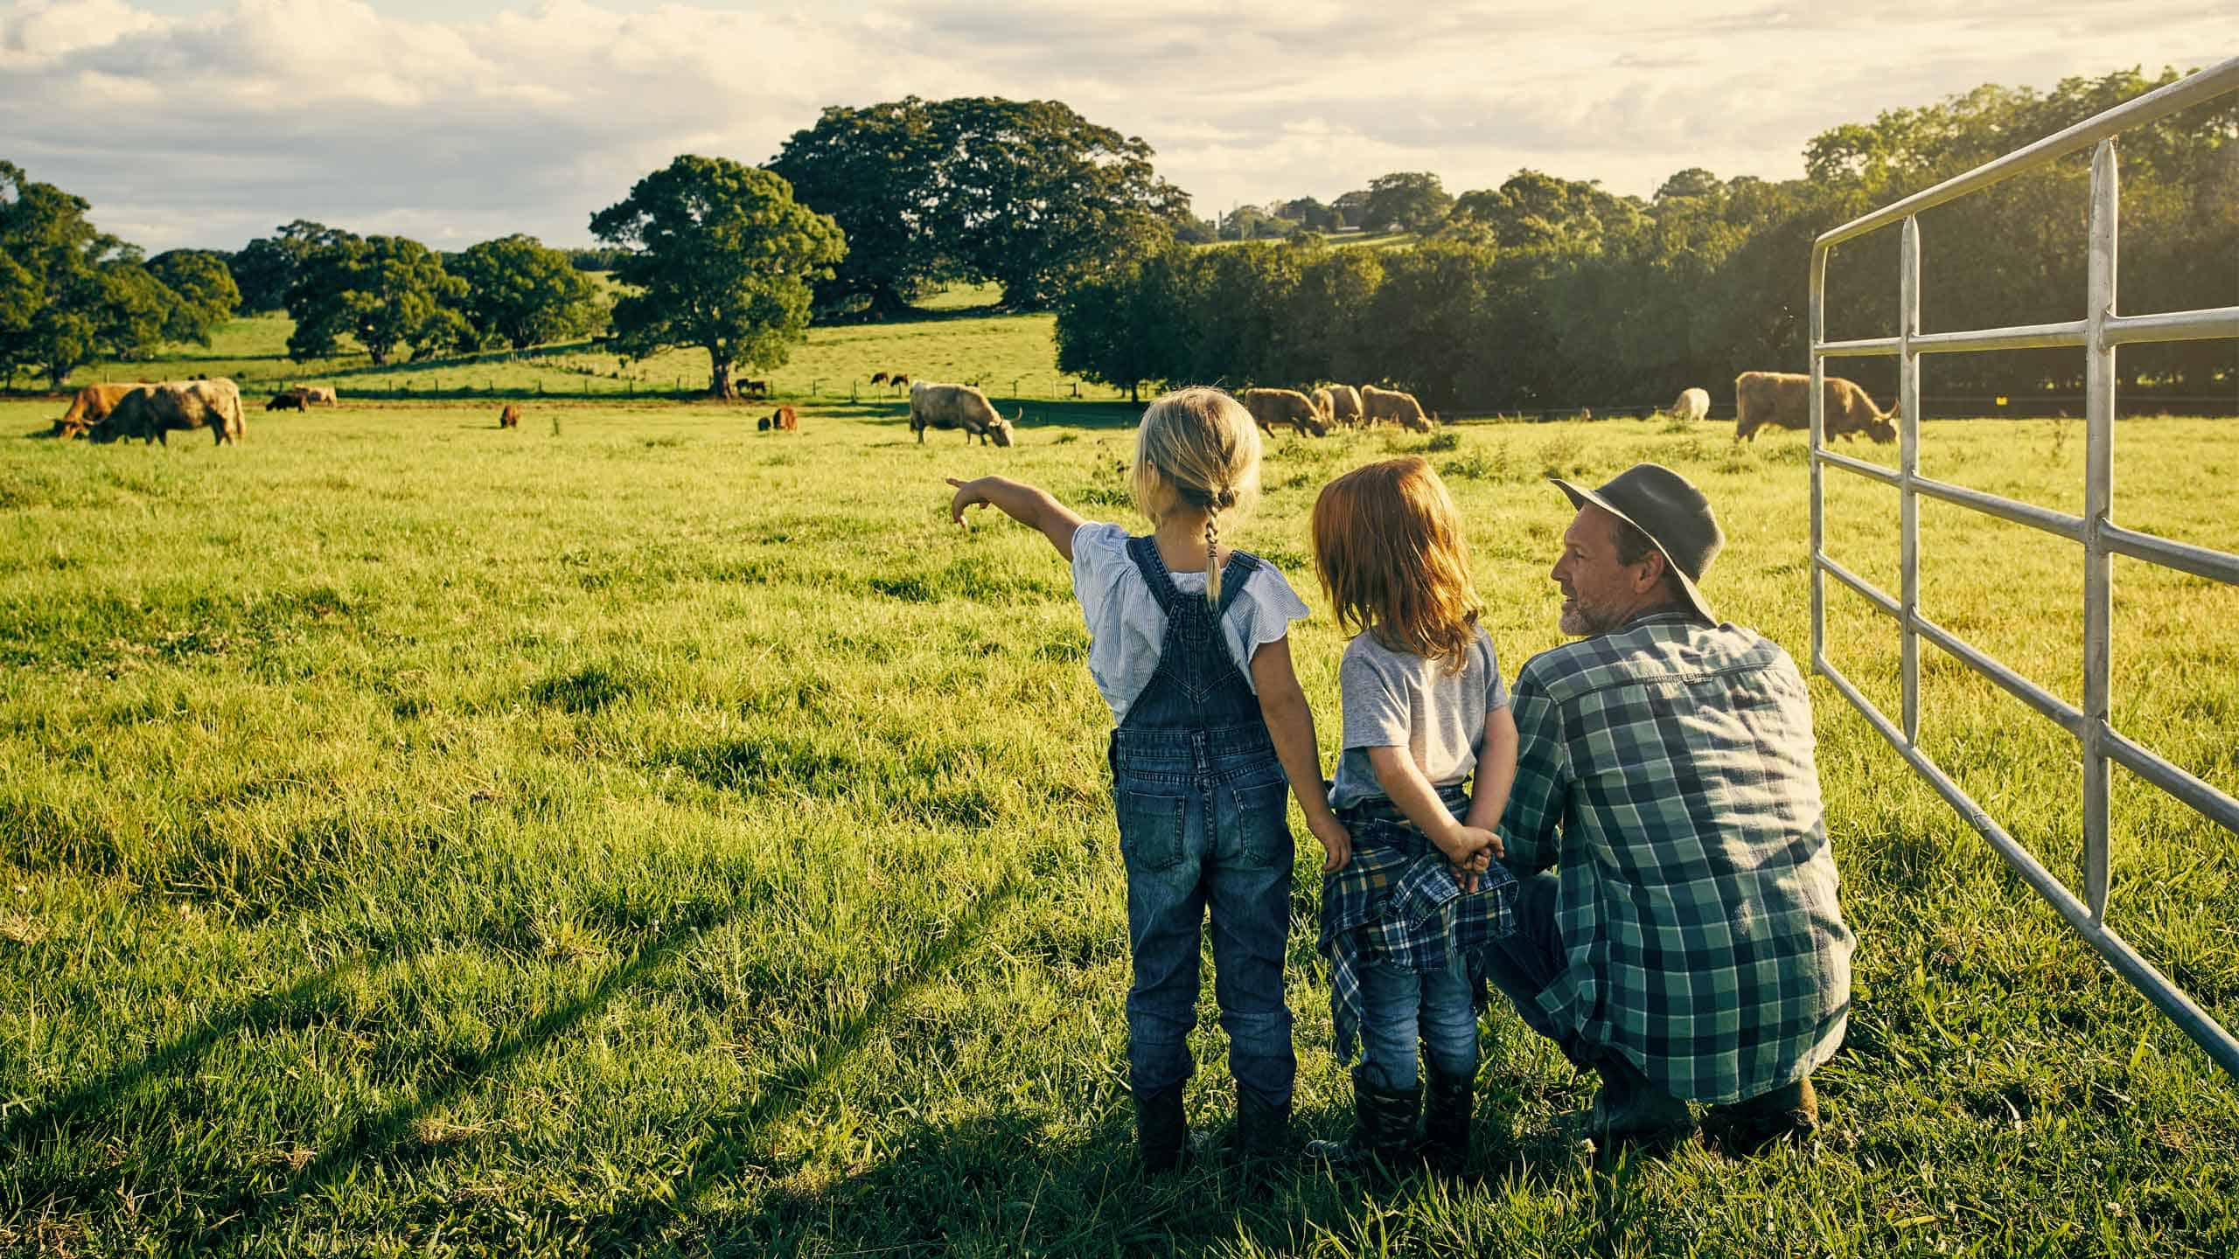
Suggested answer
Presentation
Production
6. My parents would sometimes take me to the country
in the summer back then.

Slide 47

CONSOLIDATION

Slide 48

Ask and answer the question below with your partner, using “would” for repeated past actions
Which places would you often visit with your family during holidays when you were younger?

Slide 49
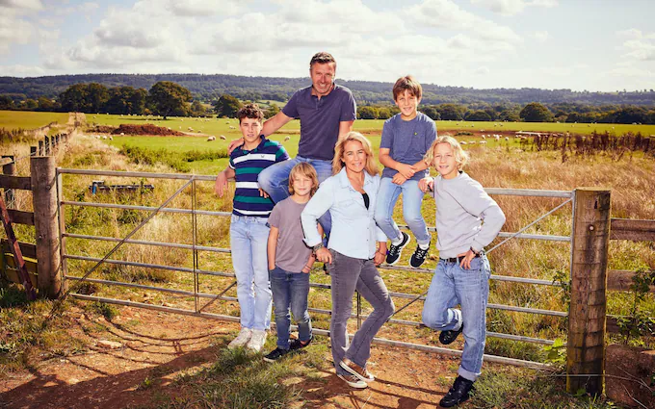
Suggested answer
Presentation
Production
My family and I would often visit my grandparents' house in the countryside during holidays when I was younger.

Slide 50

WRAP-UP

Slide 51
Today’s lesson
Grammar:
Practice and use “would” for repeated past actions.
Speaking:
Talk about things that happened regularly when they were kids.

Slide 52
Homework
Review “would” for repeated past actions .
Make sentences using “would”
Prepare for the next lesson (Pronunciation & Speaking - pages 16 & 17 - SB).
Play the consolidation games on www.eduhome.com.vn

Slide 53

Lesson 3
Stay positive and have a nice day!

