Slide 1
Unit 5: Healthy Living
Review: Listening, Reading, Vocabulary
Pages 100 - 101

Slide 2
Lesson Outline
Listening
Reading
Vocabulary
Consolidation
Wrap-up

Slide 3
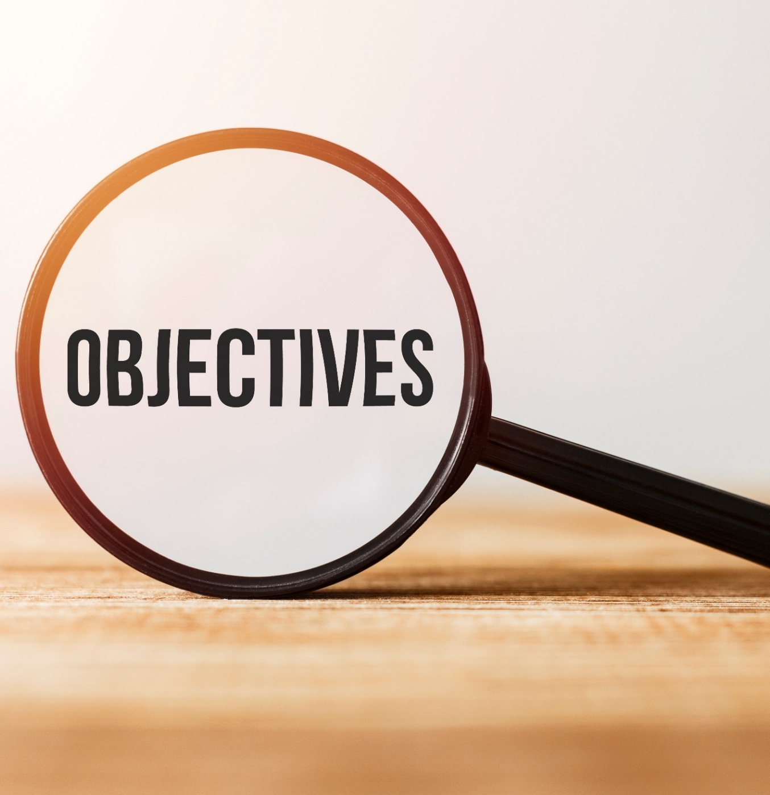
By the end of this lesson, students will be able to…
- improve listening and reading for the specific information.
- review vocabulary related to teens’ health problems.

Slide 4
Listening

Slide 5
You will hear five short conversations. You will hear each conversation TWICE. There is one question for each conversation. For each question, choose the correct answer (A, B, or C).

Slide 6
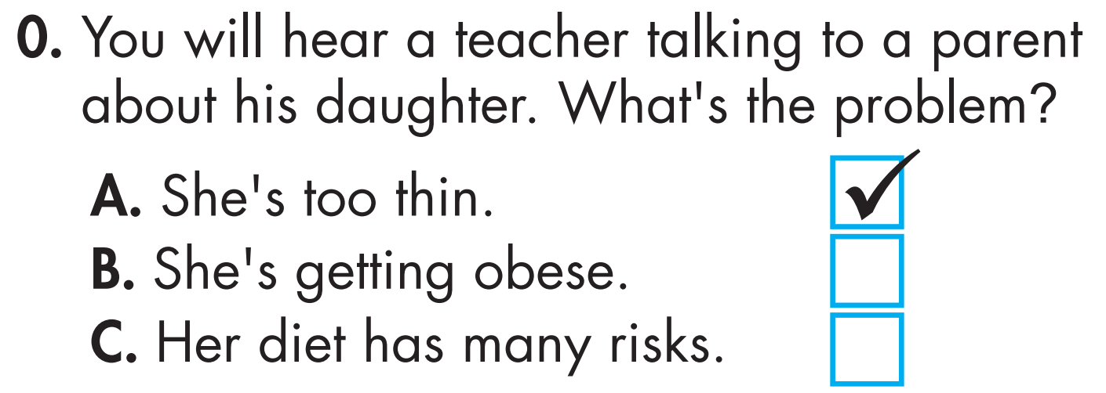
Ms. White: Mr. Brown. I think Sarah's too thin. Is she eating healthily? Mr. Brown: She used to be obese. Now, she works out all the time. Ms. White: Although being obese is bad, being too thin has many risks, too. Mr. Brown: OK. I'll talk to her.

Slide 7
✓
Nancy: I'm trying to lose weight. I only had juice today. Ms. King: You shouldn't avoid eating. Doctors suggest eating a healthy diet with less sugar.

Slide 8
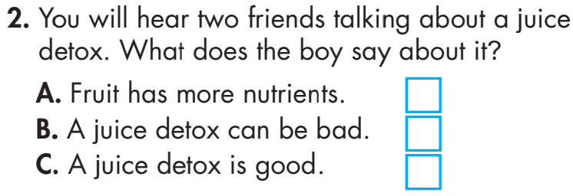
✓
Nick: I'm going on a juice detox diet. Jane: You shouldn't do that! Detoxes can be bad. Your organs detox your body. Nick: But juice has nutrients. Jane: It's not as good as eating fruit.

Slide 9
✓
Susan: Would you like some banana bread? I used natural sugar, so you can eat lots of it. John: That's a myth, Susan. Sugar is sugar. Doctors suggest eating less than fifty grams a day.

Slide 10
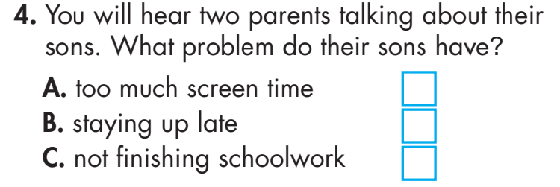
✓
Mrs. Walker: Is your son addicted to his phone? My son's always on his phone. Mr. Martin: My son's the same. We had to make a rule. It's no phones after 9 p.m.

Slide 11
✓
Mr. Anderson: I think the students need a new class. Mrs. Smith: About what? Diet? Exercise? Mr. Anderson: Stress. Although students say they’re stressed, they don't know how to deal with it. Mrs. Smith: I see.

Slide 12
Reading

Slide 13
Read and circle True or False.
Dear parents, From next week, the school cafeteria will stop selling soda and junk food. Although many students like eating chips and candy at school, we are removing these foods. They are unhealthy and don't help the students study well. Instead, we will include a variety of healthier snacks and fruit. We will also provide nourishing lunches every day for all students. We suggest noting any special diet needs on the school lunch form.

Slide 14
There will also be a weekly healthy eating and cooking class in the cafeteria. Here, students can learn about different diets, and how to prepare simple and nourishing meals. This is a fun and free class that all students could really benefit from. Please sign up for it at the library. We will also increase P.E. classes from two to four times a week. Although we already tried to promote exercise after school, students weren't very interested. We hope this will help students form a habit of getting regular physical activity and understand its benefits. Best regards, Principal Andrew Thomas

Slide 15
True False
From next week, the school cafeteria will stop selling soda and junk food. Although many students like eating chips and candy at school, we are removing these foods. They are unhealthy and don't help the students study well.

Slide 16
True False
Although many students like eating chips and candy at school, we are removing these foods. They are unhealthy and don't help the students study well. Instead, we will include a variety of healthier snacks and fruit.

Slide 17
True False
We will also provide nourishing lunches every day for all students. We suggest noting any special diet needs on the school lunch form.

Slide 18
True False
There will also be a weekly healthy eating and cooking class in the cafeteria. Here, students can learn about different diets, and how to prepare simple and nourishing meals. This is a fun and free class that all students could really benefit from..

Slide 19
True False
We will also increase P.E. classes from two to four times a week. Although we already tried to promote exercise after school, students weren't very interested.

Slide 20
True False
Although we already tried to promote exercise after school, students weren't very interested. We hope this will help students form a habit of getting regular physical activity and understand its benefits.

Slide 21
Vocabulary

Slide 22
Circle the correct answers.
1. The city is trying to increase people's ____________ to healthy food by creating community gardens. A. access B. fat C. chemical D. promote 2. How many ____________ you need to eat a day depends on your age, weight, and amount of physical activity. A. viruses B. calories C. risks D. cafeterias

Slide 23
Circle the correct answers.
3. Although many people believe it's bad for us, ____________ is necessary for our bodies, especially our organs. A. bone B. nutrients C. fat D. risks 4. Scientists are trying to find the ____________ that causes the disease. A. virus B. bone C. nutrient D. calorie

Slide 24
Circle the correct answers.
5. Let me cook you a ____________ dinner. You'll feel better. A. obese B. nourishing C. organ D. promote 6. I broke a ____________ last year. It really hurt, and I had to go to hospital. A. access B. chemical C. cafeteria D. bone

Slide 25
Circle the correct answers.
7. Did you know that you can be ____________ to sugar? You'll always want to eat sweet food. A. obese B. access C. addicted D. fat 8. Your body needs lots of different ____________ to be healthy. A. nutrients B. viruses C. detoxes D. risks

Slide 26
CONSOLIDATION

Slide 27
WRAP-UP

Slide 28
Today’s lesson
Reading & Listening:
- Reading & listening for the specific information
Vocabulary:
- Review vocabulary related to health problems.

Slide 29
Homework
Do Listening & Reading on page 54 - WB
Prepare for the next lesson (Unit 5: Review – Grammar, Pronunciation, Speaking & Writing – pages 101 & 102 - SB)
Play the consolidation games on www.eduhome.com.vn

Slide 30
Lesson 3
Stay positive and have a nice day!

