Slide 1
Unit 5: Healthy Living
Lesson 3.1: Reading
Page 52

Slide 2
Lesson Outline
Warm-up
Pre-Reading
While-Reading
Post-Reading
Consolidation
Wrap-up

Slide 3
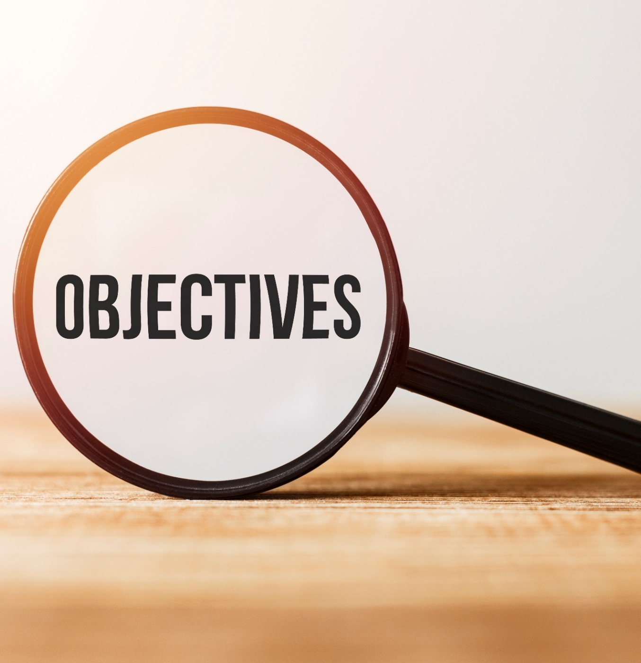
By the end of this lesson, students will be able to…
- practice reading for the main idea and details.
- practice listening for the main idea and specific information.

Slide 4
WARM-UP

Slide 6
Suggested answers:
They get information about health by
Talking to the experts
Searching for information on the Internet
Reading books
I usually get health information from:
Doctors
Books
Magazine / Newspaper

Slide 7
Pre-reading
Look at the Reading on page 45 and the Listening on page 49, then read the summary below. Why are the headings organized this way?
Task a
They are in order of importance
(1 = very important, 5 = not very important).
2. They are in the same order as the Reading and Listening tasks.

Slide 8
Reading p.45
The internet is full of health advice. Some advice is actually harmful. Let's find out the truth behind the popular health myths below. You need to detox your body.
From not eating to only drinking juice, these detox diets can be harmful because you won't get enough calories and nutrients. The truth is, we have organs that detox our bodies. Doctors suggest eating a healthy diet and drinking enough water to help your organs stay strong.

Slide 9
Reading p.45
Fat-free diets are healthy.
Your body needs fat to protect its organs, and fat helps you get the benefits from some vitamins. Fat also helps you feel full for longer. Of course, too much fat is also bad. The WHO (World Health Organization) suggests getting less than 30% of your calories from fat.

Slide 10
Reading p.45
You shouldn't use products that have chemicals.
Your food and your body are mostly chemicals. Some people suggest using natural products, but they are also full of chemicals. There are good and bad chemicals. Experts suggest learning which chemicals are safe and how to protect yourself.
So, be careful of what you read online. Knowing which health tips are myths is key to healthy living.

Slide 11
Listening p.49
Ms. Miller: Hello, everyone. Today I invited Dr. Elizabeth Anderson to talk about two important health problems teens have. Dr. Anderson: Hi, everyone. Thanks for inviting me here. The first problem is not getting enough sleep. Although teens need eight to ten hours of sleep a night, most only get six to seven. Schools often start too early for teens. They naturally go to bed late, after 11 p.m., and can't get enough sleep.

Slide 12
Listening p.49
Ms. Miller: So, schools should start later?
Dr. Anderson: If possible. You can also include nap time in the school day.
Ms. Miller: Right.
Dr. Anderson: Next is unhealthy weight. More teens are becoming obese these days. Although they already know the benefits of healthy diets, most teens still prefer a pizza over a salad. They also drink lots of soda. Although we teach the public about the dangers of sugar, not everyone knows about them.
Mr. Smith: What can we do?

Slide 13
Listening p.49
Dr. Anderson: You can help by having nourishing lunches at school, giving students more access to healthy snacks in the cafeteria, and stop selling junk food and soda.
Ms. Miller: All right. Thanks for your talk, Dr. Anderson. That's all for today. Thank you for your time.

Slide 14
Reading p.52
The article discusses how a lot of online health advice is harmful to our health. There is also information about some health problems teens have.
Eat a healthy diet
People think detox diets are healthy. However, they are harmful. Our organs detox our bodies. We should eat a healthy diet and drink enough water to help our organs stay strong.

Slide 15
Reading p.52
2. Eat a little fat
Many people eat diets with no fat because they think fat is unhealthy. However, our bodies need fat to protect our organs and get benefits from some vitamins.
3. Learn which chemicals are safe
Lots of people think that they shouldn't eat products that have chemicals in them. However, all types of food have chemicals in them. Health experts suggest learning which chemicals are safe.

Slide 16
Reading p.52
4. Teens don't get enough sleep
Teens naturally fall asleep after 11 p.m., but they have to wake up early for school. Some people say school should start later, and there should be time for a nap at school. Then, teens can get more sleep. 5. Teens are becoming obese
Lots of teens don't know about the dangers of sugar. They should have access to nourishing lunches and healthy snacks to be healthier.

Slide 17
Pre-reading
Look at the Reading on page 45 and the Listening on page 49, then read the summary below. Why are the headings organized this way?
Task a
They are in order of importance
(1 = very important, 5 = not very important).
2. They are in the same order as the Reading and Listening tasks.

Slide 18
While-reading
Task b
Now, read and choose the correct answers.
What should we do to help our organs stay strong? A. Eat a detox diet.
B. Eat a healthy diet.
C. Only drink water.
D. Detox our organs.
Eat a healthy diet
People think detox diets are healthy. However, they are harmful. Our organs detox our bodies. We should eat a healthy diet and drink enough water to help our organs stay strong.

Slide 19
While-reading
Task b
Now, read and choose the correct answers.
What do many people think about fat? A. It's unhealthy.
B. It's healthy.
C. It tastes good.
D. It makes us fat.
2. Eat a little fat
Many people eat diets with no fat because they think fat is unhealthy. However, our bodies need fat to protect our organs and get benefits from some vitamins.

Slide 20
While-reading
Task b
Now, read and choose the correct answers.
What do health experts say we should know about chemicals in food? A. which food has
chemicals in it
B. which chemicals
are OK
C. which chemicals
taste good
D. we don't need to
know
3. Learn which chemicals are safe
Lots of people think that they shouldn't eat products that have chemicals in them. However, all types of food have chemicals in them. Health experts suggest learning which chemicals are safe.

Slide 21
While-reading
Task b
Now, read and choose the correct answers.
4. The word naturally in point number 4 is closest in meaning to which phrase? A. in a way that you expect
B. as a normal result
C. in a relaxed way
D. without special help
4. Teens don't get enough sleep
Teens naturally fall asleep after 11 p.m., but they have to wake up early for school. Some people say school should start later, and there should be time for a nap at school. Then, teens can get more sleep.

Slide 22
While-reading
Task b
Now, read and choose the correct answers.
5. What can a reader infer from the summary? A. Eat a lot of vegetables.
B. Know the right information.
C. Eat different types of food.
D. Try different diets
The article discusses how a lot of online health advice is harmful to our health. There is also information about some health problems teens have.

Slide 23
While-reading
Task c
Listen and read.
The article discusses how a lot of online health advice is harmful to our health. There is also information about some health problems teens have.
Eat a healthy diet
People think detox diets are healthy. However, they are harmful. Our organs detox our bodies. We should eat a healthy diet and drink enough water to help our organs stay strong.

Slide 24
2. Eat a little fat
Many people eat diets with no fat because they think fat is unhealthy. However, our bodies need fat to protect our organs and get benefits from some vitamins.
3. Learn which chemicals are safe
Lots of people think that they shouldn't eat products that have chemicals in them. However, all types of food have chemicals in them. Health experts suggest learning which chemicals are safe.

Slide 25
4. Teens don't get enough sleep
Teens naturally fall asleep after 11 p.m., but they have to wake up early for school. Some people say school should start later, and there should be time for a nap at school. Then, teens can get more sleep. 5. Teens are becoming obese
Lots of teens don't know about the dangers of sugar. They should have access to nourishing lunches and healthy snacks to be healthier.

Slide 26
Post-reading
Task d
In pairs: Discuss which piece of information you find most interesting and say why
Suggested answer:
I’m interested in learning which chemicals are safe because it helps us understand the ratio of chemicals in food that we eat. Therefore, it’s easy for us to choose good food for our health.

Slide 27
CONSOLIDATION

Slide 28
WRAP-UP

Slide 29
Today’s lesson
Reading:
- Reading for the main idea and specific information

Slide 30
Homework
Do Listening & Reading in WB page 30
Prepare for the next lesson (Writing & Speaking – page 53 - SB)
Play the consolidation games on www.eduhome.com.vn

Slide 31
Lesson 3
Stay positive and have a nice day!

