Slide 1
Unit 5: Healthy Living
Lesson 1.3: Pronunciation. & Speaking
Pages 46 & 47

Slide 2
Lesson Outline
Warm-up
Pronunciation
Speaking
Consolidation
Wrap-up

Slide 3
By the end of this lesson, students will be able to…
Pronounce the /tr/ and /tʃ/ sound.
Talk about what health experts say.

Slide 4
WARM-UP

Slide 5
WHO’S FASTER:
Divide the class into groups of 5 students.
Say the definition of 10 definitions. Groups listen and write the words on the board.
Teacher can support by giving the first letter of each word.
Which team(s) with most correct answers win(s).

Slide 6
Example:
Teacher says: a helpful or good effect, or something intended to help.
Answer: benefit

Slide 7
Teacher says:
1. Someone whose job is to teach in a school or college
2. A disease characterized by high glucose levels in the blood
3. The activity of exerting muscles to keep fit
4. The property of being easily bent or shaped
5. Involving the body as distinguished from the mind or spirit

Slide 8
Teacher says:
6. Special emphasis attached to something
7. Food which is cooked in its packaging, usually in a microwave
8. Small amount of food between meals
9. The state of being unable to live without something
10. The medical condition of being seriously overweight

Slide 9
Answers:
1. teacher
2. diabetes
3. exercise
4. flexibility
5. physical
6. stress
7. convenience food
8. snack
9. addiction
10. obesity

Slide 10
Pronunciation

Slide 11
t
+
r
tr
=
t
+
ʃ
tʃ
=

Slide 12
Task b
Listen to the words and focus on the underlined letters.
truth
nutrient
choose
teacher

Slide 13
Task c
Listen and circle the words you hear.
1. trip chip
2. chew true
3. train chain

Slide 14
Task d
Take turns saying the words in Task c. while your partner points to them.
trip chip
chew true
train chain

Slide 15
Presentation
Speaking

Slide 16
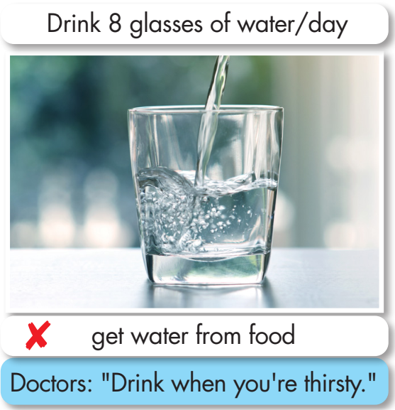
In pairs: Take turns asking and answering if the health tips are a myth or a fact, then ask and answer about what doctors suggest.
Task a

Slide 17
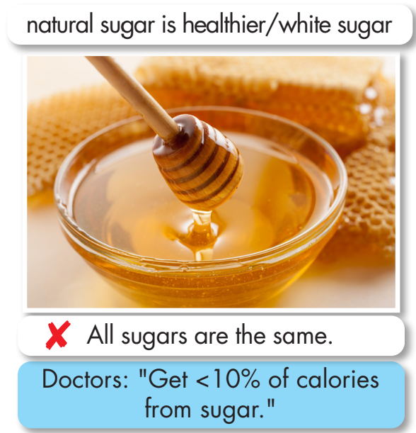
Task a
Natural sugar is healthier than white sugar. Is it a myth or a fact?
It’s a ______ because _________.
What do doctors ____________?
They suggest _______________.

Slide 18
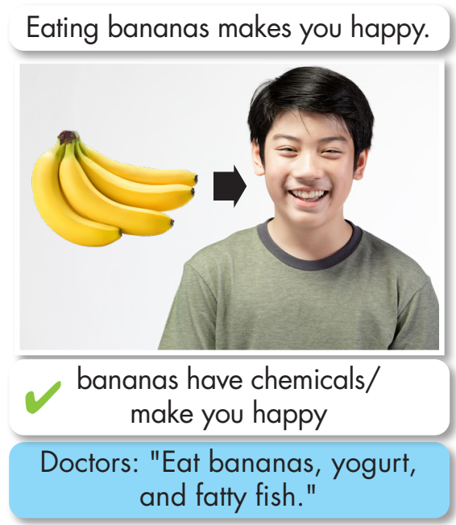
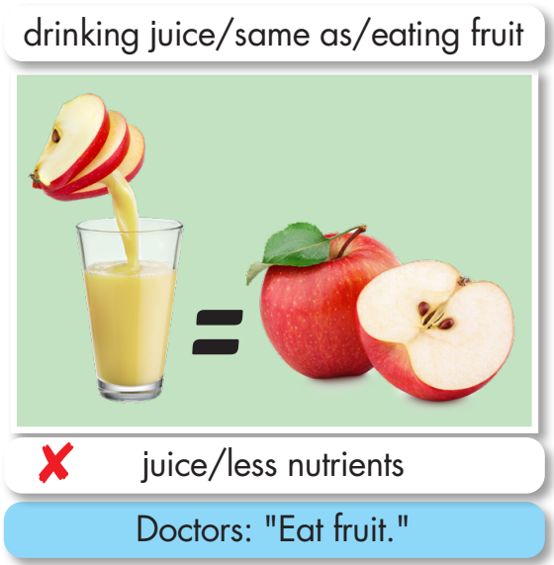

Slide 19
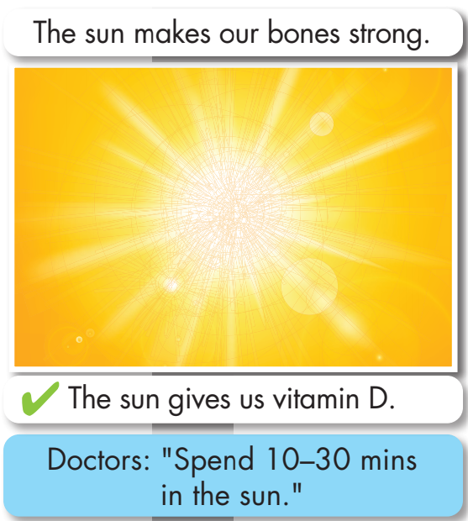
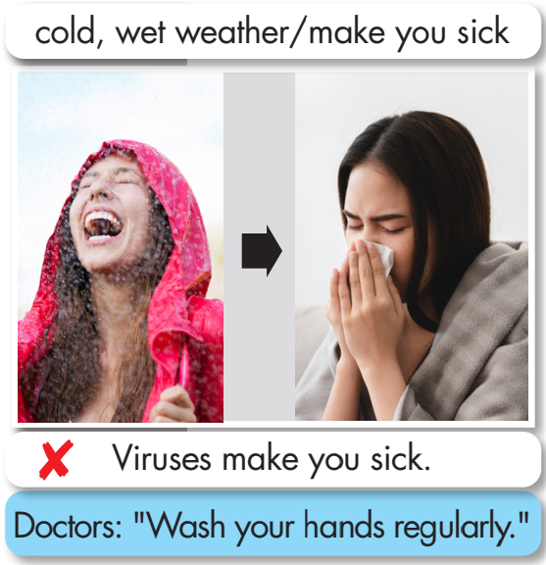

Slide 20
Task b

Slide 21
Task a
In pairs: Discuss whether the sentences below are myths or facts, why you think so, and what doctors suggest on each topic.

Slide 23
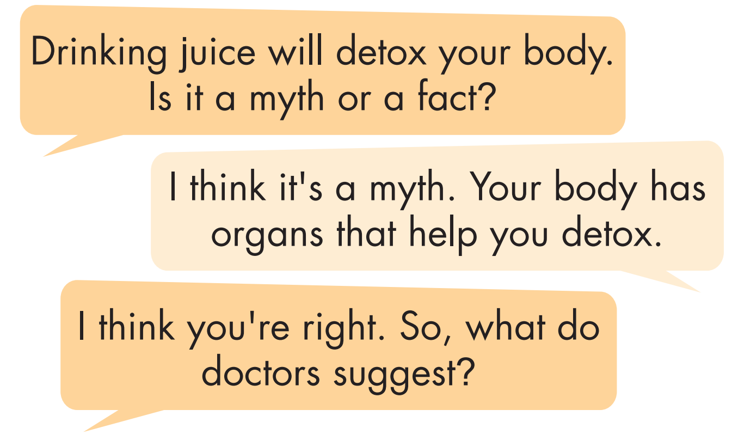
Sample answers:

Slide 24
Task b
What other health myths do you know?
I know lots of people say we should eat lots of meat, fats, and animal products. And we don't eat vegetables and fruit.

Slide 25
Share your ideas with the class.
Suggested ideas:
Breakfast foods are full of nutrients.
Eggs are not healthy.
Coffee stunts your growth.
All fat is bad.
Sugar makes kids hyperactive.

Slide 26
CONSOLIDATION

Slide 27
WRAP-UP

Slide 28
Today’s lesson
Pronunciation:
Practice the /tr/ and /tʃ/ sound
Speaking:
Talk about health myths and what health experts say.

Slide 29
Homework
Practice saying the /tr/ and /tʃ/ sound.
Do the Writing exercise on page 27 - WB
Prepare for the next lesson (Vocabulary & Listening - pages 48 & 49 - SB).
Play the consolidation games on www.eduhome.com.vn

Slide 30
Lesson 3
Stay positive and have a nice day!

