Slide 1
Unit 5: Healthy Living
Lesson 1.1: Vocab & Reading
Pages 44 & 45

Slide 2
Lesson Outline
Warm-up
Vocabulary
Reading
Consolidation
Wrap-up

Slide 3
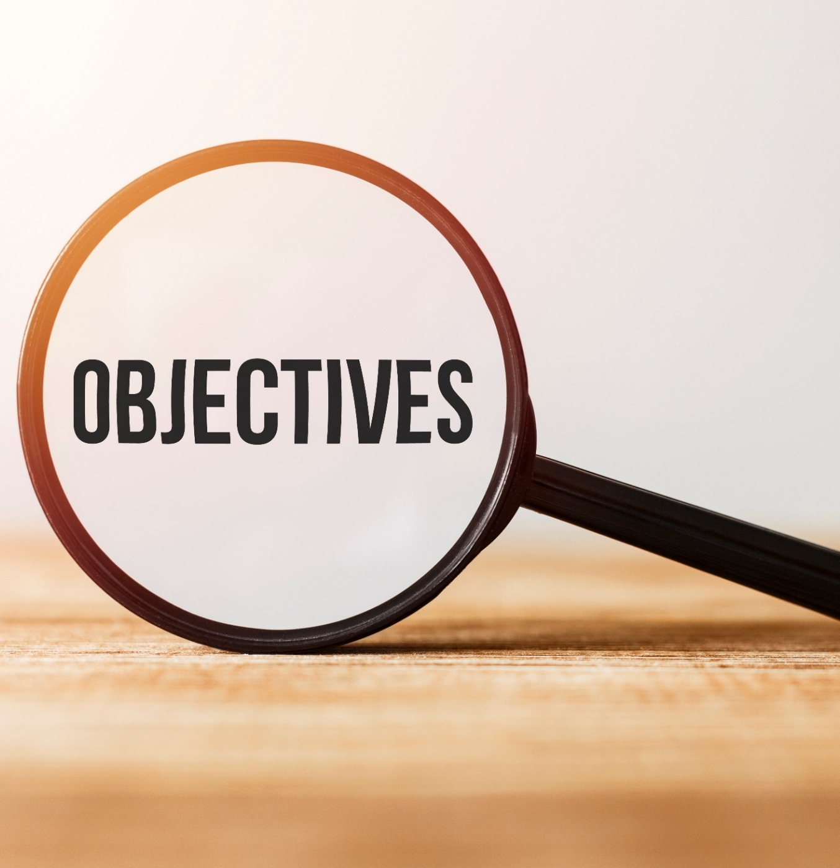
By the end of this lesson, students will be able to…
- use new words to talk about health myths.
- practice reading for inference and details.

Slide 4
WARM-UP

Slide 6
Suggested answers:
What are these people doing?
She is drinking orange juice.
He is taking vitamins.
He/she is having breakfast.
Do you think what they’re doing is healthy or unhealthy? Why?
I think what they’re doing is healthy because orange juice, vitamins, and nutrient breakfast are good for our health.

Slide 8
Listen and repeat. Click on each phrase to hear the sound.
nutrient (n) /'nju:triənt / chất dinh dưỡng
calorie (n) / 'kæləri / calo
fat (n) / fæt / mỡ
organ (n) / 'ɔ:gən/ cơ quan, bộ phận
bone (n) / boʊn / xương
virus (n) / ˈvaɪrəs / vi rút
chemical (n) / ˈkemɪkəl / chất hóa học, hóa chất
detox (n) / ˈdiː.tɑːks / thanh lọc
Notes:
GV click vào từng cụm nghe âm thanh

Slide 9
Task a
Read the definitions, then fill in the blanks with the new words.
1. Many people think only drinking juice for a week can ________ their bodies. 2. We use _________s to make many products, such as soap and toothpaste. 3. Fruit is usually low in _________s while cookies have a lot more. Cookies sometimes give us more energy than our bodies can use. 4. Most people can get all the _________s they need from a healthy diet to grow and be healthy.
detox
chemical
calorie
nutrient

Slide 10
Task a
Read the definitions, then fill in the blanks with the new words.
5. We know that washing your hands can kill the flu _________ and stop it from making you sick. 6. There are three _________s in a person's arm. One at the top and two at the bottom. 7. "Please cut off the _________ from the meat before you cook it." 8. The human body has 11 _________ systems that do different things.
virus
bone
fat
organ

Slide 11
Task b
In pairs: Use the new words to talk about what you know about the human body and healthy lifestyles.
The skin is the largest organ in our bodies.
We should wash our hands regularly to prevent viruses.

Slide 12
Suggested answer
We shouldn't eat too many calories or avoid exercise.
Eating too much fat is bad.

Slide 14
Pre - reading
Task a
Read the article about health. Which of the following is the best title for the passage? 1. Health myths: what's harmful and what's harmless 2. Health myths that you should stop believing

Slide 15
Pre - reading
Skim the text. Underline the key words for the health myths.
The internet is full of health advice. Some advice is actually harmful. Let's find out the truth behind the popular health myths below.
You need to detox your body.
From not eating to only drinking juice, these detox diets can be harmful because you won't get enough calories and nutrients. The truth is, we have organs that detox our bodies. Doctors suggest eating a healthy diet and drinking enough water to help your organs stay strong.

Slide 16
Fat-free diets are healthy.
Your body needs fat to protect its organs, and fat helps you get the benefits from some vitamins. Fat also helps you feel full for longer. Of course, too much fat is also bad. The WHO (World Health Organization) suggests getting less than 30% of your calories from fat.
You shouldn't use products that have chemicals.
Your food and your body are mostly chemicals. Some people suggest using natural products, but they are also full of chemicals. There are good and bad chemicals. Experts suggest learning which chemicals are safe and how to protect yourself.
So, be careful of what you read online. Knowing which health tips are myths is key to healthy living.
Pre - reading

Slide 17
Pre - reading
Task a
Read the article about health. Which of the following is the best title for the passage? 1. Health myths: what's harmful and what's harmless 2. Health myths that you should stop believing

Slide 18
While - reading
Task b
Now, read and circle True, False, or Doesn't say.
We need special diets to help detox our bodies.
True False Doesn't say
From not eating to only drinking juice, these detox diets can be harmful because you won't get enough calories and nutrients.

Slide 19
While - reading
Task b
Now, read and circle True, False, or Doesn't say.
2. We should eat lots of fruit and vegetables to keep our bodies strong.
True False Doesn't say
You need to detox your body.
Fat-free diets are healthy.
You shouldn't use products that have chemicals.

Slide 20
While - reading
Task b
Now, read and circle True, False, or Doesn't say.
3. Fat doesn't help your organs stay healthy.
True False Doesn't say
Your body needs fat to protect its organs, and fat helps you get the benefits from some vitamins. Fat also helps you feel full for longer. Of course, too much fat is also bad. The WHO suggests getting less than 30% of your calories from fat.

Slide 21
While - reading
Task b
Now, read and circle True, False, or Doesn't say.
4. We shouldn't eat anything that contains more than 30% fat.
True False Doesn't say
Your body needs fat to protect its organs, and fat helps you get the benefits from some vitamins. Fat also helps you feel full for longer. Of course, too much fat is also bad. The WHO suggests getting less than 30% of your calories from fat.

Slide 22
While - reading
Task b
Now, read and circle True, False, or Doesn't say.
4. Products that are natural are also full of chemicals.
True False Doesn't say
You shouldn't use products that have chemicals.
Your food and your body are mostly chemicals. Some people suggest using natural products, but they are also full of chemicals. There are good and bad chemicals.

Slide 23
While - reading
Task c
Listen and read.
The internet is full of health advice. Some advice is actually harmful. Let's find out the truth behind the popular health myths below.
You need to detox your body.
From not eating to only drinking juice, these detox diets can be harmful because you won't get enough calories and nutrients. The truth is, we have organs that detox our bodies. Doctors suggest eating a healthy diet and drinking enough water to help your organs stay strong.

Slide 24
Fat-free diets are healthy.
Your body needs fat to protect its organs, and fat helps you get the benefits from some vitamins. Fat also helps you feel full for longer. Of course, too much fat is also bad. The WHO (World Health Organization) suggests getting less than 30% of your calories from fat.
You shouldn't use products that have chemicals.
Your food and your body are mostly chemicals. Some people suggest using natural products, but they are also full of chemicals. There are good and bad chemicals. Experts suggest learning which chemicals are safe and how to protect yourself.
So, be careful of what you read online. Knowing which health tips are myths is key to healthy living.

Slide 25
Post - reading
Task d
In pairs: Do you know anyone who believes in the myths in the article? Which of the myths were surprising to you?
Suggested answer:
I have a friend who strongly believes in fat-free diets are healthy. She cuts off all fat in her diet.

Slide 26
CONSOLIDATION

Slide 27
Listen and repeat. Click on each phrase to hear the sound.
nutrient (n) /'nju:triənt / chất dinh dưỡng
calorie (n) / 'kæləri / calo
fat (n) / fæt / mỡ
organ (n) / 'ɔ:gən/ cơ quan, bộ phận
bone (n) / boʊn / xương
virus (n) / ˈvaɪrəs / vi rút
chemical (n) / ˈkemɪkəl / chất hóa học, hóa chất
detox (n) / ˈdiː.tɑːks / thanh lọc
Notes:
GV click vào từng cụm nghe âm thanh

Slide 28
WRAP-UP

Slide 29
Today’s lesson
Vocabularies
Nutrient
Calorie
Fat
Organ
Bone
Virus
Chemical
Detox

Slide 30
Today’s lesson
Vocabulary:
- Using new words to talk about health myths.
Reading:
- Practicing reading for inference and details.

Slide 31
Homework
Do Vocabulary and Reading in WB pages 26 & 27
Make sentences using the new words in SB
Prepare for the next lesson (Grammar - pages 45 & 46 - SB)
Play the consolidation games on www.eduhome.com.vn

Slide 32
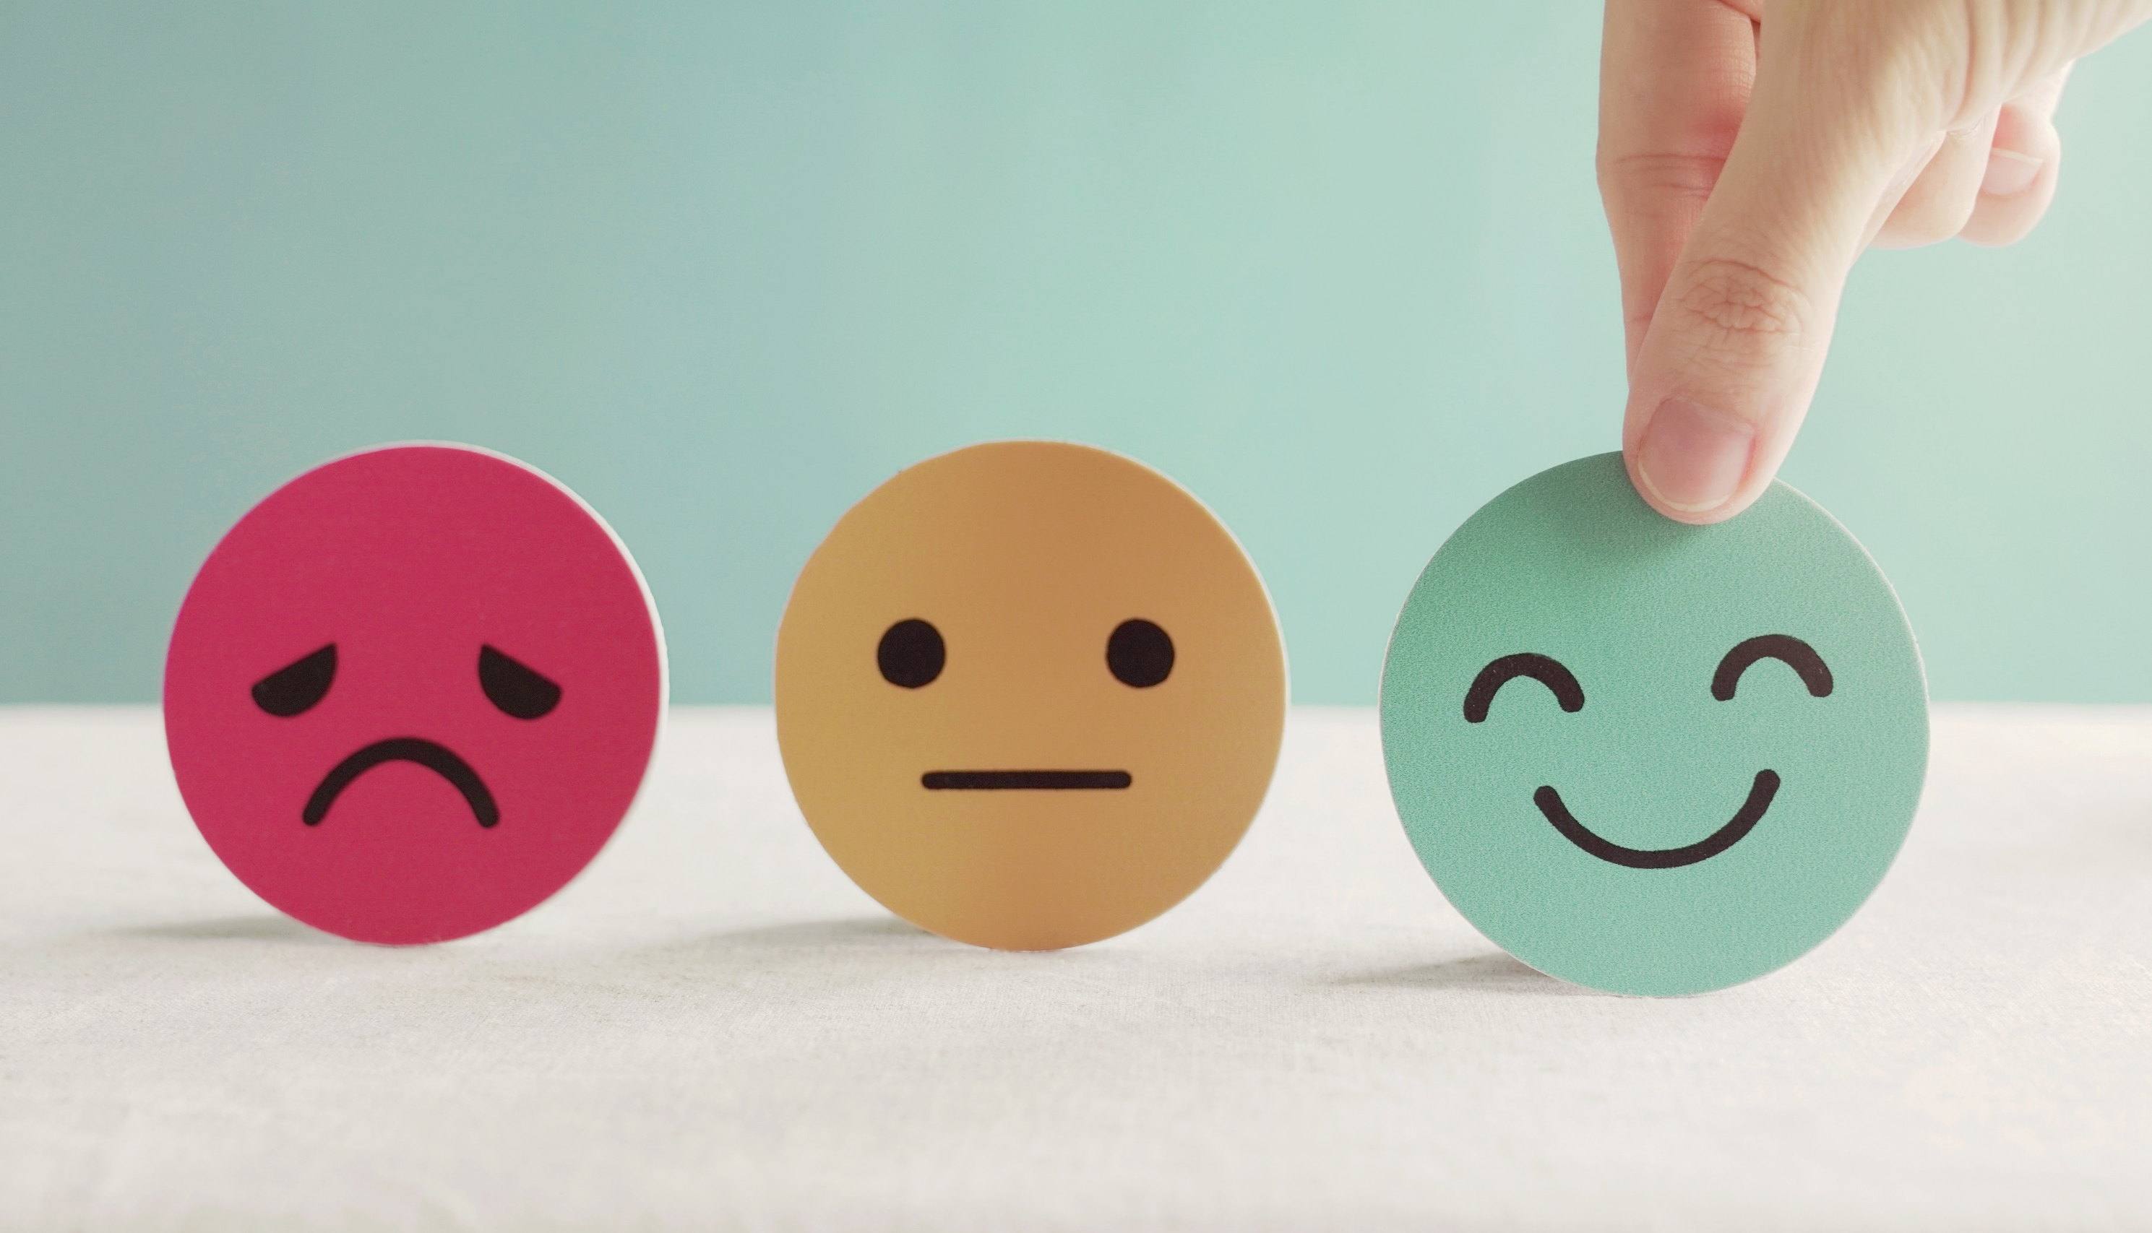
Lesson 3
Stay positive and have a nice day!

