Slide 1
Unit 3: Living Environment
Review (Grammar, Pronunciation, Pronunciation, In the Real World, Conversation, Speaking & Writing)
pages 93 & 94

Slide 2
Lesson Outline
Warm-up
Grammar
Pronunciation
In the real world
Conversation
Speaking
Writing
Consolidation
Wrap-up

Slide 3
By the end of this lesson, students will be able to…
- To review the target language learned in the unit.
- To practice test-taking skills.

Slide 4
WARM-UP

Slide 5
COMPETITION TIME:
Create groups/teams of 3 students.
You will be given some sentences with one mistake in each.
You will work in group to find out the mistakes and correct them.
The team(s) with the most correct answers win (s).
Time limit: 5 minutes

Slide 6
Find and correct the mistakes.
1. I wish I am taller.
2. I would like to live in a house which have smart appliances.
3. My brother wish he could speak Korean.
4. There are a swimming pool, a bookstore and a park in my neighborhood.
5. I wish my friend doesn’t live far from my me.

Slide 7
Answer
I wish I am taller.
I wish I were taller.
2. I would like to live in a house which have smart appliances.
I would like to live in a house which has smart appliances
3. My brother wish he could speak Korean.
My brother wishes he could speak Korean.

Slide 8
4. There are a swimming pool, a bookstore and a park in my neighborhood.
There is a swimming pool, a bookstore and a park in my neighborhood.
5. I wish my friend doesn’t live far from me.
I wish my friend didn’t live far from me.

Slide 9
Grammar

Slide 10
FORM: relative pronoun (who, whom which, that, whose) + subject + verb
USE: We can use defining relative clause with relative pronouns to give key information about the noun before them.
Presentation
1. These apartments have solar panels which generate electricity for the whole building.
2. People who love nature will like this place.

Slide 11
We use relative pronouns who/that for people.
Ex: This is a great home for families that/who like swimming.
We use relative pronouns which/that for things.
Ex: There is a smart garden that/which helps your plants grow better.
We use relative pronouns whose to show possession with people and things.
Ex: This home is great for people whose children are young.
This house whose yard is big is great for active people.
Presentation

Slide 12
Relative pronouns as subjects:
Noun + that/who/which + verb
Our apartments are great for people that/who have small children.
People that/who care about the environment will love this home.
He wants to live in a building that/which doesn't allow pets.

Slide 13
Relative pronouns as objects:
Noun + that/who/whom/which + subject + verb
This is the house which/that I really like.
The apartment manager who/whom/that you met is here.
Noun + whose + noun + verb
People whose parents are older will love this elevator.
Houses whose roofs have solar panels have lower electricity bills.

Slide 14
Note: We can leave out the pronoun when it is the object of the relative clause.
This is the house that I really like.
This is the house I really like. (that is the object of like)

Slide 15
FORM: S + wish/wishes + S + past tense verb + O
USE: express a wish for a thing / situation that is not real in the present.
Ex: I wish my house was closer to the park.
(My house isn't close to the park.)
John wishes he had a flat screen TV.
(John doesn't have a flat screen TV.)

Slide 16
Note: We can use was/wasn't or were/weren't after I/he/she/it/singular noun.
I wish my house was/were closer to the beach.
He wishes it wasn't/weren't so boring in his neighborhood.
Presentation

Slide 17
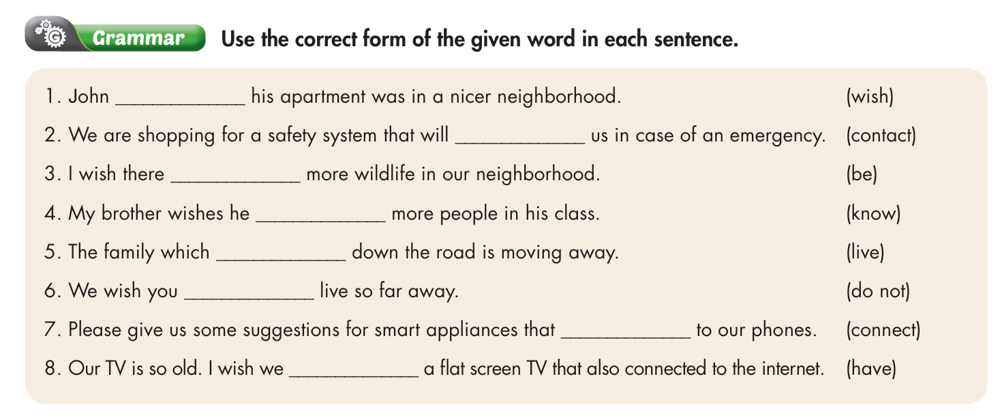

Slide 18
Answer
John _________ his apartment was in a nicer neighborhood. (wish)
We are shopping for a safety system that will __________ us in case of an emergency. (contact)
I wish there _______ more wildlife in our neighborhood. (be)
My brother wishes he ________ more people in his class. (know)
wishes
contact
was
knew

Slide 19
5. The family which ________ down the road is moving away. (live)
6. We wish you _________ live so far away. (do not)
7. Please give us some suggestions for smart appliances that __________ to our phones. (connect)
8. Our TV is so old. I wish we ______ a flat screen TV that also connected to the internet. (have)
lives
didn’t
connect
had

Slide 20
Pronunciation

Slide 22
Answer
a. Circle the word that differs from the other three in the position of primary stress in each of the following questions.
1. A. appliance B. generate C. monitor D. furniture
/əˈplaɪəns/ /ˈdʒenəreɪt/ /ˈmɑːnətər/ /ˈfɜːnɪtʃər/
2. A. sensor B. curtain C. nearby D. console
/ˈsensər/ /ˈkɜːtən/ /nɪrˈbaɪ/ /ˈkɑːnsoʊl/

Slide 23
b. Circle the word that has the underlined part pronounced differently from the others.
A. appliance B. electricity C. monitor D. assistant
/əˈplaɪəns/ /ɪˌlekˈtrɪsəti/ /ˈmɑːnɪtər/ /əˈsɪstənt/
2. A. elevator B. furniture C. curtain D. flat screen
/ˈeləveɪtər/ /ˈfɜːnɪtʃər/ /ˈkɜːtən/ /flæt ˈskriːn/

Slide 24
In the real world

Slide 26
Underline the key words in the questions.
1. What does this advertisement NOT say the house has?
A. a temperature sensor
B. safety locks
C. a garden
D. a voice assistant
2. What can you NOT do in Haven Homes?
A. buy clothes at the mall
B. buy food in the town center
C. do exercise in the parks
D. watch movies comfortably

Slide 27
Answer
1. What does this advertisement NOT say the house has?
A. a temperature sensor
B. safety locks
C. a garden
D. a voice assistant

Slide 28
2. What can you NOT do in Haven Homes?
A. buy clothes at the mall
B. buy food in the town center
C. do exercise in the parks
D. watch movies comfortably

Slide 29
Conversation

Slide 30
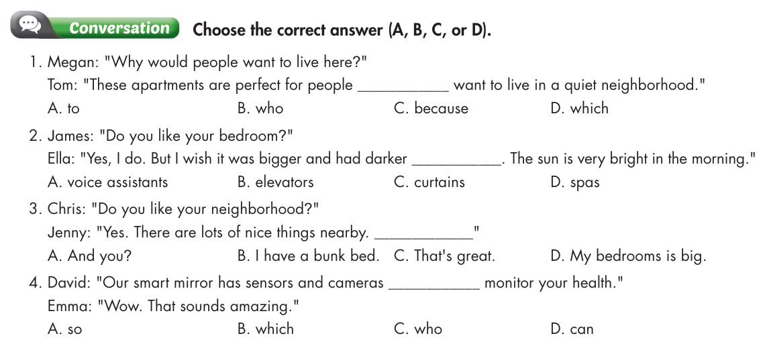

Slide 31
Megan: "Why would people want to live here?"
Tom: "These apartments are perfect for people ________ want to live in a quiet neighborhood."
A. to B. who C. because D. which
2. James: "Do you like your bedroom?"
Ella: "Yes, I do. But I wish it was bigger and had darker ____________. The sun is very bright in the morning."
A. voice assistants B. elevators C. curtains D. spas
Answer

Slide 32
3. Chris: "Do you like your neighborhood?"
Jenny: "Yes. There are lots of nice things nearby. _____________“
A. And you? B. I have a bunk bed.
C. That's great. D. My bedrooms is big.
4. David: "Our smart mirror has sensors and cameras ___________ monitor your health."
Emma: "Wow. That sounds amazing."
A. so B. which C. who D. can

Slide 33
Speaking

Slide 34
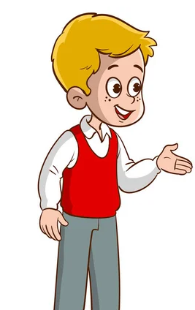
Suggested answer
I think the best smart features a house can have are smart appliances and sensors which allow you to control your house remotely.

Slide 35
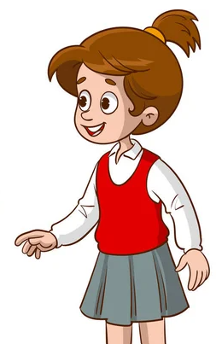
I think houses in the future might have a voice assistant that controls everything.
They also have solar panels that produce electricity using energy from the sun.

Slide 36
Writing

Slide 37
I really like my house and my neighborhood, but there are a few things I wish were different. I don't like my bedroom. I wish it was bigger and had thicker curtains. I also wish I had a game console and TV in my bedroom. My living room is OK, but I wish my sofa was more comfortable.
My neighborhood is OK. I just wish that my friends lived closer to me. I also wish it was a bit quieter at night. I hate hearing people sing karaoke. Finally, I wish there was a park near my house. I love playing soccer, but there's nowhere for me to play.

Slide 38
CONSOLIDATION

Slide 39
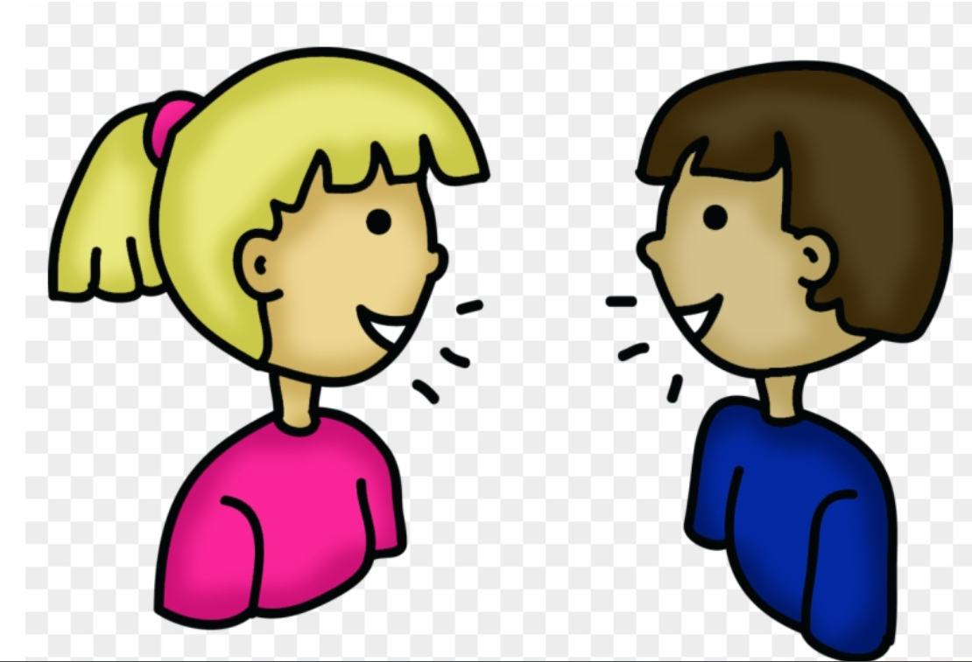
Talk to your partner about your house and neighborhood.

Slide 40
Sample answers
I like my bedroom, but I wish it was bigger and had thicker curtains. I also wish I had a game console and TV in my bedroom. My living room is OK, but I wish my sofa was more comfortable.
My neighborhood is OK. I just wish that my friends lived closer to me. I also wish it was a bit quieter at night. I hate hearing people sing karaoke. Finally, I wish there was a park near my house.

Slide 41
WRAP-UP

Slide 42
Today’s lesson
Grammar:
- review the target grammar points learned in the unit.
Speaking & Writing:
- practice speaking and writing.

Slide 43
Homework
Review relative clauses and wishes
Prepare for the next lesson (Review Unit 4, page 20)
Play the consolidation games on www.eduhome.com.vn

Slide 44
Lesson 3
Stay positive and have a nice day!

