Slide 1

Unit 3: Living Environment
Lesson 3.2: Writing & Speaking Page 33

Slide 2
Lesson Outline
Warm-up
Writing
Speaking
Consolidation
Wrap-up

Slide 3

By the end of this lesson, students will be able to…
practice parallel structures (Writing skills)
talk about the dream house.
write a paragraph about the dream house you talked about above.

Slide 4

WARM-UP

Slide 5
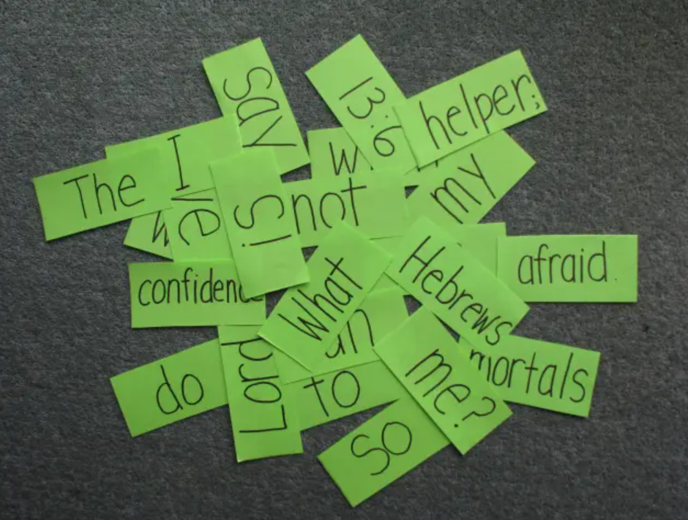
COMPETITION TIME:
Create groups/teams of 5 students.
You will be given some sentences but in the wrong order, you have to unscramble the sentences.
The team(s) with the most correct answers win (s).
Time limit: 5 minutes

Slide 6
1. My / house / will / a / dream / pool / and / home / have / theater.
2. to / be / my / dream / I / cozy. / and / want / house / small
3. to / play / watch / It’ll / space / and / listen / to / games, / TV, / music. / have
4. will /fun. / having / growing / be / a / garden / I / think / and / vegetables
5. one / two / for / my / myself. / family / I’ll / and / one / for / TVs: / have

Slide 7
Answers:
1. My / house / will / a / dream / pool / and / home / have / theater.
My dream house will have a pool and home theater.
2. to / be / my / dream / I / cozy. / and / want / house / small
I want my dream house to be small and cozy.
3. to / play / watch / It’ll / space / and / listen / to / games, / TV, / music. / have
It'll have space to play games, watch TV, and listen to music.

Slide 8
4. will /fun. / having / growing / be / a / garden / I / think / and / vegetables
I think having a garden and growing vegetables will be fun.
5. one / two / for / my / myself. / family / I’ll / and / one / for / TVs: / have
I'll have two TVs: one for my family and one for myself.

Slide 9

Writing

Slide 10

Using parallel structures
Parallel structures are when you use the same pattern of words or phrases to show that two or more ideas have the same level of importance.
We often use them when listing words in a series to avoid clunky sentences.

Slide 11
Non-parallel structure | Parallel structure
My dream house will have a pool. I also want a home theater.
My dream house will have a pool and home theater.
I want my dream house to be small, and I would like it to be cozy.
I want my dream house to be small and cozy.
It'll have space to play games. I could also watch TV and listen to music there.
It'll have space to play games, watch TV, and listen to music.

Slide 12
Non-parallel structure | Parallel structure
I think having a garden will be fun. Growing vegetables will also be fun.
I think having a garden and growing vegetables will be fun.
I'll have two TVs. I'll have one for my family. I'll also have one for myself.
I'll have two TVs: one for my family and one for myself.

Slide 13
Read Alex's blog again. Underline the parts that have parallel structures, then write what part of speech she used after each parallel structure.
Task a.
Let me tell you about my dream house. My dream house will be in the country. I don't want to live in the city center because it's always noisy there. My house will be a set of three wooden tree houses: one for my living room and kitchen, one for my bedroom, and one for my bathroom. They will have modern equipment to make life comfortable.
(phrases)

Slide 14
There will be rope bridges connecting the houses together. I want all the houses to look really nice and cozy with yellow curtains and lots of string lights. When you see them, you'll think of houses in fairy tales. The house with the living room will have an outdoor area with a view of the forest and a lake. I'll spend lots of time there reading, working, and watching sunsets.
(adjectives)
(nouns)
(verbs)

Slide 15
My bedroom will have huge windows and a window in the roof so that I can see stars and the moon from my bed. My bathroom will have an outdoor bathtub and shower. There will also be a garden where I can grow vegetables, fruit, and flowers. I'll also decorate my house with lots of photos, paintings, and small souvenirs.
So, that's my dream house. What's yours?
(nouns)
(nouns)
(nouns)
(nouns)
(nouns)

Slide 16
Task b. Rewrite the underlined parts below using parallel structures.
1.My dream house will have a big living room, ten bedrooms, and it should have a pool.
My dream house will have a big living room, ten bedrooms, and a pool.
2. There will be a large backyard to exercise and playing outdoor sports.
There will be a large backyard to exercise and play outdoor sports.
3. From my bedroom, I can hear the ocean, and I can also watch sunsets.
From my bedroom, I can hear the ocean and watch sunsets.
Presentation

Slide 17
4. The kitchen and dining room will be the biggest rooms because I'd like to enjoy meals with my family, and I'll have parties with my friends.
The kitchen and dining room will be the biggest rooms because I'd like to enjoy meals with my family and have parties with my friends.
5. My dream house won't be big, but it'll be cozy, and it will also be comfortable.
My dream house won't be big, but it'll be cozy and comfortable.

Slide 18
Speaking

Slide 19
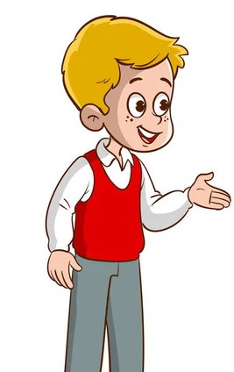
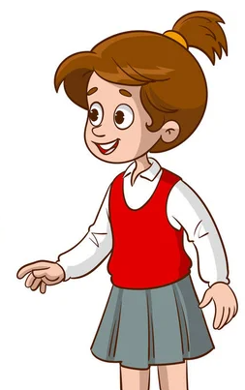
MY DREAM HOUSE
Task a.
In pairs: Discuss what's important when choosing a house.

Slide 20
Suggested ideas:
Location/Kind of house: city / country, apartment / tree house / …
Appearance: color / size / …
Rooms/Things: living room / bedrooms / kitchen / yard / garden / …
What rooms/things/have? Sofa / air conditioner / bathtub / …
Decorations: paintings / photos / plants / flowers / …

Slide 21

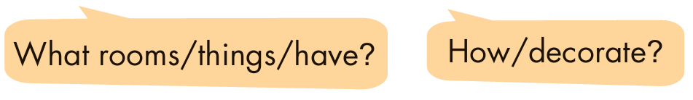
Task b.
Now, use the question prompts below to discuss your dream house. List two or three ways to say what it will look like, what rooms or things it will have, and how you will decorate it.

Slide 22
Where will your dream house be?
My dream house will be by the ocean.

Slide 23
What kind of house will it be?
It'll be a cozy cottage.

Slide 24
What will it look like?
It'll be blue and white.

Slide 25
It'll have big windows and white curtains, a big yard, a garden with lots of plants, trees, and flowers.
What will it have?

Slide 26
How will you decorate it?
I'll decorate it with lots of
paintings, photos, and plants.

Slide 27
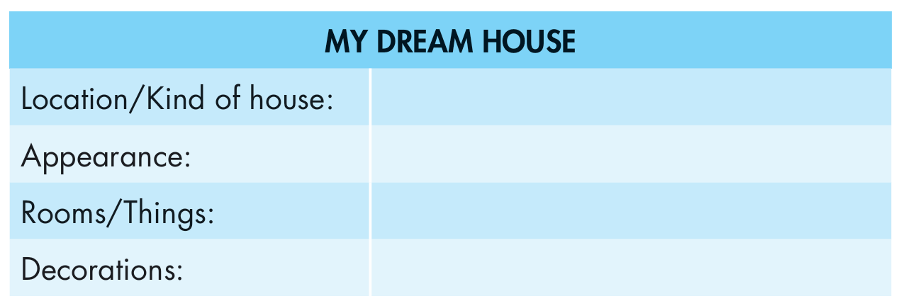
Complete the table.
by the ocean / a cottage
blue and white
big windows, white curtains, a big yard, a garden
paintings, photos, and plants

Slide 28
Production

Slide 29
Now, write a paragraph about your dream house. Use the Writing Skill box, the reading model, and your speaking notes to help you. Write 100 to 120 words.
by the ocean / a cottage
blue and white
big windows, white curtains, a big yard, a garden
paintings, photos, and plants

Slide 30
Use the clues to write complete sentences.
My dream house / be / by / ocean.
My dream house will be by the ocean.
I /want / live / there / because / love swimming / ocean / walking / beach
I want to live there because I love swimming in the ocean and walking along the beach.
It / be / cozy cottage. It / be / blue / white.
It'll be a cozy cottage. It'll be blue and white.

Slide 31
It / have / big windows / white curtains.
It'll have big windows and white curtains.
There / be / big yard / sit / watch / sunsets / read / books.
There will be a big yard where I can sit to watch sunsets and read my books.
It / have / garden / plants / trees / flowers.
It'll also have a garden with lots of plants, trees, and flowers.

Slide 32
I / grow / flowers / fruit trees / garden.
I'll grow lots of flowers and fruit trees in my garden.
My dream house / look / cozy / modern / inside.
My dream house will look very cozy and modern inside.
I / decorate / paintings / photos / plants.
I'll decorate it with lots of paintings, photos, and plants.

Slide 33
Sample writing
My dream house will be by the ocean. I want to live there because I love swimming in the ocean and walking along the beach. It'll be a cozy cottage. It'll be blue and white. It'll have big windows and white curtains. There will be a big yard where I can sit to watch sunsets and read my books. It'll also have a garden with lots of plants, trees, and flowers. I'll grow lots of flowers and fruit trees in my garden. My dream house will look very cozy and modern inside. I'll decorate it with lots of paintings, photos, and plants.

Slide 34

CONSOLIDATION

Slide 35
Tell your partner about the dream house you have written.
My dream house will be by the ocean. I want to live there because I love swimming in the ocean and walking along the beach. It'll be a cozy cottage. It'll be blue and white. It'll have big windows and white curtains. There will be a big yard where I can sit to watch sunsets and read my books. It'll also have a garden with lots of plants, trees, and flowers. I'll grow lots of flowers and fruit trees in my garden. My dream house will look very cozy and modern inside. I'll decorate it with lots of paintings, photos, and plants.

Slide 36

WRAP-UP

Slide 37
Today’s lesson
Writing:
practice parallel structures (Writing skills).
write a paragraph about the dream house
Speaking:
talk about your dream house.

Slide 38
Homework
Review parallel structures.
Prepare for the next lesson (Review Unit 3, pages 92 & 93
(Listening, Reading & Vocab)).
Play the consolidation games on www.eduhome.com.vn

Slide 39

Lesson 3
Stay positive and have a nice day!

