Slide 1
Unit 3: Living Environment
Lesson 2.2: Grammar
Pages 29 & 30

Slide 2
Lesson Outline
Warm-up
Presentation
Practice
Production
Consolidation
Wrap-up

Slide 3
By the end of this lesson, students will be able to…
practice and use wish with the past simple correctly.

Slide 4
WARM-UP

Slide 5
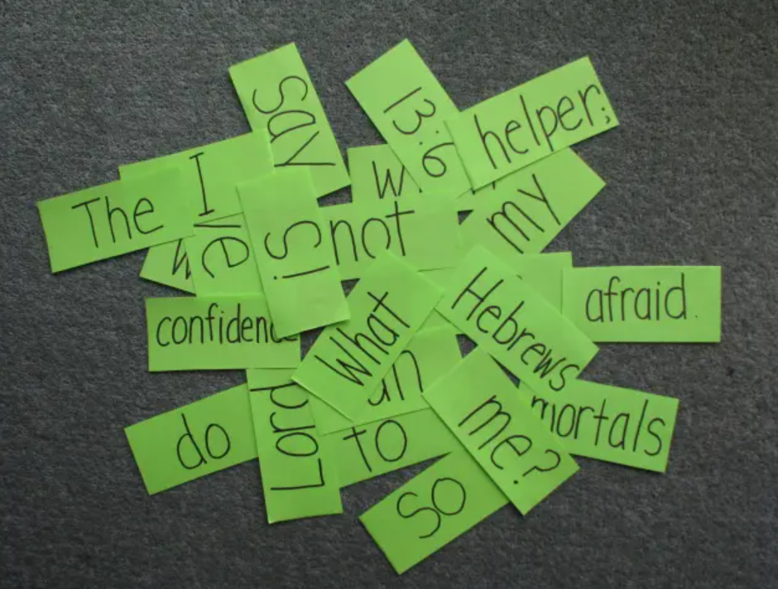
COMPETITION TIME:
Create groups/teams of 5 students.
You will be given some sentences but in the wrong order, you have to unscramble the sentences.
The team(s) with the most correct answers win (s).
Time limit: 5 minutes

Slide 6
1. Wish / my / I / closer / I / lived / to / friends.
2. My / her / sister / bedroom / a / bigger./ wishes / was / bit
3. we / a / and / a / swimming pool / house. My / family / wish / had / bath / in / our
4. The / wish / in / there / more / residents / entertainment / the / was / neighborhood.
5. principal / to / install / an / the / air conditioner / The / agreed / students / every / wish / in / classroom.

Slide 7
Answers:
1. Wish / my / I / closer / I / lived / to / friends.
I wish I lived closer to my friends.
2. My / her / sister / bedroom / a / bigger./ wishes / was / bit
My sister wishes her bedroom was a bit bigger.
3. we / a / and / a / swimming pool / house. My / family / wish / had / bath / in / our
My family wish we had a bath and a swimming pool in our house.

Slide 8
4. The / wish / in / there / more / residents / entertainment / the / was / neighborhood.
The residents wish there was more entertainment in the neighborhood.
5. principal / to / install / an / the / air conditioner / The / agreed / students / every / wish / in / classroom.
The students wish the principal agreed to install an air conditioner in every classroom.

Slide 9
Presentation

Slide 10
FORM: S + wish/wishes + S + past tense verb + ….
USE: express a wish for a thing / situation that is not real in the present.
Ex: I wish my house was closer to the park.
(My house isn't close to the park.)
John wishes he had a flat screen TV.
(John doesn't have a flat screen TV.)

Slide 11
Note: We can use was/wasn't or were/weren't after I/he/she/it/singular noun.
I wish my house was/were closer to the beach.
He wishes it wasn't/weren't so boring in his neighborhood.
Presentation

Slide 12
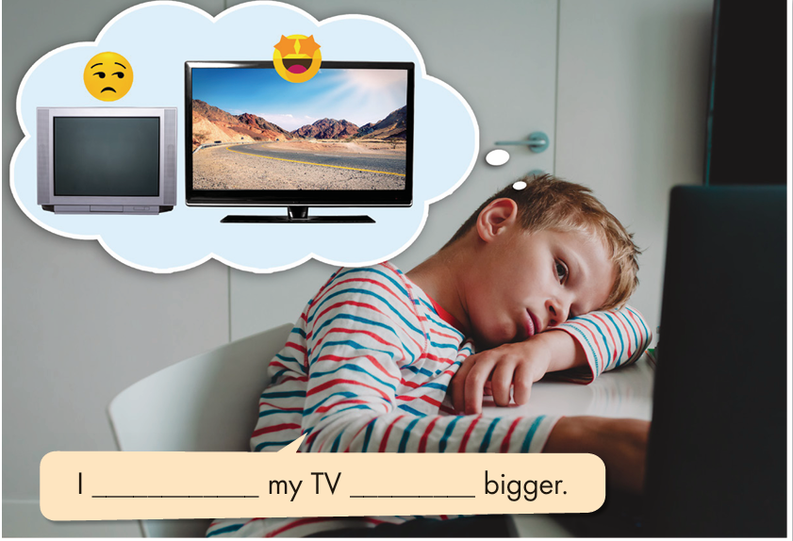
Task a. Read about wish with the Past Simple, then fill in the blanks.
Presentation

Slide 13
Task b. Listen and check.
Listen again and repeat.
Presentation
wish
Was/were

Slide 14
Practice

Slide 15
Task c. Fill in the blanks with the correct form of the verbs.
1. I wish I ________ (have) a bigger bed.
2. He wishes it _________ (be) more exciting in his neighborhood.
3. They wish their friends ________ (live) by their house.
4. I wish my TV _______________ (not be) so small.
had
was/were
lived
wasn’t / weren’t

Slide 16
5. She wishes she ________ (know) her neighbors better.
6. I wish my yard ___________ (be) bigger.
7. They wish they ________ (see) their grandparents more.
8. He wishes it _________________ (not be) so noisy on his street.
knew
was / were
saw
wasn’t / weren’t

Slide 17
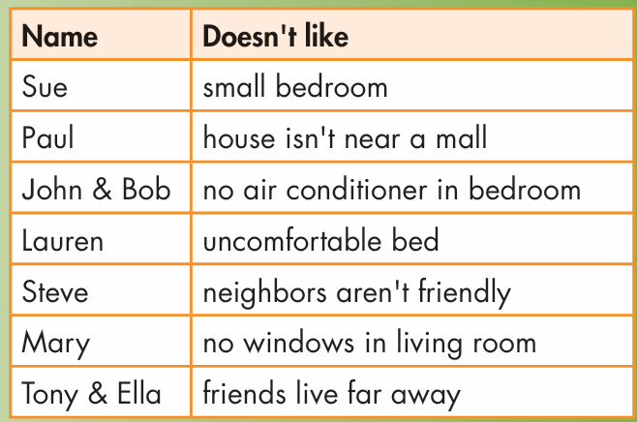
Task d. Use the table to write sentences about what each person wishes to change about their living environment.
1. Sue wishes her bedroom was bigger.

Slide 18
2. Paul wishes his house was/were closer to the mall.
3. John and Bob wish their bedroom had an air conditioner.

Slide 19
4. Lauren wishes her bed was/were (more) comfortable.
5. Steve wishes his neighbors were friendlier. / Steve wishes his neighbors weren't (so) unfriendly.

Slide 20
6. Mary wishes her living room had windows.
7. Tony and Ella wish their friends lived closer. / Tony and Ella wish their friends didn't live (so) far away.

Slide 21
Extra practice
Presentation

Slide 22
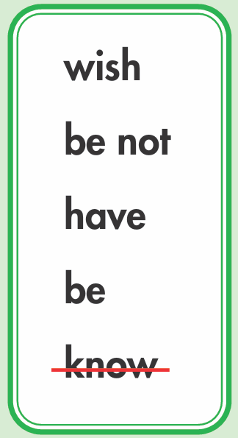
Extra Practice – WB, P 17
Task a. Fill in the blanks using the correct form of the words in the box.
1. She wishes she _________ her neighbors better.
2. I __________ there was a mall near my house.
3. John wishes he _________ a flat screen TV in his bedroom.
4. She wishes her curtains _______________ so red.
5. They wish their yard _______________ bigger.
knew
wish
had
Presentation
Production
wasn’t / weren’t
was / were

Slide 23
Task b. Choose the correct answer.
Extra Practice – WB P 17
1. I wish my friends live/lived closer to my house.
2. They wish/wishes they had an air conditioner in their living room.
3. She wishes her bedroom isn't/wasn't so small.
4. I wish there was/were more things to do nearby.
5. My mom wishes our neighborhood has/had bigger roads.
Presentation
Production

Slide 24
Production

Slide 25
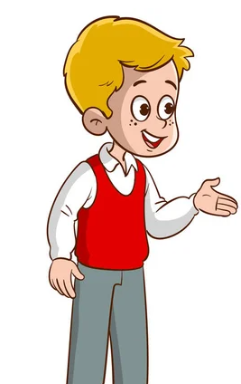
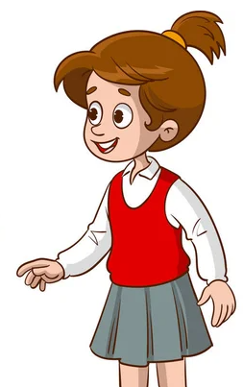
Task e. In pairs: Look at the sentences in Tasks c. and d. Discuss which sentences you also wish were true.

Slide 26
I also wish my yard wasn't so small.
I wish my bedroom was bigger, too.

Slide 27
I wish there was a skatepark near my house, too. I love skateboarding.
I also wish I had an air conditioner in my room.

Slide 28
CONSOLIDATION

Slide 29
Ask and answer the question below with your partner, using wish with simple past tense.
What do you wish for your living environment?

Slide 30
Suggested answers
I wish there was a big park near my house. I love jogging.
I wish there was a swimming pool near my house. I enjoy swimming.

Slide 31
I wish I had a flat screen TV in my room so that I watch my favorite program.
I wish I had an air conditioner in my room. It’s too hot these days.

Slide 32
WRAP-UP

Slide 33
Today’s lesson
Grammar:
practice and use wish with the past simple.
Speaking:
Make wishes for the living environment using wish with the past simple

Slide 34
Homework
Review wish with the past simple.
Prepare for the next lesson (Pronunciation & Speaking - pages 30 & 31 - SB).
Play the consolidation games on www.eduhome.com.vn

Slide 35
Lesson 3
Stay positive and have a nice day!

