Slide 1
Unit 3: Living Environment
Lesson 1.3: Pronunciation. & Speaking
Pages 26 & 27

Slide 2
Lesson Outline
Warm-up
Pronunciation
Speaking
Consolidation
Wrap-up

Slide 3
By the end of this lesson, students will be able to…
practice ‘…that can...’ and ‘…that care…’ (Sound changes and Rhythm)
talk about a cool and smart house

Slide 4
WARM-UP

Slide 5
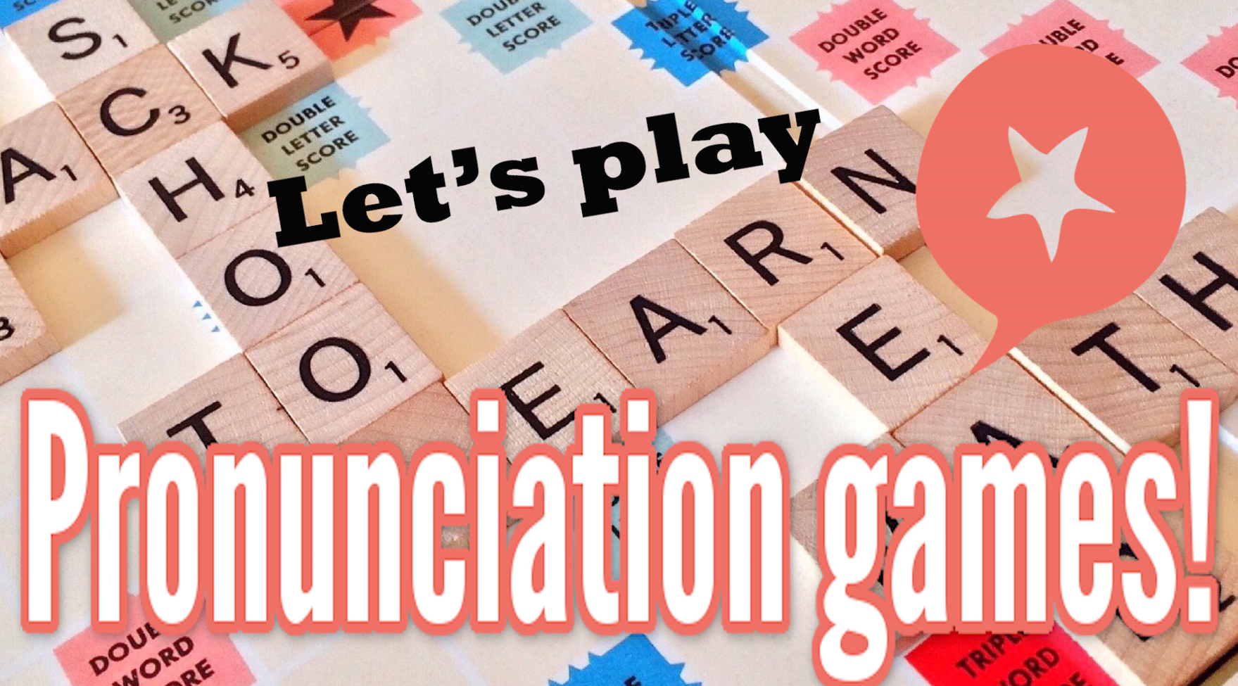
COMPETITION TIME:
Create groups/teams of 5 students.
You will be given the transcription of 10 sentences.
You have to write the 10 sentences.
The team(s) with the most correct answers win(s).
Time limit: 5 minutes

Slide 6
Example:
/aɪ lɪv ɪn speɪn/.
Answer: I live in Spain.

Slide 7
/haʊ əʊld ə jʊ/?
/ʃiː ɪz maɪ ˈsɪstə/
/duː jʊ spiːk ˈɪŋglɪʃ/?
/maɪ dæd ˈwɔːtəd ðə plɑːnts/
/kæn jʊ draɪv ə kɑː/?
/ðə ˈbeɪbɪ wəz stɪl ˈsliːpɪŋ/
/maɪ ˈfeɪvərɪt ˈkʌlə ɪz bluː/
/aɪ ˈɔːlwəz get ʌp ˈɜːlɪ/
/maɪ mʌm ˈnevə ˈdɑːnsɪz/
/ʃiː həz ɔːlˈredɪ əˈraɪvd/

Slide 8
Answers
/haʊ əʊld ə jʊ/?
How old are you?
2./ʃiː ɪz maɪ ˈsɪstə/
She is my sister.
3./duː jʊ spiːk ˈɪŋglɪʃ/?
Do you speak English?
4./maɪ dæd ˈwɔːtəd ðə plɑːnts/
My dad watered the plants.
5./kæn jʊ draɪv ə kɑː/?
Can you drive a car?

Slide 9
Answers
6./ðə ˈbeɪbɪ wəz stɪl ˈsliːpɪŋ/
The baby was still sleeping.
7./maɪ ˈfeɪvərɪt ˈkʌlə ɪz bluː/
My favorite color is blue.
8./aɪ ˈɔːlwəz get ʌp ˈɜːlɪ/
I always get up early.
9./maɪ mʌm ˈnevə ˈdɑːnsɪz/
My mom never dances.
10./ʃiː həz ɔːlˈredɪ əˈraɪvd/
She has already arrived.

Slide 10
Pronunciation

Slide 11
Task a
Notes:
'...that can...' often sounds like /ðækən/.
'...that care...' often sounds like /ðæker/.

Slide 12
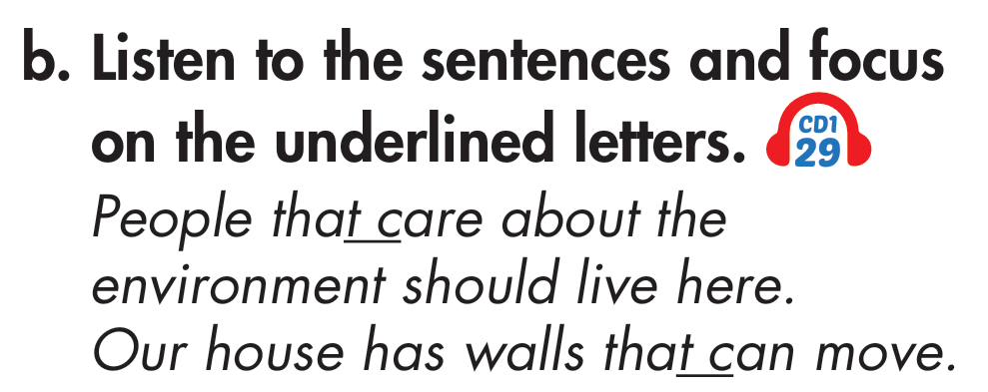
Task b

Slide 13
Task c

Slide 14
Task d
Read the sentences with the sound change noted in Task a. to a partner.
1. People that_care about the environment should live here.
2. Our house has walls that_can move.

Slide 15
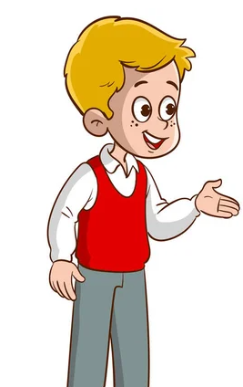
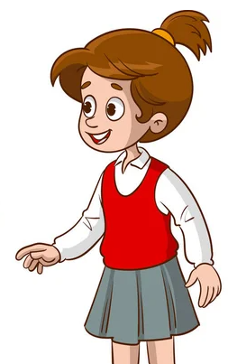
Task a
In pairs: Take turns talking about the smart homes below. Follow the example on the next slide.

Slide 16
Example

Slide 17
Task a
Now, role-play the conversations in front of the class.

Slide 18
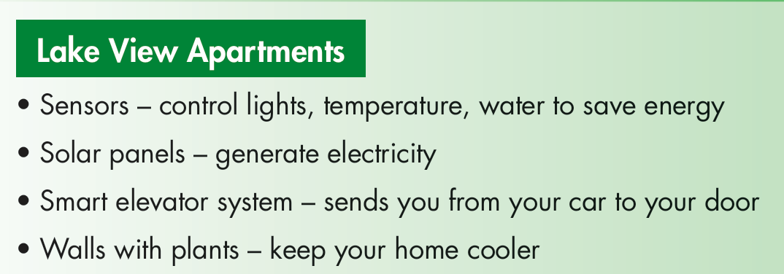
Suggested answer
What do the Lake View Apartments have?
They have solar panels that generate electricity.

Slide 19
Suggested answer
What do the Lake View Apartments have?
They have smart elevator system that sends you from car to your door.

Slide 20
Suggested answer
What do the Lake View Apartments have?
They have walls with plants that keep your house cooler.

Slide 21
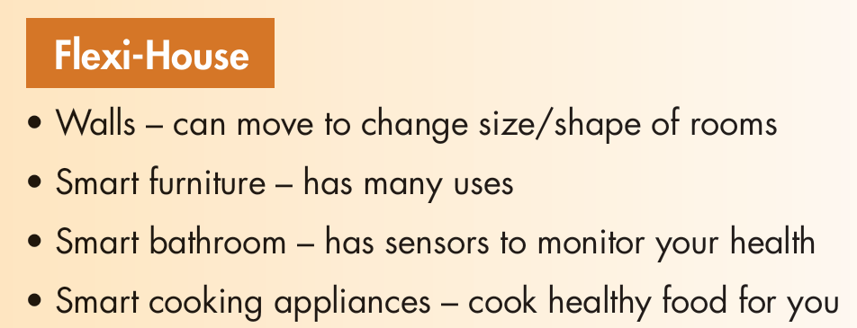
Suggested answer
What does the Flexi-House have?
It has walls that can move to change size/shape of rooms.

Slide 22
Suggested answer
What does the Flexi-House have?
It has smart furniture that has many uses.

Slide 23
Suggested answer
What does the Flexi-House have?
It has smart bathroom that has sensors to monitor your health.

Slide 24
Suggested answer
What does the Flexi-House have?
It has smart cooking appliances that cook healthy food for you.

Slide 25
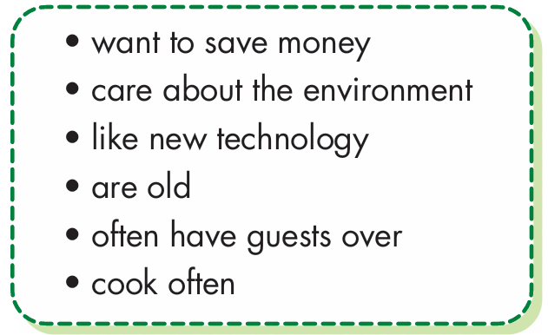
Task b
Take turns saying which groups of people would love the apartment and house in Task a.

Slide 26
Task b
Take turns saying which groups of people would love the apartment and house in Task a.
People who like new technology would love the Flexi-House.
People who are old would love the Lake View apartments

Slide 27
Task b
Take turns saying which groups of people would love the apartment and house in Task a.
People who often have guests over would love the Flexi-House.
People who cook often would love the Flexi-House.

Slide 28
Presentation
Speaking

Slide 29
Task a
You're designing a smart house for one of the types of people below. In pairs: Choose one, then discuss and design a house with at least four smart features for them.

Slide 30
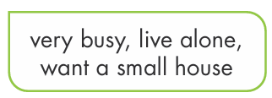
Example

Slide 31
Suggested answer:
People that are old and weak want a safe house with a safety system.
Yeah. They want a safety system which reminds them to lock the door or turn off their stove.
They also want their house to have a smart bathroom that has sensors to monitor their health.

Slide 32
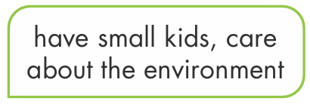
Suggested answer:
People that have small kids love a house with voice assistants.
Yeah. They want voice assistants which can entertain their kids.
They also want their house to have sensors that control lights, temperature, water to save energy.

Slide 33
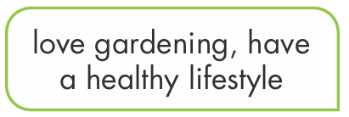
Suggested answer:
People that love gardening like a safe house with an outdoor space.
Yeah. They want an outdoor space that connects to a larger garden.
They also want their house to have smart cooking appliances that cook healthy food for them.

Slide 34
Task b
Join another pair and tell them about your house.

Slide 35
Task b
Suggested answer
We designed a house for people that are very busy, live alone, and want a small house. It has smart appliances that they can control remotely, so they can control them from everywhere. It also has refrigerators that can order food and drinks for them. In addition, it has walls that can move to change size/shape of rooms and kitchen robots that can make a whole meal and clean themselves.

Slide 36
Extra practice - WB - page 15

Slide 37
Suggested answer
My house of the future
My dream house will be in the country. The living room will be huge. It will have a big TV, a comfy sofa, and a big window to make it nice and bright. The kitchen will be small, but it will have all the best modern equipment. It will have an oven, a fridge, and a big sink.

Slide 38
Suggested answer
My house of the future
My bedroom will be great. It will have thick curtains, a huge bed, and a nice wardrobe with all my clothes in it. It will also have a really nice bathroom with a bathtub and a shower. The best part will be the balcony. I will be able to see birds, farms, and trees from it.

Slide 39
CONSOLIDATION

Slide 40
Practice saying these sentences.
People that_care about the environment should live here.
Our house has walls that_can move.

Slide 41
WRAP-UP

Slide 42
Today’s lesson
Pronunciation:
practice ‘..that can….’ And ‘…that care…’ (Sound changes and Rhythm) .
Speaking:
talk about a cool and smart house.

Slide 43
Homework
Practice saying sentences in the Pronunciation(SB)
Prepare for the next lesson (Vocabulary & Listening - pages 28 & 29 - SB).
Play the consolidation games on www.eduhome.com.vn

Slide 44
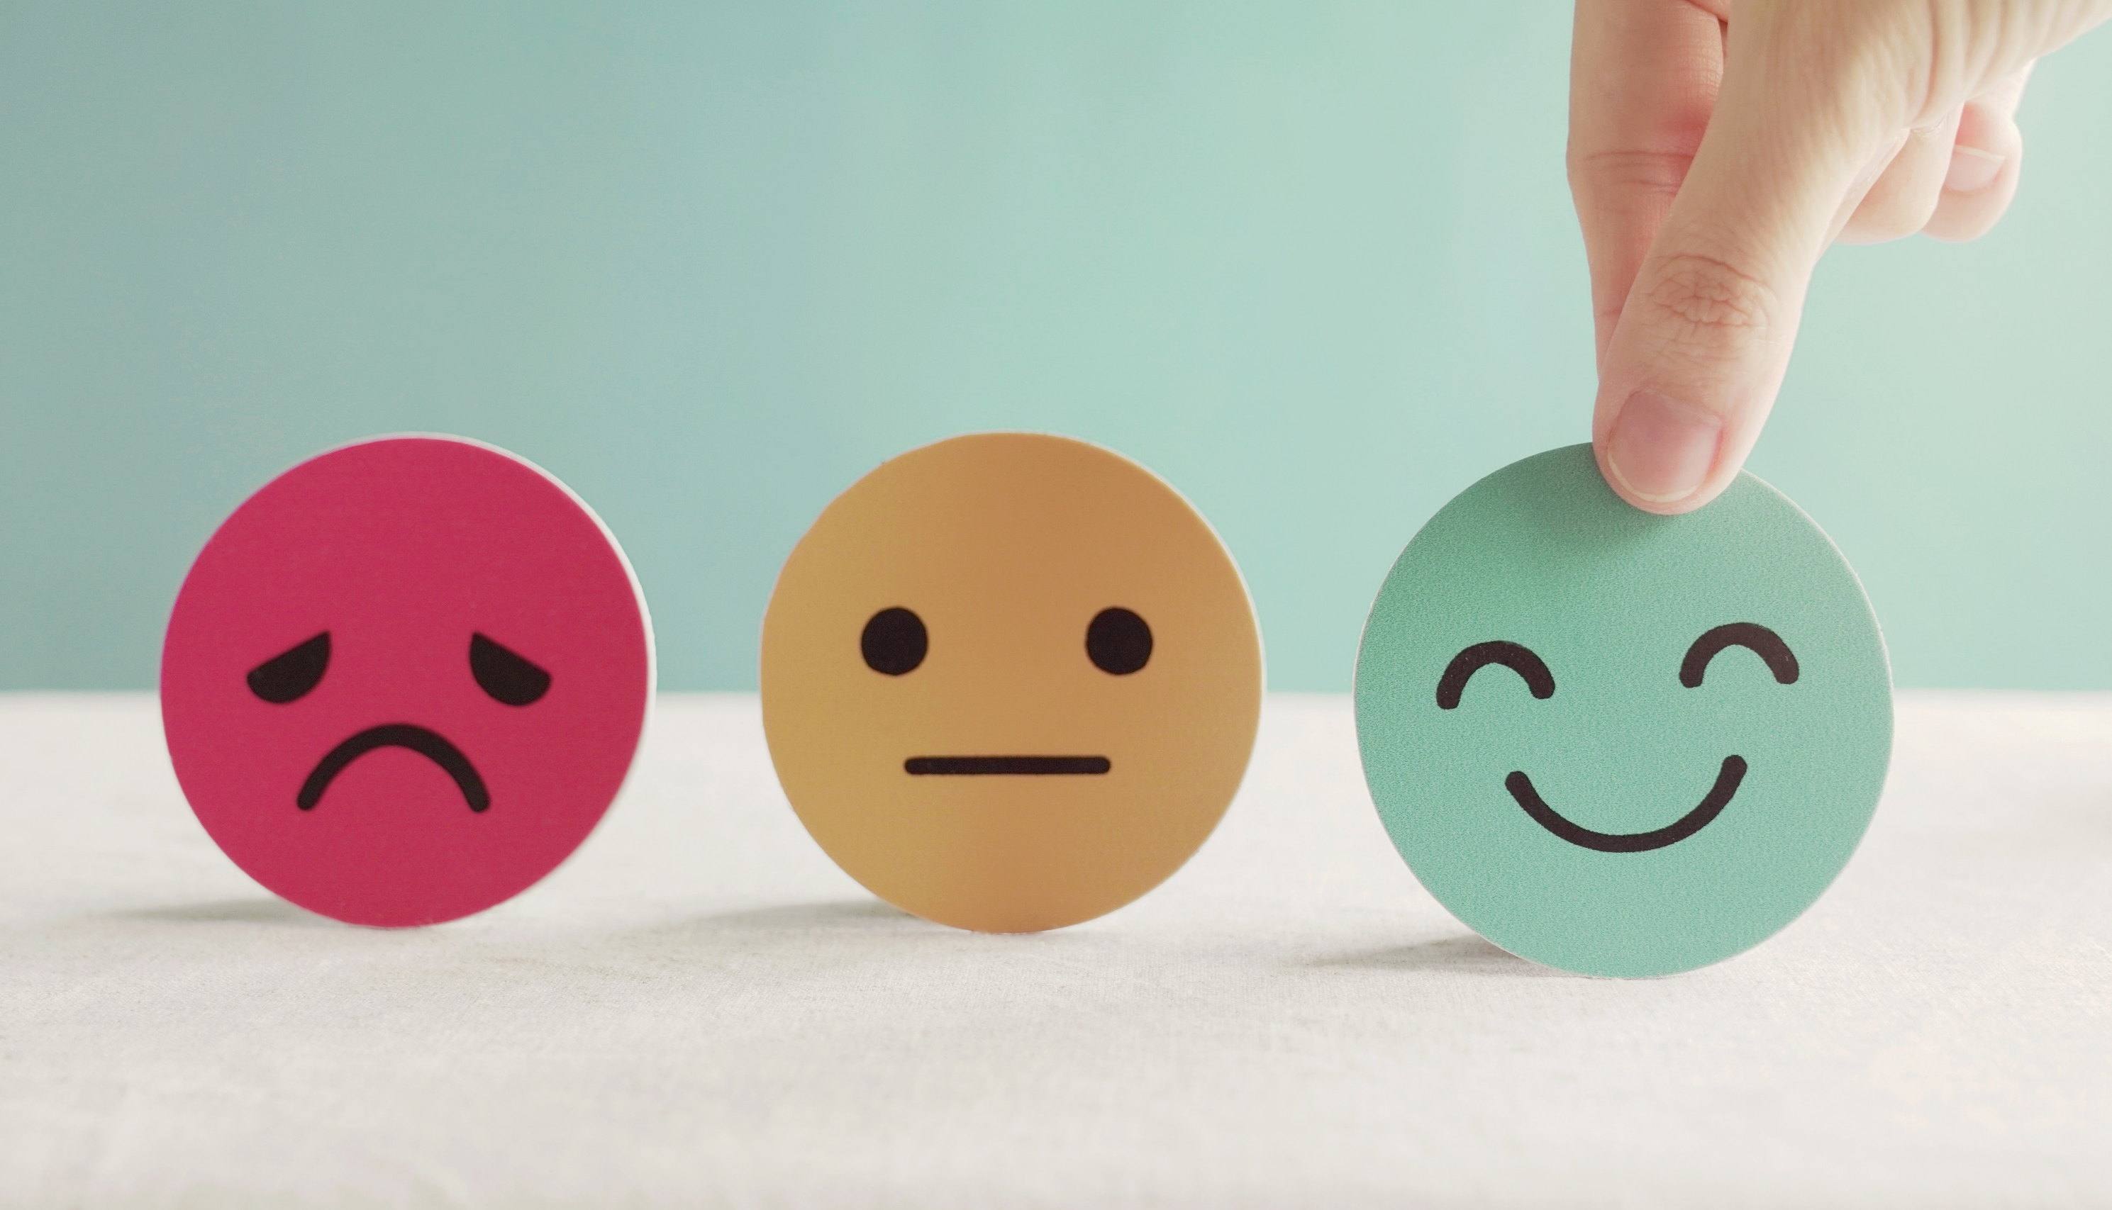
Lesson 3
Stay positive and have a nice day!

