Slide 1
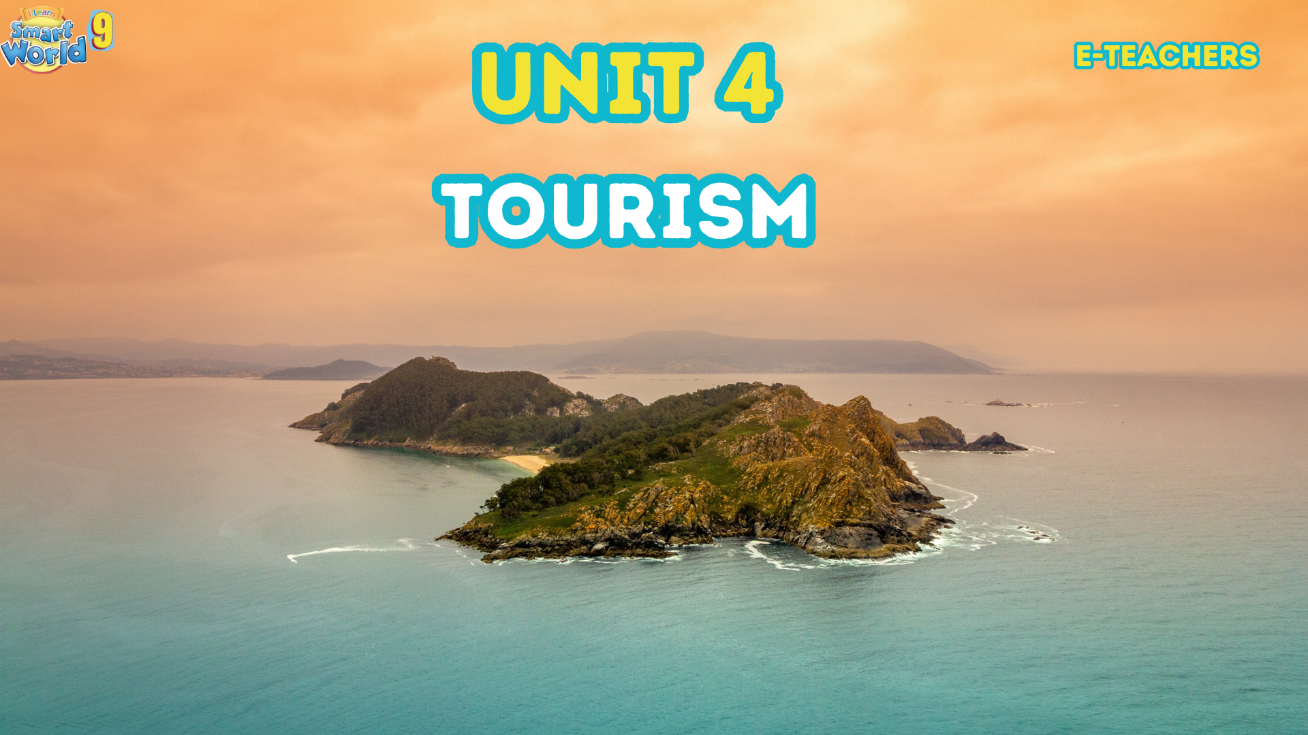

Slide 2



LESSON 10
REVIEW 2

Slide 3


Topic:
REPORTED SPEECH

Slide 4
Direct speech
(Câu trực tiếp)
Indirect speech
(Câu gián tiếp)
I’m fine! Thanks.
He said that he was fine!
I bought a new book for you yesterday.
He said he had bought a new book
for me the day before.
Do you like reading book?
He asked me if I liked reading a book.
What’s your hobby, David?
I asked him what’s his hobby was.
DISCUSSION:
1. When should we use indirect speech?
2. Are the direct speech sentence and indirect speech the same?

Slide 5
We often use reported speech to:
1. Give someone a telephone message. (Gọi điện)
2. Tell someone news that we heard from someone else. (Kể câu chuyện được nghe từ ai nói)
3. To repeort something that happened earlier.
(Báo cáo những gì đã xảy ra trước đó.)

Slide 6
Cách đổi câu trực tiếp sang câu gián tiếp
1. Thay đổi đại từ NX
Direct speech
(Câu trực tiếp)
Indirect speech
(Câu gián tiếp)
I
We
You
He/she
They
I/ we
    Ex:
Peter said “ I am so hungry”
Peter said he was so hungry.

Slide 7
Cách đổi câu trực tiếp sang câu gián tiếp
2. Thay đổi tính từ sở hữu
Direct speech
(Câu trực tiếp)
Indirect speech
(Câu gián tiếp)
my
our
Your
Her/his
Their
My/our
    Ex:
    Mary said to me “ I met your mother yesterday’
    Mary said (that) she had met my mother the day before.

Slide 8
Cách đổi câu trực tiếp sang câu gián tiếp
3. Thay đổi tân ngữ
Direct speech
(Câu trực tiếp)
Indirect speech
(Câu gián tiếp)
me
us
You
Her/him
Them
Me/us
    Ex:
He said to me “ I will give you the book”
He said he would give me the book.

Slide 9
Cách đổi câu trực tiếp sang câu gián tiếp
4. Quy tắc lùi thì của V
Direct speech
(Câu trực tiếp)
Indirect speech
(Câu gián tiếp)
Present simple (HTĐ)
Present continuous (HTTD)
Present perfect (HTHT)
Past simple (QKD)
Past continuous (QKTD)
Past perfect (QKHT)
Past simple (QKTĐ)
Past continuous (QKTD)
Past perfect (QKHT)
Past perfect (QHT)
Past perfect continuous (QKHTTD)
Past perfect (QKHT)

Slide 10

4. Quy tắc lùi thì của V
Direct speech
(Câu trực tiếp)
Indirect speech
(Câu gián tiếp)
Present simple (HTĐ)
Present continuous (HTTD)
Present perfect (HTHT)
Past simple (QKD)
Past continuous (QKTD)
Past perfect (QKHT)
Past simple (QKTĐ)
Past continuous (QKTD)
Past perfect (QKHT)
Past perfect (QHT)
Past perfect continuous (QKHTTD)
Past perfect (QKHT)
    Ex:
He said “I always wear a cap”.
He said he always wore a cap.

Slide 11
4. Quy tắc lùi thì của V
Direct speech
(Câu trực tiếp)
Indirect speech
(Câu gián tiếp)
Present simple (HTĐ)
Present continuous (HTTD)
Present perfect (HTHT)
Past simple (QKD)
Past continuous (QKTD)
Past perfect (QKHT)
Past simple (QKTĐ)
Past continuous (QKTD)
Past perfect (QKHT)
Past perfect (QHT)
Past perfect continuous (QKHTTD)
Past perfect (QKHT)
    Ex:
She said “I am looking for my keys”.
She said she was looking for her keys.

Slide 12
4. Quy tắc lùi thì của V
Direct speech
(Câu trực tiếp)
Indirect speech
(Câu gián tiếp)
Present simple (HTĐ)
Present continuous (HTTD)
Present perfect (HTHT)
Past simple (QKD)
Past continuous (QKTD)
Past perfect (QKHT)
Past simple (QKTĐ)
Past continuous (QKTD)
Past perfect (QKHT)
Past perfect (QHT)
Past perfect continuous (QKHTTD)
Past perfect (QKHT)
    Ex:
She said “He has written three letters to her friend.
She said he had written three letters to her friend.

Slide 13
4. Quy tắc lùi thì của V
Direct speech
(Câu trực tiếp)
Indirect speech
(Câu gián tiếp)
Present simple (HTĐ)
Present continuous (HTTD)
Present perfect (HTHT)
Past simple (QKD)
Past continuous (QKTD)
Past perfect (QKHT)
Past simple (QKTĐ)
Past continuous (QKTD)
Past perfect (QKHT)
Past perfect (QHT)
Past perfect continuous (QKHTTD)
Past perfect (QKHT)
    Ex:
Mary said: “My friend gave me a bar of chocolate”.
Mary said that her friend had given her a bar of chocolate.

Slide 14
4. Quy tắc lùi thì của V
Direct speech
(Câu trực tiếp)
Indirect speech
(Câu gián tiếp)
Present simple (HTĐ)
Present continuous (HTTD)
Present perfect (HTHT)
Past simple (QKD)
Past continuous (QKTD)
Past perfect (QKHT)
Past simple (QKTĐ)
Past continuous (QKTD)
Past perfect (QKHT)
Past perfect (QHT)
Past perfect continuous (QKHTTD)
Past perfect (QKHT)
    Ex:
“He was playing football when I came”.
She said he had been playing football when she had come.

Slide 15
4. Quy tắc lùi thì của V
Direct speech
(Câu trực tiếp)
Indirect speech
(Câu gián tiếp)
Present simple (HTĐ)
Present continuous (HTTD)
Present perfect (HTHT)
Past simple (QKD)
Past continuous (QKTD)
Past perfect (QKHT)
Past simple (QKĐ)
Past continuous (QKTD)
Past perfect (QKHT)
Past perfect (QKHT)
Past perfect continuous (QKHTTD)
Past perfect (QKHT)
    Ex:
He said that “I had gone when she came”
He said that he had gone when she had come.

Slide 16
Cách đổi câu trực tiếp sang câu gián tiếp
5. Thay đổi V khuyết thiếu
Direct speech
(Câu trực tiếp)
Indirect speech
(Câu gián tiếp)
Will
Can
May
Shall
Must
Would
Could
Might
Should
Must/ Hadto
    Ex:
She said “ I will tell him”
She said he would tell him.

Slide 17
Cách đổi câu trực tiếp sang câu gián tiếp
6. Thay đổi trạng từ chỉ thời gian/nơi chốn
Direct speech
(Câu trực tiếp)
Indirect speech
(Câu gián tiếp)
Yesterday
Tomorrow
Now
Today /Tonight
Last week
Ago
Next week
This / These
The day before/ the previous day
The following day/ the next day
Then
That day/ that night
The week before/ the previous week
Before
The following week/ the next week
That/ those

Slide 18
Summary
Direct speech
(Câu trực tiếp)
Indirect speech
(Câu gián tiếp)
1.
Đổi đại từ, tính từ sở hữu, tân ngữ cho phù hợp.
  2.
  Lùi thì của V.
  3.
  Thay đổi trạng từ chỉ thời gian/nơi chốn.

Slide 19



REPORTED SPEECH
QUESTIONS
STEP BY STEP

Slide 20
Reporting questions is very similar to reporting statements
We change references to people, places and times as well… but there are some differences.
“What are you doing?” Tom asked.
Tom
asked (me)
what
I
was doing
.
We place the question-word after the reporting verb.
We now place the SUBJECT before the verb (“are”) because the word order is the same as in statements:
(subject + verb).
Now we place the VERB(S) in a past tense after the SUBJECT.
DON’T FORGET! Reported questions are like statements, so we DO NOT NEED the question mark (?). Also remove the inverted commas again.

Slide 21
Let’s report yes/no questions now.
There is a small difference between these questions and wh-questions.
“Will you be here?” Tom asked.
Tom asked (me) if I would be there.
Instead of a question-word we now use
“if” (or “whether”)

Slide 22
Reporting questions with “do”
Let’s see what happens if the question has the auxiliary verb “do” in the present.
“Where do they come from?” Tom asked.
Tom asked (me) where they came from.
Reported questions are like positive statements, so we DO NOT NEED the auxiliary verb “do”.
In this case “do” is present so we change the main verb (“come”) into the Past Simple.

Slide 23
Reporting questions with “do”
Let’s see what happens if the question has the auxiliary verb “do” in the past.
“Did you see Jane?” Tom asked.
Tom asked (me) if I had seen Jane.
Again we DO NOT NEED the auxiliary verb “do”.
In this case “did” is past so we change the main verb (“see”) into the Past Perfect: had + past participle.

Slide 24
WORD ORDER in reported questions
“How fast can you run?” Tom asked.
Tom asked (me) how fast I could run.
Speaker + reporting verb + question word + S + verb(s)
(past) (or “if) (past)

Slide 25











3
Direct Question : “Are you tired?”
1
Turn to Indirect Question
Indirect Question: I wonder if you are tired.
2
Turn into Reported Speech.
Reported Question: He asked if I was tired.

Slide 26


DIRECT QUESTIONS
Question Word
Auxiliary Verb or Modal
Subject
Main
Verb
…..?
do / does
did
will
Who
What
Where
How
When
Why
etc
my friend
he
teachers
my new phone
we
coffee
wild animals
you
etc
or
V 1
am / is / are
was / were
or
V + ing
have / has
had
V 3
DIRECT QUESTIONS

Slide 27

INDIRECT QUESTIONS
Introductory
Verb / question
Subject
affirmative
verb form
.(?)
Question Word / IF
like/ likes
came
will find
who
what
Where
how
when
why
if
etc
or
my friend
he
teachers
my phone
we
coffee
wild animals
you
etc
He asked
She wondered
Could you tell me (?)
etc
am / is / are
was / were
V + ing
or
have / has
had
V 3
INDIRECT QUESTIONS

Slide 28
INDIRECT QUESTIONS
Introductory
Verb / question
Subject
affirmative
verb form
.(?)
Question Word / IF
like/ likes
came
will find
who
what
Where
how
when
why
if
etc
or
my friend
he
teachers
my phone
we
coffee
wild animals
you
etc
He asked
She wondered
Could you tell me (?)
etc
am / is / are
was / were
V + ing
or
have / has
had
V 3
INDIRECT QUESTIONS

Slide 29


We can use could to make polite requests.
We can use it with Wh-words and with Wh-words + to-infinitives to ask indirect questions.
We use tell for information and show for instructions.
Could + you tell/show me + Wh-word + subject + verb?

Slide 30
Could you tell me when the mall opens?
Could you show me what room I'm staying in?
Could you tell me who the manager is?
Could you show me where the swimming pool is?
Could you tell me how much the train costs?

Slide 31

Finish each of the sentences so that they have the same meaning as the sentence before it.
1. My dad: "What about visiting the art gallery?"
My dad suggested that _________________.
2. What time does the embassy open, please?
Could you _________________?
3. My sister: "You should try the pastries from the local bakery."
My sister said _________________.
4. Where can I get something to eat, please?
Could _________________?
Presentation

Slide 32
Finish each of the sentences so that they have the same meaning as the sentence before it.
5. My brother: "Why don't you try the dumplings?"
My brother suggested _________________.
6. Excuse me, how can I get to the monument?
Could _________________?
7. My mom: "You should take some sunblock with you."
My mom _________________.
8. Excuse me, how do I top up my phone, please?
Could _________________?
Presentation

Slide 33
Finish each of the sentences so that they have the same meaning as the sentence before it.
1. My dad: "What about visiting the art gallery?"
My dad suggested that _________________.
2. What time does the embassy open, please?
Could you __________________________________?
3. My sister: "You should try the pastries from the local bakery."
My sister said ____________________________________________.
4. Where can I get something to eat, please?
Could __________________________________________?
we visit the art gallery
tell me what time the embassy opens
Presentation
(that) we should try the pastries from the local bakery
you tell/show me where to get something to eat

Slide 34
Finish each of the sentences so that they have the same meaning as the sentence before it.
5. My brother: "Why don't you try the dumplings?"
My brother suggested _________________________.
6. Excuse me, how can I get to the monument?
Could ________________________________________?
7. My mom: "You should take some sunblock with you."
My mom _______________________________________.
8. Excuse me, how do I top up my phone, please?
Could ___________________________________?
(that) we try the dumplings
you tell/show me how to get to the monument
Presentation
said (that) I should take some sunblock with me
you tell/show me how to top up my phone

Slide 35

Circle the word that differs from the other three in the position of primary stress in each of the following questions.
1. A. embassy B. gallery C. monument D. adapter
2. A. station B. dumpling C. admire D. socket
/ˈembəsi/
/ˈɡæləri/
/ˈmɒnjəmənt/
/əˈdæptər/
/ˈsteɪʃən/
/ˈdʌmplɪŋ/
/ədˈmaɪər/
/ˈsɒkɪt/

Slide 36
Circle the word that has the underlined part pronounced differently from the others.
1. A. adapter B. pharmacy C. fanny pack D. gallery
2. A. hostel B. monument C. sunblock D. convenience store
/əˈdæptər/
/ˈfɑːməsi/
/ˈfæni ˌpæk/
/ˈɡæləri/
/ˈhɒstəl/
/ˈmɒnjəmənt/
/ˈsʌnblɒk/
/kənˈviːniəns ˌstɔːr/

Slide 37
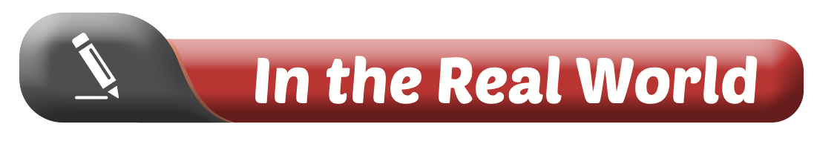
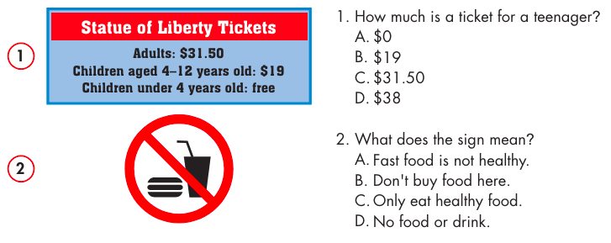
Look at the signs. Choose the best answers.
1. How much is a ticket for a teenager?
$0
$19
$31.50
$38
2. What does the sign mean?
Fast food is not healthy.
Don't buy food here.
Only eat healthy food.
No food or drink.

Slide 38

Choose the correct answer (A, B, C, or D).
Hoàng: "How about visiting a monument, Phương?"
Thương: "Did Hoàng have any suggestions for what you should do on vacation?"
Phương: "Yes. He __________________ I visit a monument."
suggesting B. suggest C. suggested D. suggestion
2. Jason: "__________________ you tell me when the store opens?"
Trang: "It opens at 10 a.m."
A. When B. Could C. What time D. Where
Conversation

Slide 39
Choose the correct answer (A, B, C, or D).
3. Khang: "I'm sick. I need to go to the pharmacy so I can buy some medicine."
Sarah: "Oh, I'm sorry. __________________.”
A. I hope you don't lose it B. I didn't take it
C. I don't like medicine D. I'll go for you
4. Emma: "You should try the dumplings."
James: "Emma __________________ we should try the dumplings." Ben: "OK. Good idea."
A. said B. should C. tried D. told

Slide 40

In pairs: Tell your partner your ideas for things that visitors should eat and do when they visit Vietnam. Write down the things your partner tells you.
Partner’s name: | Dishes to try | Places to visit
 | 1 | 1
 | 2 | 2

Slide 41
In pairs: Tell your partner your ideas for things that visitors should eat and do when they visit Vietnam. Write down the things your partner tells you.
Partner’s name: | Dishes to try | Places to visit
 | 1 | 1
 | 2 | 2
noodle soup
bread
Ha Noi capital
Ha Long Bay

Slide 42



Slide 43
Suggested Answers
Đạt suggested that visitors try phở. It's hot noodle soup. He said people should try it because it's the most famous Vietnamese dish. Đạt said it's a delicious, traditional breakfast. He said that visitors should also try bún thịt nướng. It's great for lunch or dinner. He said it’s refreshing because it's a cold noodle dish. Vietnam has many islands, and Đạt suggested people visit one or two on their trip. Phú Quốc is a beautiful island in the south. It has long, white beaches, big mountains, and green forests. Côn Đảo is much smaller and more peaceful. You can get to the islands by plane or boat. Đạt said that visitors should take a plane because it's quicker.

Slide 44
WRAP-UP
Unit 4
TOURISM
Lesson 10: Review 2
Ms Phương
Zalo: 0966765064
review the target language learned in the unit.
practice test-taking skills.

Slide 45

HOMEWORK
Review Unit 4: Tourism
Prepare Unit 5

Slide 46


