Slide 2
ONLINE GAME

Slide 3
LESSON 9
REVIEW 1

Slide 4
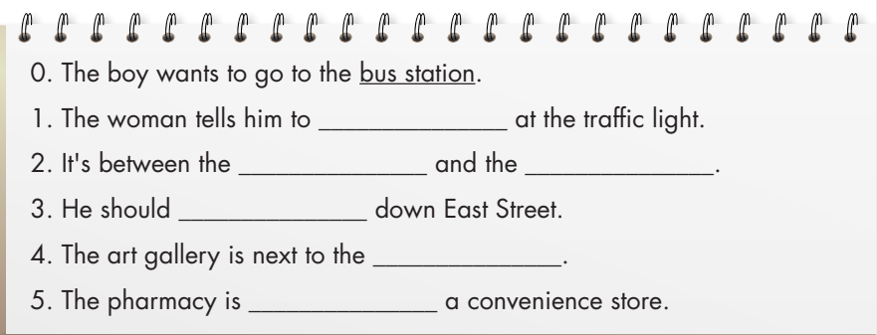
verb
noun
noun
verb
noun
preposition

Slide 6
turn left
The woman tells him to _________ at the traffic light.
2. It's between the ________ and the _______.
3. He should ___________down East Street.
4. The art gallery is next to the _____________.
5. The pharmacy is __________ a convenience store.
hospital
school
go straight
supermarket
opposite

Slide 7
Audio transcript
Tom: Excuse me. Could you help me? I don't know my way around.
Kate: Sure. How can I help?
Tom: Thanks. I need to get to the bus station. Could you tell me how to get there?
Kate: Sure. Turn left at the traffic light. Go straight, then turn right at the end of the road. It's on your left, between the hospital and the school.
Tom: Great. Thank you so much.
…

Slide 8
Audio transcript
Tom: Excuse me. Could you help me?
David: Hello. Sure.
Tom: Could you tell me how to get to the art gallery? I don't know where to go.
David: No problem. Go straight down East Street. Turn right at the corner and it's next to the supermarket.
Tom: Thank you so much.
David: You're welcome.
Tom: Also, could you tell me how to get to the pharmacy?
David: Sure. There's one near here. Go straight at the traffic light. It's on the right. It's opposite the convenience store.
Tom: Thank you. Have a nice day.
David: You too.

Slide 9
Underline keywords in the instructions
Which of the following is true?
Which phrase is the word safe in the email closest in meaning to?
Which topic is NOT mentioned in the email?
What does the word “both” refer to?
What can you infer about Sarah and Bella from the reading?

Slide 10
Hi Bella,
I spoke to my family, and they had some great ideas for our trip to Barcelona this summer. They all visited Spain last year, but I had to stay home and study for my high school exams. It'll be great to finally go!
My mom suggested we travel in May and June. She said the weather was the nicest then. She also suggested some places to visit. She said we should go to La Sagrada Familia and Camp Nou. I love soccer, so I would love to visit Camp Nou.

Slide 11
My brother said we should eat at La Casa del Sabor Restaurant. He suggested we try the paella. He said it was the best he had there. He also said we should call the restaurant and book a table before we go because it's always very busy.
Finally, my dad gave me some really useful advice. He suggested we take socket adapters. They have different sockets in Spain. He also suggested we take fanny packs to keep our things safe. We should take both, right?
Did you find anything out?
Speak soon,
Sarah

Slide 12
Example:
0. What is the best subject title for the email?
A. My mom's trip to Spain
B. Our trip to Spain
C. Your trip to Spain
D. My trip to Spainl
I spoke to my family, and they had some great ideas for our trip to Barcelona this summer. They all visited Spain last year, but I had to stay home and study for my high school exams.

Slide 14
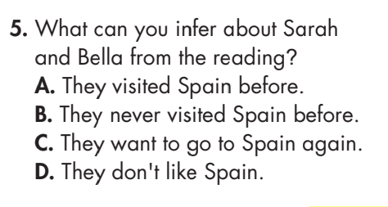

Slide 15
B. Now, read and choose the correct answer
Which of the following is true?
They're going in winter.
B. Many people like the restaurant.
C. Sarah hates soccer.
D. The paella is bad.
He also said we should call the restaurant and book a table before we go because it's always very busy.

Slide 16
B. Now, read and choose the correct answer
2. Which phrase is the word safe in the email closest in meaning to?
not lost
B. no danger
C. a strong metal box
D. careful
He also suggested we take fanny packs to keep our things safe. We should take both, right?

Slide 17
B. Now, read and choose the correct answer
3. Which topic is NOT mentioned in the email?
food
B. a sport
C. the weather
D. transportation
My brother said we should eat at La Casa del Sabor Restaurant.
I love soccer, so I would love to visit Camp Nou.
She said the weather was the nicest then.

Slide 18
B. Now, read and choose the correct answer
4. What does the word “both” refer to?
Sarah's dad and brother
B. Sarah and Bella's things
C. adapter and fanny pack
D. sockets
He suggested we take socket adapters. They have different sockets in Spain. He also suggested we take fanny packs to keep our things safe.

Slide 19
B. Now, read and choose the correct answer
5. What can you infer about Sarah and Bella from the reading?
They visited Spain before.
B. They never visited Spain before.
C. They want to go to Spain again.
D. They don't like Spain.
I spoke to my family, and they had some great ideas for our trip to Barcelona this summer. They all visited Spain last year, but I had to stay home and study for my high school exams.

Slide 20
a. Circle the correct answers.
1. I lost my passport. I need to go to the ___________ to report it lost.
A. pharmacy B. gallery
C. embassy D. monument
2. The weather is very sunny there at this time of year. We need to take some ___________ with us.
A. dumplings B. pastries
C. sunblock D. SIM cards

Slide 21
3. The ___________ is open 24 hours a day. You can go shopping there any time.
A. monument B. convenience store
C. top up D. fanny pack
4. I'm going to stay in a ___________ because I don't want to spend too much money.
A. gallery B. embassy
C. pharmacy D. hostel
5. I need to find a convenience store to ___________ my phone.
A. top up B. topped up
C. topping up D. will top up

Slide 22
6. In a ___________, you can see lots of pictures.
A. pastry B. bed and breakfast
C. monument D. gallery
7. You should try the ___________ at the local restaurant. They're really good.
A. dumplings B. fanny packs
C. bakery D. socket adapter
8. Let's take a ___________ with us. Then, we can charge our laptops.
A. fanny pack B. socket adapter
C. SIM card D. top up

Slide 23
WRAP-UP
Unit 4
TOURISM
Lesson 9 :Review 1
Ms Phương
Zalo: 0966765064
Review the target language knowledge learned in the lesson.
Practice test-taking skills.

Slide 24
HOMEWORK
Prepare for the next lesson (Review Unit 4 - Grammar, Pronunciation, Pronunciation, In the Real World, Conversation, Speaking & Writing - pages 96 & 97 - SB)

