Slide 2
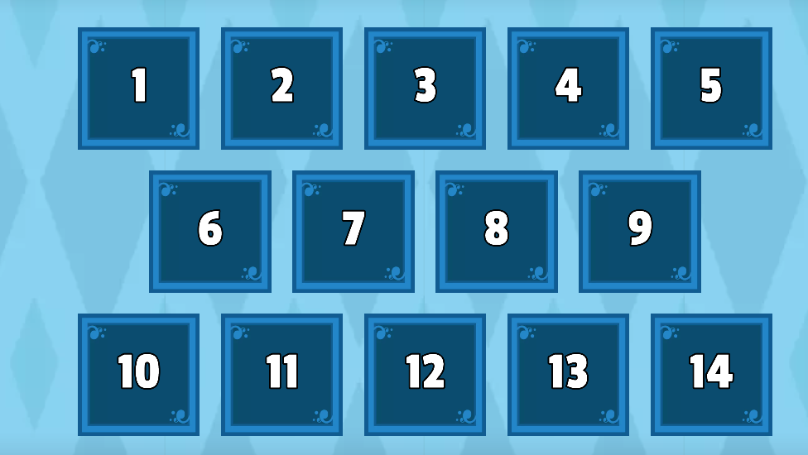
Open the box and changes into the reported speech.

Slide 3
LESSON 8
WRITING
SPEAKING

Slide 4
a. Read about using descriptive language and the travel guide for Mexico again, then underline the examples of descriptive language the writer used.
Using descriptive language
When writing descriptions of a place, person, or thing, we use descriptive language to create a clear image in the mind of our readers. We can do this by using stronger and more specific adjectives or describing how we see, hear, touch, taste, and smell the things around us.

Slide 5
a. Read about using descriptive language and the travel guide for Mexico again, then underline the examples of descriptive language the writer used.
• Describe a place: ancient, impressive, incredible, huge, fascinating, lively, historic, busy, etc.
You can spend days exploring the lively streets and busy markets of this incredible city or learning about its fascinating history and culture.
• Describe food and drinks: full of flavor, refreshing, tasty, fresh, spicy, sweet, mouth-watering, etc.
It's a dish full of flavor with tasty and spicy meat and fresh vegetables.

Slide 6
a. Read about using descriptive language and the travel guide for Mexico again, then underline the examples of descriptive language the writer used.
• Describe an activity: thrilling, relaxing, calming, fascinating, incredible, etc.
You can take part in thrilling adventures or have a relaxing day by the lake.

Slide 7
Mexico: Your Next Vacation
Mexico is an amazing country to visit and explore. The people are among the friendliest and most fascinating in the world. They're famous for music, dancing, and food. Here are the top four things to do in Mexico.
1. Explore Mexico City. This capital city is incredibly rich in history and culture. You can spend days exploring amazing historic sites and museums and admiring the architecture styles from various periods.
2. Be amazed at the sight of Chichén Itzá. This ancient Maya city is incredible. At the center of it is El Castillo. Scientists believe it's a giant Maya calendar with 365 steps, one for each day of the year.

Slide 8
3. Relax on Tulum beaches. This amazing town has it all – lovely white sand, clear waters, and impressive Maya structures. They're part of the only Maya city by the sea.
4. Fill yourself with Mexican food. As you walk along the streets of Mexico, take in the incredible smell of food and the sound of cooking all around you. There, you'll find the best tacos, tamales, tostadas, and so much more.

Slide 9
Mexico: Your Next Vacation
Mexico is an amazing country to visit and explore. The people are among the friendliest and most fascinating in the world. They're famous for music, dancing, and food. Here are the top four things to do in Mexico.
1. Explore Mexico City. This capital city is incredibly rich in history and culture. You can spend days exploring amazing historic sites and museums and admiring the architecture styles from various periods.
2. Be amazed at the sight of Chichén Itzá. This ancient Maya city is incredible. At the center of it is El Castillo. Scientists believe it's a giant Maya calendar with 365 steps, one for each day of the year.

Slide 10
3. Relax on Tulum beaches. This amazing town has it all – lovely white sand, clear waters, and impressive Maya structures. They're part of the only Maya city by the sea.
4. Fill yourself with Mexican food. As you walk along the streets of Mexico, take in the incredible smell of food and the sound of cooking all around you. There, you'll find the best tacos, tamales, tostadas, and so much more.

Slide 11
b. What other words and phrases can we use to describe the things below?
peaceful, quiet, busy, amazing, ancient, historic, pretty, noisy, modern.
Describe a place:
Describe food and drinks:
Describe an activity:
sweet, sour, tasty, delicious
exciting, amazing, interesting, wonderful, great

Slide 12
c. Think of examples in your country for each prompt below, then use descriptive language to describe them.
1. A small town: Hội An Ancient Town is a peaceful town with fascinating historic buildings and a lovely river.
2. A city:
3. A beach:
4. Food tourists should try:
5. Activities to do:

Slide 13
c. Think of examples in your country for each prompt below, then use descriptive language to describe them.
2. A city:
3. A beach:
4. Food tourists should try:
Hanoi is an incredible city that has lots of impressive historic buildings.
Phú Quốc has incredible beaches with clear blue water.
Make sure you try phở. It's really tasty and full of flavor.

Slide 14
c. Think of examples in your country for each prompt below, then use descriptive language to describe them.
5. Activities to do:
When you're in Đà Nẵng, you should go to the beaches for a relaxing experience or hike Marble Mountains for a more thrilling adventure.

Slide 16
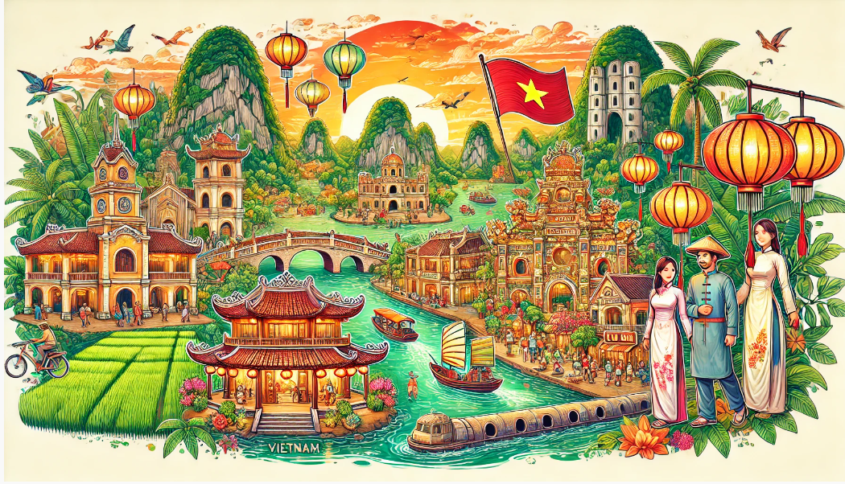
a. In pairs: Discuss ways to describe Vietnamese people, things they're famous for, tourist places in Vietnam, and food and drinks tourists should try.

Slide 17
Sample answer.
Vietnamese people
An: Can you tell me about Vietnamese people?
Binh: Sure. Vietnamese people are friendly and hospitable. They are known for their hard work and resilience. Vietnamese culture is rich and diverse.

Slide 18
Sample answer.
Vietnamese food
An: What can you tell me about Vietnamese food?
Binh: Vietnamese food is fresh and flavorful. Pho is a famous Vietnamese noodle soup. Banh Mi is a delicious Vietnamese sandwich.

Slide 19
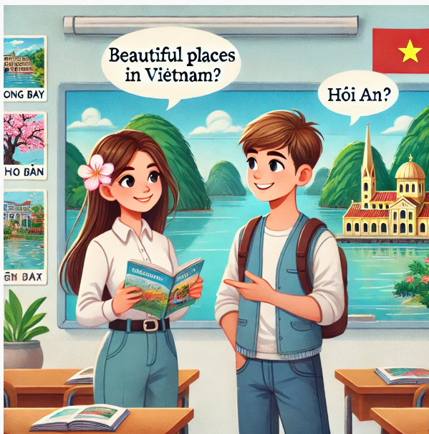
Sample answer.
Vietnamese places
An: What are some beautiful places in Vietnam?
Binh: Ha Long Bay is famous for its stunning limestone islands. Hoi An Ancient Town is known for its charming lantern-lit streets. The Mekong Delta is a picturesque region with lush greenery and winding rivers.

Slide 20
b. Complete the table with your favorite ideas, then use descriptive language to make your ideas more interesting.

Slide 21
Now, write a short travel guide for the destinations you discussed in Speaking. Use the Writing Skill box, the reading model, and your speaking notes to help you. Write 100 to 120 words.

Slide 22
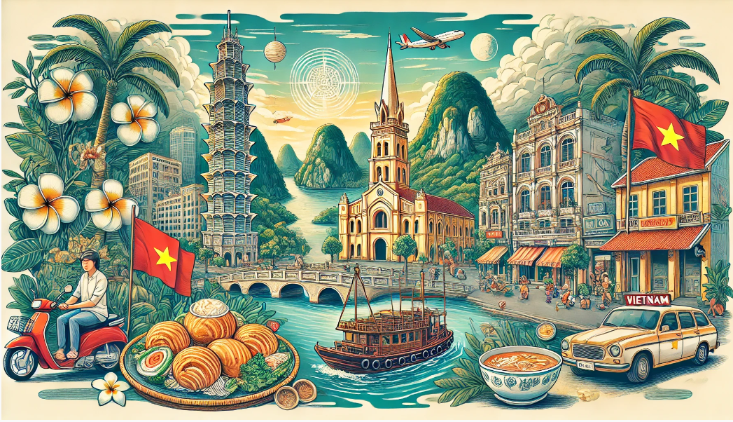
Sample answer
Vietnam is an amazing country. It has lots of incredible places and tasty food. Here are the top things to do in Vietnam.
Explore Ho Chi Minh City. It's a very exciting city. You'll always hear the sound of life around you. You should visit old buildings and admire the architecture. You should also visit Landmark 81 to get a view of the whole city.
Take a boat tour of Hạ Long Bay. It's a very scenic place with lots of incredible caves and mountains.
Try Vietnamese food. Vietnamese food is very tasty and healthy. You should try bún thịt nướng, mì quảng, cà phê sữa đá, and nước mía.

Slide 23
WRAP-UP
Unit 4
TOURISM
Lesson 8: Writing and Speaking
Ms Phương
Zalo: 0966765064
Speaking:
Practice making a travel guide.
Writing:
Learn to use descriptive language (Writing skills).

Slide 24
HOMEWORK
Prepare for the next lesson (Review unit 4 - Listening, Reading & Vocab - pages 95 & 96 - SB).

