Slide 2
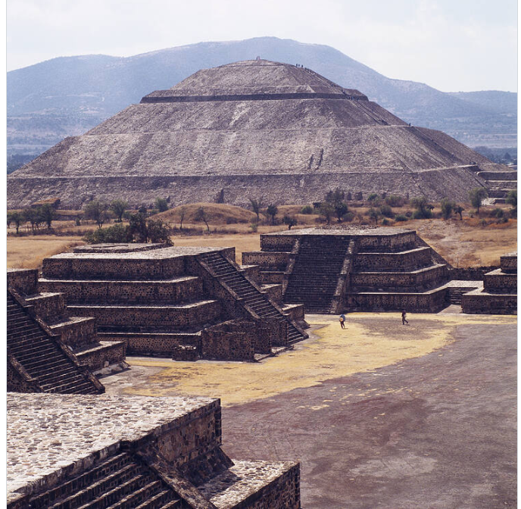
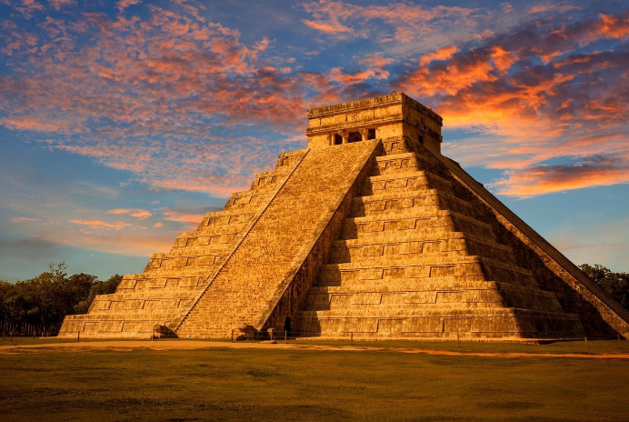
Look at the three famous places and guess where are they?
Pyramid of Teotihuacán
Chichén Itzá
MEXICO

Slide 3
LESSON 7
READING

Slide 4
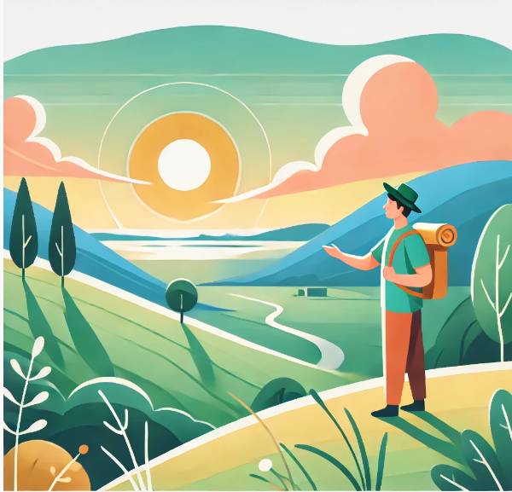
admire
(v) /ədˈmaɪə(r)/
Ngưỡng mộ
To look at something or someone with pleasure because you like or respect them.

Slide 5
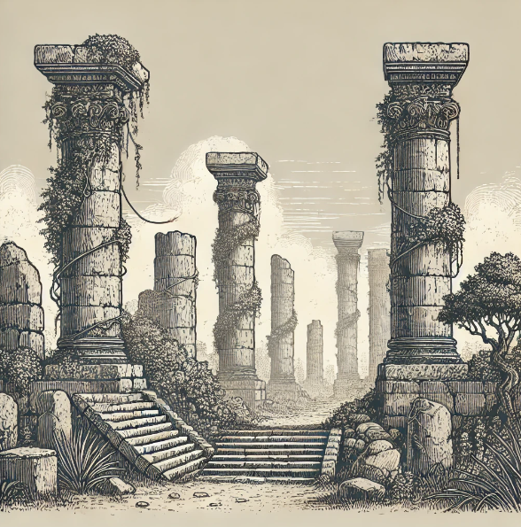
ancient
(adj) /ˈeɪnʃənt/
Cổ xưa
Very old; from a long time ago.

Slide 6
fascinating
(adj) /ˈfæsɪneɪtɪŋ/
Hấp dẫn, quyến rũ
Very interesting and attractive.

Slide 7
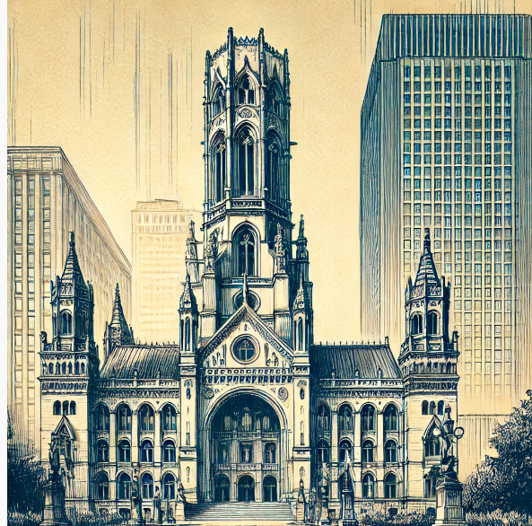
impressive
(adj) /im’presɪv(r)/
Cổ xưa
Something that makes you admire it because it is very good, large, important, etc.

Slide 8
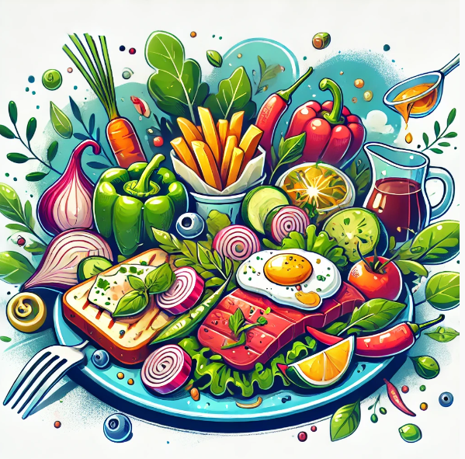
mouth-watering
(adj) /ˈmaʊθ wɔːtərɪŋ/
Ngon lành.
Food that looks or smells very good, making you want to eat it.

Slide 9
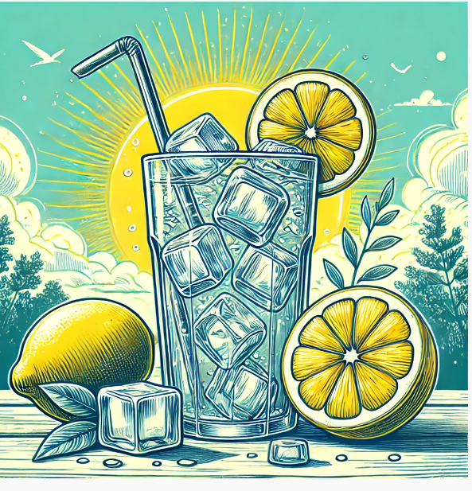
fresh
(adj) /freʃ/
Tươi mát
Making you feel cool.

Slide 10
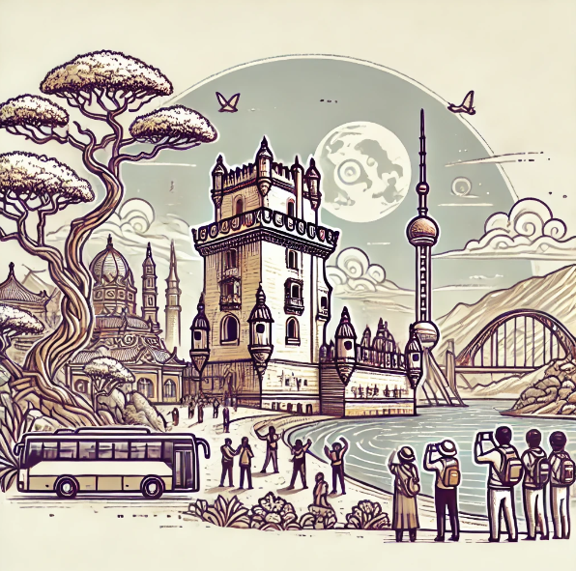
sight
(n) /saɪt/
Cảnh đẹp
A place that is interesting to see and visit.

Slide 11
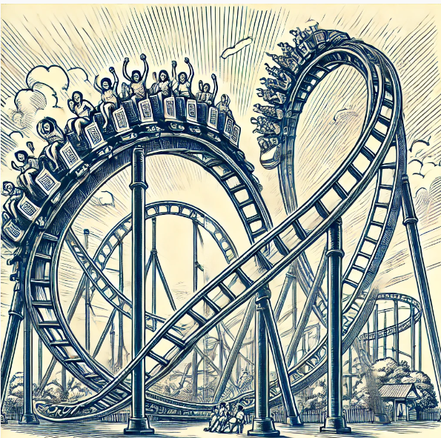
thrilling
(adj) //ˈθrɪlɪŋ/
Ly kỳ, kịch tính.
Very exciting and surprising.

Slide 12
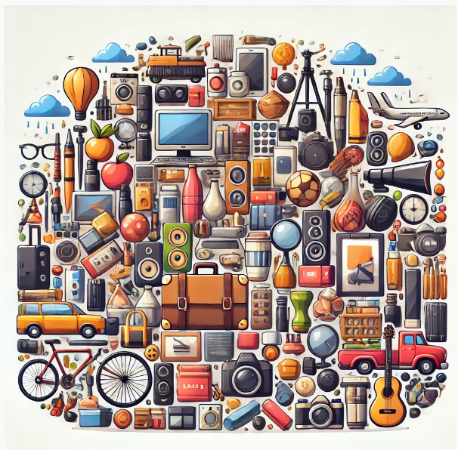
various
(adj) /ˈveəriəs/
Đa dạng
Different kinds of things.
To look at something or someone with pleasure because you like or respect them.

Slide 13
1. admire 2. ancient 3. fascinating 4. impressive 5. mouth-watering 6. refreshing
7. sight
8. thrilling
9. various
Ngưỡng mộ
Cổ xưa
Tuyệt vời
Ấn tượng
Ngon lành
Tươi mát
Phong cảnh
Ly kỳ, bất ngờ
Đa dạng

Slide 14
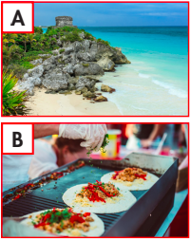
Read the travel guide for Mexico and match the pictures (A–D) with the paragraphs numbered (1– 4).

Slide 15
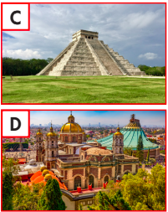
Read the travel guide for Mexico and match the pictures (A–D) with the paragraphs numbered (1– 4).

Slide 16
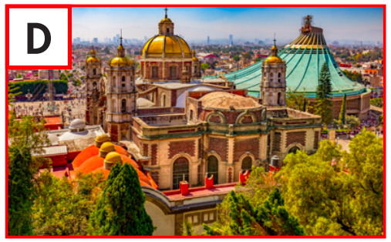
1. Explore Mexico City. This capital city is incredibly rich in history and culture. You can spend days exploring amazing historic sites and museums and admiring the architecture styles from various periods.

Slide 17
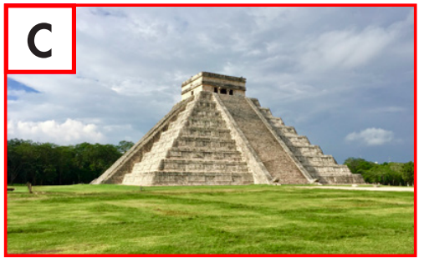
2. Be amazed at the sight of Chichén Itzá. This ancient Maya city is incredible. At the center of it is El Castillo. Scientists believe it's a giant Maya calendar with 365 steps, one for each day of the year.

Slide 18
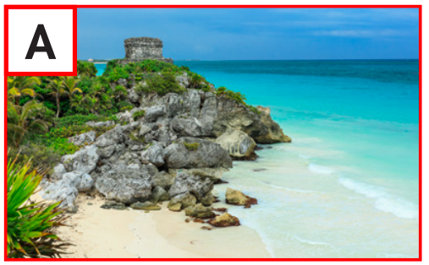
3. Relax on Tulum beaches. This amazing town has it all-lovely white sand, clear waters, and impressive Maya structures. They're part of the only Maya city by the sea.

Slide 19
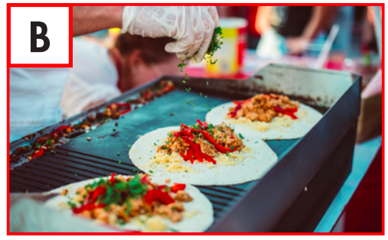
4. Fill yourself with Mexican food. As you walk along the streets of Mexico, take in the incredible smell of food and the sound of cooking all around you. There, you'll find the best tacos, tamales, tostadas, and so much more.

Slide 20
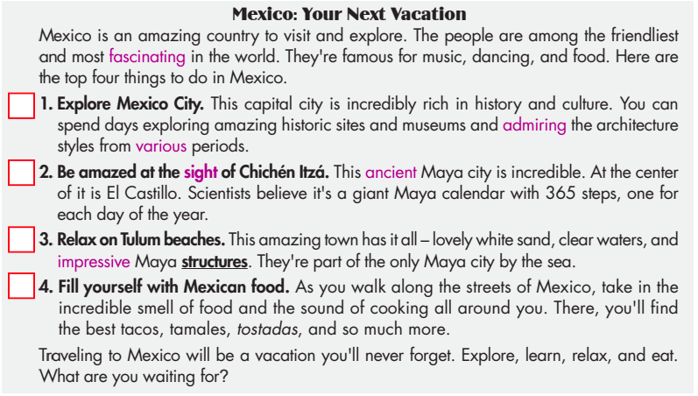
b. Now, read and choose the correct answers.

Slide 21
b. Now, read and choose the correct answers.

Slide 22
b. Now, read and choose the correct answers.
1. According to the guide, what can you do in Mexico City? A. learn about history B. explore the nature
C. see ancient castles D. watch famous plays
Explore Mexico City. This capital city is incredibly rich in history and culture.

Slide 23
b. Now, read and choose the correct answers.
2. What do experts think El Castillo is?
A. the old capital city B. an ancient calendar
C. Mexico's oldest garden D. a stone palace
At the center of it is El Castillo. Scientists believe it's a giant Maya calendar with 365 steps, one for each day of the year.

Slide 24
b. Now, read and choose the correct answers.
3. Which word is closest in meaning to the word structures in the passage?
A. sentences B. machines
C. buildings D. statues
This amazing town has it all – lovely white sand, clear waters, and impressive Maya structures. They're part of the only Maya city by the sea.

Slide 25
b. Now, read and choose the correct answers.
4. Where can you find the best food in Mexico?
A. in Mexico City B. at El Castillo
C. at small restaurants D. on the streets
As you walk along the streets of Mexico, take in the incredible smell of food and the sound of cooking all around you.

Slide 26
b. Now, read and choose the correct answers.
5. Which of the following is NOT a Mexican food?
A. tulum B. tamales
C. tostadas D. tacos
There, you'll find the best tacos, tamales, tostadas, and so much more.

Slide 27
C. Listen and read

Slide 28
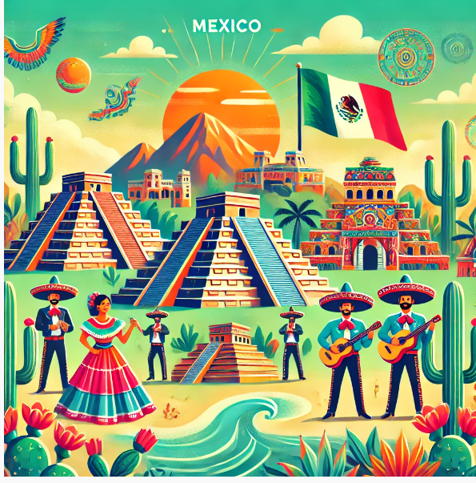
D. In pairs: Ask and answer:
1. What else do you know about Mexico?
2. What would you like most about visiting it?

Slide 29
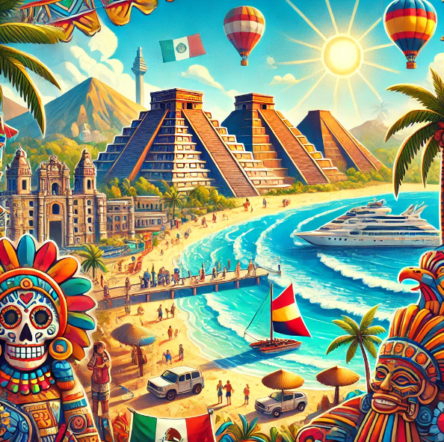
D. In pairs: Ask and answer
1. What else do you know about Mexico?
Sample Answer:
Mexico has many beautiful beaches and ancient pyramids. It is famous for its delicious food like tacos and burritos. Mexico City is a very big and lively city.

Slide 30
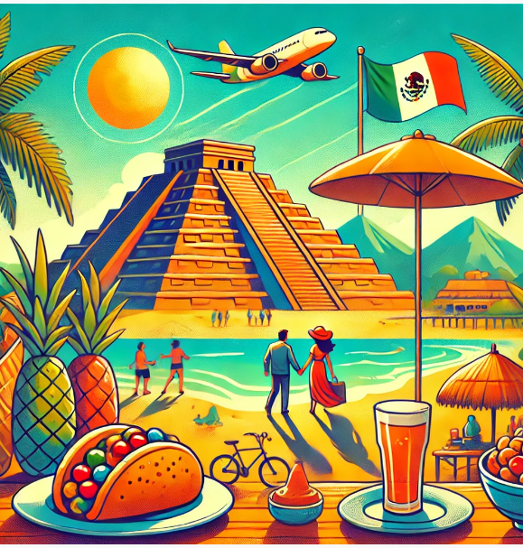
D. In pairs: Ask and answer
2. What would you like most about visiting it?
Sample Answer:
I would love to visit the ancient pyramids and enjoy the beautiful beaches. Trying the local food would be very exciting too.

Slide 31
WRAP-UP
Unit 4
TOURISM
Lesson 7: Reading
Ms Phương
Zalo: 0966765064
Vocabularies
1. admire 2. ancient 3. fascinating 4. impressive 5. mouth-watering 6. refreshing
7. sight
8. thrilling
9. various
-Vocabulary:
- Learn vocabulary to describe a country.
Reading:
- Practicing reading for details.

Slide 32
HOMEWORK
1. Review vocabulary and use them to make sentences
2. Prepare for the next lesson (Speaking & Writing - page 43 – SB)

