Slide 3
PRONUNCIATION
LESSON 6
SPEAKING

Slide 4
a. Don't stress function words in a sentence.
b. Listen to the sentences and focus on the underlined words
Could you show me where to buy a SIM card?
Could you show me how to get to the bus station?
c. Listen and cross out the sentence that doesn't follow the note in Task a.
Could you show me the way to the park?
Could you show me how to top up my phone?

Slide 5
d. Read the sentences with the rhythm noted in Task a. to a partner.

Slide 6
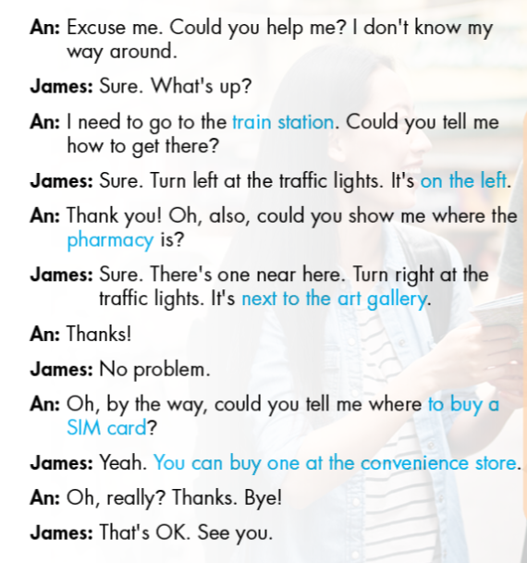
B. Now, role-play the conversations in front of the class

Slide 7
B. Make two more conversations using the following ideas.
pharmacy
next to the convenience store
bus stop
in front of the embassy
the art gallery is
It's next to the embassy
art gallery
convenience store
opposite the pharmacy
behind the restaurant
the Embassy of Vietnam is
It's near the art gallery

Slide 8
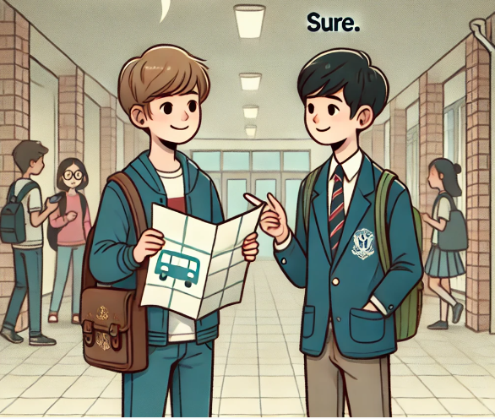
B. Make two more conversations using the following ideas.
An: Where is the Embassy of Vietnam?
James: It's next to the art gallery.

Slide 9
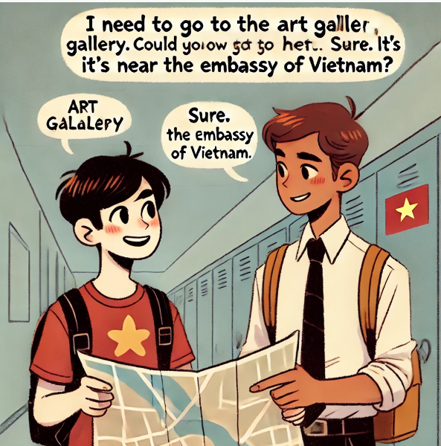
B. Make two more conversations using the following ideas.
An: Where is the Embassy of Vietnam?
James: It's next to the art gallery.

Slide 10
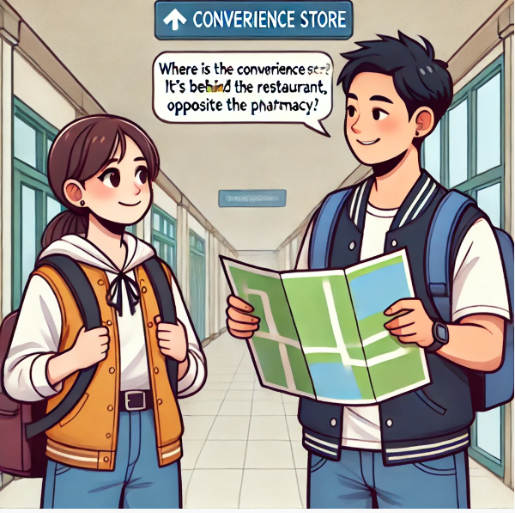
B. Make two more conversations using the following ideas.
An: Where is the convenience store?
James: It's behind the restaurant, opposite the pharmacy.

Slide 11
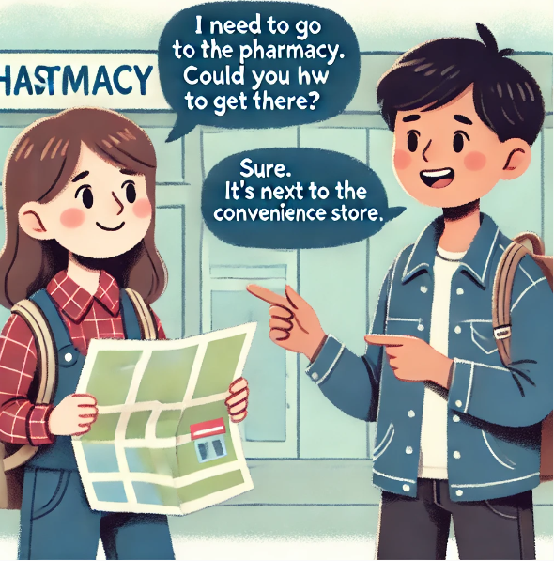
B. Make two more conversations using the following ideas.
An: I need to go to the pharmacy. Could you tell me how to get there?
James: Sure. It's next to the convenience store.

Slide 12
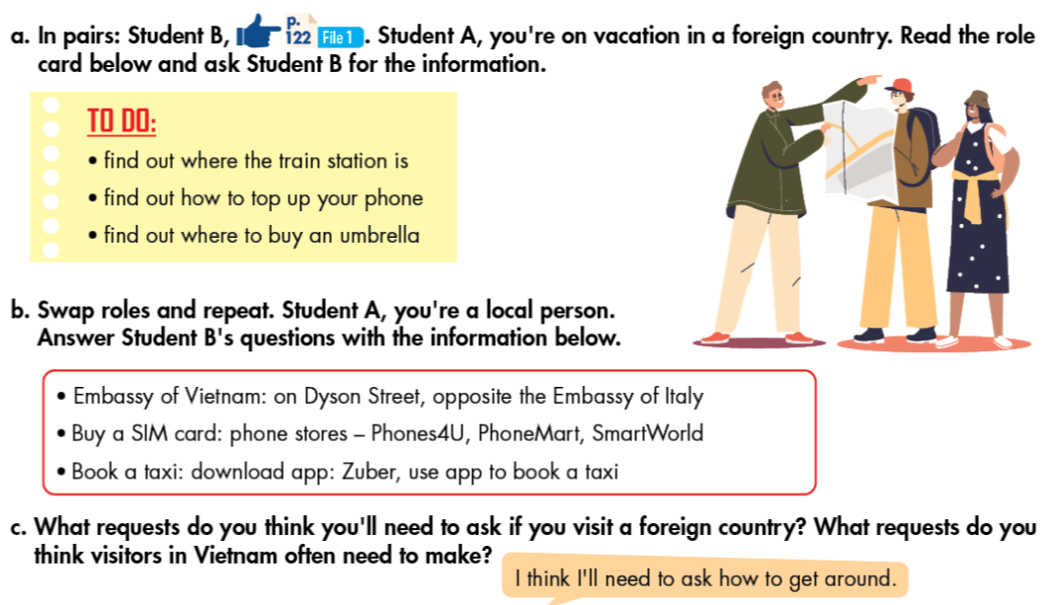

Slide 13
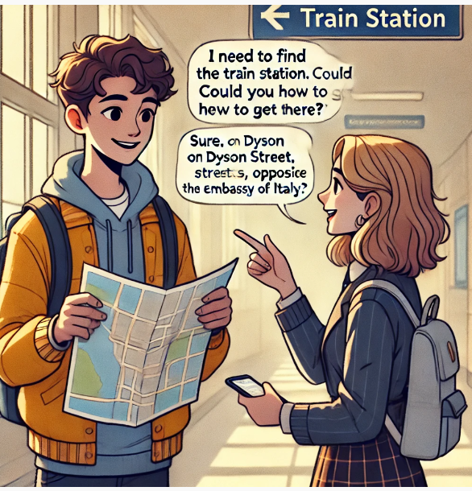
Conversation 1: Find the train station
An: I need to find the train station. Could you tell me how to get there?
James: Sure. It's on Dyson Street, opposite the Embassy of Italy.

Slide 14
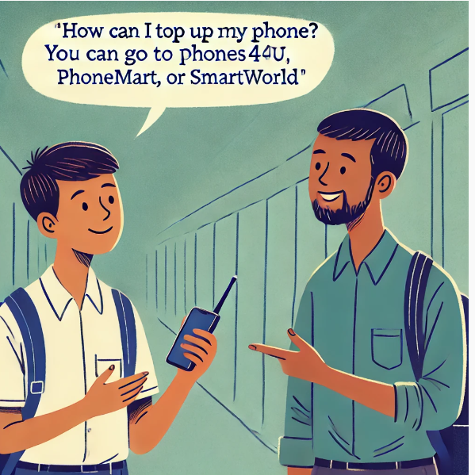
Conversation 2: Find how to top up your phone.
An: How can I top up my phone?
James: You can go to phone stores like Phones4U, PhoneMart, or SmartWorld.

Slide 15
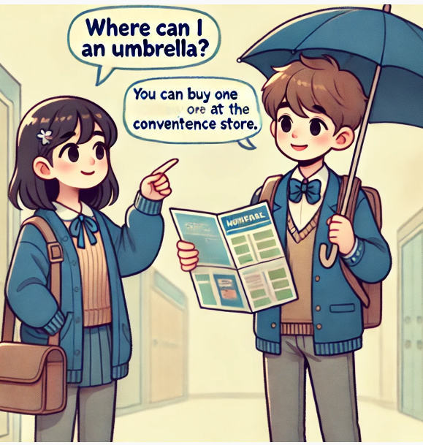
Conversation 3: Find where to buy an umbrella.
An: Where can I buy an umbrella?
James: You can buy one at the convenience store.

Slide 16
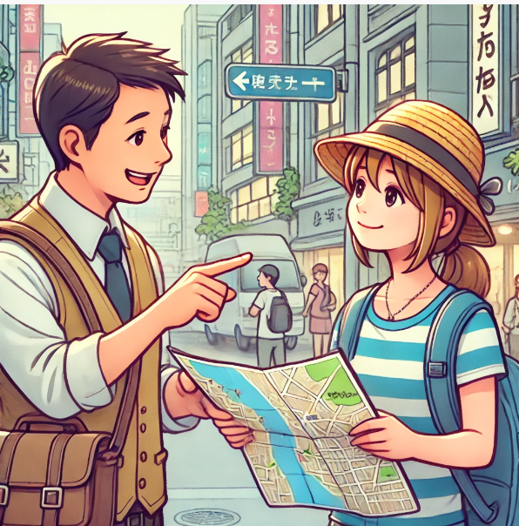
C. What requests do you think you'll need to ask if you visit a foreign country? What requests do you think visitors in Vietnam often need to make?

Slide 17
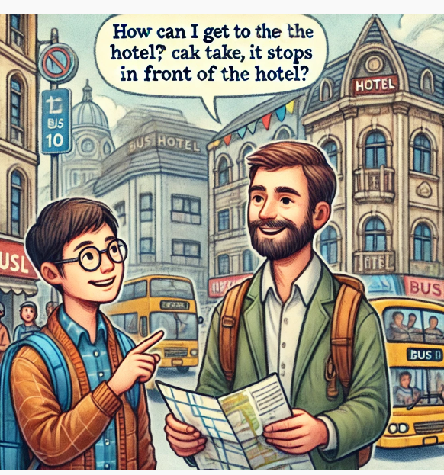
What requests do you think you'll need to ask if you visit a foreign country?
How can I get to the hotel?
Where can I find a pharmacy?
How do I use public transportation here?
Where can I buy a SIM card?
Can you recommend any good restaurants nearby?
How do I get to the nearest tourist attraction?
Where is the nearest ATM?

Slide 18
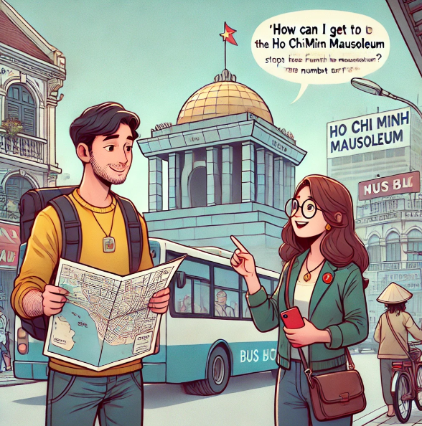
What requests do you think visitors in Vietnam often need to make?
How do I get to the Ho Chi Minh Mausoleum?
Where can I find a good place to eat pho?
How do I get to the beach from here?
Where is the nearest convenience store?
How can I book a taxi?
Where can I exchange foreign currency?

Slide 19
WRAP-UP
Unit 4
TOURISM
Lesson 6:Prouniciation and Speaking
Ms Phương
Zalo: 0966765064
- Pronunciation:
Practice Rhythm in a sentence having funtion words.
Speaking:
Practice asking and giving directions.

Slide 20
HOMEWORK
1. Practice saying the sentences in the Pronunciation(SB).
2. Prepare for the next lesson (Reading - page 42 - SB)

