Slide 1


Slide 2
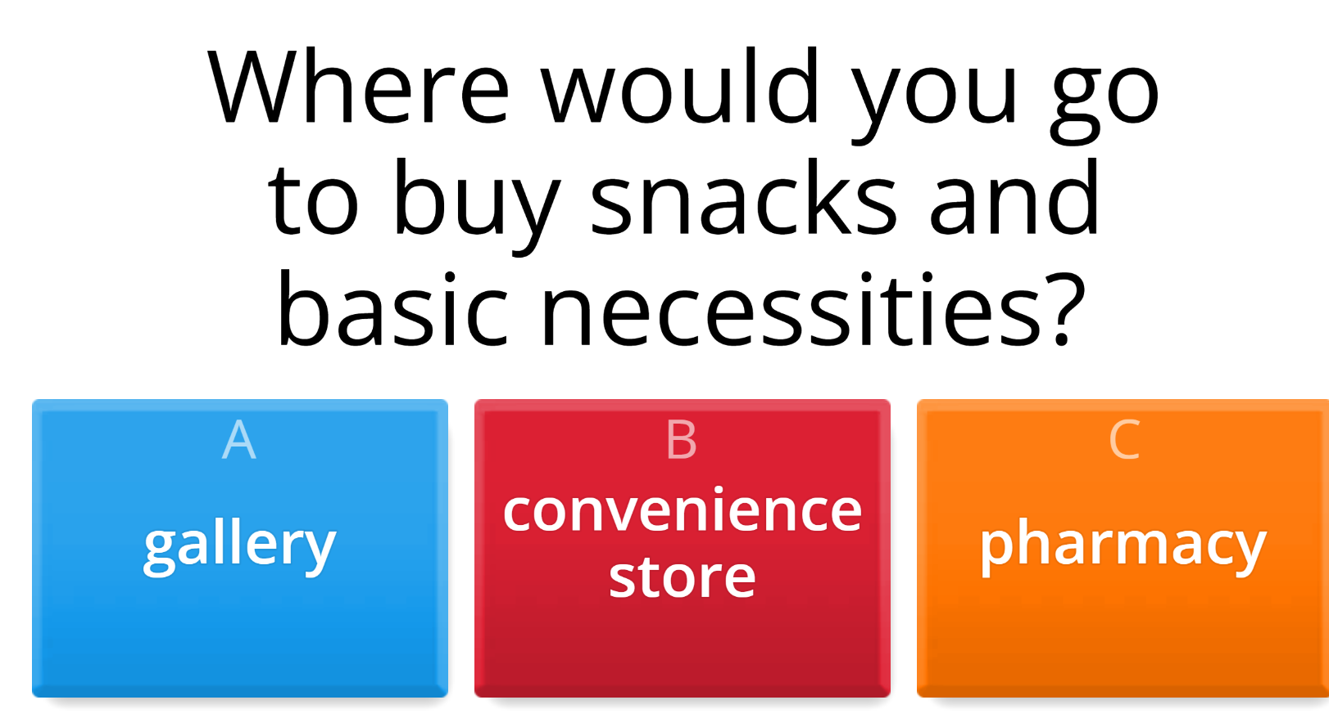

Click the circle and guess the words.
ONLINE GAME

Slide 3

Watch the vide and look at the way the boy is asking for direction.

Slide 4




LESSON 5
GRAMMAR

Slide 5


We can use could to make polite requests.
We can use it with Wh-words and with Wh-words + to-infinitives to ask indirect questions.
We use tell for information and show for instructions.
Could + you tell/show me + Wh-word + subject + verb?

Slide 6
Could you tell me when the mall opens?
Could you show me what room I'm staying in?
Could you tell me who the manager is?
Could you show me where the swimming pool is?
Could you tell me how much the train costs?

Slide 7
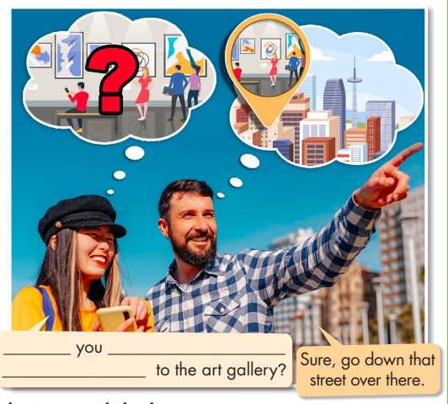

a. Read about could and wh-words before to-infinitives, then fill in the blanks
Could
show me how
to get

Slide 8
C. Write questions using the prompts.
1. Could/tell me/where/get/SIM card?
Could you tell me where to get a SIM card?
2. Could/tell me/where/nearest/restaurant is?
3. Could/show me/how/book/spa?
Could you tell me where the nearest restaurant is?
Could you show me how to book the spa?

Slide 9
C. Write questions using the prompts.
4. Could/tell me/how much/pay/the tour guide?
5. Could/show me/who/ask/about/booking/trip?
6. Could/tell me/when/gallery/open?
Could you tell me how much to pay the tour guide?
Could you show me who to ask about booking a trip?
Could you tell me when the gallery opens/will open?

Slide 10
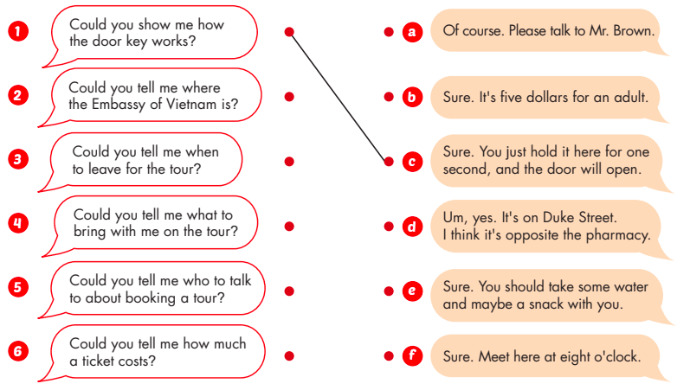
d. Match the questions to the responses.
1. c
2. d
3. f
4. e
5. a
6. b

Slide 11
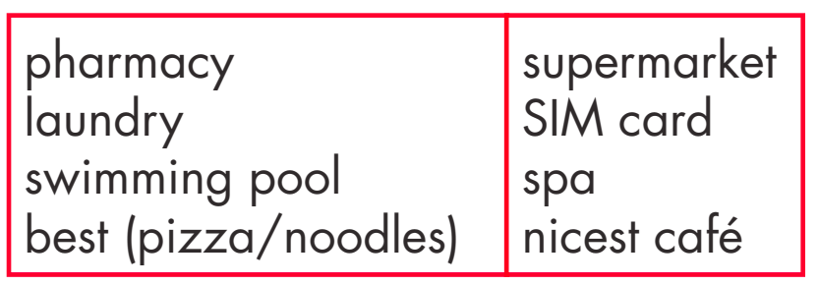
e. In pairs: Ask and answer questions about things in your town or city using could with wh-words.

Slide 12

e. In pairs: Ask and answer questions about things in your town or city using could with wh-words.
Could you tell me where the nearest pharmacy is?
B. : The nearest pharmacy is on Main Street, next to the bank.

Slide 13
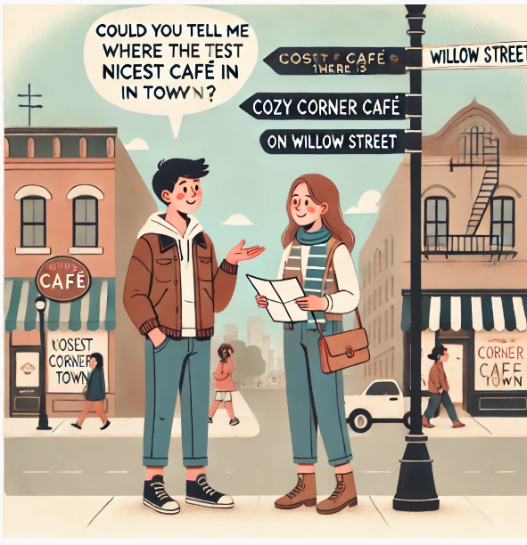
e. In pairs: Ask and answer questions about things in your town or city using could with wh-words.
A: Could you tell me where the nicest café in town is?
B: The nicest café in town is Cozy Corner Café on Willow Street.

Slide 14
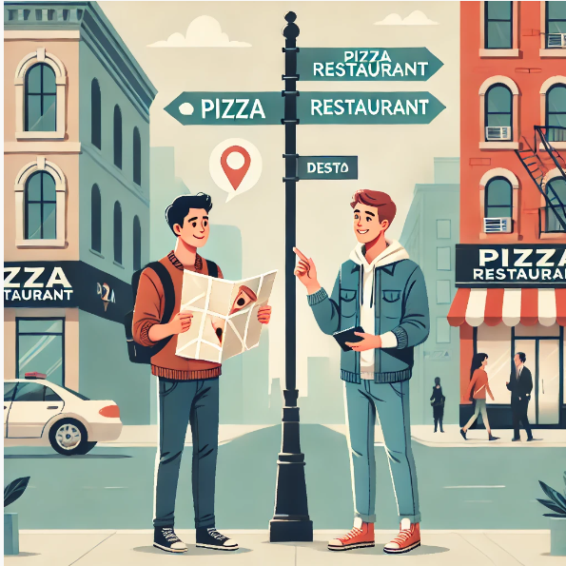
e. In pairs: Ask and answer questions about things in your town or city using could with wh-words.
A: Could you tell me where I can get the best pizza in town?
B: The best pizza in town is at Mario's Pizzeria on Oak Street.

Slide 15
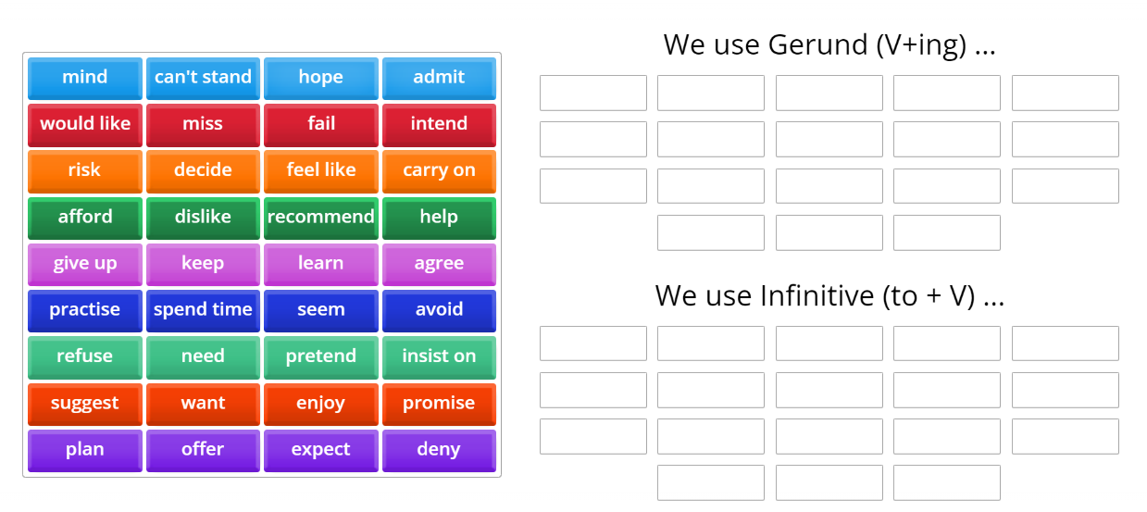
ONLINE GAME

Slide 16
WRAP-UP
Unit 4
TOURISM
Lesson 5:Grammar
Ms Phương
Zalo: 0966765064
-Grammar:
Practice and use Could and wh-words before to-infinitives
Speaking:
Make conversations about things in your town or city.

Slide 17

HOMEWORK
1. Review Could and wh-words before to-infinitives.
2. Prepare for the next lesson (Pronunciation & Speaking - pages 40 & 41 - SB)

Slide 18


