Slide 1


Slide 2
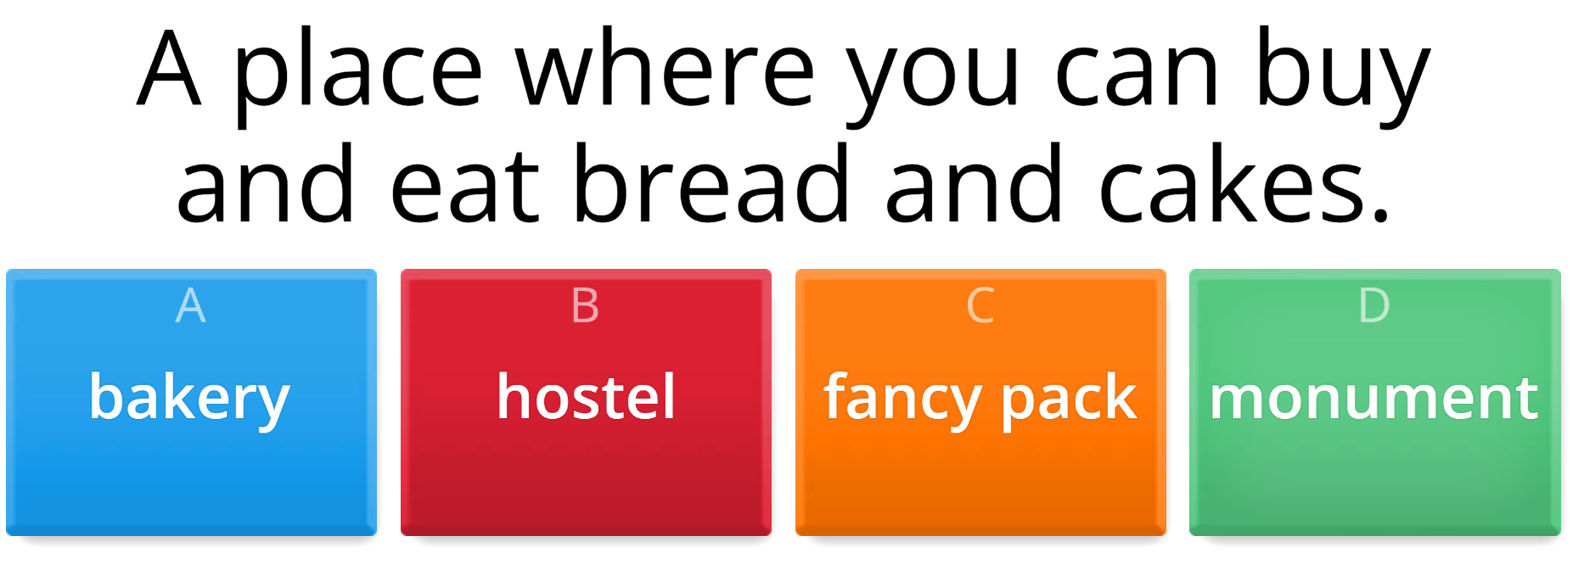

Click the circle and guess the words.
ONLINE GAME

Slide 3
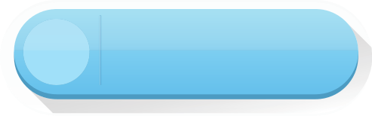



VOCABULARY
LESSON 4
LISTENING

Slide 4


pharmacy
(n) /ˈfɑːməsi/
Hiệu thuốc
I need to pick up my medicine from the pharmacy.

Slide 5
convenience store
(n) /kənˈviːniəns stɔː/
Cửa hàng tiện ích.
I bought snacks at the convenience store.

Slide 6
Sim card
(n) /sɪm kɑːd/
Sim điện thoại
I bought a new SIM card for my phone.

Slide 7
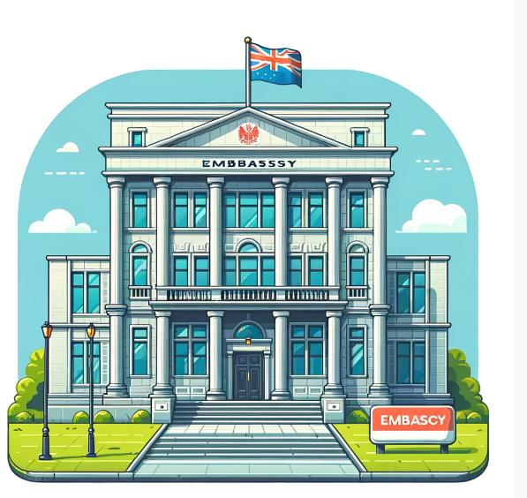
embassy
(n) /ˈembəsi/
Đại sứ quán.
I went to the embassy to apply for a visa.

Slide 8
top up
(v) /tɒp ʌp/
Nạp thêm, làm đầy
I need to top up my phone credit.

Slide 9
gallery
(n) /ˈɡæləri/
Triển lãm
The art gallery had many beautiful paintings.

Slide 10
Task a. Match the underlined words to the definitions. Listen and repeat.
a. I need to go to the pharmacy so that I can buy medicine.
b. If you get hungry at midnight, you can get a snack at the convenience store.
c. If you want to use your mobile phone in a foreign country, you need to buy a local SIM card.
d. If you have any big problems in another country, you can go to your country's embassy for help.
e. I made a lot of calls yesterday, so I need to top up my phone today. Can I borrow ten dollars?
f. Let's go to the gallery to look at some art.

Slide 11

b. Now listen and check
1. _ SIM card _____: a plastic card inside a smartphone that is needed to make local calls and stores information about the phone and the person using it
2. ______________: a small store that sells food, newspapers, etc. and has long opening hours
3. ______________: a store, or part of one, that sells medicine
4. ______________: a room or building for showing art, especially to the public
5. ______________: increase the amount of something to the level you want or need
6. ______________: an office that represents a country in another country, as well as the people who work there
Convenience store
Pharmacy
Gallery
Top up
Embassy

Slide 12
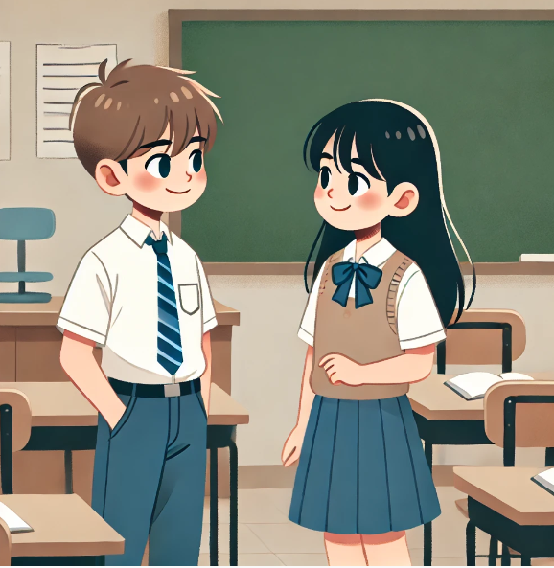
Task b. In pairs: Use the new words to talk about places or services that your town has.

Slide 13
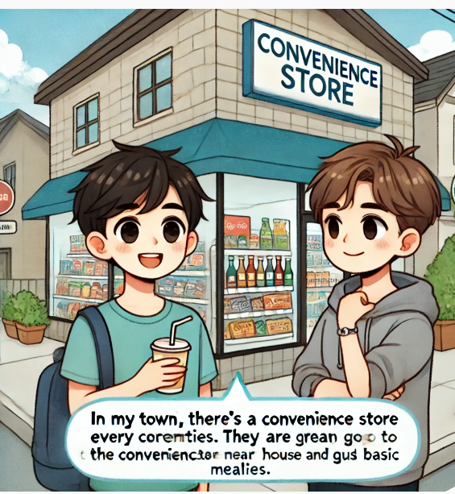
Suggested answer 1.
  Convenience Store
A: “In my town, there's a convenience store on every corner. They are great for picking up snacks and basic necessities”.
B: “Yes, I often go to the convenience store near my house to buy drinks and quick meals.”

Slide 14
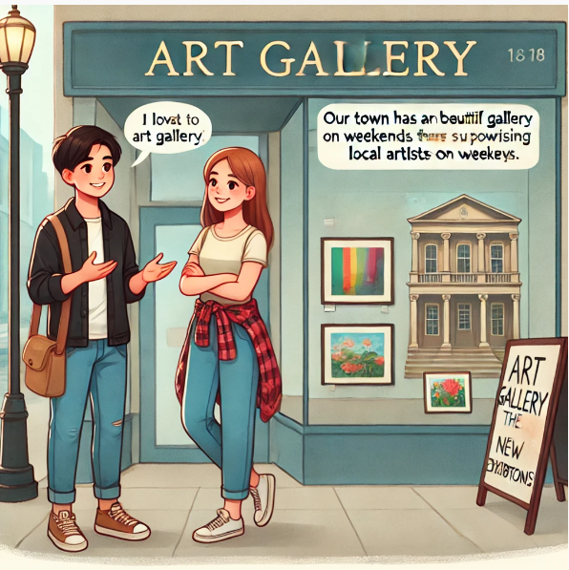
Suggested answer 2.
A: “Our town has a beautiful art gallery that showcases local artists' work.”
B: “I love visiting the gallery on weekends. They often have new exhibitions”.

Slide 15

Watch the video and say the information the tourists asking for.

Slide 16

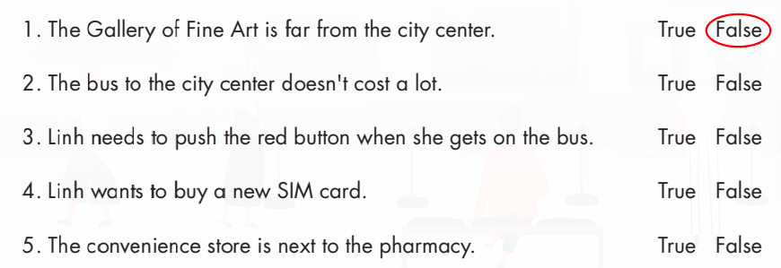
a. Listen to a teenage tourist asking for information and instructions. Where will she go first?
1. the gallery 2. the convenience store 3. the pharmacy
B. Now, listen and circle True or False.

Slide 17
Audio transcript
Linh: Excuse me?
Michael: Oh, hello.
Linh: I'm a bit lost. Could you tell me how to get to the Gallery of Fine Art?
Michael: Sure. It's pretty far from here. It's in the city center. You can take a bus there from here. It’s not too expensive.
Linh: I'm not sure I know how to use the bus here. Could you tell me how to do it?

Slide 18
Audio transcript
Michael: OK. You need to take the number ten bus. It goes downtown, near where the gallery is. Get on the bus, tell the driver where you want to go, and pay him. He will give you a ticket. Push the red button when you want to get off the bus.
Linh: Thank you! By the way, I need to buy a new SIM card. Could you tell me where to get one?
Michael: Sure. You can buy one at any convenience store.

Slide 19
Audio transcript
Linh: Great. Also, could you tell me where the nearest
convenience store is?
Michael: Sure. The nearest one is Timothy's. Turn left at
the traffic lights. It's opposite the pharmacy.
Linh: Thank you. Bye!
Michael: Enjoy the gallery!

Slide 20
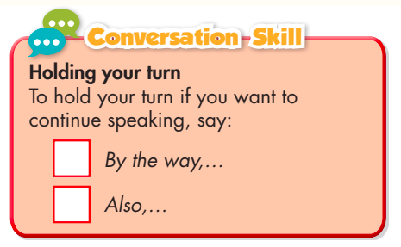
C. Read the Conversation Skill box, then listen and repeat.

Slide 21
In pairs: What other items do you think Linh will need to buy in Sacramento? Why?
What other items do you think Linh will need to buy in Sacramento? Why?
I think Linh will need to buy souvenirs here to keep her memories in Sacramento.

Slide 22
WRAP-UP
Unit 4
TOURISM
Lesson 4:Vocabulary and Listening.
Ms Phương
Zalo: 0966765064
Vocabularies
1. convenience store
2. embassy
3. gallery
4. pharmacy
5. SIM card
6. top up
Vocabulary:
- Learn and use vocabulary related to tourism.
Listening
- To practice listening for specific information.

Slide 23
Vocabulary Review
No | Word | Meaning
1
Pharmacy (n)
Hiệu thuốc
2
Convenience store (n)
Cửa hàng tiện ích
3
Embassy (n)
Đại sứ quán
4
Gallery (n)
Phòng triển lãm nghệ thuật
5
6
Sim card (n)
Sim điện thoại
7
Top up (n)
Sạc, nạp đầy

Slide 24
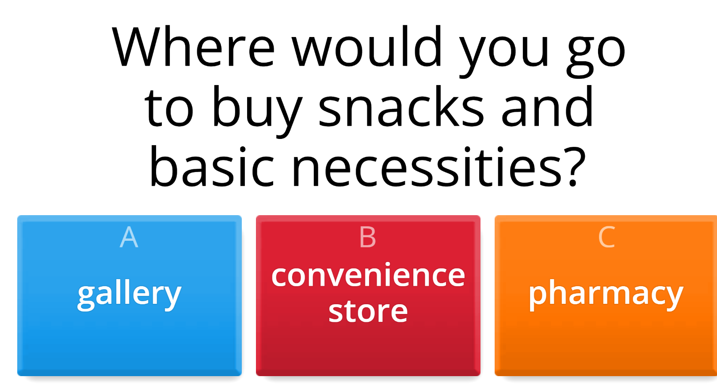
Click the circle and guess the words.
ONLINE GAME

Slide 25

HOMEWORK
1. Review vocabulary related to tourism.
2. Make sentences using the vocabulary in SB
3. Prepare for the next lesson (Grammar - pages 39 & 40 - SB)

Slide 26


