Slide 2
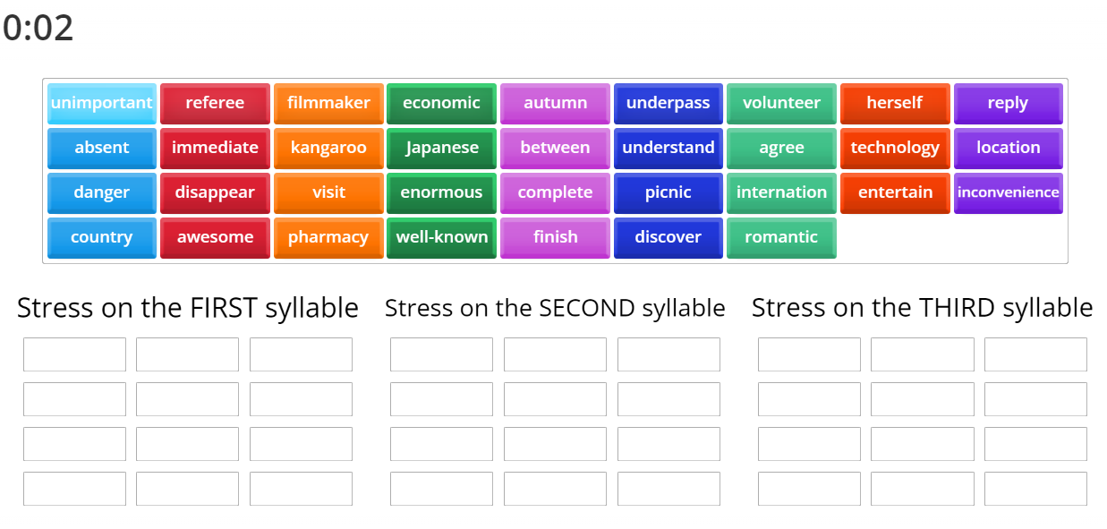
ONLINE GAME

Slide 3
PRONUNCIATION
LESSON 3
SPEAKING

Slide 4
Try to say aloud the words with right stress.
Central Park
Golden Gate
Grand Canyon
Eiffel Tower
Great Wall
Bondi Beach
Niagara Falls
Red Square
Mount Everest
Time Square

Slide 5
a. Stress the last word in proper nouns with two words.

Slide 6
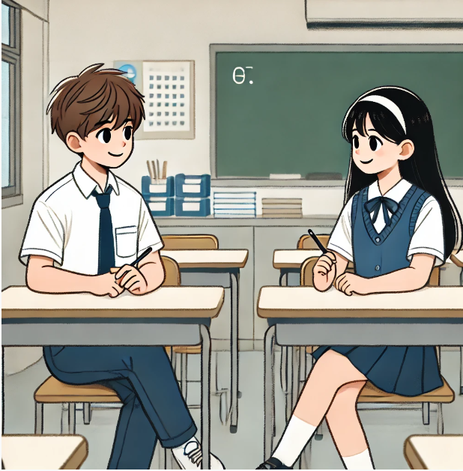
Read the words with the sentence stress noted in Task a. to a partner.
Effel Tower Central Park
Hyde Park National Monument
Opera House

Slide 7
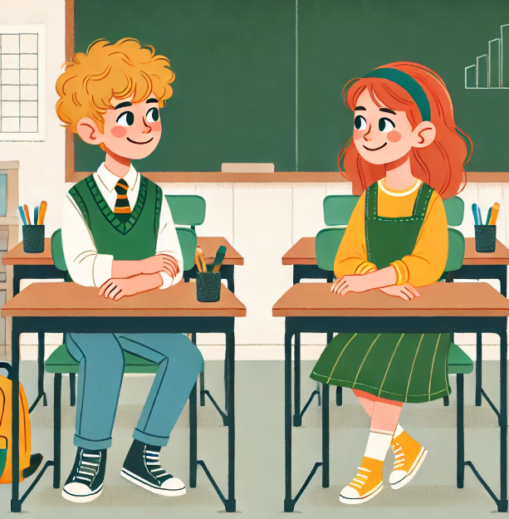
a. In pairs: Take turns reporting the suggestions.

Slide 8
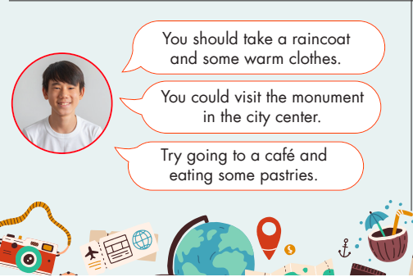

Slide 9
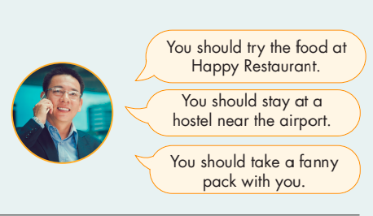
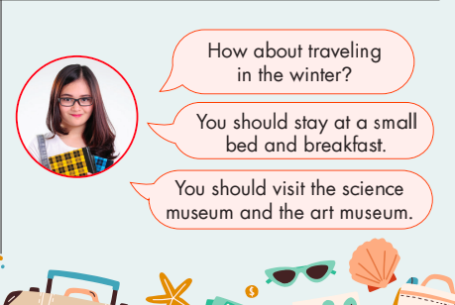

Slide 10
Some agreement phrases.
I completely agree with you.
That's a great point.
Absolutely, I think you're right.
I couldn't agree more.
That's exactly what I was thinking.
Yes, I see your point.
I totally agree with your perspective.
You're absolutely right.
I agree with that.
That's a very good point.
That’s good idea.

Slide 11
She said that I should travel between May and July.
She suggested that I visit Hyde Park.
She said that I should take a socket adapter.
That’s a good idea.

Slide 12
He said that I should take a raincoat and some warm clothes.
He suggested that I visit the monument in the city center.
He said that I should try going to a caffe and eating some pastries.
I couldn't agree more.

Slide 13
He said that I should try the food at Happy Restaurant.
He suggested that I stay at a hostel near the airport.
He said that I should take a fanny pack with me.
That's a great point.

Slide 14
She said that I should traveling in the winter.
She suggested that I stay at a small bed and breakfast.
She said that I should visit the science museum and the art museum.
You're absolutely right.

Slide 15
b. Use your own ideas to make similar suggestions to your partner about famous places in your country, then report your partner's suggestions to another student.
Suggested answer 1.
You should travel between February and April when the weather is cool and dry.
How about visiting Ha Long Bay? It's a UNESCO World Heritage site.
You should take a good camera to capture the beautiful landscapes.

Slide 16
b. Use your own ideas to make similar suggestions to your partner about famous places in your country, then report your partner's suggestions to another student.
Suggested answer 2.
You should try the local food in Hanoi, especially Pho and Bun Cha.
You should stay at a hotel near Hoan Kiem Lake for convenient access to many attractions.
You should take comfortable walking shoes to explore the Old Quarter.

Slide 17
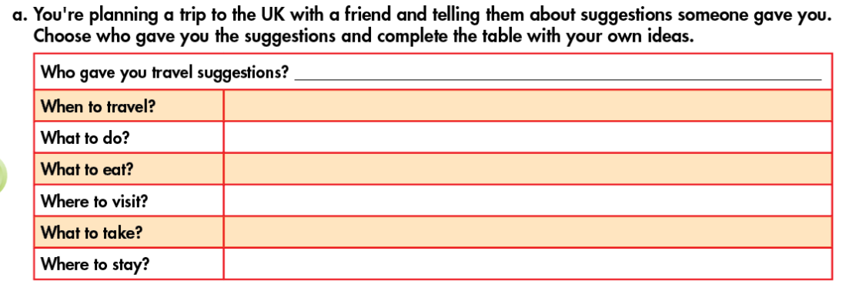
My English teacher
Spring or early Autumn for mild weather
visit historical landmarks like Buckingham Palace
try traditional English breakfast with bacon, eggs,…
explore the picturesque villages of the Cotswolds
comfortable walking shoes, umbrella, and a camera
stay in a cozy bed and breakfast in the countryside

Slide 18
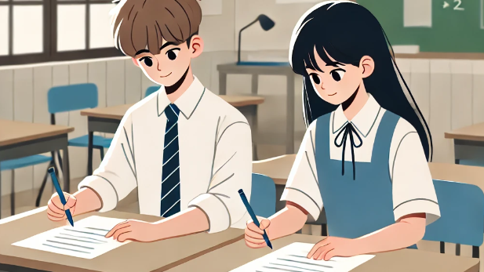
b. In pairs: Report and discuss the suggestions.

Slide 19
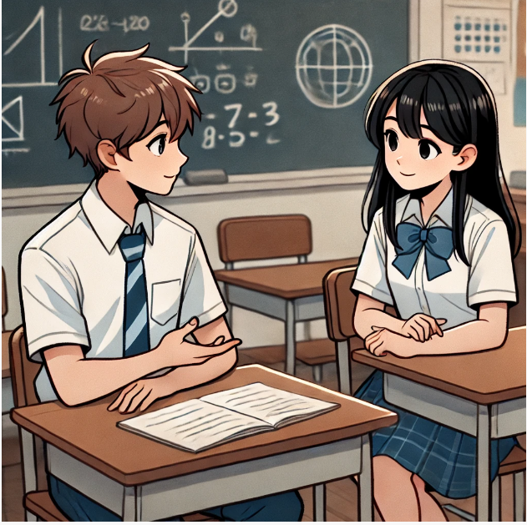
b. In pairs: Report and discuss the suggestions.
What month should we travel?
My English teacher said we should travel Spring or early Autumn for mild weather.

Slide 20
b. In pairs: Report and discuss the suggestions.
What places should we go to?
He suggested that we explore the picturesque villages of the Cotswolds.

Slide 21
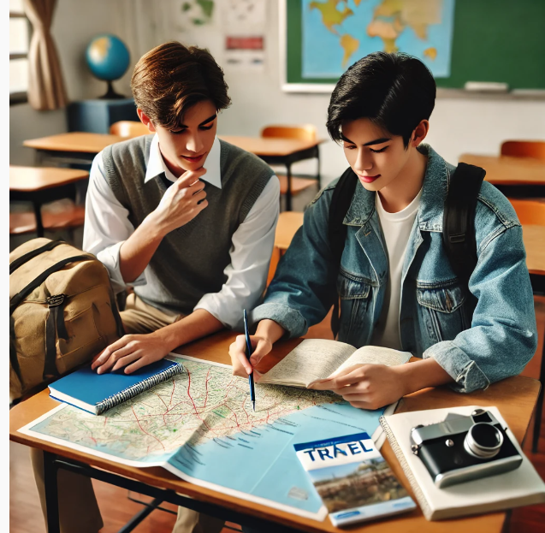
C. What do you think is the most important information to learn when planning a trip? Why?

Slide 22
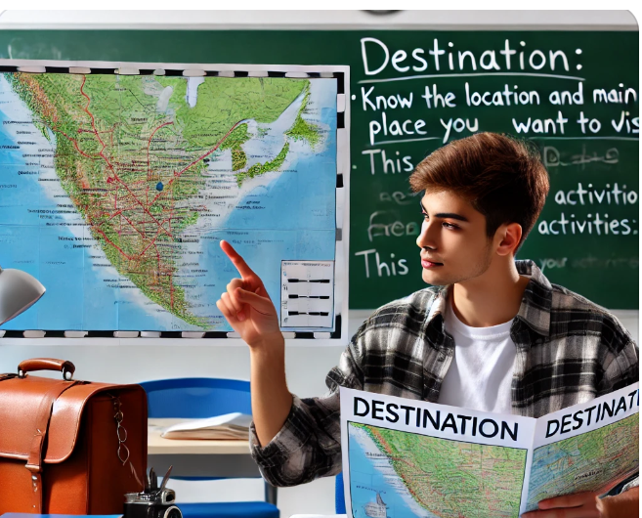
Destination: Know the location and main attractions of the place you want to visit. This helps you plan your activities.

Slide 23
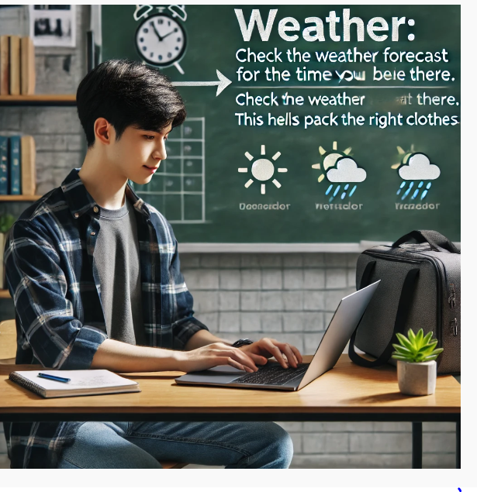
Weather: Check the weather forecast for the time you will be there. This helps you pack the right clothes.

Slide 24
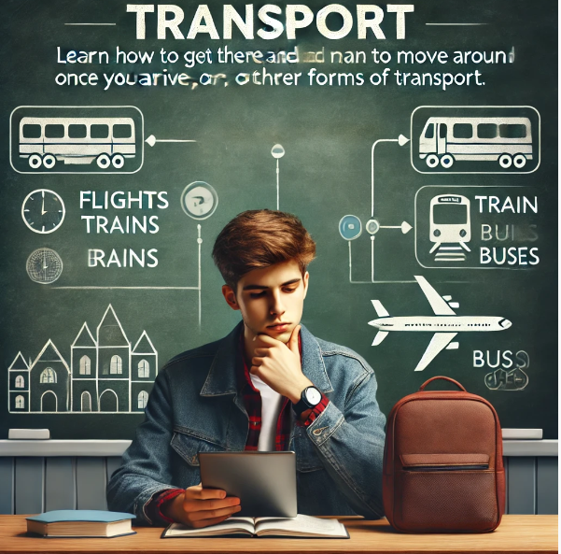
Transport: Learn how to get there and how to move around once you arrive. This includes flights, trains, buses, or other forms of transport.

Slide 25
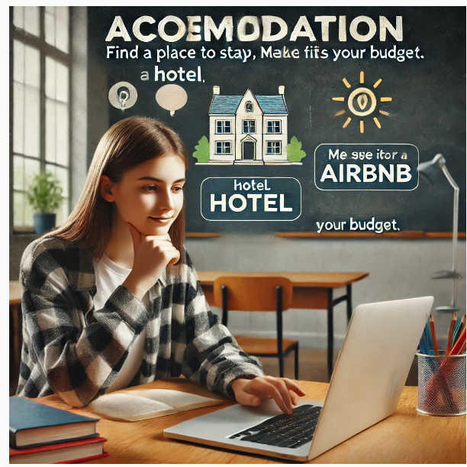
Accommodation: Find a place to stay, like a hotel or an Airbnb. Make sure it is in a good location and fits your budget.

Slide 26
WRAP-UP
Unit 4
TOURISM
Lesson 3:Pronunciation and speaking
Ms Phương
Zalo: 0966765064
-Pronunciation:
Practice stress the last word in proper nouns with two words.
Speaking:
Practice planning a vacation.

Slide 27
HOMEWORK
1. Practice sentence stress in the Pronunciation(SB).
2. Prepare for the next lesson (Vocabulary & Listening - pages 38 & 39 - SB).

