Slide 1


Slide 2
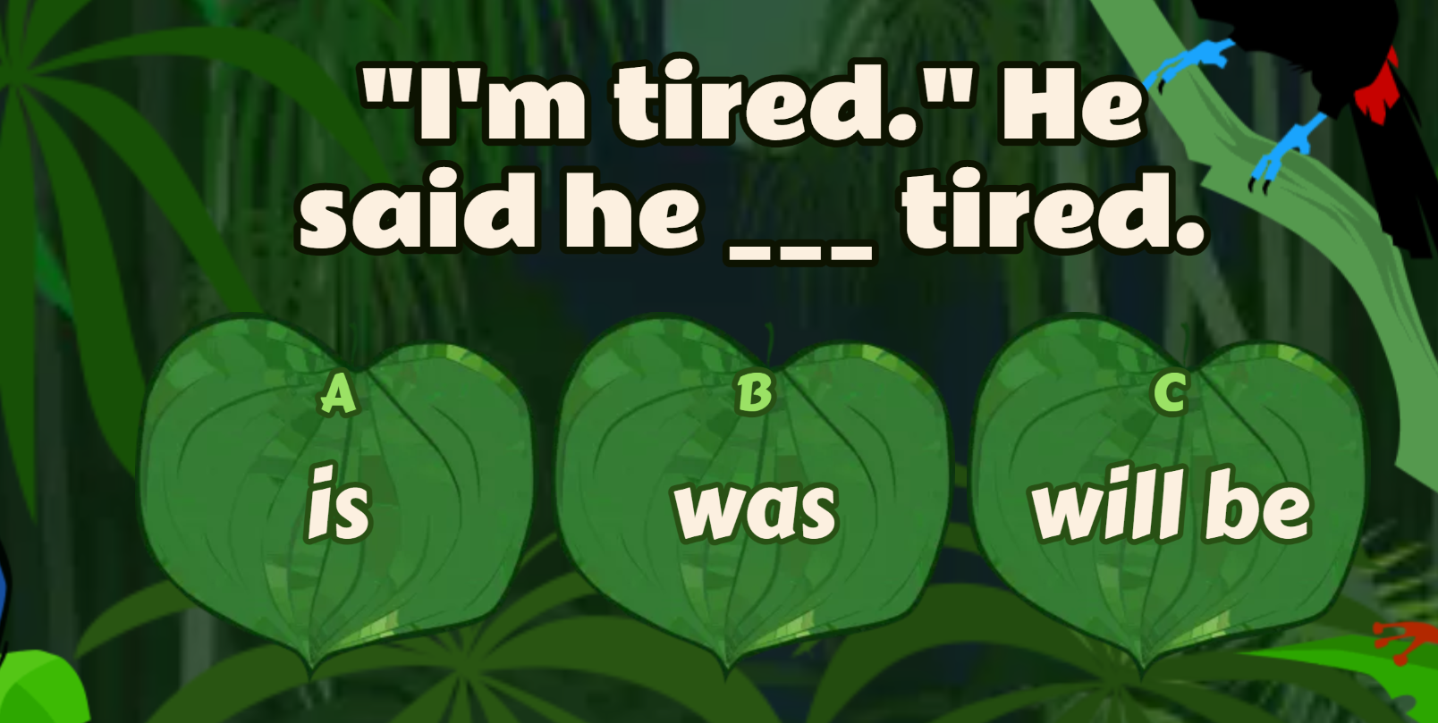

ONLINE GAME

Slide 3




LESSON 2
GRAMMAR

Slide 4




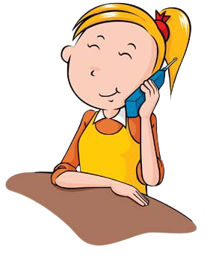
What did you do yesterday baby?
I’m fine! Thanks.
Hi, how are you David?
Mommy, I met David yesterday.
He said that he was fine!

Slide 5
What did he say?
I bought a new book for you yesterday.
He said he had bought a new book for me the day before.

Slide 6
What did he ask you?
Yes, I do
Do you like reading book?
He asked me
if I liked reading a book.

Slide 7
What did you ask him?
What’s your hobby, David?
I enjoy playing football.
I asked him
what’s his hobby was.

Slide 8


Topic:
REPORTED SPEECH

Slide 9
Direct speech
(Câu trực tiếp)
Indirect speech
(Câu gián tiếp)
I’m fine! Thanks.
He said that he was fine!
I bought a new book for you yesterday.
He said he had bought a new book
for me the day before.
Do you like reading book?
He asked me if I liked reading a book.
What’s your hobby, David?
I asked him what’s his hobby was.
DISCUSSION:
1. When should we use indirect speech?
2. Are the direct speech sentence and indirect speech the same?

Slide 10
We often use reported speech to:
1. Give someone a telephone message. (Gọi điện)
2. Tell someone news that we heard from someone else. (Kể câu chuyện được nghe từ ai nói)
3. To repeort something that happened earlier.
(Báo cáo những gì đã xảy ra trước đó.)

Slide 11
Cách đổi câu trực tiếp sang câu gián tiếp
1. Thay đổi đại từ NX
Direct speech
(Câu trực tiếp)
Indirect speech
(Câu gián tiếp)
I
We
You
He/she
They
I/ we
    Ex:
Peter said “ I am so hungry”
Peter said he was so hungry.

Slide 12
Cách đổi câu trực tiếp sang câu gián tiếp
2. Thay đổi tính từ sở hữu
Direct speech
(Câu trực tiếp)
Indirect speech
(Câu gián tiếp)
my
our
Your
Her/his
Their
My/our
    Ex:
    Mary said to me “ I met your mother yesterday’
    Mary said (that) she had met my mother the day before.

Slide 13
Cách đổi câu trực tiếp sang câu gián tiếp
3. Thay đổi tân ngữ
Direct speech
(Câu trực tiếp)
Indirect speech
(Câu gián tiếp)
me
us
You
Her/him
Them
Me/us
    Ex:
He said to me “ I will give you the book”
He said he would give me the book.

Slide 14
Cách đổi câu trực tiếp sang câu gián tiếp
4. Quy tắc lùi thì của V
Direct speech
(Câu trực tiếp)
Indirect speech
(Câu gián tiếp)
Present simple (HTĐ)
Present continuous (HTTD)
Present perfect (HTHT)
Past simple (QKD)
Past continuous (QKTD)
Past perfect (QKHT)
Past simple (QKTĐ)
Past continuous (QKTD)
Past perfect (QKHT)
Past perfect (QHT)
Past perfect continuous (QKHTTD)
Past perfect (QKHT)

Slide 15

4. Quy tắc lùi thì của V
Direct speech
(Câu trực tiếp)
Indirect speech
(Câu gián tiếp)
Present simple (HTĐ)
Present continuous (HTTD)
Present perfect (HTHT)
Past simple (QKD)
Past continuous (QKTD)
Past perfect (QKHT)
Past simple (QKTĐ)
Past continuous (QKTD)
Past perfect (QKHT)
Past perfect (QHT)
Past perfect continuous (QKHTTD)
Past perfect (QKHT)
    Ex:
He said “I always wear a cap”.
He said he always wore a cap.

Slide 16
4. Quy tắc lùi thì của V
Direct speech
(Câu trực tiếp)
Indirect speech
(Câu gián tiếp)
Present simple (HTĐ)
Present continuous (HTTD)
Present perfect (HTHT)
Past simple (QKD)
Past continuous (QKTD)
Past perfect (QKHT)
Past simple (QKTĐ)
Past continuous (QKTD)
Past perfect (QKHT)
Past perfect (QHT)
Past perfect continuous (QKHTTD)
Past perfect (QKHT)
    Ex:
She said “I am looking for my keys”.
She said she was looking for her keys.

Slide 17
4. Quy tắc lùi thì của V
Direct speech
(Câu trực tiếp)
Indirect speech
(Câu gián tiếp)
Present simple (HTĐ)
Present continuous (HTTD)
Present perfect (HTHT)
Past simple (QKD)
Past continuous (QKTD)
Past perfect (QKHT)
Past simple (QKTĐ)
Past continuous (QKTD)
Past perfect (QKHT)
Past perfect (QHT)
Past perfect continuous (QKHTTD)
Past perfect (QKHT)
    Ex:
She said “He has written three letters to her friend.
She said he had written three letters to her friend.

Slide 18
4. Quy tắc lùi thì của V
Direct speech
(Câu trực tiếp)
Indirect speech
(Câu gián tiếp)
Present simple (HTĐ)
Present continuous (HTTD)
Present perfect (HTHT)
Past simple (QKD)
Past continuous (QKTD)
Past perfect (QKHT)
Past simple (QKTĐ)
Past continuous (QKTD)
Past perfect (QKHT)
Past perfect (QHT)
Past perfect continuous (QKHTTD)
Past perfect (QKHT)
    Ex:
Mary said: “My friend gave me a bar of chocolate”.
Mary said that her friend had given her a bar of chocolate.

Slide 19
4. Quy tắc lùi thì của V
Direct speech
(Câu trực tiếp)
Indirect speech
(Câu gián tiếp)
Present simple (HTĐ)
Present continuous (HTTD)
Present perfect (HTHT)
Past simple (QKD)
Past continuous (QKTD)
Past perfect (QKHT)
Past simple (QKTĐ)
Past continuous (QKTD)
Past perfect (QKHT)
Past perfect (QHT)
Past perfect continuous (QKHTTD)
Past perfect (QKHT)
    Ex:
“He was playing football when I came”.
She said he had been playing football when she had come.

Slide 20
4. Quy tắc lùi thì của V
Direct speech
(Câu trực tiếp)
Indirect speech
(Câu gián tiếp)
Present simple (HTĐ)
Present continuous (HTTD)
Present perfect (HTHT)
Past simple (QKD)
Past continuous (QKTD)
Past perfect (QKHT)
Past simple (QKĐ)
Past continuous (QKTD)
Past perfect (QKHT)
Past perfect (QKHT)
Past perfect continuous (QKHTTD)
Past perfect (QKHT)
    Ex:
He said that “I had gone when she came”
He said that he had gone when she had come.

Slide 21
Cách đổi câu trực tiếp sang câu gián tiếp
5. Thay đổi V khuyết thiếu
Direct speech
(Câu trực tiếp)
Indirect speech
(Câu gián tiếp)
Will
Can
May
Shall
Must
Would
Could
Might
Should
Must/ Hadto
    Ex:
She said “ I will tell him”
She said he would tell him.

Slide 22
Cách đổi câu trực tiếp sang câu gián tiếp
6. Thay đổi trạng từ chỉ thời gian/nơi chốn
Direct speech
(Câu trực tiếp)
Indirect speech
(Câu gián tiếp)
Yesterday
Tomorrow
Now
Today /Tonight
Last week
Ago
Next week
This / These
The day before/ the previous day
The following day/ the next day
Then
That day/ that night
The week before/ the previous week
Before
The following week/ the next week
That/ those

Slide 23
Summary
Direct speech
(Câu trực tiếp)
Indirect speech
(Câu gián tiếp)
1.
Đổi đại từ, tính từ sở hữu, tân ngữ cho phù hợp.
  2.
  Lùi thì của V.
  3.
  Thay đổi trạng từ chỉ thời gian/nơi chốn.

Slide 24



REPORTED SPEECH
QUESTIONS
STEP BY STEP

Slide 25
Reporting questions is very similar to reporting statements
We change references to people, places and times as well… but there are some differences.
“What are you doing?” Tom asked.
Tom
asked (me)
what
I
was doing
.
We place the question-word after the reporting verb.
We now place the SUBJECT before the verb (“are”) because the word order is the same as in statements:
(subject + verb).
Now we place the VERB(S) in a past tense after the SUBJECT.
DON’T FORGET! Reported questions are like statements, so we DO NOT NEED the question mark (?). Also remove the inverted commas again.

Slide 26
Let’s report yes/no questions now.
There is a small difference between these questions and wh-questions.
“Will you be here?” Tom asked.
Tom asked (me) if I would be there.
Instead of a question-word we now use
“if” (or “whether”)

Slide 27
Reporting questions with “do”
Let’s see what happens if the question has the auxiliary verb “do” in the present.
“Where do they come from?” Tom asked.
Tom asked (me) where they came from.
Reported questions are like positive statements, so we DO NOT NEED the auxiliary verb “do”.
In this case “do” is present so we change the main verb (“come”) into the Past Simple.

Slide 28
Reporting questions with “do”
Let’s see what happens if the question has the auxiliary verb “do” in the past.
“Did you see Jane?” Tom asked.
Tom asked (me) if I had seen Jane.
Again we DO NOT NEED the auxiliary verb “do”.
In this case “did” is past so we change the main verb (“see”) into the Past Perfect: had + past participle.

Slide 29
WORD ORDER in reported questions
“How fast can you run?” Tom asked.
Tom asked (me) how fast I could run.
Speaker + reporting verb + question word + S + verb(s)
(past) (or “if) (past)

Slide 30











3
Direct Question : “Are you tired?”
1
Turn to Indirect Question
Indirect Question: I wonder if you are tired.
2
Turn into Reported Speech.
Reported Question: He asked if I was tired.

Slide 31


DIRECT QUESTIONS
Question Word
Auxiliary Verb or Modal
Subject
Main
Verb
…..?
do / does
did
will
Who
What
Where
How
When
Why
etc
my friend
he
teachers
my new phone
we
coffee
wild animals
you
etc
or
V 1
am / is / are
was / were
or
V + ing
have / has
had
V 3
DIRECT QUESTIONS

Slide 32

INDIRECT QUESTIONS
Introductory
Verb / question
Subject
affirmative
verb form
.(?)
Question Word / IF
like/ likes
came
will find
who
what
Where
how
when
why
if
etc
or
my friend
he
teachers
my phone
we
coffee
wild animals
you
etc
He asked
She wondered
Could you tell me (?)
etc
am / is / are
was / were
V + ing
or
have / has
had
V 3
INDIRECT QUESTIONS

Slide 33
INDIRECT QUESTIONS
Introductory
Verb / question
Subject
affirmative
verb form
.(?)
Question Word / IF
like/ likes
came
will find
who
what
Where
how
when
why
if
etc
or
my friend
he
teachers
my phone
we
coffee
wild animals
you
etc
He asked
She wondered
Could you tell me (?)
etc
am / is / are
was / were
V + ing
or
have / has
had
V 3
INDIRECT QUESTIONS

Slide 34

a
Use an Intro verb in the past.
asked
wondered
wanted to know
etc
b
Move the indirect question one step backwards in time.

Slide 35



Reported Speech – past intro verb
Direct | Reported
“Do you know?” | I asked him
“Where are you going?” | He asked her
“Did you believe me?” | I wanted to know
“How are you?” | He asked me
“Is Ann sleeping?” | I asked
“Were you watching TV?” | He asked
“Can they come?” | I wondered
“Who did you meet?” | They asked me
“Did Mary go?” | She asked
“Will you go?” | They asked me
if he knew
where she was going
if you had believed me
how I was
if Ann was sleeping
if I had been watching TV
if they could come
who I had met
whether Mary had gone.
whether I would go.

Slide 36

Reported Speech – past intro verb
Direct |  | Reported
...where does Anna live..?
tomorrow
are working
Did they come..? |  | whether
will forget
can train
Tom expected
is going to take
Who is Jo waiting for?
this dog
where Anna lived
the next/following day
were working
they had come
would forget
could train
Tom had expected
was going to take
.. who Jo was waiting for
the dog / that dog

Slide 37


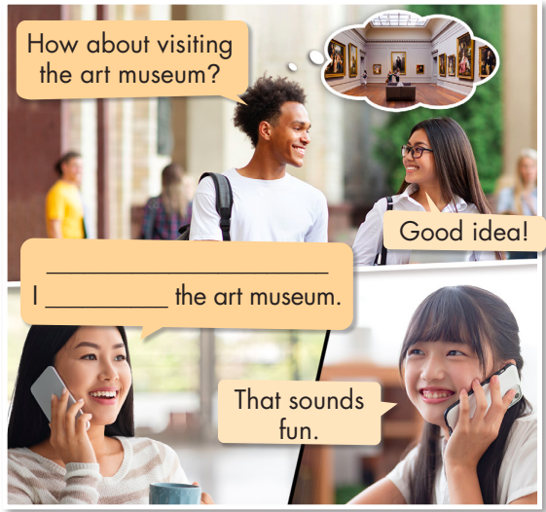
a. Read about reported speech, then fill in the blanks.
He suggested
Presentation
visit

Slide 38
REPORTED SPEECH
suggested (that) + subject + bare infinitive
Ex: "Why don't you travel in July?" Sally said to me.
=> Sally suggested (that) I go in July.
Presentation

Slide 39
REPORTED SPEECH
said (that) + subject + should/shouldn't + bare infinitive (if the suggestion has should )
Ex: "You should try the dumplings at Presgo," Adam said to us.
Adam said (that) we should try the dumplings at Presgo.
Presentation

Slide 40
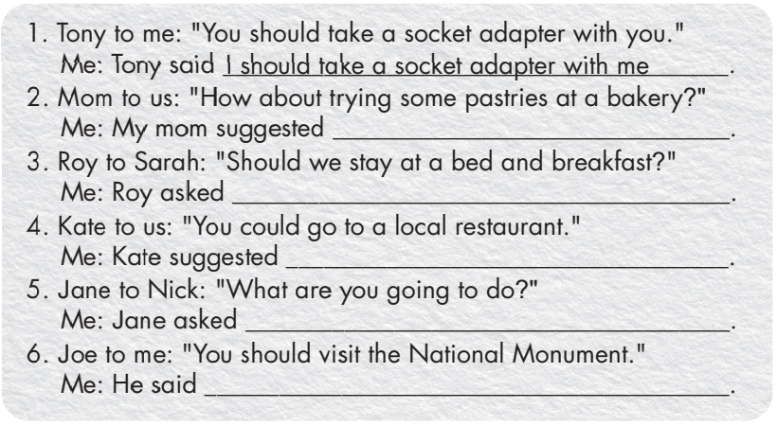
C. Complete the sentences to report what these people said.
Presentation

Slide 41
C. Complete the sentences to report what these people said.
2. Mom to us: "How about trying some pastries at a bakery?"
Me: My mom suggested ________________________________.
3. Roy to Sarah: "Should we stay at a bed and breakfast?"
Me: Roy asked ________________________________________.
4. Kate to us: "You could go to a local restaurant."
Me: Kate suggested ___________________________________.
(that) we try some pastries at the bakery
Sarah if/whether they should stay at a bed and
breakfast
(that) we go to a local restaurant

Slide 42
C. Complete the sentences to report what these people said.
5. Jane to Nick: "What are you going to do?"
Me: Jane asked_______________________________________.
6. Joe to me: "You should visit the National Monument."
Me: He said __________________________________________.
Nick what he was going to do
(that) I should visit the National Monument

Slide 43
d. Report what these people said.
Brother to us: "You should take a fanny pack to Hanoi.”
=> My brother said we should take a fanny pack to Hanoi.
2. Sister to me: "Try the dumplings at Jumbo’s.”
3. Mary to us: "You should stay at a hostel in Phú Quốc.”
4. Tom to me: "Is there a Vietnamese restaurant nearby?”
5. Kate to John: "What time does the train leave?”
6. Father to me: "We need to buy some sunblock."
7. Bill to me and Tom: "What do you want to try?"

Slide 44
d. Report what these people said.
2. Sister to me: "Try the dumplings at Jumbo’s.”
3. Mary to us: "You should stay at a hostel in Phú Quốc.”
4. Tom to me: "Is there a Vietnamese restaurant nearby?”
=> My sister suggested (that) we eat dumplings at Jumbo's.
=> Mary said (that) we should stay at a hostel in Phú Quốc.
=> Tom asked me if/whether there was a Vietnamese restaurant nearby.

Slide 45
d. Report what these people said.
5. Kate to John: "What time does the train leave?”
6. Father to me: "We need to buy some sunblock.”
7. Bill to me and Tom: "What do you want to try?”
=> Kate asked Tom what time the train left.
=> My father said to me/told me (that) we needed to buy some sunblock.
=> Bill asked us what we wanted to try.

Slide 46
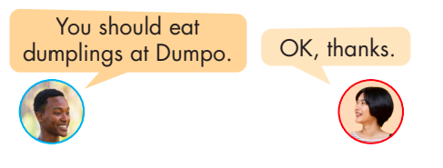
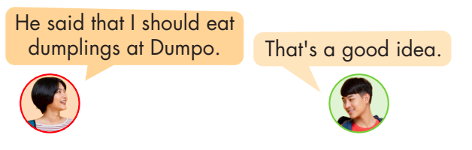
e. In groups of three: Take turns suggesting places to go and things to do in your town, then report them to the other group members

Slide 47

e. In groups of three: Take turns suggesting places to go and things to do in your town, then report them to the other group members
Student A: "You should visit the local museum."
Student B: "OK, thanks."
Student B : He said that I should visit the local museum.
Student C: "That's a good idea."

Slide 48
e. In groups of three: Take turns suggesting places to go and things to do in your town, then report them to the other group members
Student B: "You should try the pizza at Bella's."
Student C: "OK, I'll check it out."
Student C reporting: She said that I should try the pizza at Bella's.
Student A: "Sounds delicious!"

Slide 49
e. In groups of three: Take turns suggesting places to go and things to do in your town, then report them to the other group members
Student C: "You should walk in the central park."
Student A: "Great, I'll do that."
Student A: He said that I should walk in the central park.
Student B: "Nice, it's a beautiful place."

Slide 50
WRAP-UP
Unit 4
TOURISM
Lesson 2:Grammar
Ms Phương
Zalo: 0966765064
-Learn how to use reported speech to report what someone said.
Practice suggesting places to go and things to do when travelling.

Slide 51


Slide 52


