Slide 1

Unit 5: Healthy Living
Lesson 2.1: Vocab & Listening
Pages 48 & 49

Slide 2
Lesson Outline
Warm-up
Vocabulary
Listening
Consolidation
Wrap-up

Slide 3

By the end of this lesson, students will be able to…
use new words to describe health problems
practice listening for the main idea and specific information.

Slide 4

WARM-UP

Slide 5
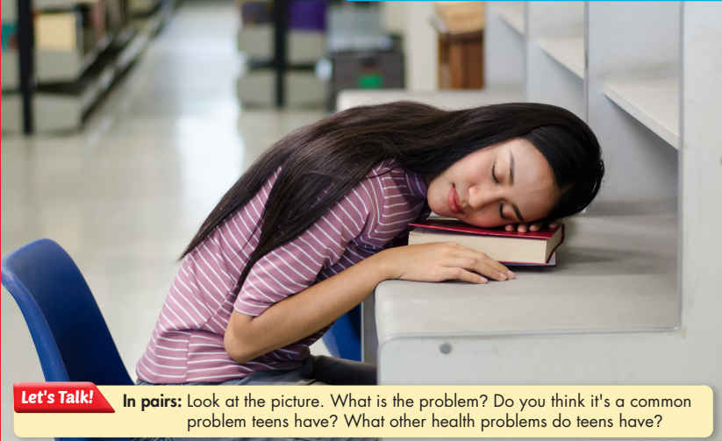

Slide 6
Suggested answers:
She doesn’t get enough sleep and feels tired at school.
It’s a common problem teens have recently.
Other health problems that teens have:
Eating too much fast food or junk food
Addicting to online games
Sleeping late
Skipping meals

Slide 7



Slide 8



Task a
Match the underlined words to the definitions. Listen and repeat.
1. _________: (of people) very fat, in a way that is not healthy 2. _________: (of food or drink) helping a person, an animal, or a plant to grow and be healthy 3. _________: a place for eating at school – you choose and pay for your food before you eat it 4. _________: the possibility of something bad happening
obese
nourishing
cafeteria
risk

Slide 9
Task a
Match the underlined words to the definitions. Listen and repeat.
5. _________: help something to happen or improve 6. _________: unable to stop using or doing something, especially something harmful 7. _________: the ability to use or get something 8. _________: make something continue in the same way or stay the same
promote
addicted
access
maintain

Slide 10
Listen and repeat. Click on each phrase to hear the sound.
promote (v) / prəˈmoʊt / xúc tiến
access (n) / ˈækses / cơ hội sử dụng cái gì
risk (n) / rɪsk / rủi ro
maintain (v) / meɪnˈteɪn / duy trì
addicted (adj) / əˈdɪktɪd / nghiện
obese (adj) / oʊˈbiːs / béo phì
nourishing (adj) / ˈnɝːɪʃɪŋz / bổ dưỡng
cafeteria (n) / ˌkæfəˈtɪriə / quán ăn tự phục vụ
Notes:
GV click vào từng cụm nghe âm thanh

Slide 11


Task b
In pairs: Use the new words to talk about things that people are addicted to, what things people should have access to, and what things we should promote at school.
People are often addicted to online games.
People should have access to fresh food.

Slide 12
Suggested answer
People are often addicted to online games.
People should have access to fresh food.
We should promote sports at school.

Slide 13


Slide 14
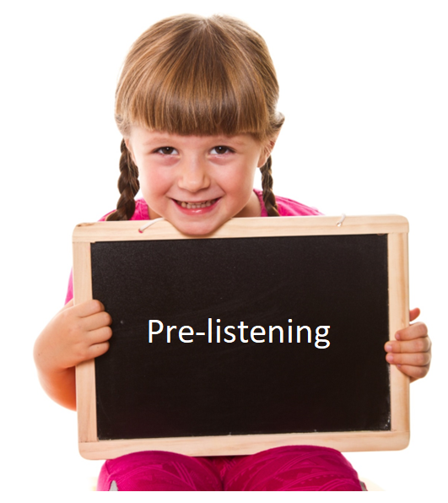
Pre-reading

Slide 15

Pre-listening
Task a
Listen to people talking about teens' health problems. Who are the participants?
A doctor and some teachers
A doctor and some parents
Dr. Elizabeth Anderson ➔ a doctor
Ms. Miller ➔ teacher

Slide 16
Pre-listening
Task b
Now, listen and fill in the blank.
1. Most teens don't get enough sleep and only get _____________________ hours of sleep a night. 2. Teens naturally fall asleep after ________________. 3. _____________________ should start later, and there should be time for naps.
six to seven
11 p.m.
School

Slide 17
Pre-listening
Task b
Now, listen and fill in the blank.
4. More teens are becoming ___________________. 5. Although doctors teach the public about the dangers of _____________________, not everyone knows about them. 6. Teens should have access to ______________ and healthy snacks.
obese
sugar
nourishing lunch

Slide 18
Script
Ms. Miller: Hello, everyone. Today I invited Dr. Elizabeth Anderson to talk about two important health problems teens have. Dr. Anderson: Hi, everyone. Thanks for inviting me here. The first problem is not getting enough sleep. Although teens need eight to ten hours of sleep a night, most only get six to seven. Schools often start too early for teens. They naturally go to bed late, after 11 p.m., and can't get enough sleep.

Slide 19
Script
Ms. Miller: So, schools should start later?
Dr. Anderson: If possible. You can also include nap time in the school day.
Ms. Miller: Right.
Dr. Anderson: Next is unhealthy weight. More teens are becoming obese these days. Although they already know the benefits of healthy diets, most teens still prefer a pizza over a salad. They also drink lots of soda. Although we teach the public about the dangers of sugar, not everyone knows about them.
Mr. Smith: What can we do?

Slide 20
Script
Dr. Anderson: You can help by having nourishing lunches at school, giving students more access to healthy snacks in the cafeteria, and stop selling junk food and soda.
Ms. Miller: All right. Thanks for your talk, Dr. Anderson. That's all for today. Thank you for your time.

Slide 21

While-listening

Slide 22

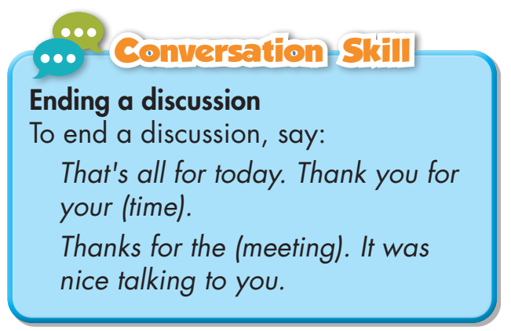
While-listening
Task c
Read the Conversation Skill box, then listen and repeat.

Slide 23
While-listening
Task d
Now, listen to the conversation again and circle the phrase that you hear .
Ms. Miller: All right. Thanks for your talk, Dr. Anderson. That's all for today. Thank you for your time.

Slide 24
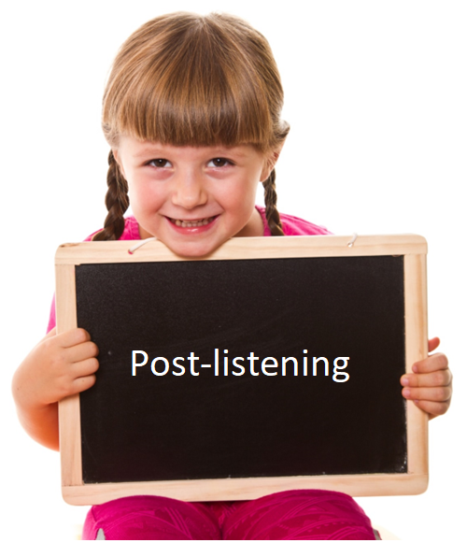
Post-reading

Slide 25
Post-listening
Task e
In pairs: Do you have any of the problems Dr. Anderson talked about? What other health problems do you have?
Suggested answers:
Yes, I do. I usually don’t get enough sleep, so I always feel sleepy during daytime. I do have a busy schedule every day so I keep skipping meals. I know this habit is harmful to my body and always makes me feel under the weather.

Slide 26

CONSOLIDATION

Slide 27

WRAP-UP

Slide 28

Today’s lesson
Vocabularies
1. obese 2. nourishing 3. cafeteria 4. risk 5. promote 6. addicted 7. access 8. maintain

Slide 29
Today’s lesson
Vocabulary:
- Using new words to describe health problems.
Listening:
- Listening for the main idea and specific information.

Slide 30
Homework
Do Vocabulary and Listening in WB pages 28 & 29
Make sentences using the new words in SB
Prepare for the next lesson (Grammar - pages 49 & 50 - SB)
Play the consolidation games on www.eduhome.com.vn

Slide 31

Lesson 3
Stay positive and have a nice day!

