Slide 1







WELCOME TO OUR CLASS
Teacher: Dương Thị Kim

Slide 2

WARM-UP

Slide 3
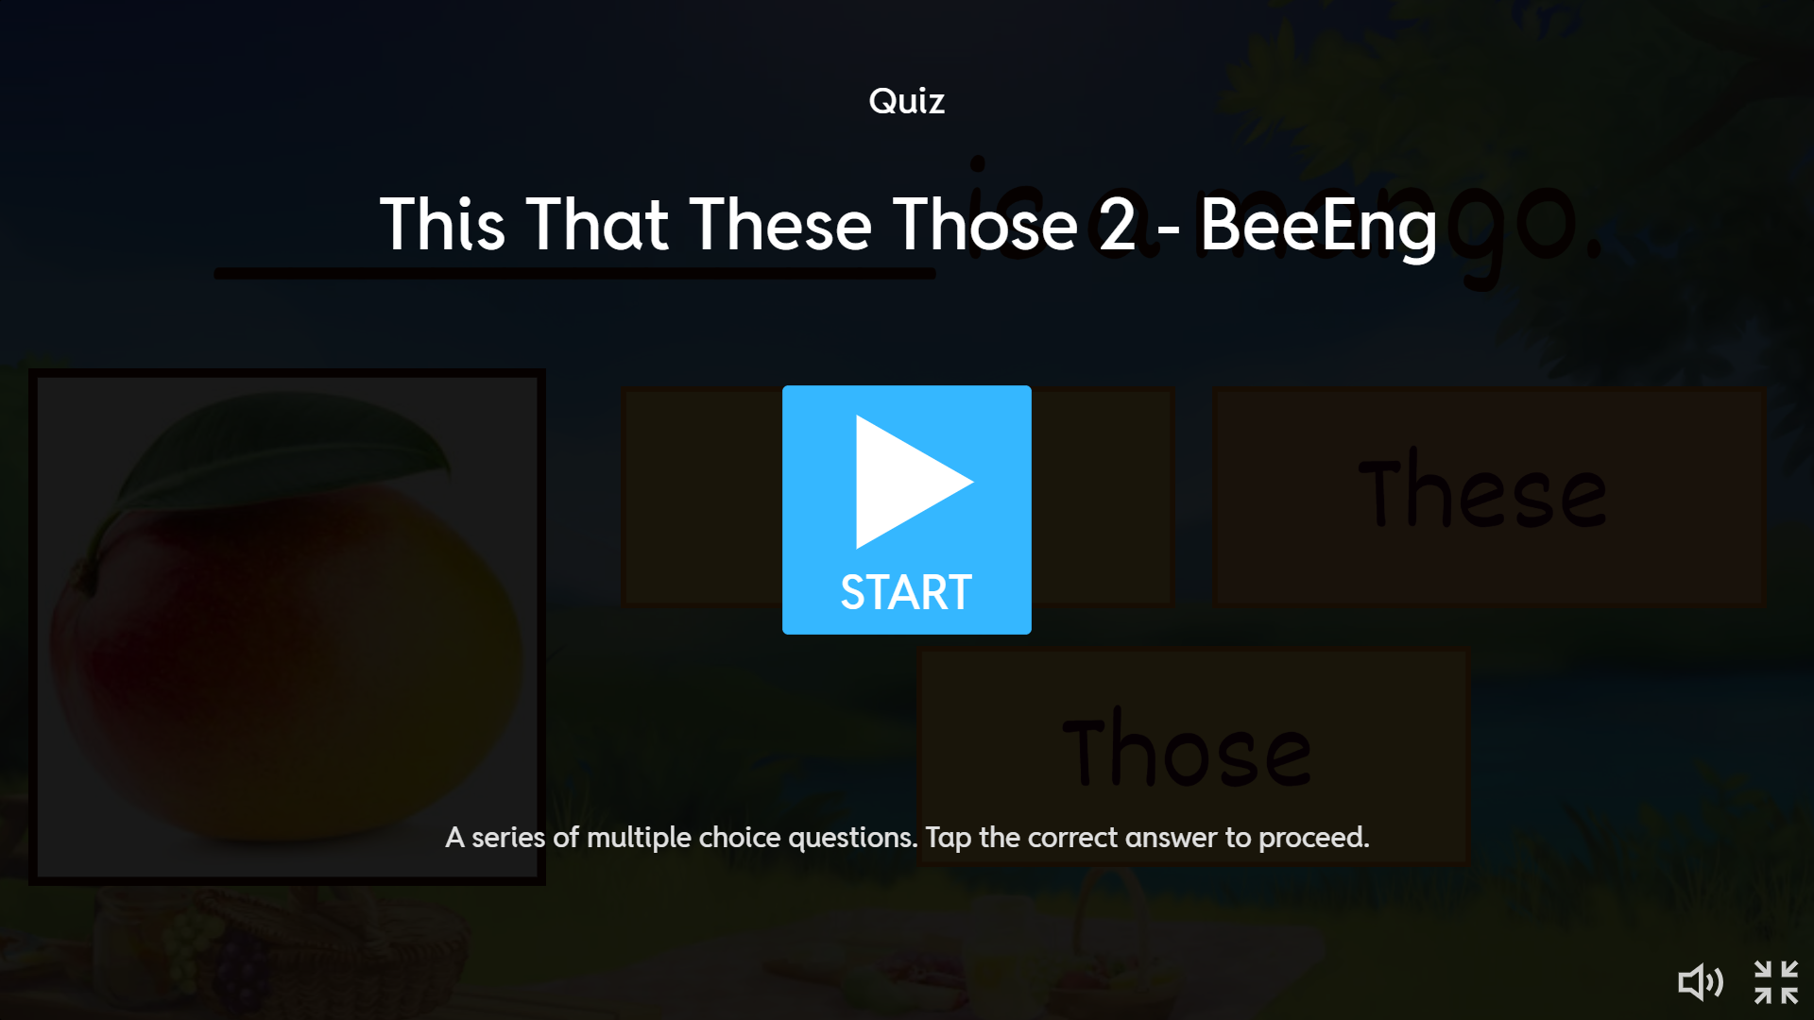

Slide 4
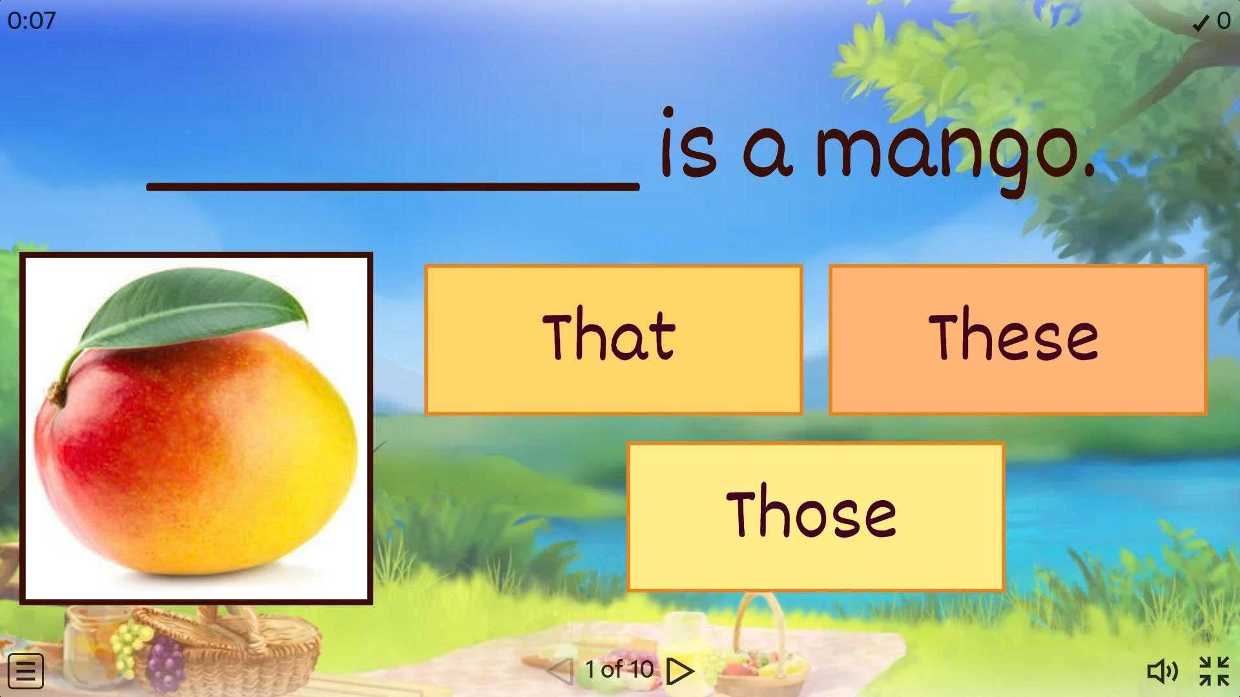

Slide 5
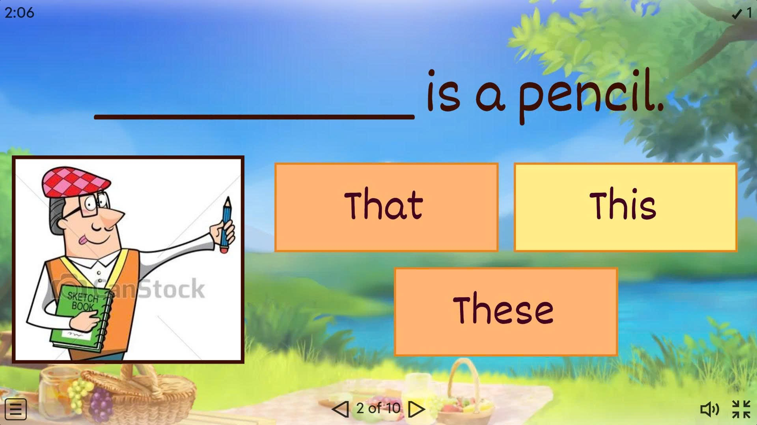

Slide 6
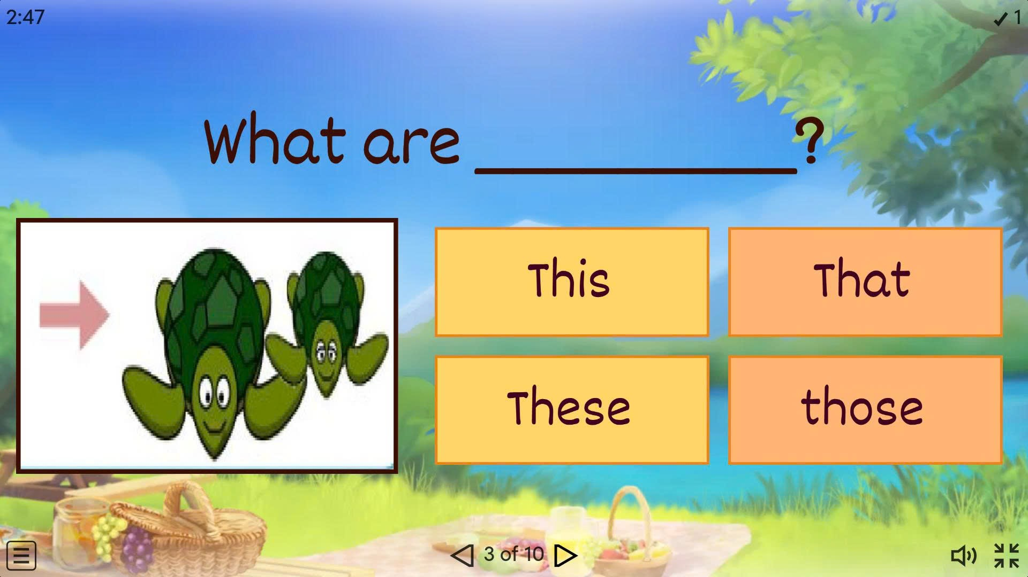

Slide 7
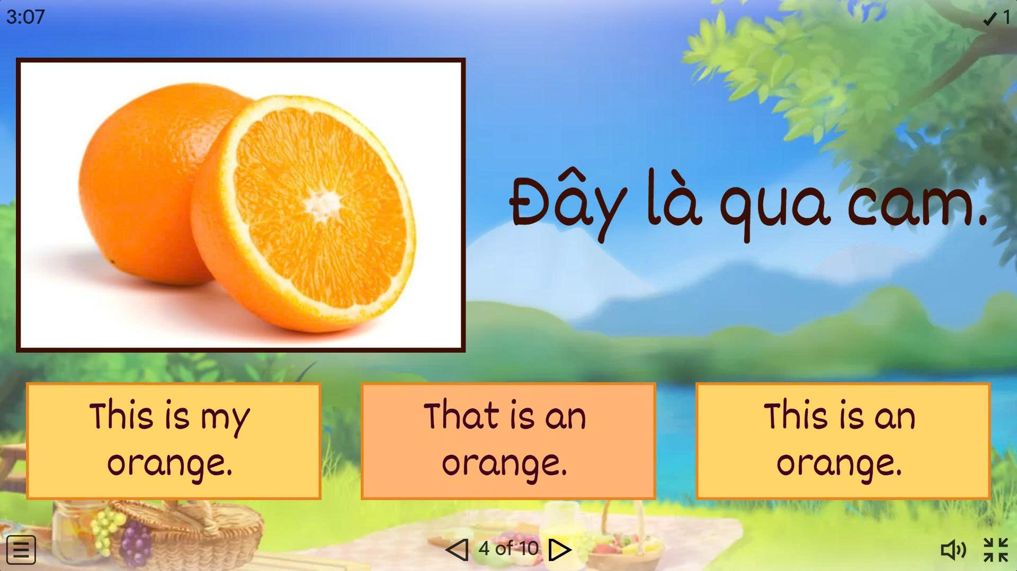

Slide 8
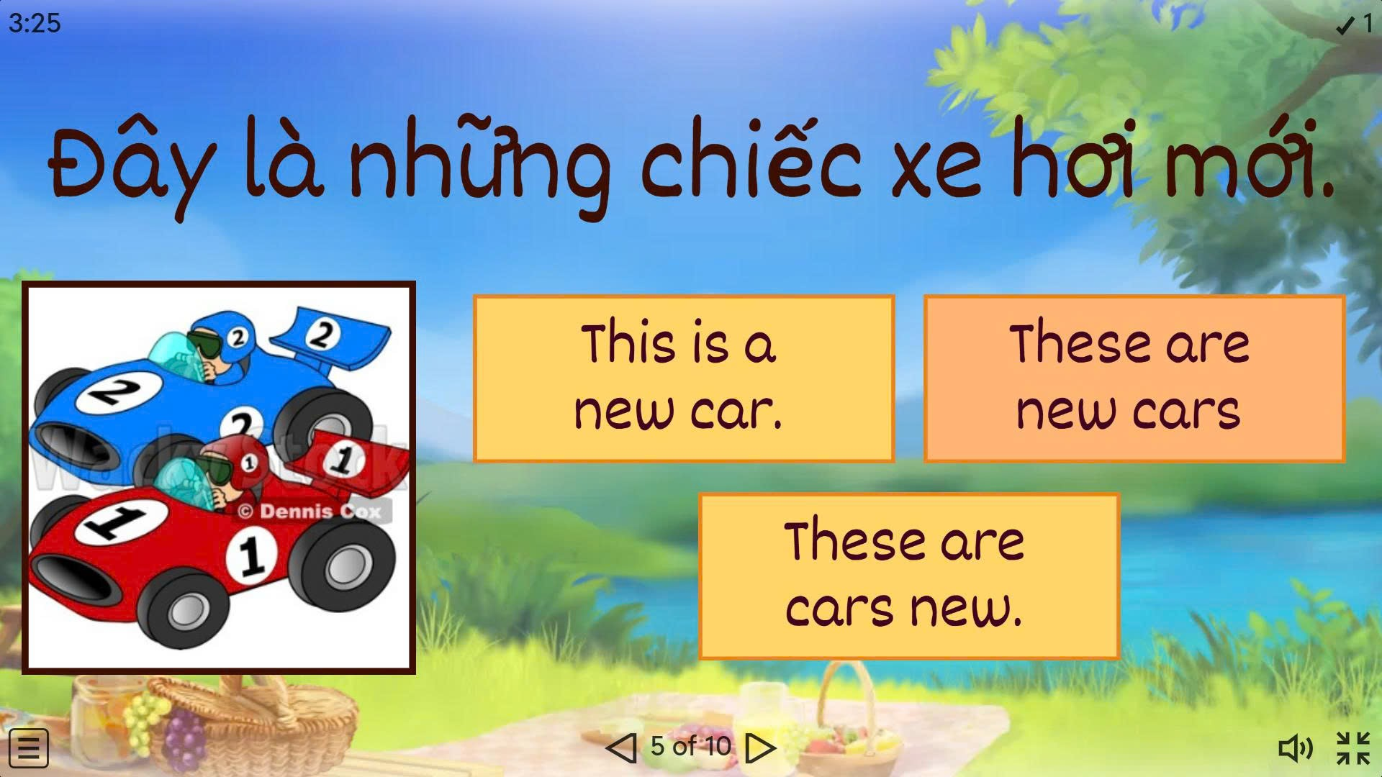

Slide 9
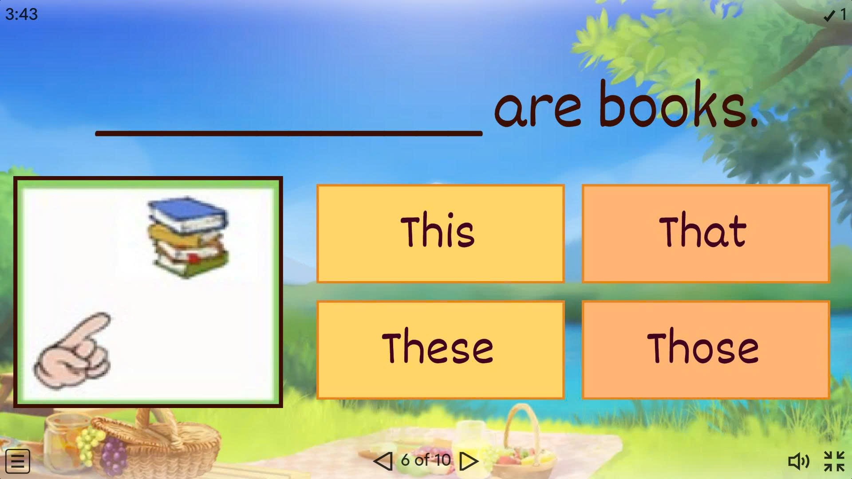

Slide 10
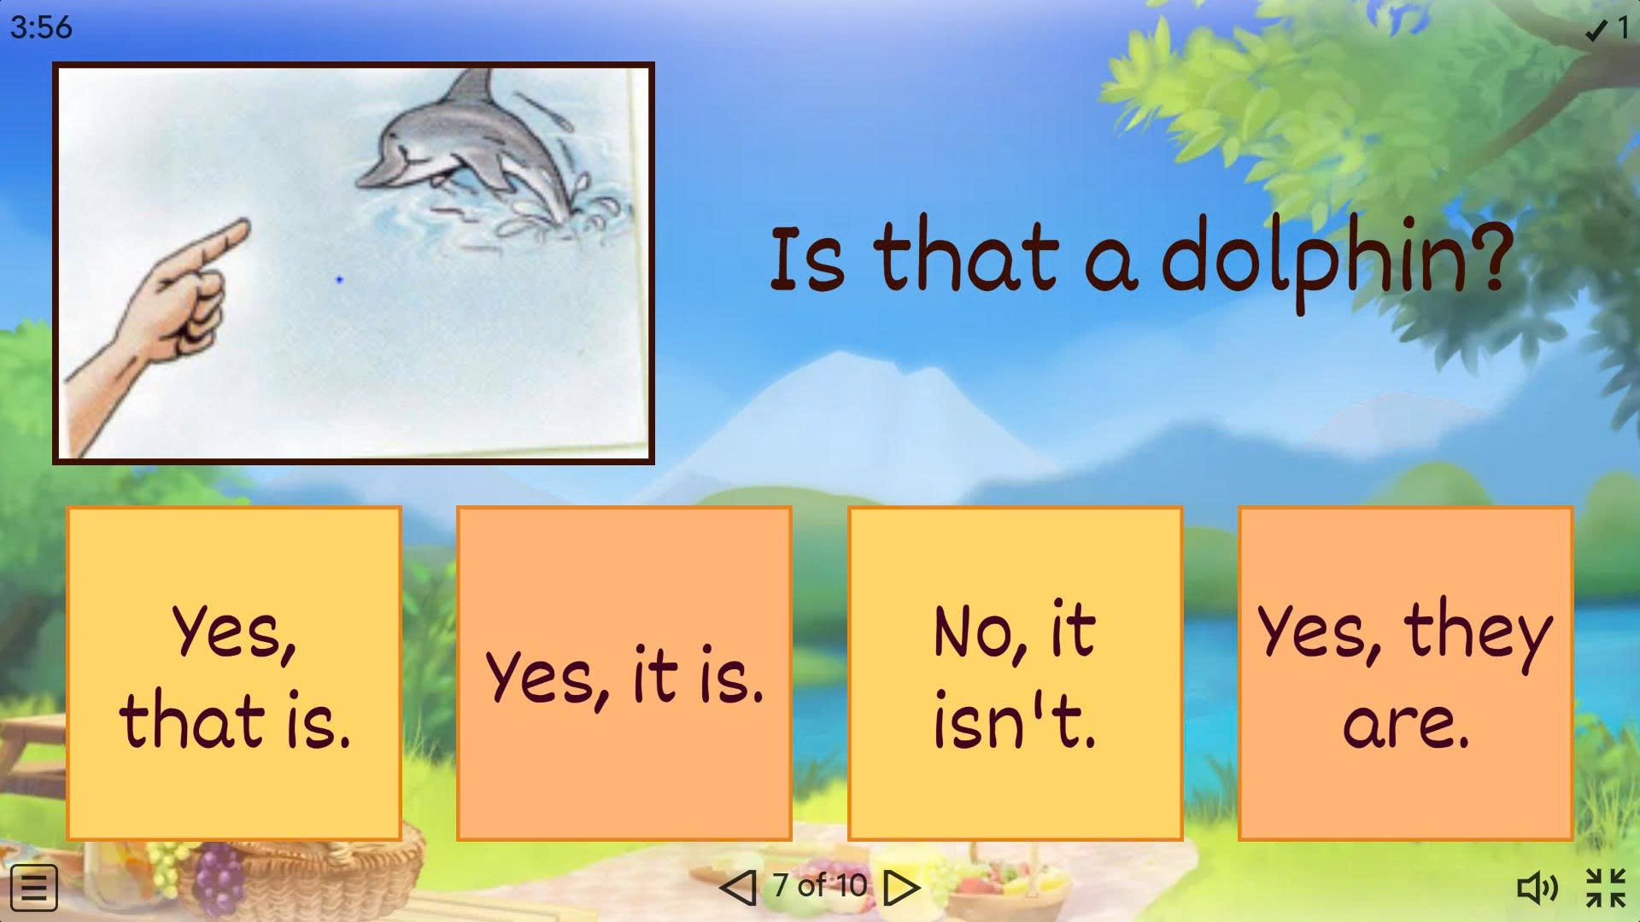

Slide 11
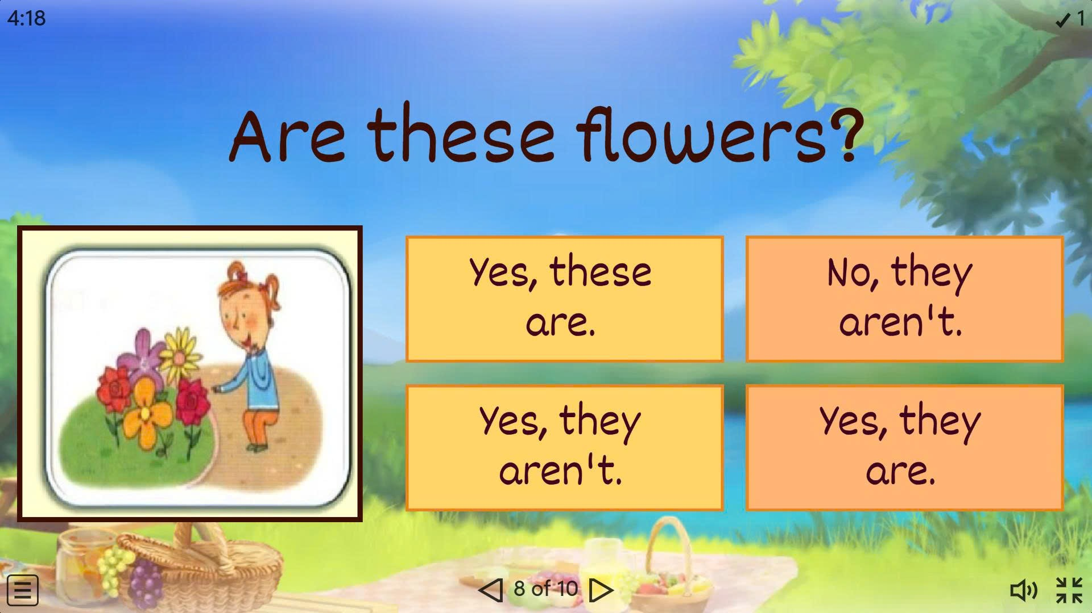

Slide 12
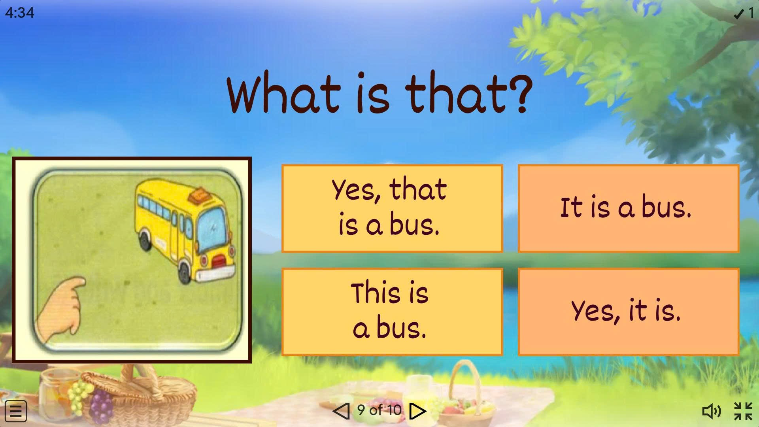

Slide 13
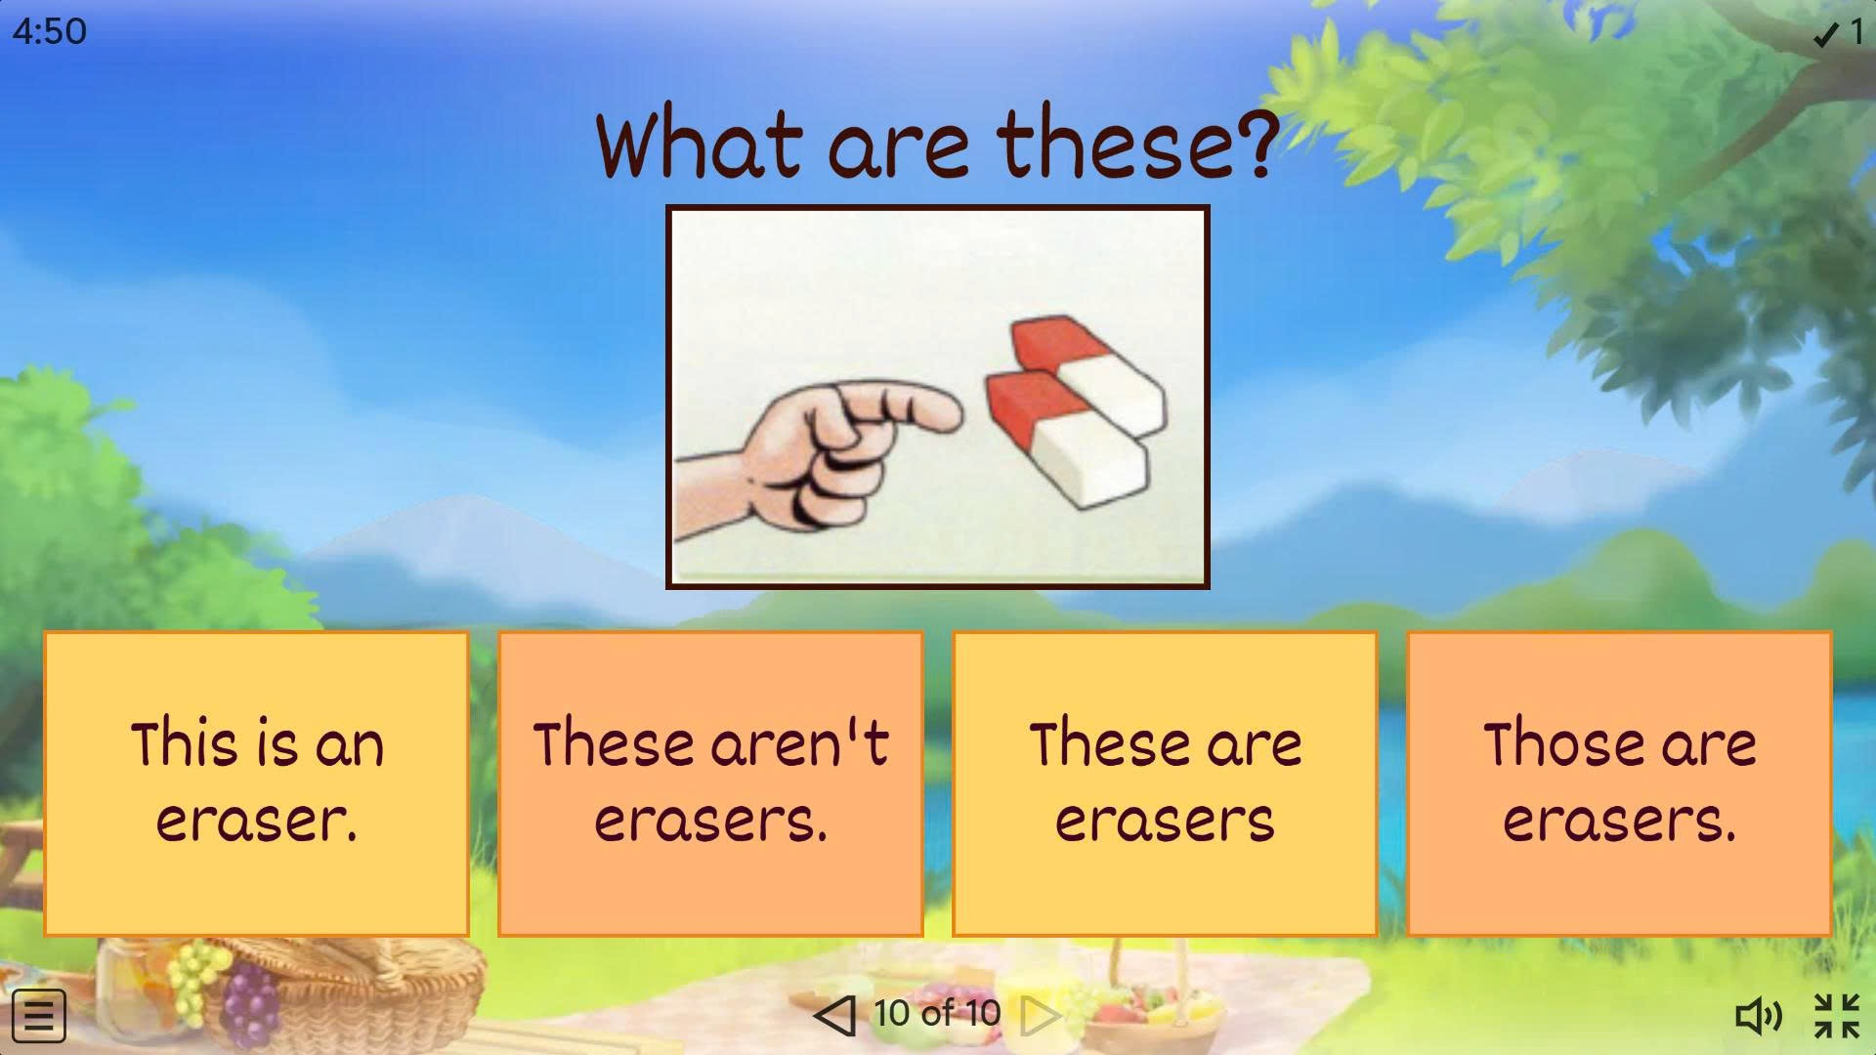

Slide 14

Period 43 Unit 5: Around Town
Lesson 1.2: Grammar
Page 39

Slide 15

Presentation
Demonstratives
Object pronouns

Slide 16
1. How much is this T-shirt?
2. I like this jacket. Do you have it in blue?

Slide 17
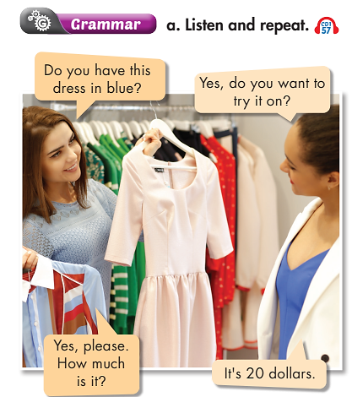

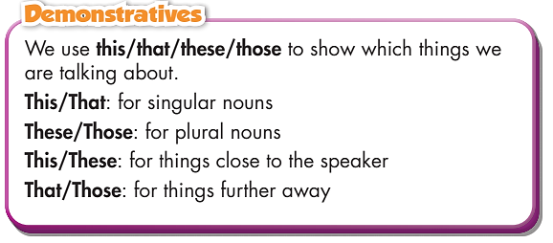
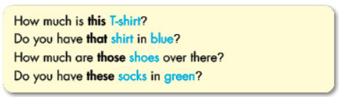
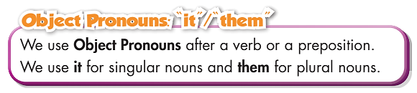

Slide 18
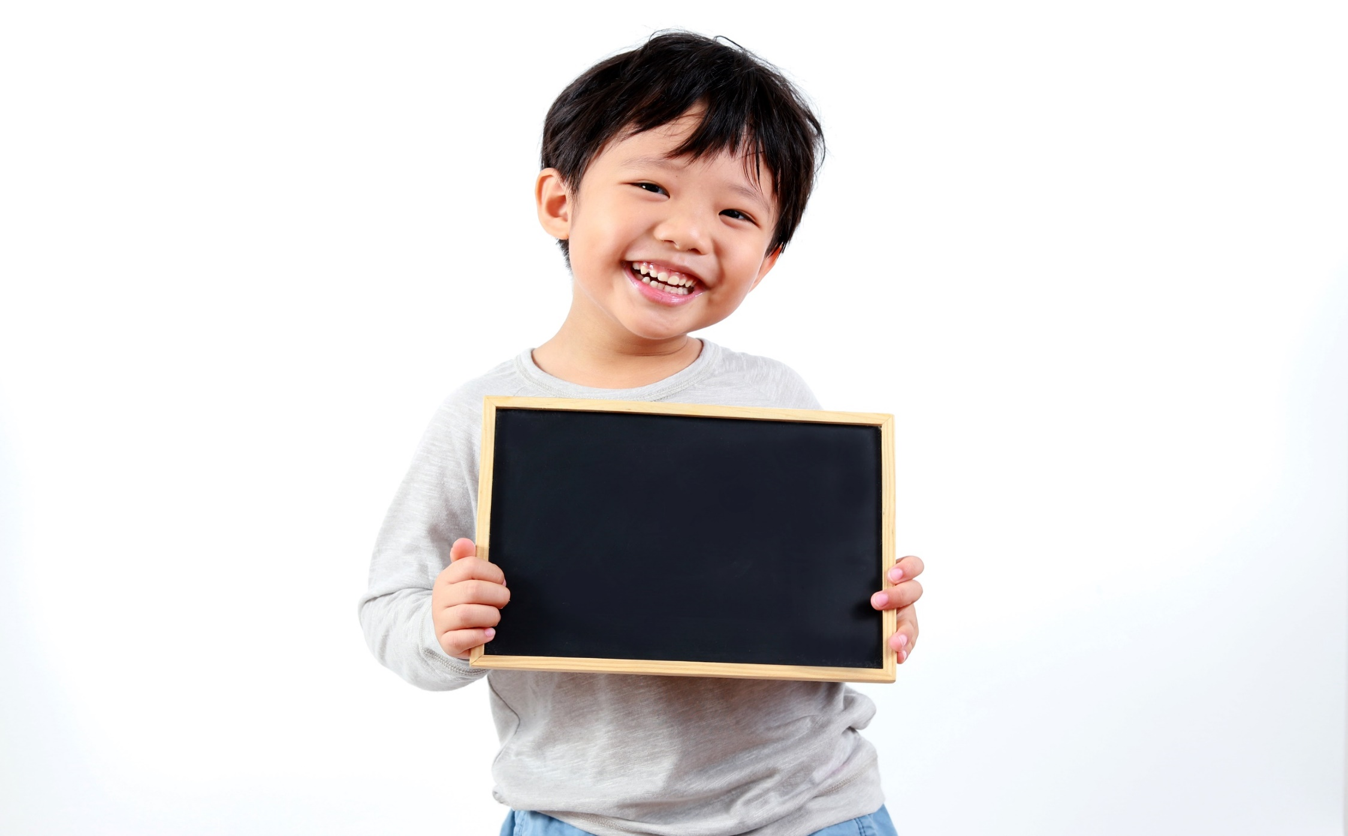
Practice

Slide 19
Practice
b. Read the sentences. Circle the correct words.
How many sentences are there?
1. How much are that/those shoes?
2. Excuse me, how much is this/these shirt?
3. I like that skirt. Do you have it/them in black?
4. Do you have this/these shoes in black?
5. I like these shorts. Can I try it/them on?
6. What size are those/these pants over there?
7. How much is that/this shirt by the window?
→ There are 7.
What are you going to do?
Read the sentences.
And then?
Circle the correct words.

Slide 20
Practice
b.Read the sentences. Circle the correct words.
1. How much are that/those shoes?
2. Excuse me, how much is this/these shirt?
3. I like that skirt. Do you have it/them in black?
4. Do you have this/these shoes in black?
5. I like these shorts. Can I try it/them on?
6. What size are those/these pants over there?
7. How much is that/this shirt by the window?

Slide 21
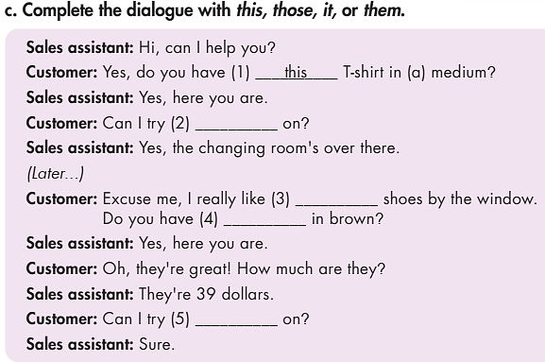
Practice
Who are there in the dialogue?
→ Sales assistant and customer.
What are you going to do?
Complete the dialogue with this, those, it
or them

Slide 22
c. Complete the dialogue with this, those, it, or them.
Sales assistant: Hi, can I help you?
Customer: Yes, do you have (1) __________ T-shirt in (a) medium?
Sales assistant: Yes, here you are.
Customer: Can I try (2) __________ on?
Sales assistant: Yes, the changing room's over there.
(Later...)
Customer: Excuse me, I really like (3) __________ shoes by the window.
Do you have (4) __________ in brown?
Sales assistant: Yes, here you are.
Customer: Oh, they're great! How much are they?
Sales assistant: They're 39 dollars.
Customer: Can I try (5) __________ on?
Sales assistant: Sure.
this
it
those
them
them

Slide 23
Extra Practice
WB, page 27
1.
A: Do you have this/these shoes in black?
B: Yes, do you want to try it/them on?
A: Yes, please. How much is/are they?
B: It's/They're thirty-five dollars.

Slide 24
Extra Practice
WB, page 27
2.
A: Do you have this/these dress in red?
B: Yes, do you want to try it/them on?
A: Yes, please. How much is/are it?
B: It's/They're forty-three dollars.

Slide 25

Production

Slide 26

Work in pairs.
d.Now, practice the conversation with your partner
1. A: Do you have these shoes in black?
B: Yes, do you want to try them on?
A: Yes, please. How much are they?
B: They're thirty-five dollars.
2. A: Do you have this dress in red?
B: Yes, do you want to try it on?
A: Yes, please. How much is it?
B: It's forty-three dollars.

Slide 27
Today’s lesson
Grammar: Practice and use demonstratives and object pronouns correctly.
Speaking: Ask and answer when going shopping.

Slide 28
Homework
Learn by heart the use of demonstratives and object pronouns and make sentences using them.
Do the exercises in Tiếng Anh 6 i-Learn Smart World Workbook page 27.
Prepare the next lesson (page 40 - SB).

Slide 29
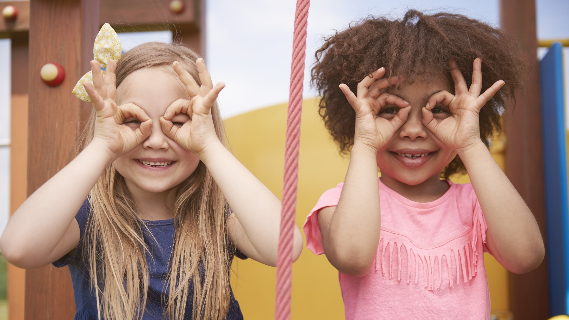
Enjoy your day!

