Slide 1

Unit 2: Life in the Country
Lesson 3.1: Reading & Writing
Pages 22 & 23

Slide 2
Lesson Outline
Warm-up
Reading
Writing
Consolidation
Wrap-up

Slide 3

By the end of this lesson, students will be able to…
- practice reading for main ideas and specific information/ detail
- learn how to write long-form announcements

Slide 4

WARM UP

Slide 5
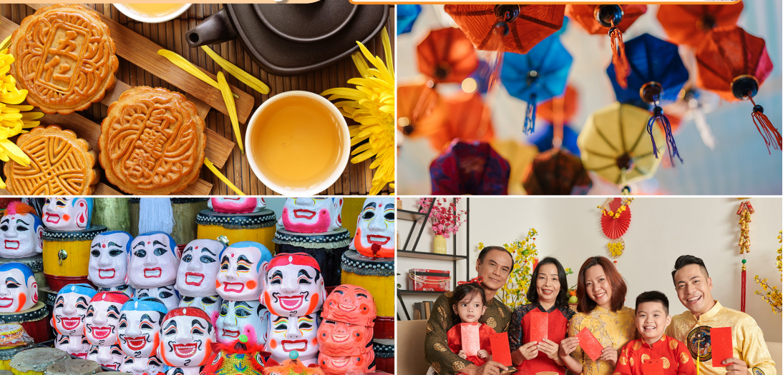
In pairs: Look at the pictures.
What traditional festivals can you see?
What are some other activities people do during these festivals?
Let’s talk

Slide 6

Reading

Slide 7
Look at the title of the announcement and guess its main purpose.
Say when and where the festival will be.
Say what you can do at the festival.

Slide 8
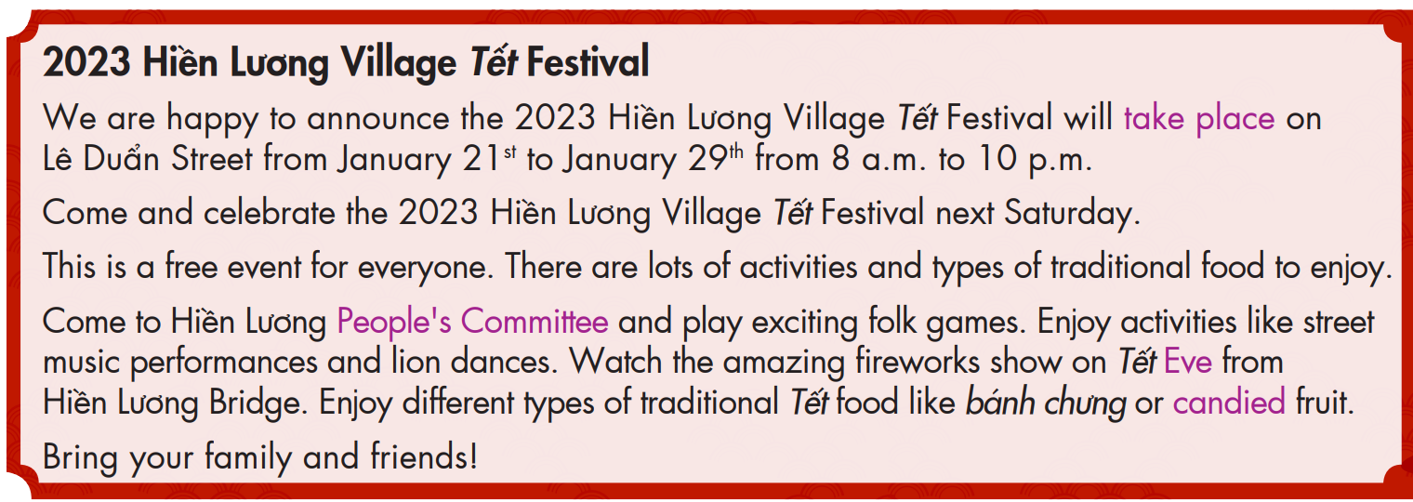
Task a
Read the announcement. What is the main purpose of it?
Say when and where the festival will be.
Say what you can do at the festival.

Slide 9
Vocabulary
take place (v phr) /teɪk pleɪs/ xảy ra
People’s Committee (n phr) /ˈpiːpəlz kəˈmɪti/ ủy ban nhân dân
Eve (n) /iːv/ ngày hoặc đêm trước lễ hội
candied (a) /ˈkændid/ tẩm ướp đường

Slide 10
Task b
Read the sentences below and underline key words.
1. The announcement is for the 2020 Tết festival in Hiền Lương Village.
2. The festival will be on Lê Duẩn Street.
3. The festival is only free for children.
4. You can enjoy music performances from famous Vietnamese singers.
5. The festival will have some types of traditional Tết food like candied fruit and bánh chưng.

Slide 11
Now, read and write True, False, or Doesn't say.
2023 Hiền Lương Village Tết Festival
We are happy to announce the 2023 Hiền Lương Village Tết Festival will take place on Lê Duẩn Street from January 21st to January 29th from 8 a.m. to 10 p.m.
Come and celebrate the 2023 Hiền Lương Village Tết Festival next Saturday.
This is a free event for everyone. There are lots of activities and types of traditional food to enjoy.
Come to Hiền Lương People's Committee and play exciting folk games. Enjoy activities like street music performances and lion dances. Watch the amazing fireworks show on Tết Eve from Hiền Lương Bridge. Enjoy different types of traditional Tết food like bánh chưng or candied fruit.
Bring your family and friends!
1. The announcement is for the 2020 Tết festival in Hiền Lương Village.
F

Slide 12
2023 Hiền Lương Village Tết Festival
We are happy to announce the 2023 Hiền Lương Village Tết Festival will take place on Lê Duẩn Street from January 21st to January 29th from 8 a.m. to 10 p.m.
Come and celebrate the 2023 Hiền Lương Village Tết Festival next Saturday.
This is a free event for everyone. There are lots of activities and types of traditional food to enjoy.
Come to Hiền Lương People's Committee and play exciting folk games. Enjoy activities like street music performances and lion dances. Watch the amazing fireworks show on Tết Eve from Hiền Lương Bridge. Enjoy different types of traditional Tết food like bánh chưng or candied fruit.
Bring your family and friends!
2. The festival will be on Lê Duẩn Street.
T

Slide 13
2023 Hiền Lương Village Tết Festival
We are happy to announce the 2023 Hiền Lương Village Tết Festival will take place on Lê Duẩn Street from January 21st to January 29th from 8 a.m. to 10 p.m.
Come and celebrate the 2023 Hiền Lương Village Tết Festival next Saturday.
This is a free event for everyone. There are lots of activities and types of traditional food to enjoy.
Come to Hiền Lương People's Committee and play exciting folk games. Enjoy activities like street music performances and lion dances. Watch the amazing fireworks show on Tết Eve from Hiền Lương Bridge. Enjoy different types of traditional Tết food like bánh chưng or candied fruit.
Bring your family and friends!
3. The festival is only free for children.
F

Slide 14
2023 Hiền Lương Village Tết Festival
We are happy to announce the 2023 Hiền Lương Village Tết Festival will take place on Lê Duẩn Street from January 21st to January 29th from 8 a.m. to 10 p.m.
Come and celebrate the 2023 Hiền Lương Village Tết Festival next Saturday.
This is a free event for everyone. There are lots of activities and types of traditional food to enjoy.
Come to Hiền Lương People's Committee and play exciting folk games. Enjoy activities like street music performances and lion dances. Watch the amazing fireworks show on Tết Eve from Hiền Lương Bridge. Enjoy different types of traditional Tết food like bánh chưng or candied fruit.
Bring your family and friends!
4. You can enjoy music performances from famous Vietnamese singers.
F

Slide 15
2023 Hiền Lương Village Tết Festival
We are happy to announce the 2023 Hiền Lương Village Tết Festival will take place on Lê Duẩn Street from January 21st to January 29th from 8 a.m. to 10 p.m.
Come and celebrate the 2023 Hiền Lương Village Tết Festival next Saturday.
This is a free event for everyone. There are lots of activities and types of traditional food to enjoy.
Come to Hiền Lương People's Committee and play exciting folk games. Enjoy activities like street music performances and lion dances. Watch the amazing fireworks show on Tết Eve from Hiền Lương Bridge. Enjoy different types of traditional Tết food like bánh chưng or candied fruit.
Bring your family and friends!
5. The festival will have some types of traditional Tết food like candied fruit and bánh chưng.
T

Slide 16

Task c
Listen and read.
2023 Hiền Lương Village Tết Festival
We are happy to announce the 2023 Hiền Lương Village Tết Festival will take place on Lê Duẩn Street from January 21st to January 29th from 8 a.m. to 10 p.m.
Come and celebrate the 2023 Hiền Lương Village Tết Festival next Saturday.
This is a free event for everyone. There are lots of activities and types of traditional food to enjoy.
Come to Hiền Lương People's Committee and play exciting folk games. Enjoy activities like street music performances and lion dances. Watch the amazing fireworks show on Tết Eve from Hiền Lương Bridge. Enjoy different types of traditional Tết food like bánh chưng or candied fruit.
Bring your family and friends!

Slide 17
Extra practice
Read the summary and guess the types of the missing words.
Hiền Lương Village Tết Festival will take place on ...........................Street from January 21st to January ....................... This is a free event for ......................... There are lots of activities to join such as ...................... games, street
music performances and ........................ dances. We can watch the amazing ................................. show on Tết Eve from Hiền Lương Bridge. We can also enjoy different types of ............................. Tết food like bánh chưng or candied fruit.
name
date
noun
adjective
adjective/noun
noun
adjective

Slide 18
Hiền Lương Village Tết Festival will take place on ...........................Street from January 21st to January ....................... This is a free event for ......................... There are lots of activities to join such as ...................... games, street
music performances and ........................ dances. We can watch the amazing ................................. show on Tết Eve from Hiền Lương Bridge. We can also enjoy different types of ............................. Tết food like bánh chưng or candied fruit.
Lê Duẩn
29th
everyone
folk
lion
fireworks
traditional

Slide 19
Post-reading
In pairs: Which Tết activities do you like best? Why?
I like playing games with my family and friends because it's fun!
I like visiting my grandparents because I can send them best wishes!

Slide 20
Writing

Slide 21
Task a
Read about writing long-form announcements.
Writing long-form announcements
To write a long-form announcement, you should:
1. Write a heading. Say what the event is.
The 2024 Culture Festival
2. Write a summary sentence about what, where, and when the festival is.
We are excited to announce the 2024 Culture Festival will take place at King Park on Saturday, October 8th from 1 p.m. to 10 p.m.

Slide 22
3. Give a call to action. Ask the readers to take part or join in.
Come and celebrate the 2024 Culture Festival…
4. Say the cost.
This is a free event for everyone; Tickets to the festival cost 50,000 VND.
5. Say the different activities and food at the festival.
Enjoy activities like…, Take part in…, Eat many types of traditional food like…

Slide 23
Read the announcement for the Tết Festival again and underline the place, time, cost, activities, and food for the event.
2023 Hiền Lương Village Tết Festival
We are happy to announce the 2023 Hiền Lương Village Tết Festival will take place on Lê Duẩn Street from January 21st to January 29th from 8 a.m. to 10 p.m.
Come and celebrate the 2023 Hiền Lương Village Tết Festival next Saturday.
This is a free event for everyone. There are lots of activities and types of traditional food to enjoy.
Come to Hiền Lương People's Committee and play exciting folk games. Enjoy activities like street music performances and lion dances. Watch the amazing fireworks show on Tết Eve from Hiền Lương Bridge. Enjoy different types of traditional Tết food like bánh chưng or candied fruit.
Bring your family and friends!

Slide 24
Task b
Reorder the parts of the announcement. Use the Writing skill box to help you.
4
Tickets to the festival cost 25,000 VND.
Take part in activities like a lantern parade.
The 2024 Mid-Autumn Festival
Come and take part in the 2024 Mid-Autumn Festival.
We are happy to announce the 2024 Mid-Autumn Festival will take place on Nguyễn Huệ Street on Tuesday, September 21st from 1 p.m. to 9 p.m.
5
1
3
2

Slide 25

CONSOLIDATION

Slide 26
Write the five sentences in exercise b in the correct order to make a complete paragraph.
The 2024 Mid-Autumn Festival. We are happy to announce the 2024 Mid-Autumn. Festival will take place on Nguyễn Huệ Street on Tuesday, September 21st from 1 p.m. to 9 p.m. Come and take part in the 2024 Mid-Autumn Festival. Tickets to the festival cost 25,000 VND. Take part in activities like a lantern parade.

Slide 27

WRAP-UP

Slide 28
Today’s lesson
Reading
Reading an announcement about a festival.
Writing
Writing a long-form announcement.

Slide 29
Homework
Do the exercises on page 12 WB.
Do the exercises in Tiếng Anh 8 i-Learn Smart World Notebook on page 18.
Prepare the next lesson (pages 23 SB)
Play the consolidation games on www.eduhome.com.vn

Slide 30

Lesson 3
Stay positive and have a nice day!

