Slide 1

Unit 2: Life in the Country
Lesson 2.3:
Pronunciation & Speaking
Pages 20 & 21

Slide 2
Lesson Outline
Warm-up
Pronunciation
Speaking
Consolidation
Wrap-up

Slide 3

By the end of this lesson, students will be able to…
- practice intonation for Yes / No questions
- practice talking about folk games and activities in the country, using Which activities do you prefer to do? Which activities don't you like? Why?

Slide 4

WARM UP

Slide 5
Choose the word whose underlined part is pronounced differently form that of the others.
A. herd B. help C. send D. sell
/hɜːd/ /help/ /send/ /sel/
2. A. folk B. rope C. top D. home
/foʊk/ /roʊp/ /tɑːp/ /muːn/
3. A. jump B. pull C. shut D. cut
/dʒʌmp/ /pʊl/ /ʃʌt/ /kʌt/

Slide 6
Choose the words whose main stress is placed differently from the others.
A. visit B. follow C. travel D. enjoy
/ˈvɪzɪt/ /ˈfɑːloʊ/ /ˈtrævəl/ /ɪnˈdʒɔɪ/
2. A. police B. country C. weather D. hometown
/pəˈliːs/ /ˈkʌntri/ /ˈweðər/ /ˈhoʊmtaʊn/
3. A. buffalo B. tradition C. festival D. family
/ˈbʌfəloʊ/ /trəˈdɪʃən/ /ˈfestəvəl/ /ˈfæməli/

Slide 7

Pronunciation

Slide 8
Task a
Intonation for Yes/No questions
Intonation for Yes/No questions rises
For example:
Does he like to play folk games?
Do you enjoy jumping rope?

Slide 9

Task b
Listen to the words and how the intonation rises.
Does she like to eat hamburgers?
Do they like to jump rope?

Slide 10
Task c
Listen and cross out the sentence whose intonation doesn’t rise.
Does he love to pick flowers?
Do they prefer to play soccer?
Do you like to visit the country?
Task d
Read the sentences with the rising intonation to a partner.

Slide 11
Practice

Slide 12
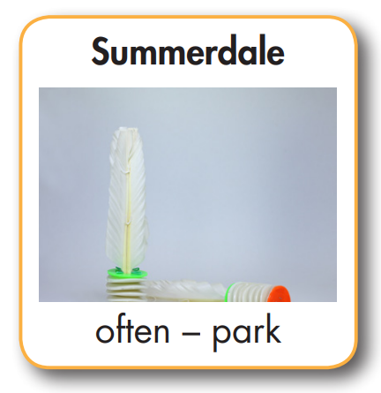
In pairs: Ask and answer about what young people like to do in these places.
What do young
people like to do in Summerdale?
They like to play
shuttlecock. They often play at the park.

Slide 13
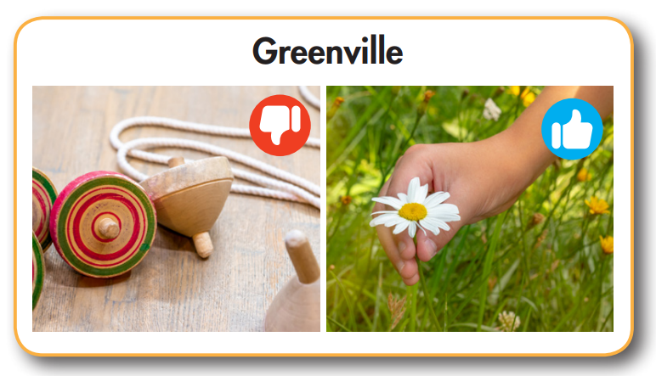
Do young people
like to play spinning tops in Greenville?
No, they don't.
They prefer to pick flowers.

Slide 14
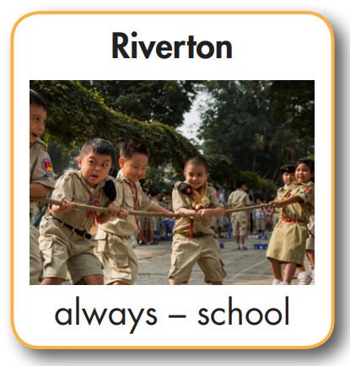
What do young
people like to do
in Riverton?
They like to play
Tug of war. They always play at school.

Slide 15
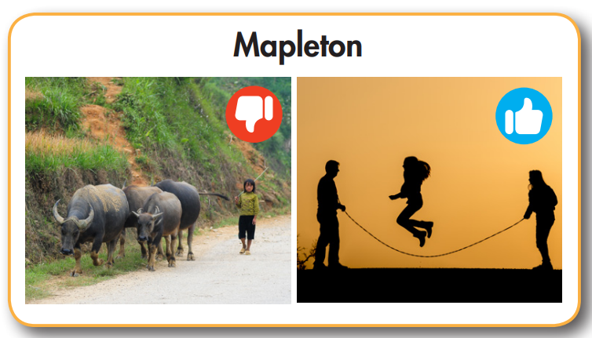
Do young people
like to herd buffalo in Mapleton?
No, they don’t.
They prefer to jump rope.

Slide 16
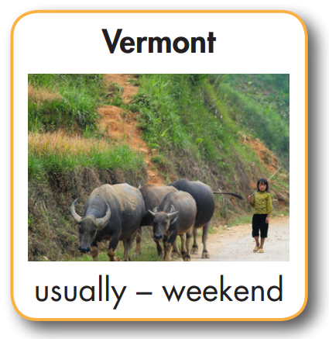
What do young
people like to do in Vermont?
They like to herd buffalo. They usually do it at the weekend.

Slide 17
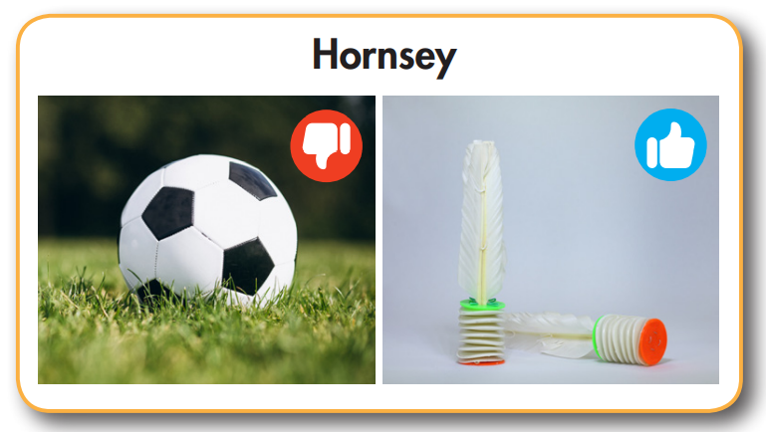
Do children
like to play soccer in Hornsey?
No, they don’t.
They prefer to play shuttlecock.

Slide 18
Speaking

Slide 19
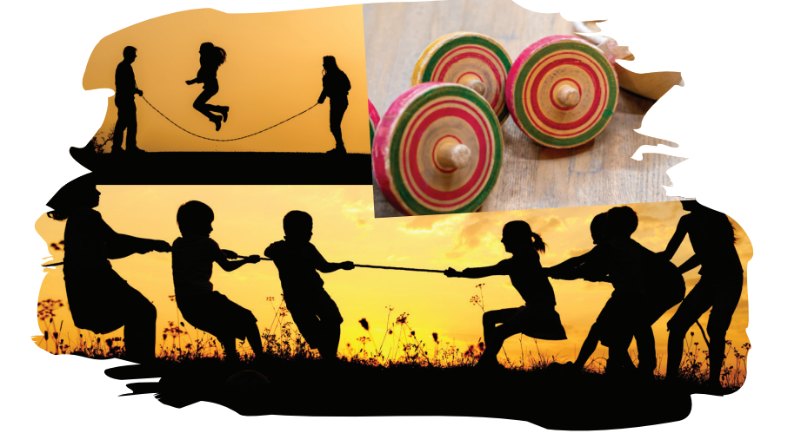
Task a
FUN AND GAMES IN THE COUNTRY
In pairs: What activities do young people often like to do in the country? Where and when do they usually do the activities? Talk about the activities below and some of your own ideas.

Slide 20
What do young people
like to do in the country?
They like to jump rope. They usually jump rope after school.
Do they like to play
tug of war?
Yes, they do, but I
think they prefer to...

Slide 21
Task b
Which activities do you prefer to do? Which activities don't you like? Why?
I prefer to play tug of war because it’s fun and I can play with my friends. I don’t like to herd buffalo because it’s boring.

Slide 22

CONSOLIDATION

Slide 23
Write four sentences about what you can do for fun in the country.
Example:
There are many things young people can do for fun in the country. Boys can play tug of war, and girls can jump rope. Some boys prefer spinning tops, and some girls prefer to pick flowers. Most of them like to do things with friends.

Slide 24

WRAP-UP

Slide 25
Today’s lesson
Pronunciation
Intonation of Yes/No questions.
Speaking
Talk about folk games and activities in the country.

Slide 26
Homework
Practice saying Yes/No questions
Prepare the next lesson (pages 22 SB)
Play the consolidation games on www.eduhome.com.vn

Slide 27

Lesson 3
Stay positive and have a nice day!

