Slide 1
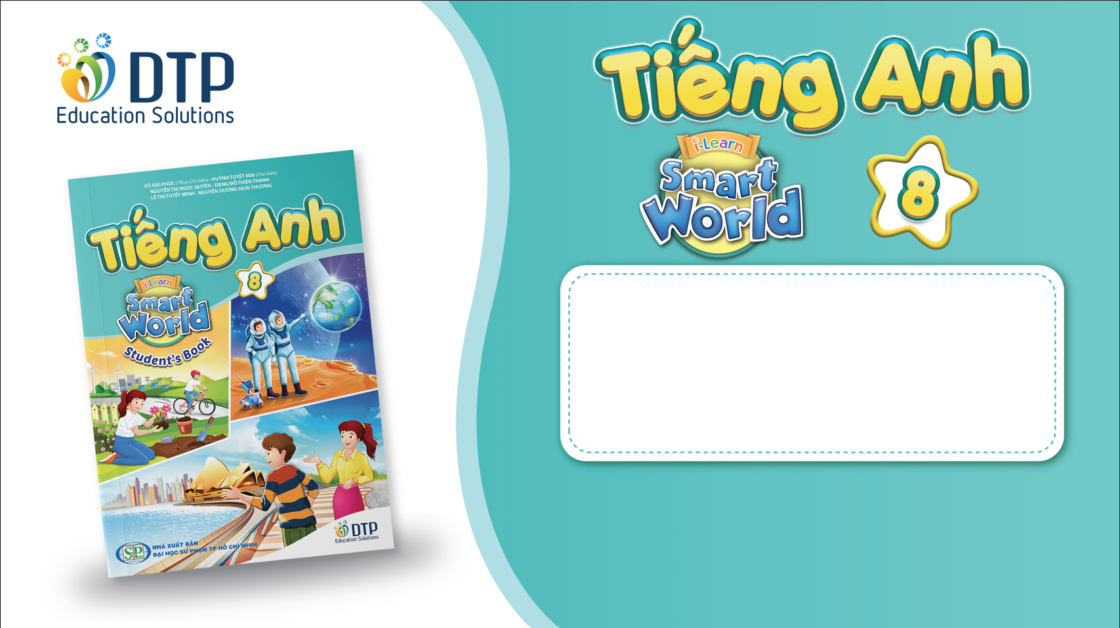
Unit 2: Life in the Country
Lesson 2.1: Vocab & Reading
Pages 18 & 19

Slide 2
Lesson Outline
Warm-up
Vocabulary
Reading
Consolidation
Wrap-up

Slide 3

By the end of this lesson, students will be able to…
- learn and use vocabulary related to life in the country and life in the city
- practice reading for gist and for detail

Slide 4
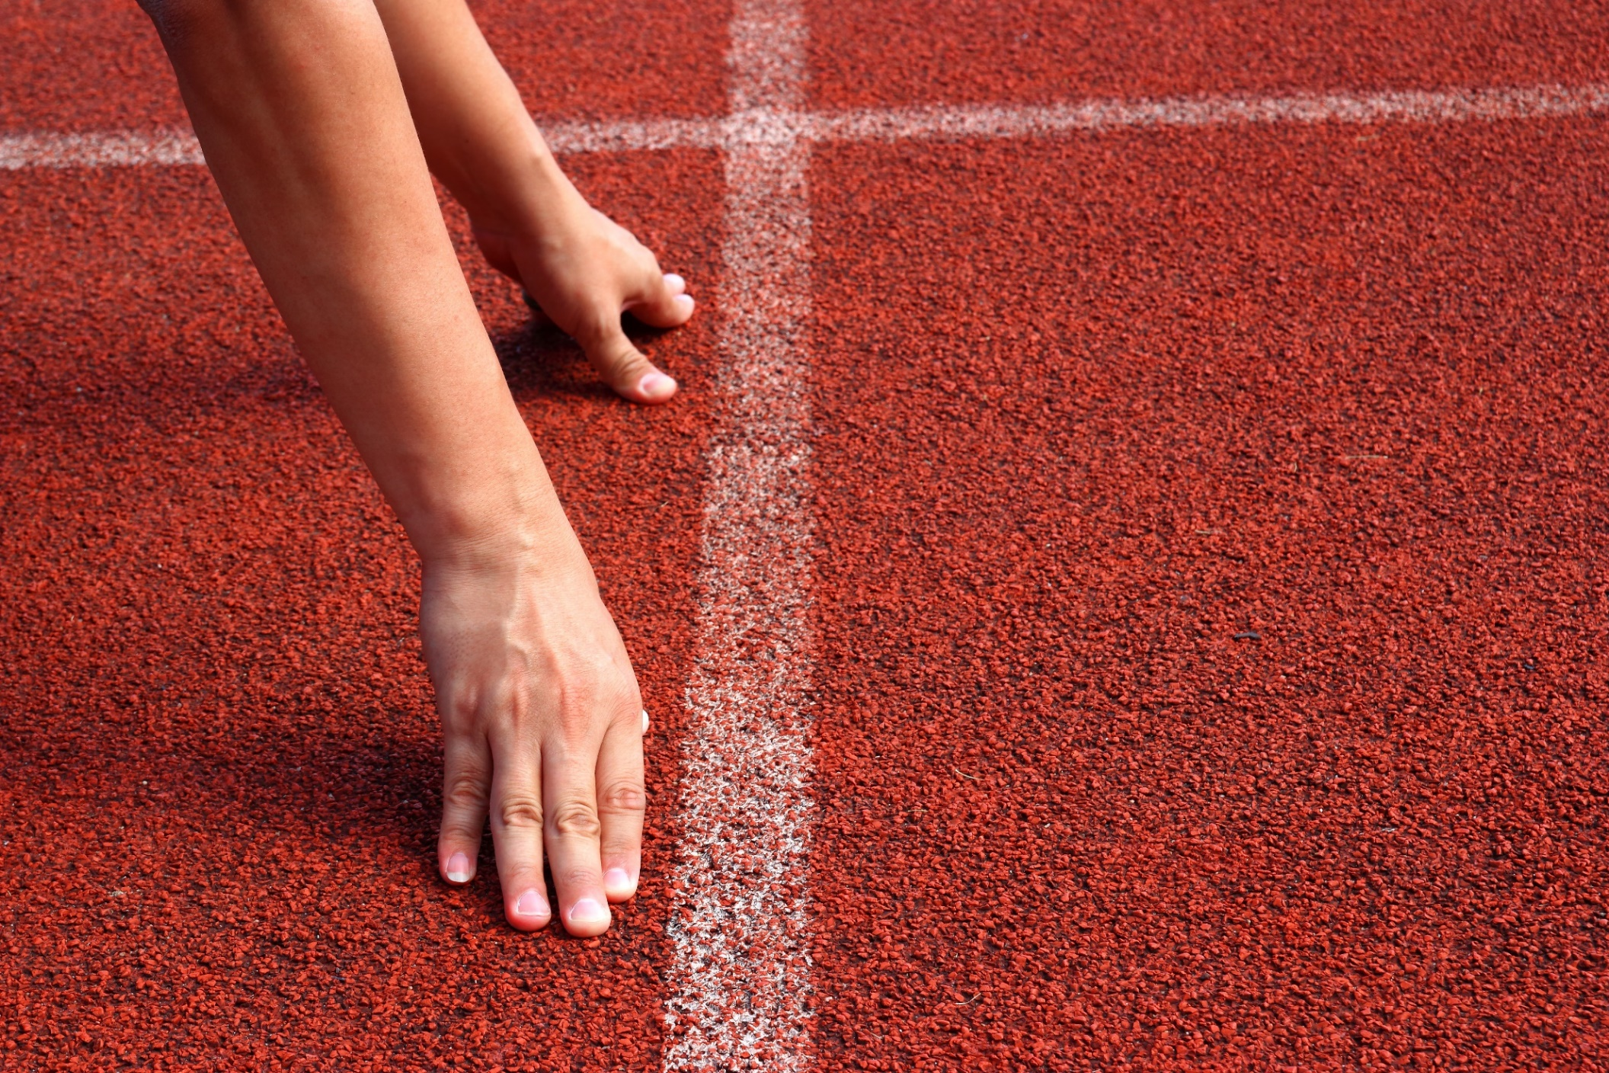
WARM UP

Slide 5

Work in pairs.
Look at the picture.
What are the children doing?
What else can children do for fun in the country?

Slide 6
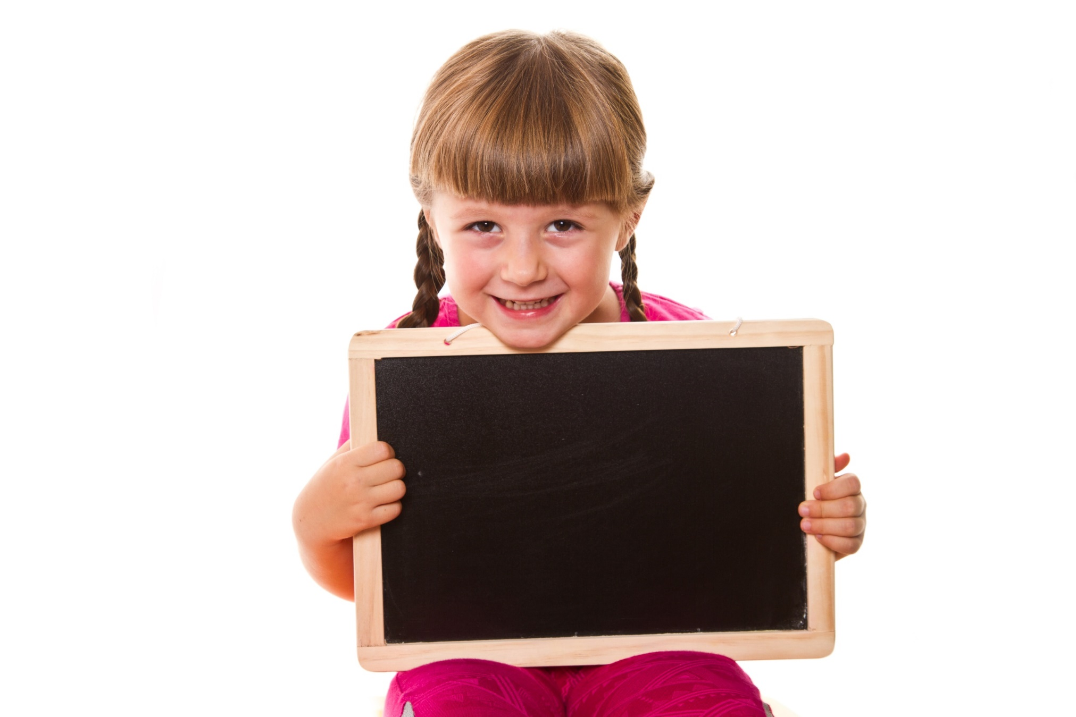
Pre-Reading

Slide 7



Slide 8
Task a
Read the sentences, then match the words with the definitions.
Last weekend, I went to visit my family in my hometown. I don't come from a big city. I'm from a village in the country. In my village, young people love to pick flowers and play folk games. They jump rope and play tug of war with a rope. When they play spinning tops, they use small wooden toys. They also herd buffalo to help their parents.
1. __________: a person's place of birth
2. __________: traditional to a group of people or a place
3. __________: a game that two teams hold a rope and try to pull the hardest
hometown
folk
tug of war

Slide 9
Last weekend, I went to visit my family in my hometown. I don't come from a big city. I'm from a village in the country. In my village, young people love to pick flowers and play folk games. They jump rope and play tug of war with a rope. When they play spinning tops, they use small wooden toys. They also herd buffalo to help their parents.
jump rope
4. _____________: a game that two people hold a rope and one or more people jump over it
5. _____________: to take flowers or fruit from the plant or tree where they are growing
6. _____________: a game that players use wooden toys which spin very quickly
7. _____________: to make animals move together as a group
pick
spinning tops
herd

Slide 10

Listen and repeat. Click on each phrase to hear the sound.
Hometown (n) /ˈhoʊmtaʊn/ quê hương
Folk (a) /foʊk/ thuộc về dân gian
Tug of war (n phr) /tʌɡ əv ˈwɔːr/ trò chơi kéo co
Jump rope (v phr) /dʒʌmp ˈroʊp/ nhảy dây
Pick (v) /pɪk/ hái
Spinning top (n phr) /ˈspɪnɪŋ tɑːp/ trò chơi con quay
Herd (v) /hɜːrd/ chăn giữ vật nuôi

Slide 11
Task b
In pairs: : Talk about what you like to do when you visit places in the country.
When I go to my hometown, I like to play soccer with my friends.
I prefer to play folk games
with my family.

Slide 12
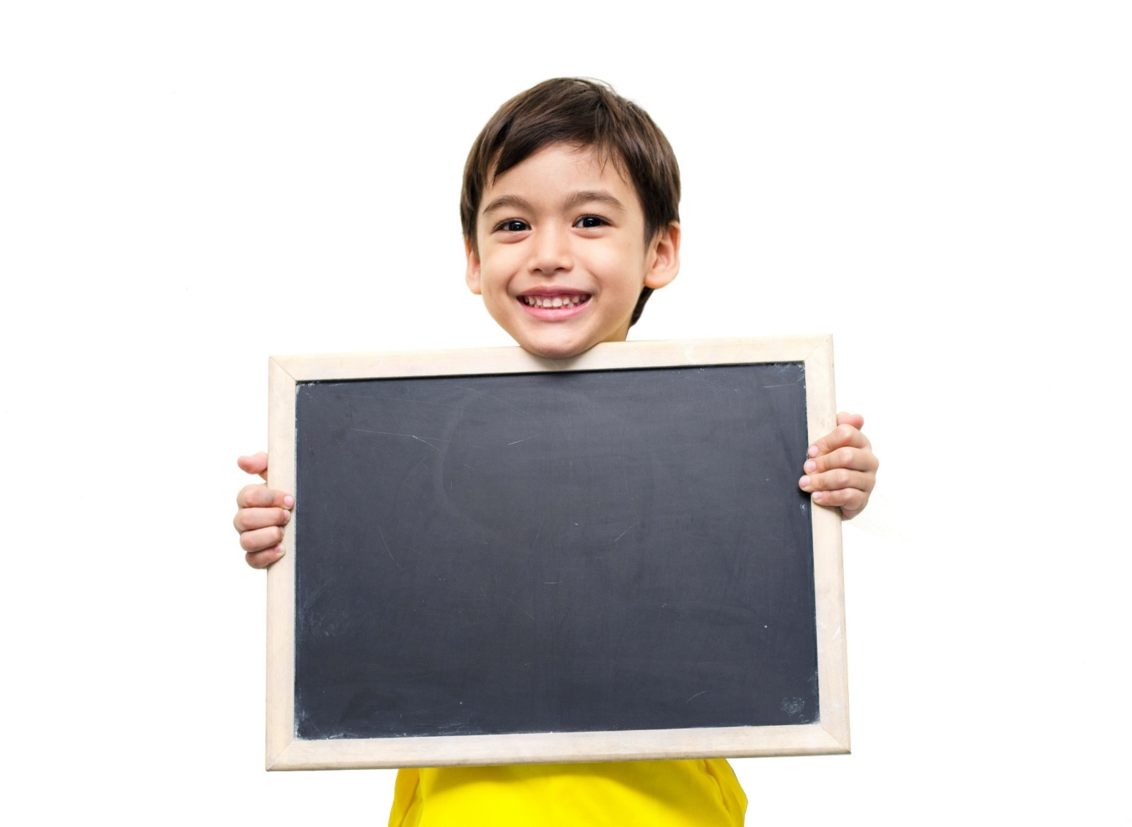
Reading

Slide 13
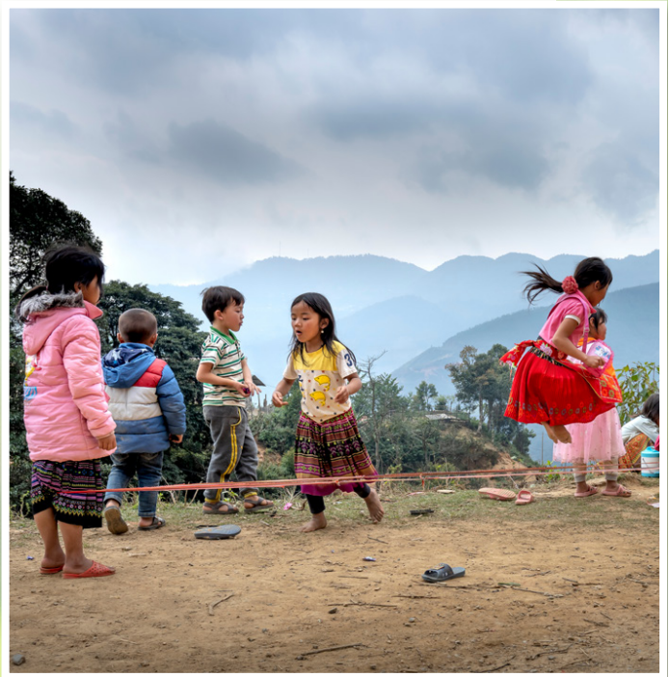
Pre - reading
Look at the title of Vy’s blog post and the picture and what she mostly talks about:
1. popular activities in her hometown
2. her family's favorite folk games

Slide 14
Task a
Read and check.
Hi, everyone! Sorry I didn't post anything last week! I couldn't use my computer because I wasn't at home. I visited my family in my hometown. It's a small village in the country, about 200 kilometers from Ho Chi Minh City. My hometown is very different from the city. It's smaller, and it's much more traditional. Here, the kids never play computer games, and they rarely watch TV. They prefer to play outdoors. They play sports and folk games. The girls love to jump rope and pick flowers. The boys love to play tug of war and soccer. I often play with the kids here, but I don't like to run around during the day because the weather is usually so sunny and hot. I prefer to play chess because it's more relaxing than some folk games. My uncle and I sometimes sit down and play it under a tree. What are your favorite activities?
1. popular activities in her hometown 2. her family's favorite folk games

Slide 15
Task b
Read the questions and underline the key words.
1. Where was Vy last week?
2. What don't kids do in Vy's hometown?
3. What do girls like to do in Vy's hometown?
4. What do boys like to do in Vy's hometown?
5. What does the word it in paragraph 4 refer to?

Slide 16
While-Reading

Slide 17
Hi, everyone! Sorry I didn't post anything last week! I couldn't use my computer because I wasn't at home.
I visited my family in my hometown. It's a small village in the country, about 200 kilometers from Ho Chi Minh City. My hometown is very different from the city. It's smaller, and it's much more traditional.
Here, the kids never play computer games, and they rarely watch TV. They prefer to play outdoors. They play sports and folk games. The girls love to jump rope and pick flowers. The boys love to play tug of war and soccer. I often play with the kids here, but I don't like to run around during the day because the weather is usually so sunny and hot.
I prefer to play chess because it's more relaxing than some folk games. My uncle and I sometimes sit down and play it under a tree.
What are your favorite activities?
1. Where was Vy last week?
A. in Ho Chi Minh City B. in her hometown C. in another country

Slide 18
Hi, everyone! Sorry I didn't post anything last week! I couldn't use my computer because I wasn't at home.
I visited my family in my hometown. It's a small village in the country, about 200 kilometers from Ho Chi Minh City. My hometown is very different from the city. It's smaller, and it's much more traditional.
Here, the kids never play computer games, and they rarely watch TV. They prefer to play outdoors. They play sports and folk games. The girls love to jump rope and pick flowers. The boys love to play tug of war and soccer. I often play with the kids here, but I don't like to run around during the day because the weather is usually so sunny and hot.
I prefer to play chess because it's more relaxing than some folk games. My uncle and I sometimes sit down and play it under a tree. What are your favorite activities?
2. What don't kids do in Vy's hometown?
A. play computer games B. pick flowers C. play soccer

Slide 19
Hi, everyone! Sorry I didn't post anything last week! I couldn't use my computer because I wasn't at home.
I visited my family in my hometown. It's a small village in the country, about 200 kilometers from Ho Chi Minh City. My hometown is very different from the city. It's smaller, and it's much more traditional.
Here, the kids never play computer games, and they rarely watch TV. They prefer to play outdoors. They play sports and folk games. The girls love to jump rope and pick flowers. The boys love to play tug of war and soccer. I often play with the kids here, but I don't like to run around during the day because the weather is usually so sunny and hot.
I prefer to play chess because it's more relaxing than some folk games. My uncle and I sometimes sit down and play it under a tree. What are your favorite activities?
3. What do girls like to do in Vy's hometown?
A. play spinning tops B. play tug of war C. pick flowers

Slide 20
Hi, everyone! Sorry I didn't post anything last week! I couldn't use my computer because I wasn't at home.
I visited my family in my hometown. It's a small village in the country, about 200 kilometers from Ho Chi Minh City. My hometown is very different from the city. It's smaller, and it's much more traditional.
Here, the kids never play computer games, and they rarely watch TV. They prefer to play outdoors. They play sports and folk games. The girls love to jump rope and pick flowers. The boys love to play tug of war and soccer. I often play with the kids here, but I don't like to run around during the day because the weather is usually so sunny and hot.
I prefer to play chess because it's more relaxing than some folk games. My uncle and I sometimes sit down and play it under a tree. What are your favorite activities?
4. What do boys like to do in Vy's hometown?
A. jump rope B. play tug of war C. herd buffalo

Slide 21
Hi, everyone! Sorry I didn't post anything last week! I couldn't use my computer because I wasn't at home.
I visited my family in my hometown. It's a small village in the country, about 200 kilometers from Ho Chi Minh City. My hometown is very different from the city. It's smaller, and it's much more traditional.
Here, the kids never play computer games, and they rarely watch TV. They prefer to play outdoors. They play sports and folk games. The girls love to jump rope and pick flowers. The boys love to play tug of war and soccer. I often play with the kids here, but I don't like to run around during the day because the weather is usually so sunny and hot.
I prefer to play chess because it's more relaxing than some folk games. My uncle and I sometimes sit down and play it under a tree. What are your favorite activities?
5. What does the word it in paragraph 4 refer to?
A. a game B. a song C. a place

Slide 22
Post-Reading

Slide 23
Task c
Listen and read
Hi, everyone! Sorry I didn't post anything last week! I couldn't use my computer because I wasn't at home. I visited my family in my hometown. It's a small village in the country, about 200 kilometers from Ho Chi Minh City. My hometown is very different from the city. It's smaller, and it's much more traditional. Here, the kids never play computer games, and they rarely watch TV. They prefer to play outdoors. They play sports and folk games. The girls love to jump rope and pick flowers. The boys love to play tug of war and soccer. I often play with the kids here, but I don't like to run around during the day because the weather is usually so sunny and hot. I prefer to play chess because it's more relaxing than some folk games. My uncle and I sometimes sit down and play it under a tree. What are your favorite activities?

Slide 24
Task d
In pairs: Which folk games do you like? Why?.
I really like tug of war because it's exciting, and many people can play it together.

Slide 25

CONSOLIDATION

Slide 26
Write five sentences about the activities kids usually/never do in the country, using the new words in the lesson.
For example:
Kids in the countryside never play computer games or surf the internet. They usually play folk games. Girls enjoy jumping rope or picking flowers. Boys prefer tug of war or spinning tops. They all like outdoor activities.

Slide 27

WRAP-UP

Slide 28
Today’s lesson
Vocabularies
Hometown, pick, tug of war, jump rope, folk, herd, spinning tops
Reading
Read a blog post about popular activities in the country.
Speaking
Talk about activities in the country.

Slide 29
Homework
Learn by heart the new words and practice making sentences with them.
Do the exercises in Tiếng Anh 8 i-Learn Smart World Notebook on page 15
Do new words and reading exercises on pages 10 & 11 WB.
Prepare the next lesson (pages 19 & 20 SB)
Play the consolidation games on www.eduhome.com.vn

Slide 30

Lesson 3
Stay positive and have a nice day!

