Slide 1

Unit 2: Life in the Country
Lesson 1.3: Pronun. & Speaking
Pages 16 & 17

Slide 2
Lesson Outline
Warm-up
Pronunciation
Speaking
Consolidation
Wrap-up

Slide 3

By the end of this lesson, students will be able to…
- talk about talk about life in the country and the city, using quantifiers with countable and uncountable nouns and politely disagreeing

Slide 4

WARM UP

Slide 5
Choose the word whose underlined part is pronounced differently form that of the others.
A. school B. child C. chair D. chore
/skuːl/ /tʃaɪld/ /tʃer/ /tʃɔːr/
2. A. peace B. bread C. meat D. beach
/piːs/ /bred/ /miːt/ /biːtʃ/
3. A. nature B. nation C. fashion D. bacon
/ˈneɪtʃər/ /ˈneɪʃən/ /ˈfæʃən/ /ˈbeɪkən/

Slide 6
Choose the words whose main stress is placed differently from the others.
A. vehicle B. library C. pollution D. hospital
/ˈviːəkəl/ /ˈlaɪbreri/ /pəˈluːʃən/ /ˈhɑːspɪtəl/ 2. A. theater B. animal C. computer D. vegetable
/ˈθɪətər/ /ˈænɪməl/ /kəmˈpjuːtər/ /ˈvedʒtəbəl/
3. A. facility B. activity C. environment D. transportation
/fəˈsɪləti/ /ækˈtɪvəti/ /ɪnˈvaɪrənmənt/ /trænspɔːˈteɪʃən/

Slide 7

Pronunciation

Slide 8
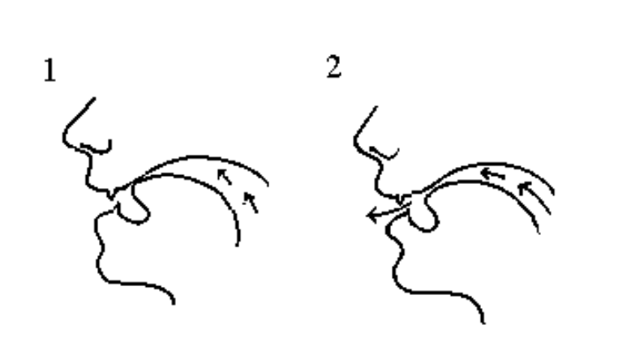
Task a
Pronunciation of the /tʃ/ sound
/tʃ/ is the voiceless consonant sound.
To make this sound, begin to make /t/, then move your tongue back and away from the roof of the mouth as you say /ʃ/.

Slide 9

Task b
Listen to the words and focus on the underlined letters.
Much
Nature
/mʌtʃ/
/ˈneɪtʃər/
More example:
Teacher /ˈtiːtʃər/
Child /tʃaɪld/
Chips /tʃɪps/
Catch /kætʃ/
Change /tʃeɪndʒ/
Chicken /ˈtʃɪkɪn/

Slide 10
Task c
Listen and cross out the one with the different sound.
such
cheese
stomach
chair
/sʌtʃ/
/tʃiːz/
/ˈstʌmək/
/tʃer/
Task d
Read the words to your partner.

Slide 11
Speaking

Slide 12
Task a
Practice the conversation. Swap roles and repeat.
Annie: Hi, James. Do you think it's better to live in the city or the country?
James: Hi, Annie. I think it's better to live in the country.
Annie: Really? Why?
James: Because there is lots of fresh air in the country.
Annie: Yes, but it's boring. I want to live in the city because there are lots of facilities.
James: Really? I think there are too many vehicles in the city, and there isn't enough room.
Annie: That's true, but there are lots of schools and hospitals in the city.
James: Yes, but I still prefer the country. I want to live there when I'm older.

Slide 13
Task b
Make two more conversations using the ideas on the right.
Annie: Hi, James. Do you think it's better to live in the city or the country?
James: Hi, Annie. I think it's better to live in the country.
Annie: Really? Why?
James: Because there is lots of nature in the country.
Annie: Yes, but it's boring. I want to live in the city because there is lots of entertainment.
James: Really? I think isn't enough peace and quiet in the city, and there isn't enough fresh air.
Annie: That's true, but there are lots of shops and movie theaters in the city.
James: Yes, but I still prefer the country. I want to live there when I'm older.
is – nature
is – entertainment
isn't enough peace and quiet
fresh air
shops
movie theaters

Slide 14
Annie: Hi, James. Do you think it's better to live in the city or the country?
James: Hi, Annie. I think it's better to live in the country.
Annie: Really? Why?
James: Because there are lots of animals in the country.
Annie: Yes, but it's boring. I want to live in the city because there are lots of things to do.
James: Really? I think is too much noise in the city, and there isn't enough nature.
Annie: That's true, but there are lots of markets and cafes in the city.
James: Yes, but I still prefer the country. I want to live there when I'm older.
are – animals
are – things to do
is too much noise
nature
markets
cafés

Slide 15
Production

Slide 16
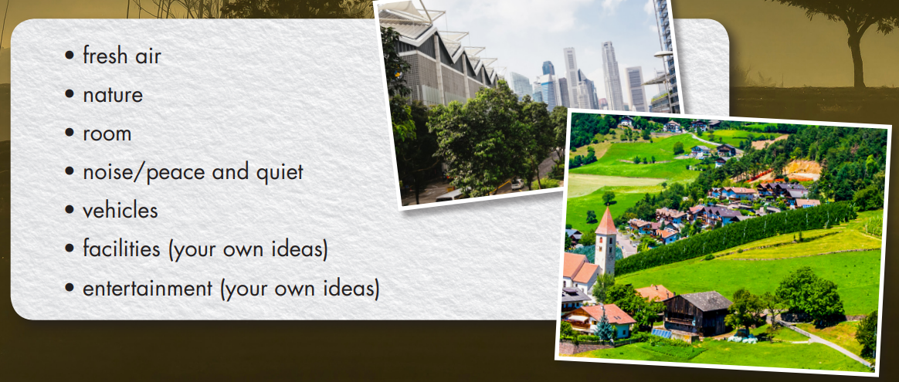
Task a
IS IT BETTER TO LIVE IN THE CITY OR THE COUNTRY?
In threes: Compare the points below, and say which place you think is better to live in and why.

Slide 17
Useful expressions for polite disagreement.
I see what you’re saying but I think…
That’s true, but I have to say I disagree.
I’m sorry but I have to disagree with you.
I’m not sure I agree with you on…
I’m afraid I disagree.
I’m sorry but I don’t agree.
I don’t see it that way.
I’m sorry but I disagree with you on this.
I have a completely different opinion on that.

Slide 18
I would like to live in the country because there is lots of nature.
That's true, but the country is boring, and there isn't enough entertainment like shopping malls. I'd prefer to live in the city.
Yes, but there is too much
noise in the city…

Slide 19
Task b
In your group, choose the two best and worst things about life in the city and life in the country, and present to the class.
We think it is better to live in the country because there is a lot of fresh air and it’s close to nature. However, there aren’t many things to do for fun and the facilities are not modern.

Slide 20

CONSOLIDATION

Slide 21
Write four sentences about 2 advantages and 2 disadvantages of living in the country/city.
Examples:
There are many kinds of entertainment in the city.
The facilities in the city are very modern.
There are too many vehicles on the streets during rush hours.
There is not enough room for all people to live.

Slide 22

WRAP-UP

Slide 23
Today’s lesson
Pronunciation
Pronouncing the /tʃ/ sound.
Speaking
Talking about living in the country and the city.

Slide 24
Homework
Practice saying the /tʃ/ sound.
Prepare the next lesson (pages 18 & 19 SB)
Play the consolidation games on www.eduhome.com.vn

Slide 25

Lesson 3
Stay positive and have a nice day!

