Slide 1
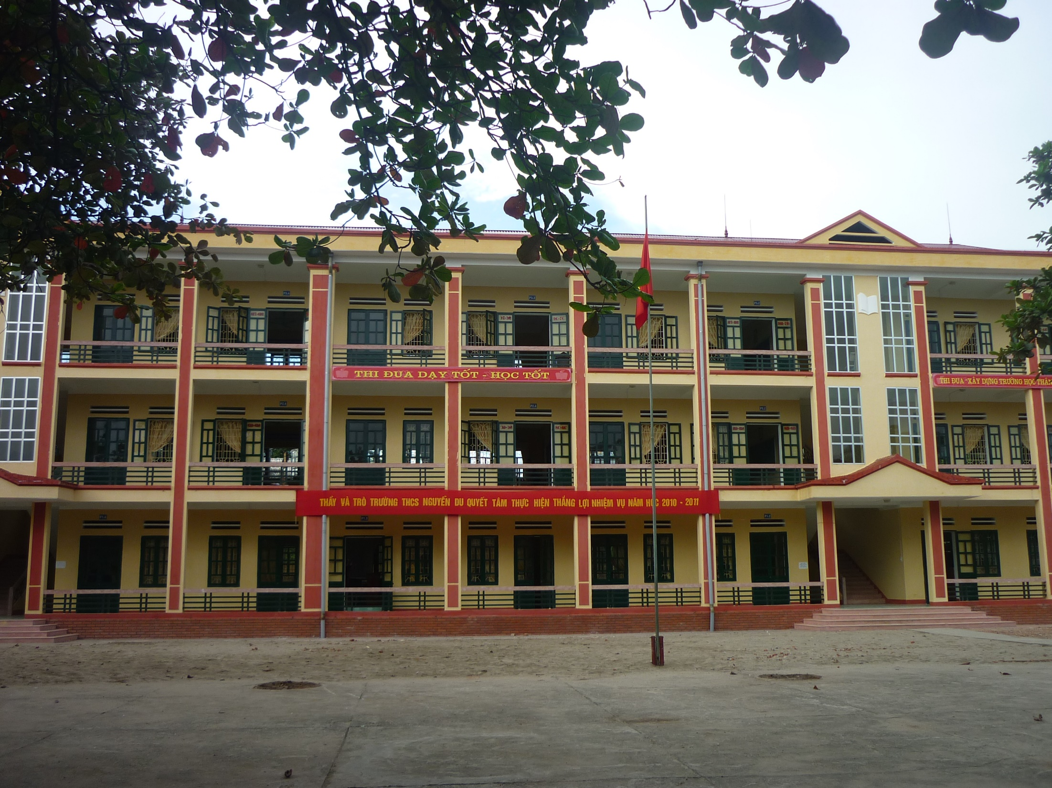
NICE TO MEET YOU!
11/10/2023
Welcome to our class!

Slide 2
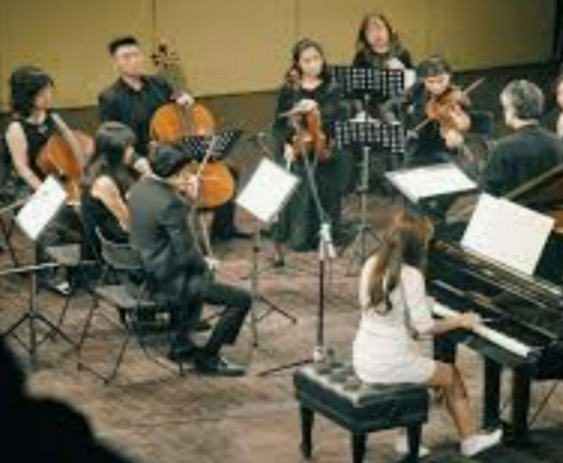
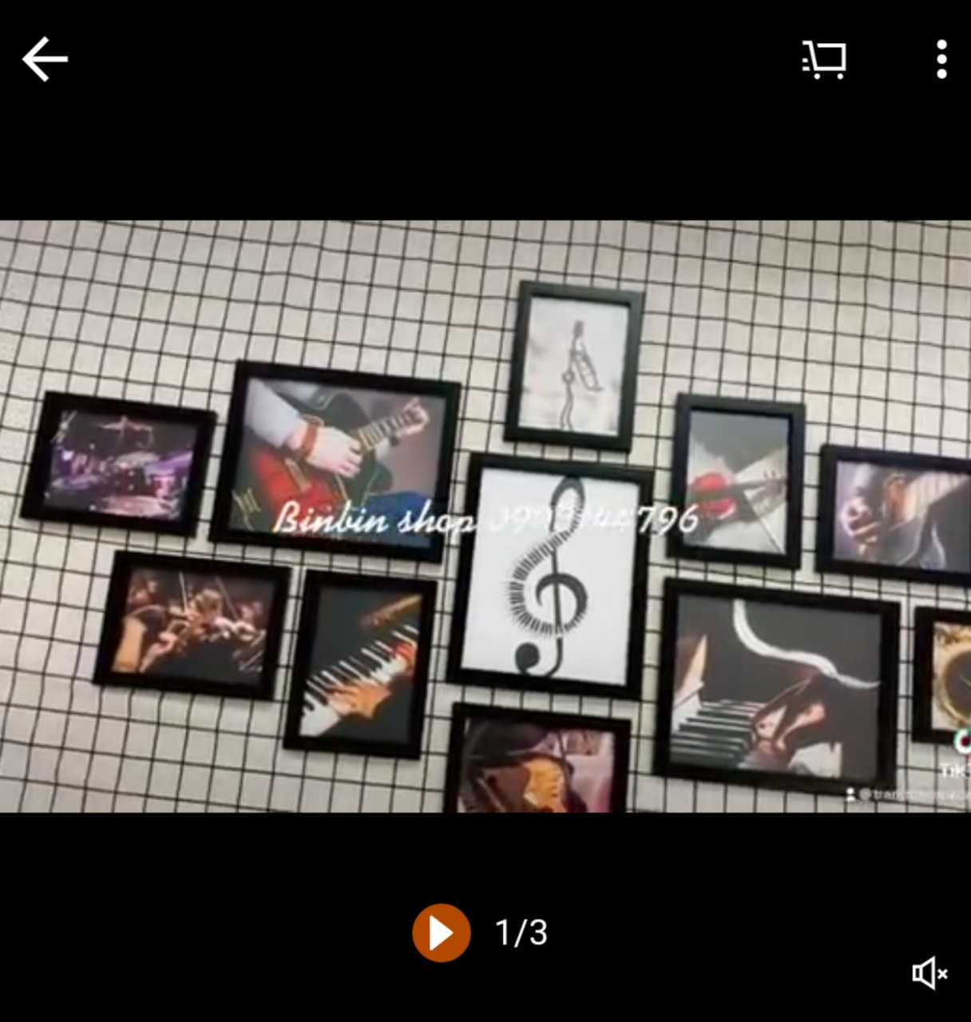
What are these pictures about?
Music and arts

Slide 3
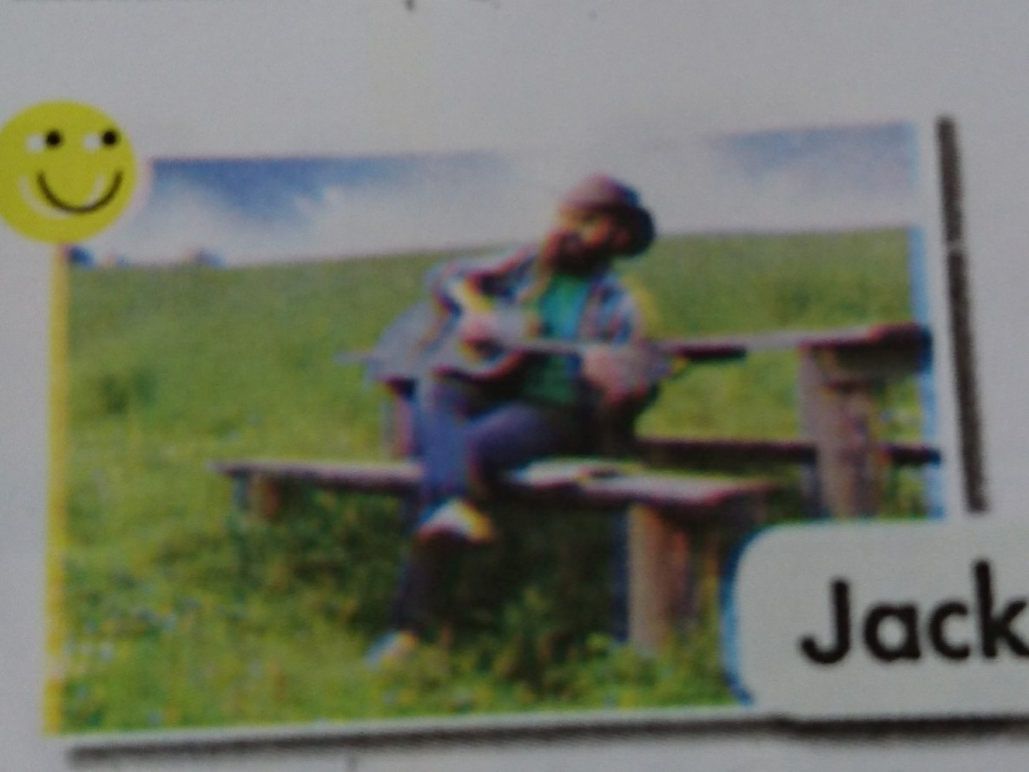
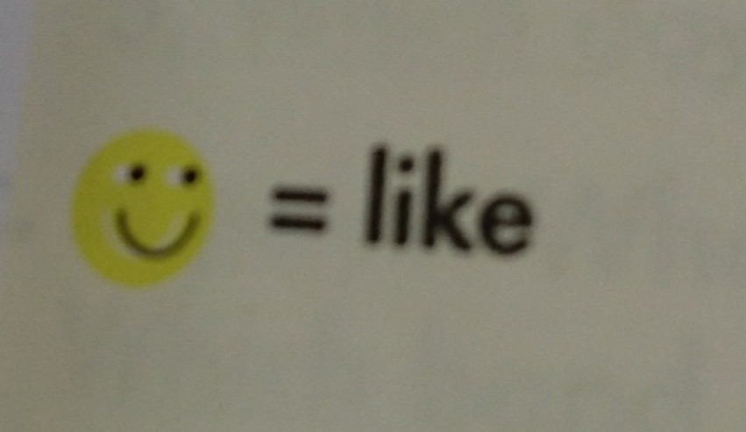
Does Jack like music?
Yes, he does.

Slide 4
Unit 3: Music and Arts
Lesson 1.2: Grammar
Page 21

Slide 5
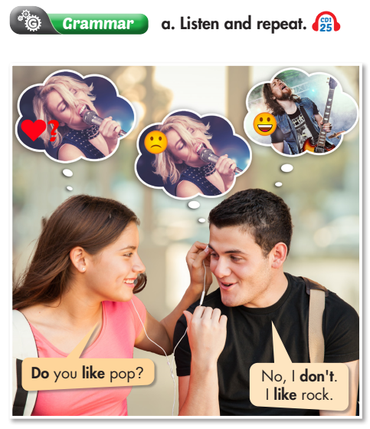
Present Simple for facts We can use the Present Simple to talk about things that we consider as facts (such as likes and dislikes), or are true for a long time. We form the Present Simple with regular verbs like this: • Positive: Subject + Verb (-s/-es) + (object) • Negative: Subject + don't/doesn't + Verb + (object) • Question: Do/Does + Subject + Verb + (object)?

Slide 6
Eg:
We
1. I like jazz. I don’t like rock.
We
Lan
She
2. He likes pop. He doesn’t like classical mucic.
3. Does Nam like pop?
-Yes, he does ( No, he doesn’t)

Slide 8
look
s
wash
es
clean
go
s
es

Slide 9
b. Circle the correct words. (p21)
1. Sarah love/loves jazz. She don't/doesn't like rock music.
2. Matt often listen/listens to his favorite rock songs when he do/does his homework.

Slide 10
b. Circle the correct words.(P21)
3. I don't/doesn't like listening to classical music. It is/are boring.
4. - Do/Does your parents listen/listens to country music? - Yes, they love/loves it. 5. My sister and I play/plays the piano every day. We practice/practices in the evening.
6. - When do/does the music show finish/finishes? - It finish/finishes at 11 p.m.

Slide 11
b. Circle the correct words.
3. I don't/doesn't like listening to classical music. It is / are boring.
4. - Do/Does your parents listen/listens to country music? - Yes, they love/loves it. 5. My sister and I play / plays the piano every day. We practice/ practices in the evening.
6. - When do/does the music show finish / finishes? - It finish / finishes at 11 p.m.

Slide 12
Joe doesn’t like pop.

Slide 13
Joe doesn’t like pop.
I love rock.
I don’t like
hip hop.
Does Tom like
classical music?
Jack likes country music.

Slide 14
Ask and answer.
+ Pop
+ hip hop
What kind of music do you like?
A:
+ Classical music
+ Country music
I like pop. It’s interesting.
B:

Slide 15
Homework
Practice making sentences using the Present Simple.
Complete the grammar notes in Tiếng Anh 7 i-Learn Smart World Notebook on page 15.
Prepare the next lesson (page 22 SB).

