Slide 1
Unit 1: English in the World
Lesson 1.1: Vocab & Reading
Pages 4 & 5

Slide 2
Lesson Outline
Warm-up
Vocabulary
Reading
Consolidation
Wrap-up

Slide 3
By the end of this lesson, students will be able to…
- learn and use phrasal verbs to describe study methods.
- practice reading for details.

Slide 4
WARM-UP

Slide 5
Work in pairs. Look at the pictures:
What are these people doing to improve their English?
What do you do to improve your English in your free time?

Slide 6
Suggested answers:
Reading books in English
Listening to English music
Watching TV or movies in English

Slide 7
Pre-reading

Slide 9
Task a. Read the sentences, then match the words to the definitions.
a. Look up words you don't know in the dictionary. b. You can find the lyrics of your favorite songs on the internet. c. You might come across interesting phrases when you read books in a foreign language. d. It's important to go over your homework and look for mistakes. e. When you watch TV in English, remember to use the English subtitles. f. "Turn on the TV. I'm so bored!" g. Practicing new words is important, so find a study method you like. h. It's a good idea to note down new words in a notebook so that you don't forget them.

Slide 10
turn on
1. ______________ – make something work by moving a switch or pressing a button 2. ______________ – a way of doing something, often with a plan 3. ______________ – look for information about something 4. ______________ – meet or find somebody or something by chance 5. ______________ – check something very carefully 6. ______________ – write something so that you don't forget it
7. ______________ – words you can read at the bottom of a television screen to explain what you hear, often in another language 8. ______________ – the words in a song

Slide 11
Now listen and check
turn on
1. ______________ – make something work by moving a switch or pressing a button 2. ______________ – a way of doing something, often with a plan 3. ______________ – look for information about something 4. ______________ – meet or find somebody or something by chance 5. ______________ – check something very carefully 6. ______________ – write something so that you don't forget it
7. ______________ – words you can read at the bottom of a television screen to explain what you hear, often in another language 8. ______________ – the words in a song

Slide 12
turn on
1. ______________ – make something work by moving a switch or pressing a button 2. ______________ – a way of doing something, often with a plan 3. ______________ – look for information about something 4. ______________ – meet or find somebody or something by chance 5. ______________ – check something very carefully 6. ______________ – write something so that you don't forget it
7. ______________ – words you can read at the bottom of a television screen to explain what you hear, often in another language 8. ______________ – the words in a song
method
look up
come across
go over
note down
subtitles
lyrics
ANSWERS

Slide 13
Listen and repeat. Click on each phrase to hear the sound.
turn on (phr v) /tɜːrn ɑːn/ bật lên
method (n) /ˈmeθəd / phương pháp
look up (phr v) /ˈlʊk ʌp / tra cứu
come across (phr v) / kʌm əˈkrɑːs / bắt gặp
go over (phr v) /ɡoʊ ˈoʊvər/ kiểm tra lại, xem lại
note down (n) / noʊt daʊn / ghi chú
subtitle (n) / ˈsʌbˌtaɪtl / phụ đề
lyrics (n) /ˈlɪrɪks / lời bài hát
Notes:
GV click vào từng cụm nghe âm thanh

Slide 14
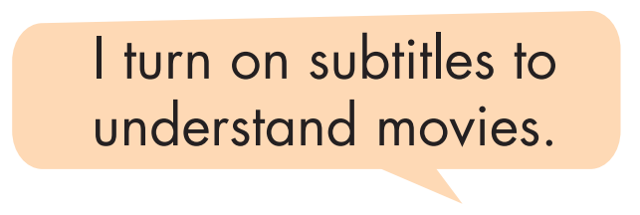
Task b. In pairs: Use the new words to talk about the ways you read, watch, or listen to English.

Slide 15
Suggested answer
I turn on my computer to watch English videos.

Slide 16
Suggested answer
2. My favorite method of learning English is through reading books.

Slide 17
Suggested answer
3. When I don't understand a word, I look it up in the dictionary.

Slide 18
Suggested answer
4. While browsing the internet, I come across interesting English articles.

Slide 19
Suggested answer
5. I go over my English notes before exams to review the information.

Slide 20
Suggested answer
6. During English class, I note down important points in my notebook.

Slide 21
Suggested answer
7. When watching movies, I like to use subtitles to understand better.

Slide 22
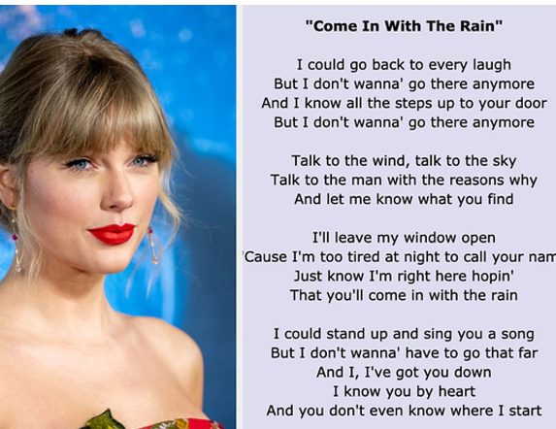
Suggested answer
8. I enjoy listening to English songs and often read the lyrics to improve my vocabulary.

Slide 23
While-reading

Slide 24
Read the online article about English study methods. What is the passage mainly about? Reading 1. writing good texts 2. taking difficult exams 3. learning in fun ways
Task a

Slide 25
You already know learning English is useful, but do you know there are fun ways to learn? 1. Read English books/newspapers/websites: You can read more to improve your vocabulary. Your speaking, listening, reading, and writing skills will improve if you learn more vocabulary. Find books, newspapers, or websites on topics you like. Choose one slightly above your level to learn new words each time. 2. Watch television shows and movies in English: You can turn on the English subtitles to understand the actors clearly or copy the actors to improve your pronunciation. You can also note down new words to look up later.

Slide 26
3. Keep a notebook: Write down new words or grammar from class in a notebook. When you go home, go over your notes to help you remember what you learned. You should also go over them to see if you come across any mistakes. 4. Listen to music in English: Listening (and singing) to music is another fun way to improve your English. There are so many songs to choose from. Go over the lyrics to help you understand the English words.
Now you know some fun ways to learn English. Which ones are you going to try today?

Slide 27
ANSWERS
Read the online article about English study methods. What is the passage mainly about? Reading 1. writing good texts 2. taking difficult exams 3. learning in fun ways
Task a

Slide 28
Clues
You already know learning English is useful, but do you know there are fun ways to learn? 1. Read English books/newspapers/websites: You can read more to improve your vocabulary. Your speaking, listening, reading, and writing skills will improve if you learn more vocabulary. Find books, newspapers, or websites on topics you like. Choose one slightly above your level to learn new words each time.

Slide 29
Guess the type of missing word(s). Noun? Verb? Adj? etc,?
Task b
Now, read and fill in the blanks.
1. According to the article, you will improve all four skills if you learn more ________________. 2. Look for books or ________________ on topics you like and choose one just above your level. 3. When you watch movies or TV shows in English, you can ________________ vocabulary to look up later. 4. You should go over your notes to help you ________________ new words and grammar you learned. 5. When listening to music in English, use the ________________ to help you understand the words.
noun
noun
verb
verb
noun

Slide 30
ANSWERS
Task b
Now, read and fill in the blanks.
1. According to the article, you will improve all four skills if you learn more ________________.
vocabulary

Slide 31
ANSWERS
2. Look for books or ________________ on topics you like and choose one just above your level.
websites

Slide 32
ANSWERS
3. When you watch movies or TV shows in English, you can ________________ vocabulary to look up later.
note down

Slide 33
ANSWERS
4. You should go over your notes to help you ________________ new words and grammar you learned.
remember

Slide 34
ANSWERS
5. When listening to music in English, use the ________________ to help you understand the words.
lyrics

Slide 35
Task c
Listen and read

Slide 36
Post-reading

Slide 37
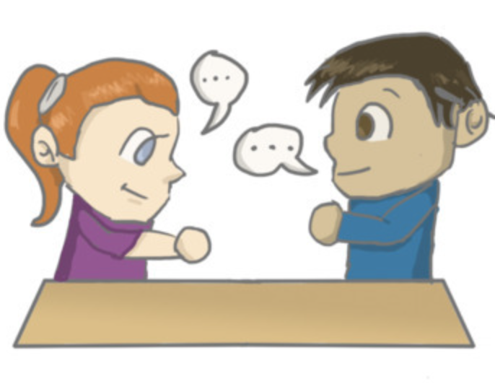
In pairs: Ask and answer:
Which English study methods do you want to try? Why?
Task d

Slide 38
Sample answer
Which English study methods do you want to try? Why?
I want to try watching TV and movies to learn English. It's a fun way to pick up the language because I can see and hear how people speak in real-life situations.

Slide 39
Extra practice – WB,
Task a. Read and do the crossword puzzle.

Slide 40
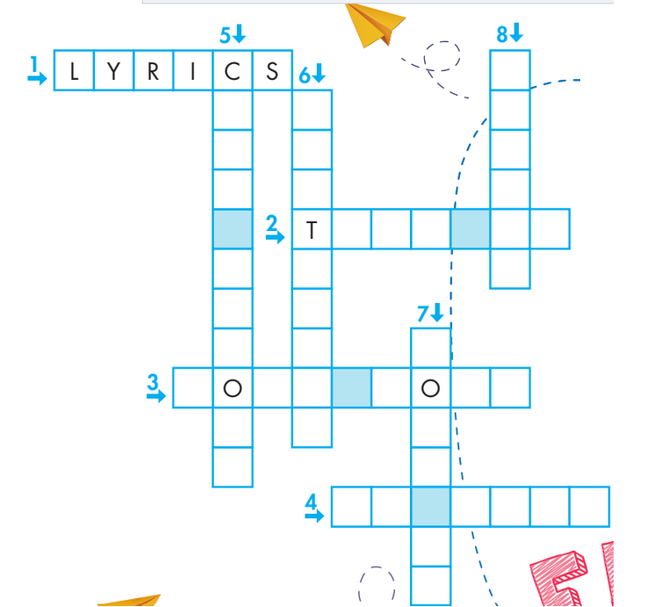
METHOD
O
M E
A
C
R
S
S
SUB
T I
TL
E
S
U R N O N
LOOK
UP
N T E D WN
G O O V E R

Slide 41
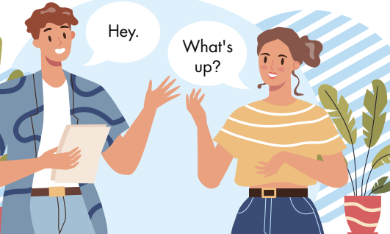
Task b. Fill in the blanks using the words from Task a.
look up
1. When you _____________ the definition of a word in a dictionary, you should read the example sentences, too.
2. I like to keep a note of interesting phrases I _____________ when reading books.
3. You can look for the _____________ to songs and read them while you listen.
4. You can put on English _____________ for TV shows in English and your native language.
come across
lyrics
subtitles

Slide 42
5. You should keep a pen and paper with you so you can _____________ new words you learn.
6. I always _____________ music when I study. Listening to music helps me focus better.
7. A good _____________ for learning English is to copy what actors say and do on TV.
8. It's always a good idea to _____________ your
essays before giving them to your teacher.
note down
turn on
method
go over

Slide 43
Task a. Read the article about methods of learning English.
What is the main message?
There are lots of ways to learn.
There is one good way for each person.
If you don't practice every day, you won't learn.

Slide 44
Are you finding it difficult to learn English? Don't worry! I'm here to help. Everyone learns differently. Maybe one or two of the ideas below will make it easier.
1. Turn on the English subtitles
You can learn English while watching your favorite TV shows in your native language. Turn on the English subtitles and read them while the people are speaking.
2. Note down new words you learn
Do you often try to learn something new and then forget it? Keep a note to note down new words and phrases, then look up their definitions. Then, use them later when you practice speaking.

Slide 45
3. Sing along to music
If you like English music, you should start singing along. You can find the lyrics online and read them while you listen to your favorite song. After that, sing along to your favorite English songs loudly and proudly to help you say the words in the future.
4. Practice every day
You should try to use new English words, phrases, and sentences you learned every day. Go over the notes you made in your notebook, and it will help you remember them better.
I hope that helps. There are so many ways to learn. Find the ways that work best for you!

Slide 46
Answer and clues:
There are lots of ways to learn.
There is one good way for each person.
If you don't practice every day, you won't learn.
Are you finding it difficult to learn English? Don't worry! I'm here to help. Everyone learns differently. Maybe one or two of the ideas below will make it easier.

Slide 47
Task b. Now, read and fill in the blanks.
1. You should read the _________________________ when you watch your favorite TV shows.
2. You can note down new words in __________________.
3. You can find song _________________________ online.
4. Singing along to _________________________ will help you say words in the future.
5. Using new words and phrases every day will ________________________________.

Slide 48
ANSWERS
1. You should read the _________________________ when you watch your favorite TV shows.
subtitles

Slide 49
ANSWERS
a note
2. You can note down new words in __________________.

Slide 50
ANSWERS
lyrics
3. You can find song _________________________ online.

Slide 51
ANSWERS
(your favorite) English songs
4. Singing along to _________________________ will help you say words in the future.

Slide 52
ANSWERS
5. Using new words and phrases every day will ________________________________.
help you remember them better

Slide 53
CONSOLIDATION

Slide 54
Talk to your partner about other methods to improve your English.

Slide 55
Sample answers
Write Regularly: Practice writing essays, short stories, or a daily journal to improve grammar and expression.
Use Educational Apps: Explore language-learning apps that make English learning interactive and engaging.
Join a Book Club or English Group: Discussing books or topics with peers enhances speaking and listening skills.

Slide 56
WRAP-UP

Slide 57
Today’s lesson
Vocabularies
1. turn on 2. method 3. look up 4. come across 5. go over 6. note down 7. subtitles 8. lyrics

Slide 58
Today’s lesson
Vocabulary:
- Using phrasal verbs to describe study methods.
Reading:
- Understanding an online article about English study methods.
- Practicing reading for details.

Slide 59
Homework
Review phrasal verbs to describe study methods
Make sentences using the phrasal verbs in SB
Prepare for the next lesson (Grammar - pages 5 & 6 - SB)
Play the consolidation games on www.eduhome.com.vn

Slide 60
Lesson 3
Stay positive and have a nice day!

