Slide 1
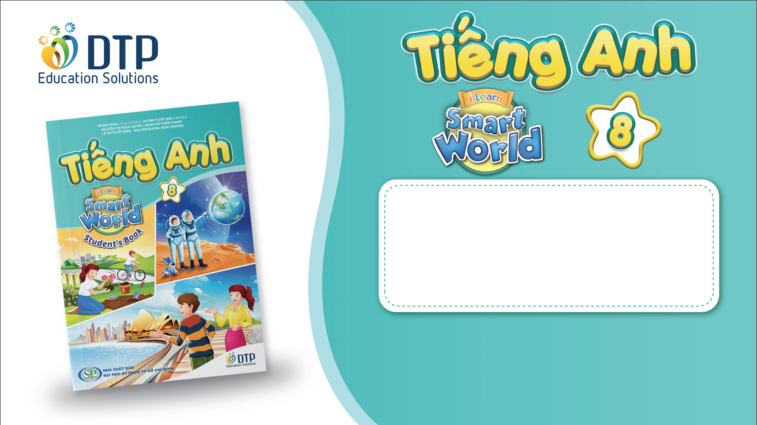
Unit 2: Life in the country
Lesson 1.1: Vocab & Listening
Pages 14 & 15

Slide 2
Lesson Outline
Warm-up
Vocabulary
Reading
Consolidation
Wrap-up

Slide 3

By the end of this lesson, students will be able to…
- learn vocab. related to life in the country and life in the city
- practice listening for gist and detail

Slide 4

New words
1. entertainment
2. nature
3. noise
4. peace
5. fresh
6. vehicle
7. room
8. facility

Slide 5

WARM UP

Slide 6

Work in pairs.
Look at the pictures and answer the questions:
- Which two places do they show?
- What are some good and bad things about each place?

Slide 7

Pre-Listening

Slide 8



Slide 9
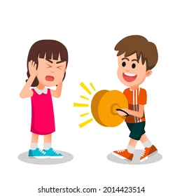
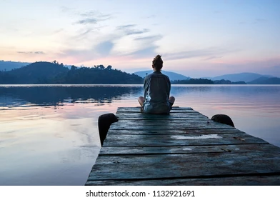

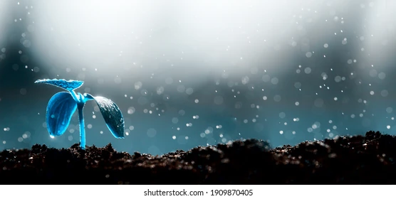
a. Label the pictures.
1. entertainment
2. nature
3. noise
4. peace
5. fresh
6. vehicle
7. room
8. facility
noise
peace
room
fresh

Slide 10
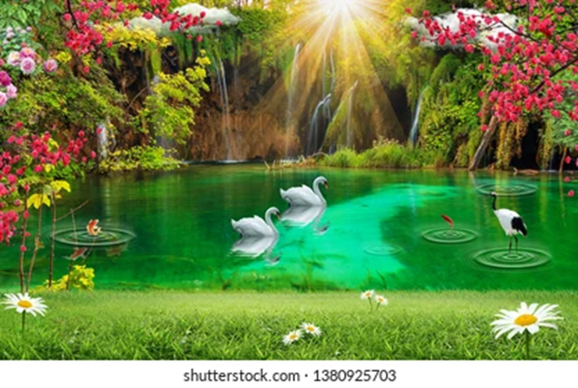
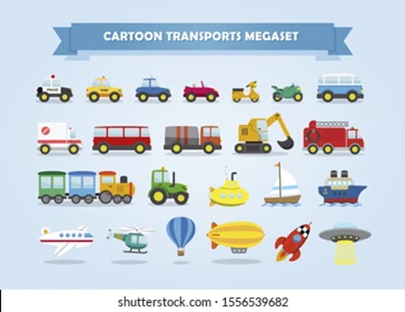
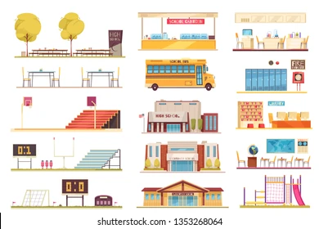

1. entertainment
2. nature
3. noise
4. peace
5. fresh
6. vehicle
7. room
8. facility
nature
vehicle
facility
entertainment

Slide 11

Listen and repeat. Click on each phrase to hear the sound.
entertainment (n) /entərˈteɪnmənt/ sự giải trí, tiêu khiển
nature (n) /ˈneɪtʃər/ thiên nhiên
noise(n) /nɔɪz/ tiếng ồn
peace (n) /piːs/ sự yên tĩnh
fresh (a) /freʃ/ trong lành, mát mẻ
vehicle (n) /ˈviːəkl/ xe cộ
room(n) /ruːm/ không gian
facility(n) /fəˈsɪləti/ cơ sở vật chất
Notes:
GV click vào từng cụm nghe âm thanh

Slide 12
Task a
Read the definitions, then fill in the blanks with the new words.
entertainment – things people can use or do for fun
nature – animals, plants, and things not made by people
noise – unpleasant and/or loud sounds peace – the state of being calm or quiet fresh – clean or cool (e.g. water, air)
vehicle – a thing used for transporting people or things from one place to another, such as a car or a truck
room – available empty space to use
facility – a building, service, piece of equipment, etc. with a particular purpose
1. I want a big garden because I need __________ to grow vegetables.
2. Many people visit Hawaii for its __________. It has lots of beautiful beaches and mountains with trees and colorful birds.
3. My favorite thing about the library isn't the books. It's the _____ and quiet.
4. The air outside is so __________. Let's go for a walk!
room
nature
peace
fresh

Slide 13
entertainment – things people can use or do for fun
nature – animals, plants, and things not made by people
noise – unpleasant and/or loud sounds peace – the state of being calm or quiet
fresh – clean or cool (e.g. water, air)
vehicle – a thing used for transporting people or things from one place to another, such as a car or a truck
room – available empty space to use
facility – a building, service, piece of equipment, etc. with a particular purpose
5. I live near an airport, and I can't sleep at night because the _______ is so loud!
6. I have to use public transportation every day because I don't have a __________.
7. Amusement parks and theaters are two examples of _____________ in my city.
8. I think that the new hospital is the most important ______ in our town.
noise
vehicle
entertainment
facility

Slide 14
Task b
In pairs: Say where you live, and why you like/dislike living there.
I live in a small town. I like living there because there is a lot of nature and fresh air.
I live in a big city. I don’t like living there because there is a lot of noise and vehicles.

Slide 15

Pre - Listening

Slide 16
Pre - Listening
Pair work: list the advantages and disadvantages of living in the country and living in the city.
 | Living in the city | Living in the country
Advantages
Disadvantages
- Different types of entertainment
- Modern facilities
- Good education
- Peace
- Nature
- Fresh air/food
- Pollution
- Noise
- Crowds
Not many types of entertainment
- Old facilities
- Poor education

Slide 17
Task a
Read the instruction and underline the key words.
What are you going to do?
Listen to Joe and Mai talking about life in the city and in the country. What do they agree on?
the pollution 2. the noise
Listen to Joe and Mai’s conversation and figure out what they agree on: the pollution or the noise.

Slide 18
Task a
Listen to Joe and Mai talking about life in the city and in the country. What do they agree on?
the pollution
the noise

Slide 19
Task b
Guess the missing types of words:
1. Mai thinks the country is better because there is lots of ___________.
2. Joe likes the ___________ in the city.
3. Mai thinks there's not enough ___________ for all the people in the city.
4. She also thinks there is too much ___________ in the city.
5. She doesn't like the city because there are too many ___________.
6. Joe prefers living in the ___________.
Uncount. noun
noun
uncount. noun
uncount. noun
plural noun
noun

Slide 20
Underline the key words:
1. Mai thinks the country is better because there is lots of ___________.
2. Joe likes the ___________ in the city.
3. Mai thinks there's not enough ___________ for all the people in the city.
4. She also thinks there is too much ___________ in the city.
5. She doesn't like the city because there are too many ___________.
6. Joe prefers living in the ___________.

Slide 21
While-Listening

Slide 22
While-Listening
Now, listen and fill in the blanks.
1. Mai thinks the country is better because there is lots of ___________.
2. Joe likes the _____________ in the city.
3. Mai thinks there's not enough ___________ for all the people in the city.
4. She also thinks there is too much ___________ in the city.
5. She doesn't like the city because there are too many ___________.
6. Joe prefers living in the ___________.
nature
entertainment
room
noise
vehicles
city

Slide 23
Now, listen and fill in the blanks.
better
Joe: Hi, Mai. Do you think its …………..to live in the country or the city?
Mai: Hi, Joe. I think the country is better because there is lots of nature I love ……………….. and animals.
Joe: But life in the country is too……………. I like the entertainment in the city. There are lots of malls and …………………………..
Mai: Yes, but the city is too …………………, there’s not enough room for all the people there.
Joe: I like lots of people. It’s exciting. For me, the country is too ……………...
Mai: Really? I like …………….. and quiet. I think there's too much noise in the city.
Joe: Well I think there aren't enough …………………….. in the country. The city has better public transportation.
Mai: That’s true, but I prefer the country because there are too many vehicles in the city. They make the air ………………...
Joe: OK, You’re right about that. There’s lots of ……………. air in the country, but I still think city life is best.
trees
boring
movie theaters
crowded
quiet
peace
facilities
dirty
fresh

Slide 24
Post-Listening

Slide 25
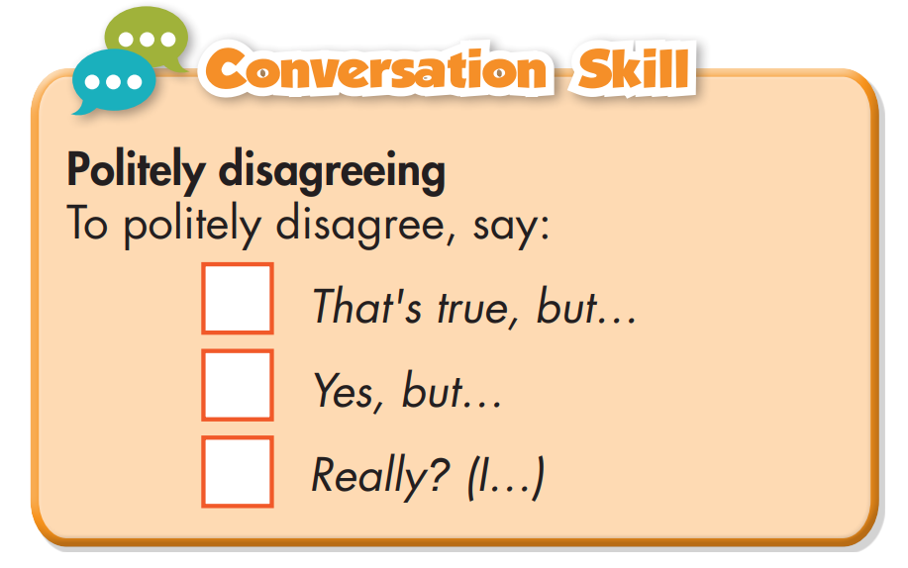
Task c
Read the Conversation Skill box.
Then, listen and repeat.

Slide 26
Task d
Now, listen to the conversation again and number the phrases in the order you hear them.
That's true, but...
Yes, but...
Really? (I...)
3
1
2

Slide 27
Task e
Work in pairs
Do you agree with Mai or Joe? Why?
I agree with Mai. I like the country more than the city because it's cleaner and quieter.

Slide 28

CONSOLIDATION

Slide 29
Talk to your partner where you prefer living: in the city or in the country?
I prefer living in the city because there are many modern facilities.
I prefer living in the country because I enjoy the peace and quiet there.

Slide 30

WRAP-UP

Slide 31
Today’s lesson
Vocabularies
1. entertainment
2. nature
3. noise
4. peace
5. fresh
6. vehicle
7. room
8. facility

Slide 32
Today’s lesson
Listening:
- Understanding instructions
Listening for specific information
Speaking:
- Talking about life in the city and the country

Slide 33
Homework
Learn by hearts vocab. and make sentences using them.
Do the vocab. and reading exercises on pages 8 & 9 WB.
Do the exercises in Tiếng Anh 8 i-Learn Smart World Notebook on pages 12 & 13
Prepare the next lesson (pages 15 & 16 SB)
Play the consolidation games on www.eduhome.com.vn

Slide 34

Lesson 3
Stay positive and have a nice day!

