Slide 5
A / an/ some
Chicken pasta
coffee
cupcake
fries
hamburger
lemonade
Orange juice
pizza
Egg sandwich
tea

Slide 6
What would you like to eat? Bạn muốn ăn gì? I’d like to eat__________
Chicken pasta
coffee
cupcake
fries
hamburger
lemonade
Orange juice
pizza
Egg sandwich
tea

Slide 7
What would you like to drink? Bạn muốn uống gì? I’d like to drink some __________
Chicken pasta
coffee
cupcake
fries
hamburger
lemonade
Orange juice
pizza
Egg sandwich
tea

Slide 8
Would you like some dessert? Bạn muốn món tráng miệng không? Yes, I’d like __________
Chicken pasta
coffee
cupcake
fries
hamburger
lemonade
Orange juice
pizza
Egg sandwich
tea

Slide 9
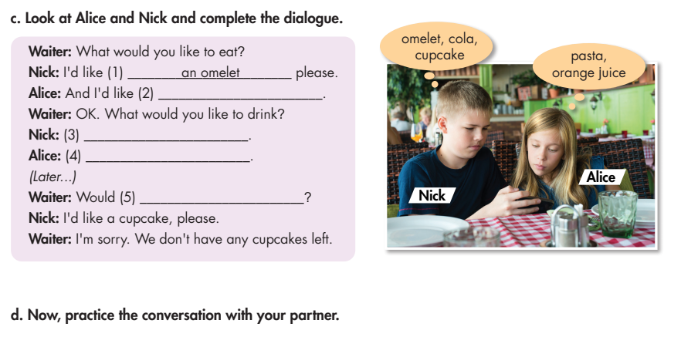
Lesson 2
some pasta
I’d like some cola, please
I’d like some orange juice, please
you like some dessert

Slide 10
Lesson 2
a
some
a
some
an
any

Slide 11
HOMEWORK
STUDY NEW WORDS
PREPARE NEXT LESSON

