Slide 1
Unit 3:
Protecting the Environment
Lesson 2.1 – Vocabulary & Listening
Pages 28 & 29

Slide 2
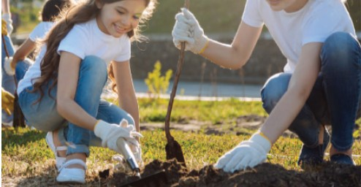
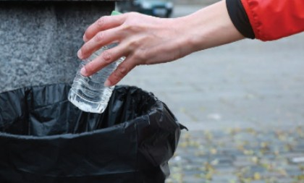
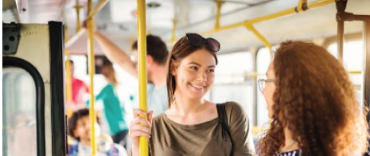
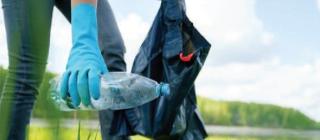
1. What are the people doing?
In the pictures, people are planting trees, picking up plastic bottles and using public transport
2. Do you think what they’re doing can help protect the environment? How?
In my opinion, the things they do can help protect the environment such as reducing plastic waste, reducing air pollution...

Slide 3
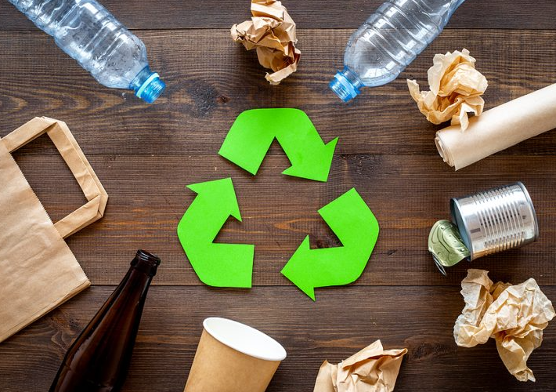
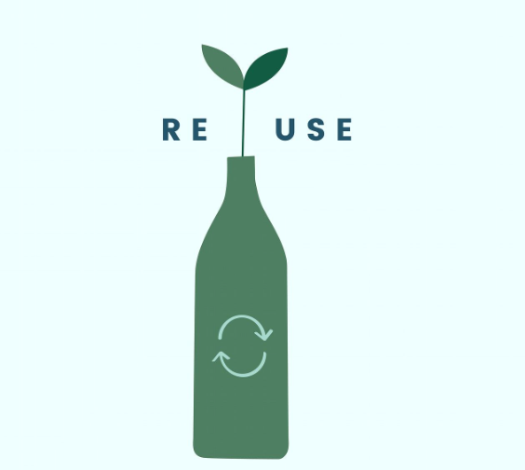
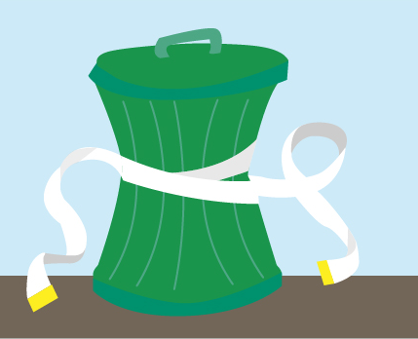
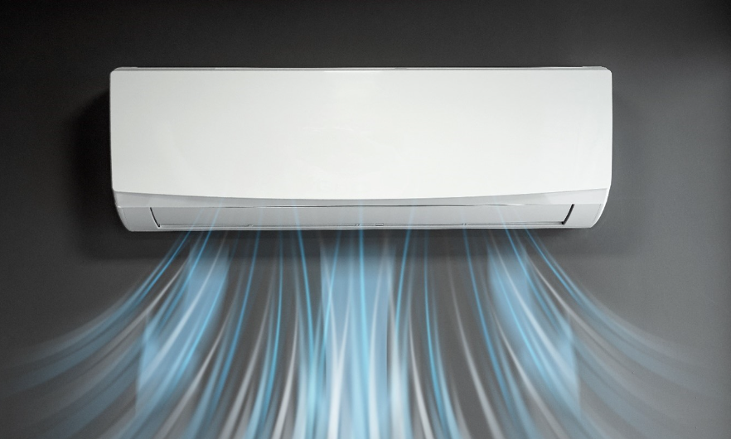
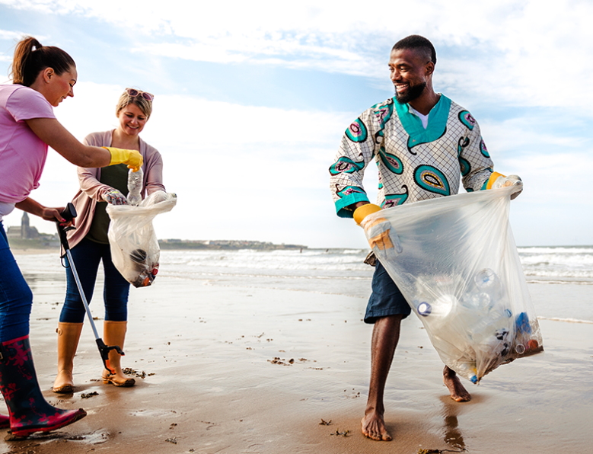
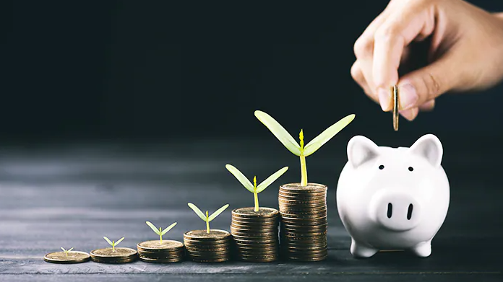
Look at pictures and guess the words
recycle
reuse
reduce
air conditioner
waste
clean up
electricity
save

Slide 4
Listen and repeat. Practice saying these words with a partner.
recycle (v) /ˌriːˈsaɪkl/: tái chế
reuse (v) /riːˈjuːz/: tái sử dụng
reduce (v) /rɪˈduːs/: cắt giảm
save (v) /seɪv/: tiết kiệm
waste (v) /weɪst/: lãng phí
clean up (v) /kliːn ʌp/ : làm sạch, dọn dẹp
electricity (n) /ɪˌlekˈtrɪsəti/ : điện
air conditioner (n) /ˈer kəndɪʃənər/: máy lạnh, điều hòa
Notes:
GV click vào từng cụm nghe âm thanh

Slide 5
Match the words with the descriptions.

Slide 6
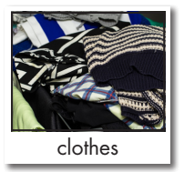
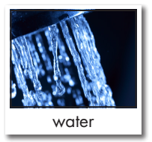
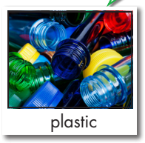
Look at the following items and say what you can/can’t recycle, reuse, or save
We can recycle clothes.
We can save water.
We can recycle TV.
We can recycle plastic.
We can reuse paper.

Slide 7
Read the instruction and underline the key words.
Listen to Amy and Daniel talking about ways to reduce pollution. What are they working on?
a poster 2. a presentation

Slide 8
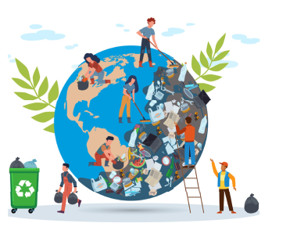
Listen to Amy and Daniel conversation and figure out what they work on: a poster or a presentation.
a poster 2. a presentation

Slide 9
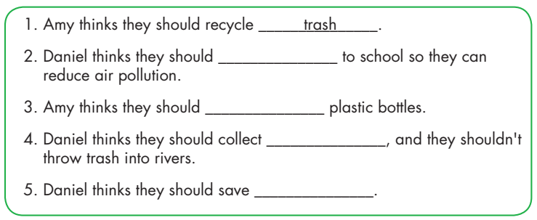
ride their bikes
reuse
rain water
electricity

Slide 10
What else..?
Anything else..?
3 times
2 times

Slide 11
Work in pairs
Example:
A: What do you do to reduce pollution?
B: I reuse plastic bottles and bags.
A: What else..?
B: I also save electricity. I turn off TV when I don’t use.

Slide 12
Home work
Learn by heart new words
Prepare lesson 2: Grammar

Slide 13
THANK YOU

