Slide 1



Welcome to class 6a3
Teacher: Nguyen Thi Huyen

Slide 2
Unit 3. lesson 2.1: grammar
PRESENT CONTINUOUS TENSE
Page 26

Slide 3
WHEN TO USE
PRESENT CONTINUOUS?

Slide 4
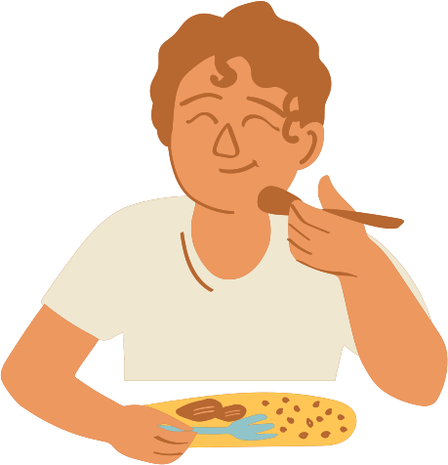
ACTIONS HAPPENING NOW
Examples: “I am eating lunch.”
“She is writing a letter.”
“They are playing soccer in the park.”
“He is cooking dinner.”
“We are watching a movie.”

Slide 5


UNDERLINE “V-ING” AND CIRCLE FUTURE TIME EXPRESSIONS.
Ex 1. I am watching a movie tonight.
Ex 2. He is making a cake tomorrow.
Ex 3. They are playing soccer on the weekend.
We also use Present continuous tense to talk about fixed future plans

Slide 6
PRESENT CONTINUOUS FOR FIXED FUTURE PLANS.
We also use Present continuous tense to talk about fixed future plans
Examples: “I am watching a movie tonight”
“They are playing soccer this weekend”
“She is making a cake tomorrow”
“He isn’t playing soccer tomorrow afternoon”
“What are you doing tomorrow night?
Time expressions: this weekend, on Saturday, tomorrow, tonight, etc

Slide 7
HOW TO FORM
PRESENT CONTINUOUS?

Slide 8
Structure of Present Continuous Tense
Positive Sentences:
Negative Sentences:
Subject + am/is/are + verb-ing.
Subject + am/is/are + not + verb-ing.
Example: She is cooking dinner.
Example: They are not playing games.
Yes/ No questions:
Wh-questions:
Am/Is/Are + subject + verb-ing?
=> Yes, S + is/are/am
=> No, S + isn’t/ aren’t. am not
Wh-word + Am/Is/Are + subject + verb-ing?
=> S + is/are/am + V-ing
Example: Are you reading a book?
=> Yes, I am / No, I am not
Example: What is he doing tonight?
=> He is watching a movie tonight.

Slide 9
PRACTICE
Task 1. CIRCLE the correct ANSWERS
(My brother = He)
1. My brother is going/ are going shopping on Friday.
What + are + you + Ving?
2. What is/are you doing tomorrow?
3. I am making/ is making a pizza tomorrow.
I + am + V-ing
Are + they + V-ing
4. Are they have/ having a picnic in the park this weekend?
5. She isn’t/ aren’t going to the mall with Mark on Saturday.
She + isn’t + V-ing
6. We are playing/ am playing basketball this evening.
We + are + V-ing
Is + he + V-ing?
7. Is/ Am he watch/ watching a movie at home tonight?

Slide 10
PRACTICE
Task 2. reorder the sentences
Group 1: “He isn’t having a picnic this Saturday.”
“What are you doing tomorrow night?”
Group 2: “ I am having a barbecue today.”
“Is David playing badminton this evening?
Group 3: “Emma and Jane aren’t watching a movie on Sunday.”
Is your sister watching a movie tonight?”
Group 4: “We are making a pizza this weekend.”
“Are they having a party tomorrow afternoon?”

Slide 11



PRODUCTION
Ask and answer about your future plans, using the present continuous
What are you doing tonight?
I am having a barbecue tonight.

Slide 12
CONSOLIDATION
* Present Continuous for future action:
=> Form: (+) S + am / is / are + V-ing
(-) S + am / is / are + not + V-ing
(?) Am / Is / Are + S + V-ing
Future time expressions: this weekend, on the weekend, on Saturday, tomorrow, tonight, this week, …

Slide 13
HOMEWORK
- Make 2 sentences, using the Present Continuous for future use.
- Do exercises in WB: Lesson 2 - Grammar – Part a, b, c (page 17).
- Prepare: Lesson 2 – Pronunciation and Speaking (page 27 – SB).

Slide 14
Thank you for your attention!

