Slide 1
UNIT 4: DISASTERS
Lesson 3.2 – Speaking & Writing
page 43

Slide 2
Lesson Outline
Warm-up
Speaking
Writing
Consolidation
Wrap-up

Slide 3
By the end of this lesson, students will be able to…
To talk about the dangers of disasters and what people should do
To write an emergency announcement for a disaster

Slide 4
WARM UP

Slide 5
In pairs:
Discuss the different disasters you know.
What are the dangers of these disasters?
What should and shouldn't people do during each disaster?

Slide 6
Speaking

Slide 7
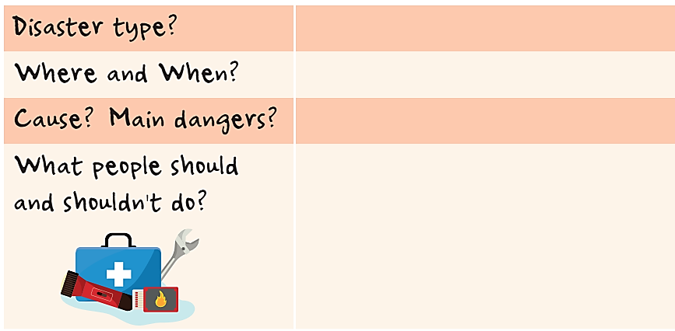
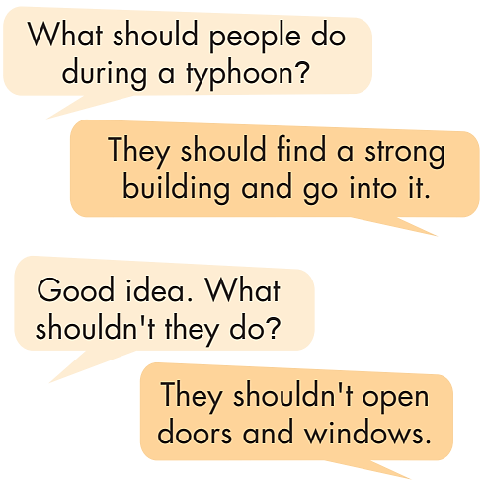
b. Imagine it's your job to warn your town about a disaster. Choose one disaster and complete the table with information about the dangers and your most important pieces of advice. (You can use ideas from the last lesson.)

Slide 8
PAIR WORK
Share ideas with a partner.

Slide 9
CLASS DISCUSSION
Share ideas with the class.

Slide 10
Writing

Slide 11
Now, write an emergency announcement warning another town about the disaster you discussed in Speaking. Use the Writing Skill box and your speaking notes to help you. Write 80 to 100 words.
……………………………………………………………………………………………..
……………………………………………………………………………………………..
……………………………………………………………………………………………..
……………………………………………………………………………………………..
……………………………………………………………………………………………..
……………………………………………………………………………………………..
……………………………………………………………………………………………..
……………………………………………………………………………………………..
……………………………………………………………………………………………..
……………………………………………………………………………………………..
……………………………………………………………………………………………..

Slide 12
Read the emergency announcements in front of the class.
Give feedback on each announcement using the Feedback box.

Slide 13
CONSOLIDATION

Slide 14

Typhoon warning from the National Weather Service Sent: 20:15 July 11 What: Typhoon Where: Rainytown When: From 22:30 July 11 to 08:00 July 12 There is a large typhoon coming to Rainytown. Winds could be as strong as 100 km/h with heavy rain. We expect damage to buildings, trees, and houses
Listen and read the Sample announcement.
Instructions
Have an escape plan.
Have emergency items ready to go.
Make sure cell phones/radios etc. are fully charged.
Board up windows.
Turn off electricity/gas.
Stay indoors.
Listen to local news reports.
Be prepared to leave your home and follow your escape plan.

Slide 15
Circle and number (1–4) the four parts of the announcement noted in the Writing Skill box.
Typhoon warning from the National Weather Service
Sent: 20:15 July 11 What: Typhoon Where: Rainytown When: From 22:30 July 11 to 08:00 July 12 There is a large typhoon coming to Rainytown. Winds could be as strong as 100 km/h with heavy rain. We expect damage to buildings, trees, and houses.
Instructions
Have an escape plan.
Have emergency items ready to go.
Make sure cell phones/radios etc. are fully charged.
Board up windows.
Turn off electricity/gas.
Stay indoors.
Listen to local news reports.
Be prepared to leave your home and follow your escape plan .

Slide 16
WRAP-UP

Slide 17
Today’s lesson
Speaking:
To talk about the dangers of disasters and what people should do
Writing:
To write an emergency announcement for a disaster

Slide 18
Homework
Do the exercises on page 25, WB.
Do the exercises in Tiếng Anh 8 i-Learn Smart World Notebook on page 35.
Prepare the next lesson (page 92, SB)
Play the consolidation games on www.eduhome.com.vn

Slide 19
Lesson 3
Stay positive and have a nice day!

