Slide 1

WARM UP

Slide 2


Slide 3

It’s time to learn …

Slide 4

Unit 6: Clothes
Lesson 1.1
Page 82

Slide 5

Presentation

Slide 6


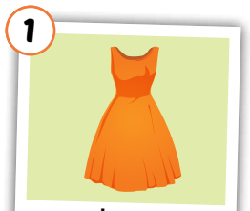
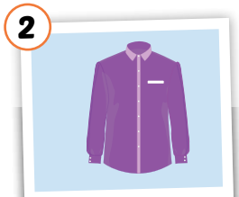
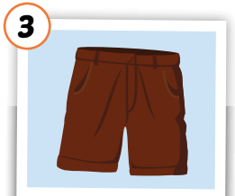
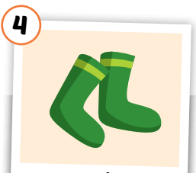
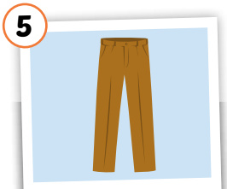
Click each English word to hear the sound.
dress
shirt
shorts
socks
pants
/dres/
đầm, áo đầm
/ʃɜːrt/
áo sơ mi
/ʃɔːrts/
quần soóc,
quần cộc
/sɑːks/
đôi tất
/pænts/
quần tây, quần dài
Notes:
GV giới thiệu từ vựng, CCQ

Slide 7
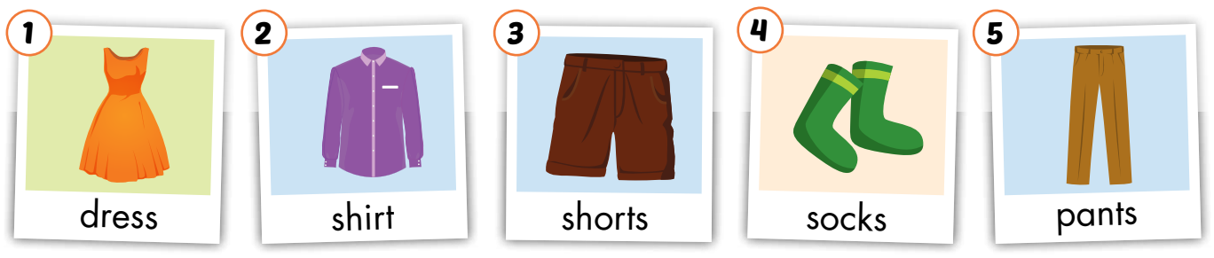
Look and read. Then listen and point to the right picture .
a
b
c
d
e
f
g
h
i
j
Click on the letters to play audios.

Slide 8
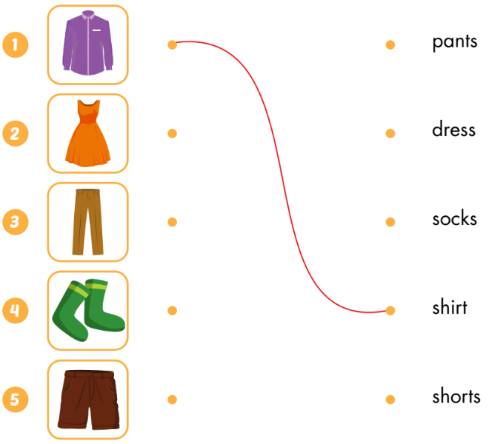
Draw lines

Slide 9

Look at the word and say the right number
Hết giờ
Thời gian còn lại ...
Bắt đầu tính giờ
0
:
0
0
00
59
58
57
56
55
54
53
52
51
50
49
48
47
46
45
44
43
42
41
40
39
38
37
36
35
34
33
32
31
30
29
28
27
26
25
24
23
22
21
20
19
18
17
16
15
14
13
12
11
10
09
08
07
06
05
04
03
02
01
00
shirt

Slide 10

Look at the word and say the right number
socks

Slide 11
Look at the word and say the right number
dress

Slide 12
Look at the word and say the right number
pants

Slide 13
Look at the word and say the right number
shorts

Slide 14
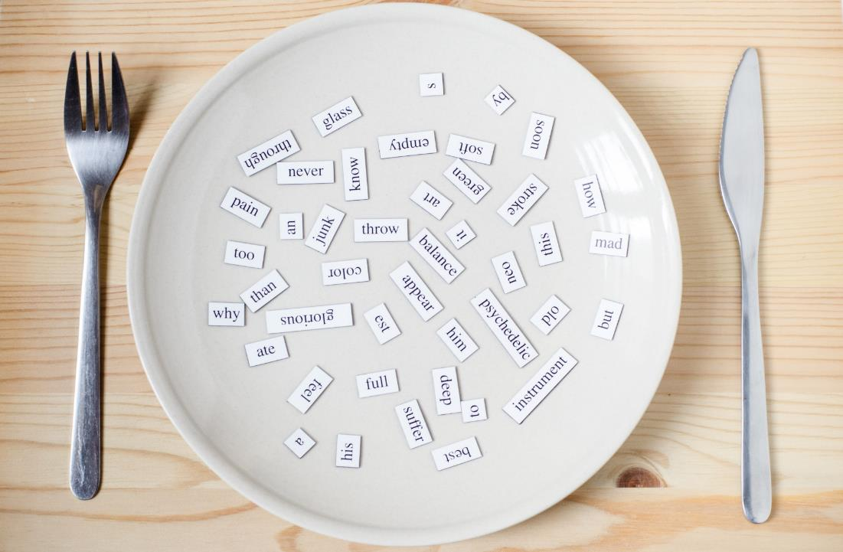
Structures
What do you want?
I want a dress.
What do you want?
I want some socks.

Slide 15

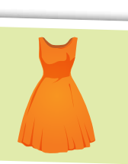
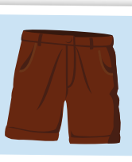
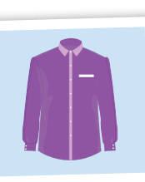

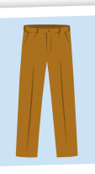
◆
❖
a
some
What do you want?
-> I want_________

Slide 16
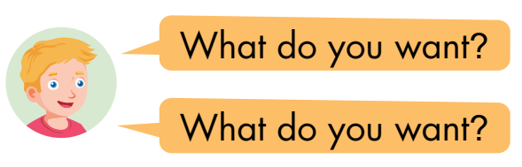
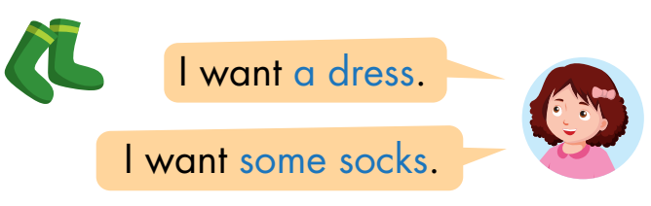

◆
❖
⬥


Slide 17

Practice

Slide 18


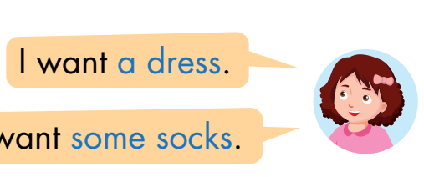
some shorts
__________

Slide 19
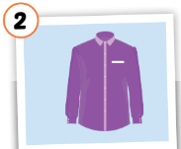
some socks
__________

Slide 20

some pants
__________

Slide 21

a dress
__________

Slide 22
a shirt
__________

Slide 23

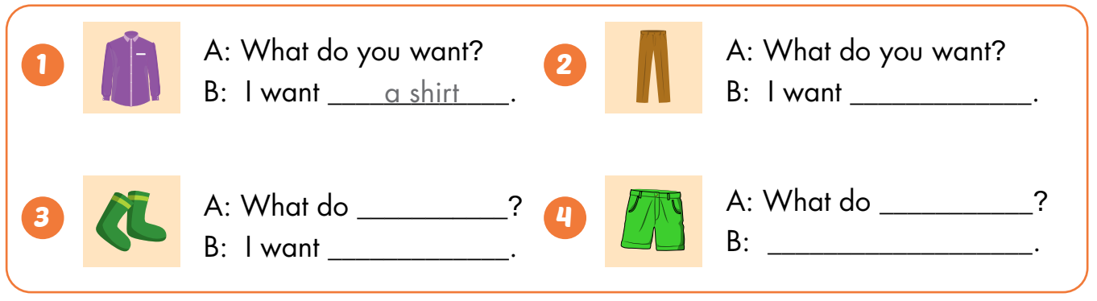
some pants
you want
you want
some socks
I want some shorts

Slide 24

CONSOLIDATION

Slide 25



Draw clothes you want. Ask and answer with 3 friends.

Slide 26

WRAP-UP

Slide 27
Today’s lesson
Vocabularies
dress
shirt
shorts
socks
pants
Structures/ Sentence patterns
What do you want?
I want a dress.
What do you want?
I want some shorts.

Slide 28
Homework
Practice the vocabularies and structure; and make sentences using them.
Do the exercises in Tiếng Anh 3 i-Learn Smart Start Workbook (page 58)
Prepare the next lesson (page 83 SB)

Slide 29

Enjoy your day!

