Slide 1


Chieng Son Primary School
Welcome to our class
Teacher: Nguyen Huu Thanh
Class: 5A1

Slide 2
Warm up.
Subjects

Slide 3
Unit 6:
How many lessons do you have today?
Lesson 1
1.Look,listen and repeat.

Slide 4
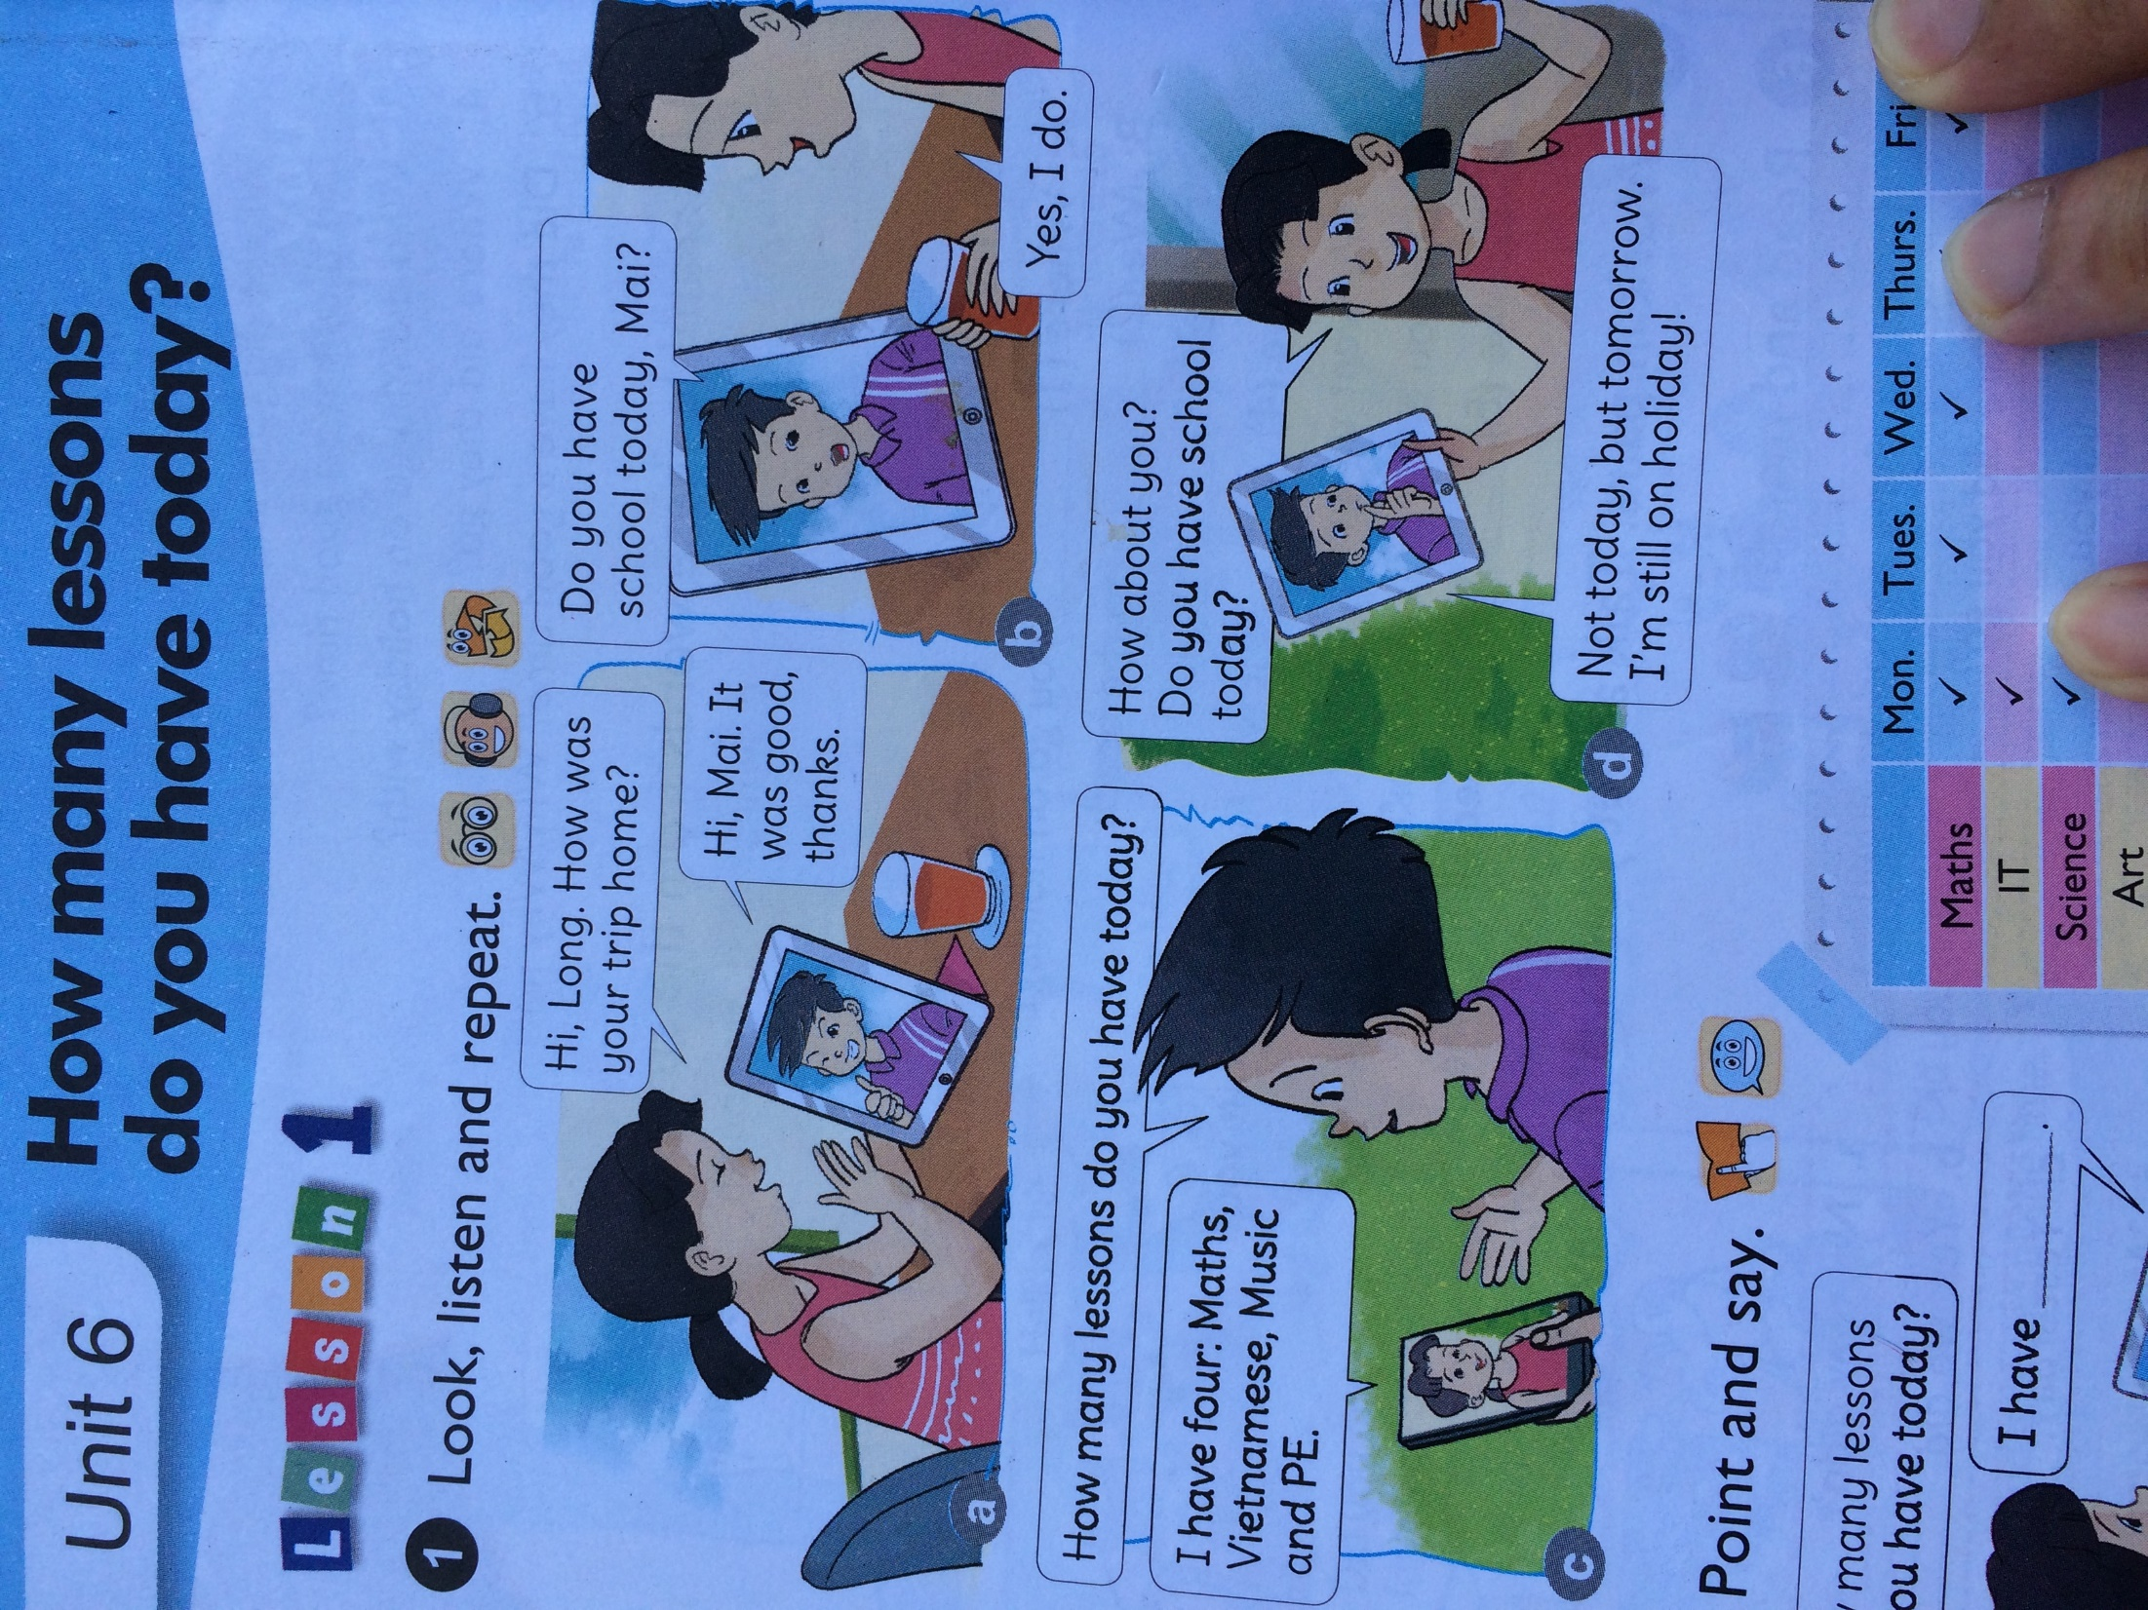


Slide 5
2.Point and say.
*Sentence pattern :
How many lessons do you have today ?
I have________
four: Maths, Vietnamese, Music and PE
1) Meaning: Bạn có bao nhiêu tiết học hôm nay?
Note
2) Usage: Dùng để hỏi bạn của mình có bao nhiêu tiết học hôm nay.

Slide 6
2.Point and say.
 | Mon. | Tues. | Wed. | Thurs. | Fri.
Maths |  |  |  |  | 
IT | 
Science |  |  |  | 
Art |  |  |  | 
Music |  |  | 
Vietnamese |  |  |  |  | 
PE |  |  | 
English |  |  |  |  | 
How many lessons do you have today ?
I have_______________________

Slide 7
3. Let’s talk
Ask and answer questions about the lessons you have today.
I have__________
How many lessons do you have today ?
four: Maths, Vietnamese, Music and PE
What lessons do you have today ?
I have_____________________
Maths, Vietnamese, Music and PE

Slide 8





Game

Slide 9


Lucky numbers
2
3
1
4
6
5

Slide 10




Lucky number !

Slide 11
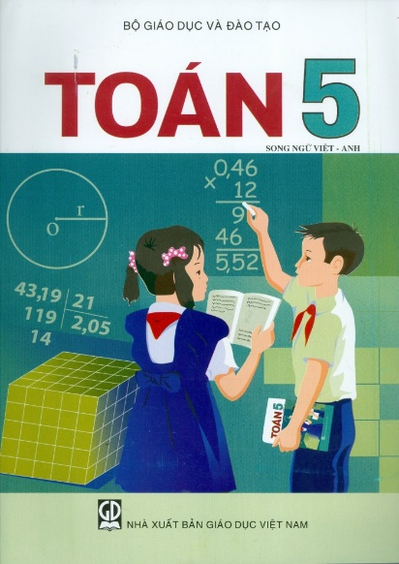



How many lessons do you have today?
I have _________________________________
four: Maths, English, Music and Science.

Slide 12


How many lessons do you have today?
I have _______________________________
three: Maths, English and Vietnamese.

Slide 13


What lessons do you have today?
I have ____________________________________
Maths, Vietnamese, Music, Art and Science.

Slide 14


Homework
Learn by heart the sentence pattern.
Practice the sentence at home
Prepare next lesson Unit 6: lesson 2

Slide 15

Thanks for your attendance.
Good bye!

