Slide 1
Unit 8: WEATHER
Lesson 1.2
Page 107

Slide 2
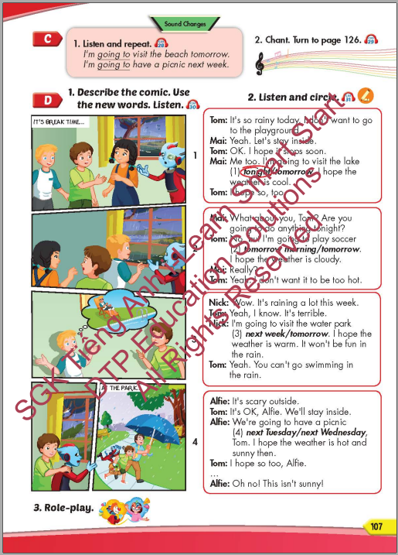
Lesson Outline
Warm-up
Pronunciation
Listening
Speaking
Consolidation
Wrap-up

Slide 3
Objectives
By the end of this lesson, students will be able to practice the sound changes, the target language and the conversations.
Pronunciation: Sound Changes
Structure: I'm going to visit the beach tomorrow.
I'm going to have a picnic next week.

Slide 4
WARM-UP

Slide 5
It’s time to learn …

Slide 6
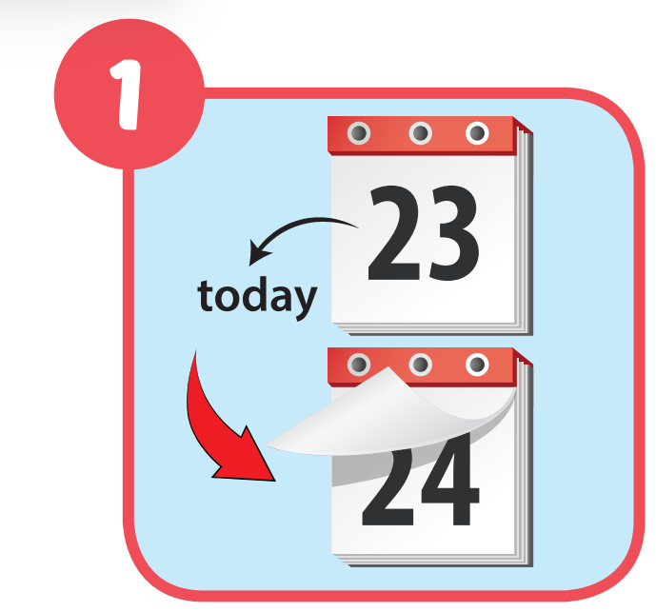
Click on the right word
next week
tonight
tomorrow

Slide 7
Click on the right word
next week
tonight
tomorrow

Slide 8
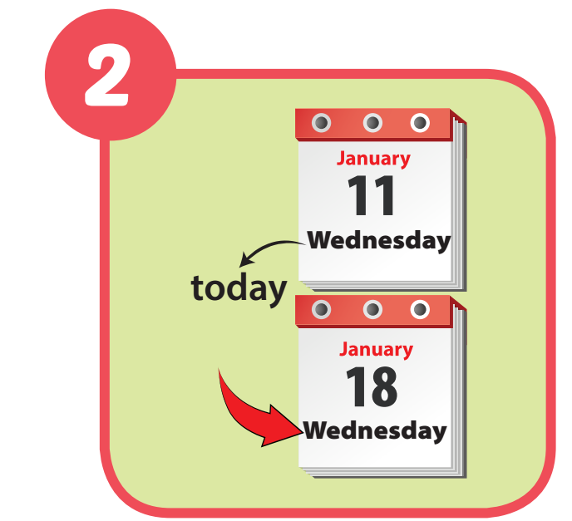
Click on the right word
next weekend
next Wednesday
tomorrow morning

Slide 9
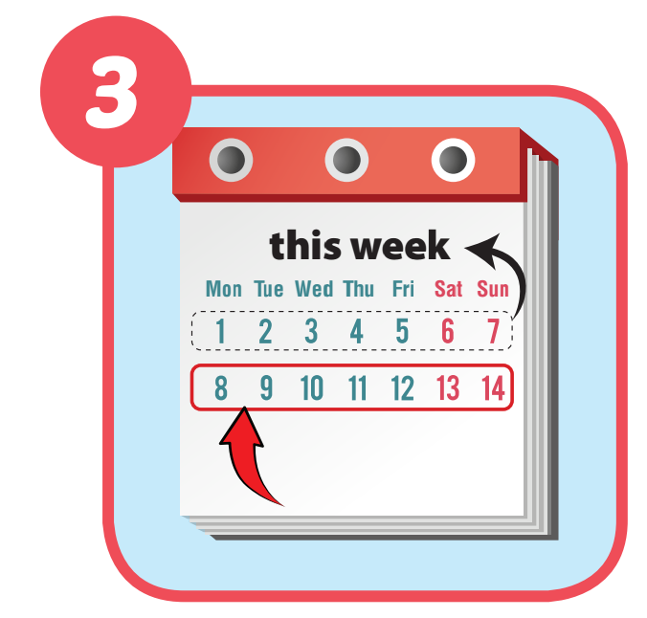
Click on the right word
tonight
next week
next weekend

Slide 10
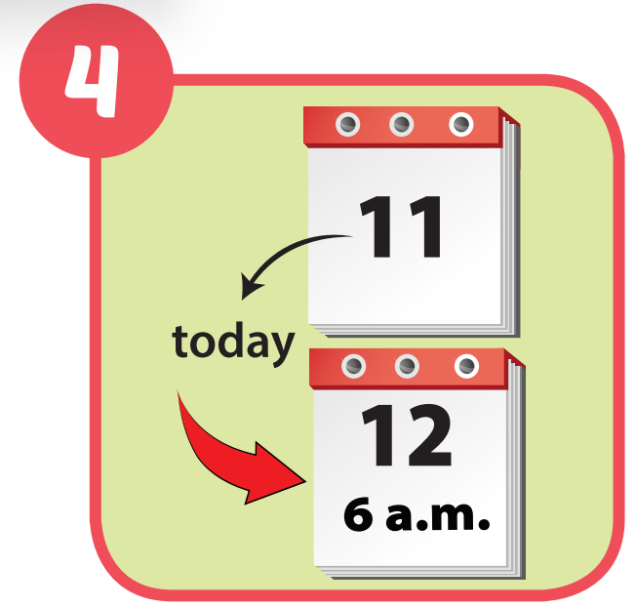
Click on the right word
tonight
tomorrow morning
next week

Slide 11
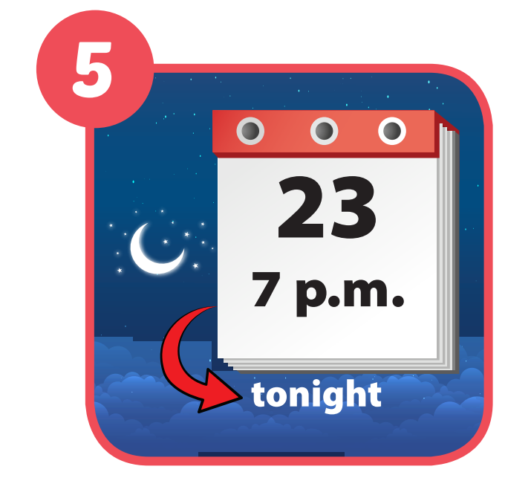
Click on the right word
tonight
tomorrow
next Sunday

Slide 12
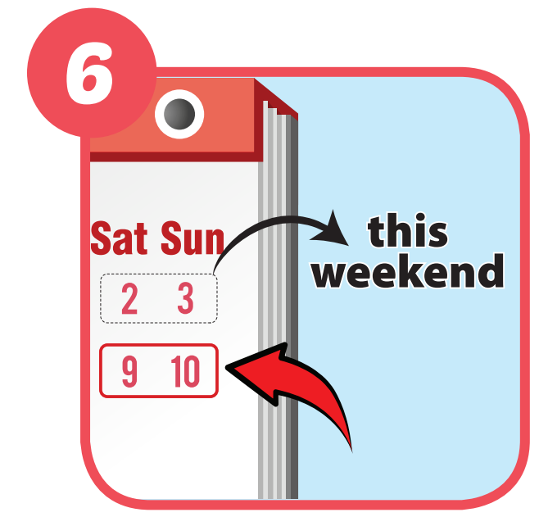
Click on the right word
next week
tonight
Next weekend

Slide 13
Pronunciation
Sound Changes

Slide 14
Pronunciation

Slide 16
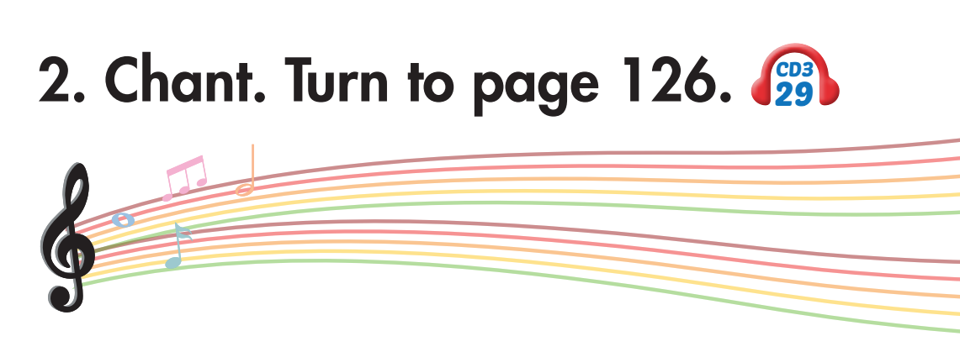
Click on C to hear the sound.

Slide 17
Pre-Listening

Slide 18
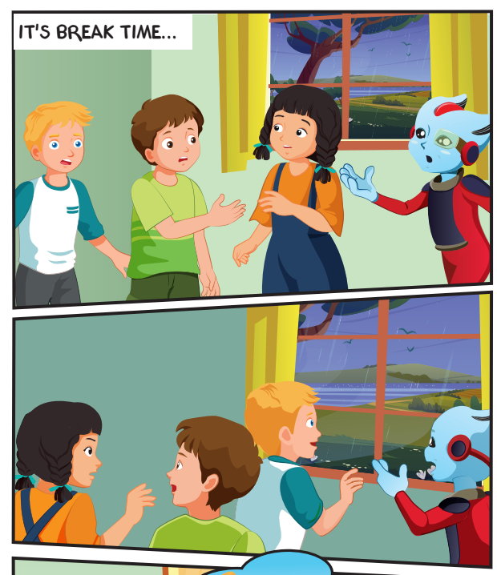
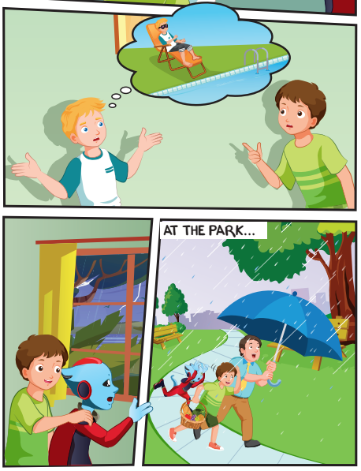
What are they doing?
What type of weather can you see?
Who are they ?

Slide 19
While-Listening

Slide 20
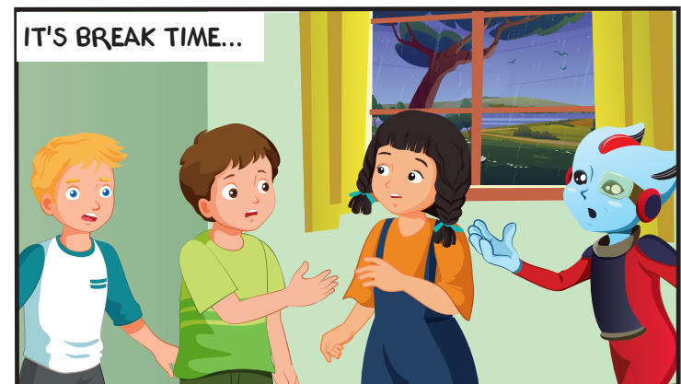
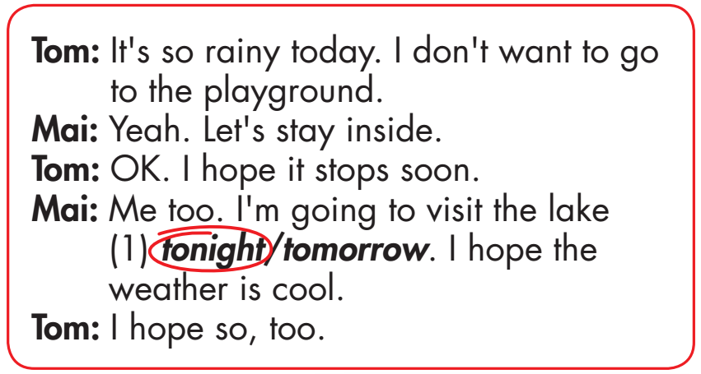
What is the weather like?
It’s raining.

Slide 21
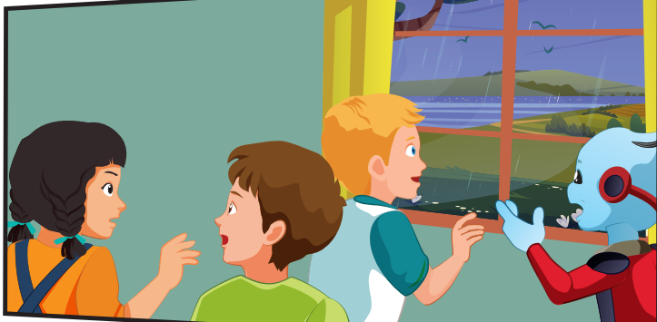

Slide 22
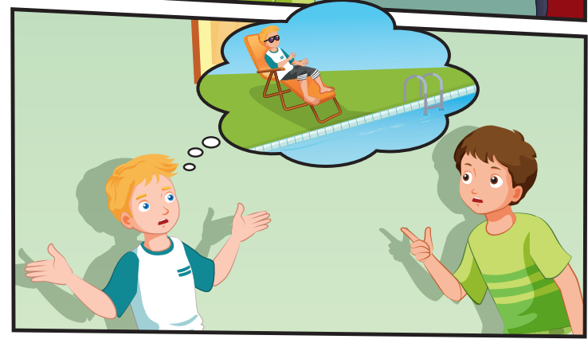
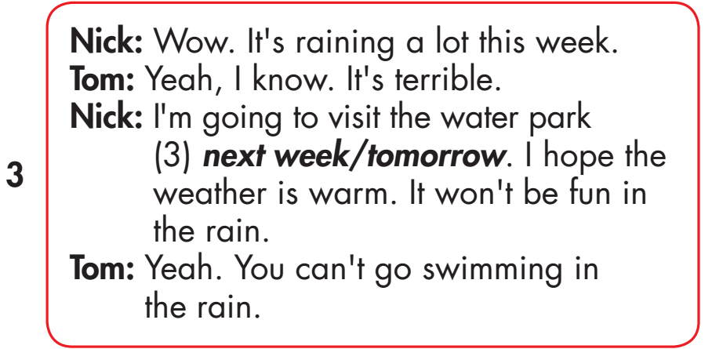

Slide 23
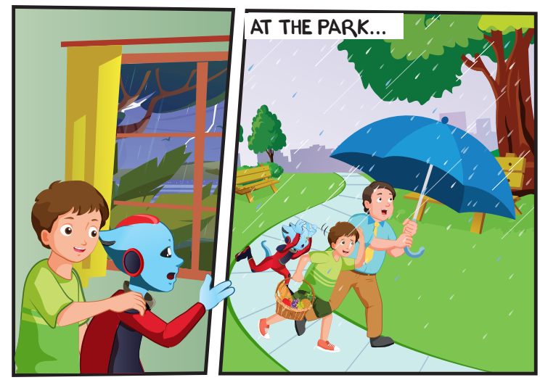
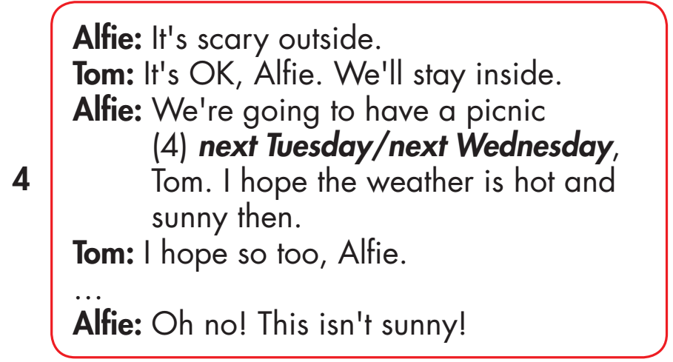

Slide 24
Practice

Slide 26
Listen and say.

Slide 27
Production

Slide 28
CONSOLIDATION

Slide 29
WRAP-UP

Slide 30
Today’s lesson
Pronunciation: Sound changes
I'm going to visit the beach tomorrow.
I'm going to have a picnic next week.
Structures/ Sentence patterns
I'm going to visit the beach tomorrow.
I'm going to have a picnic next week.

Slide 31
Homework
Practice the vocabulary and structure, and make sentences using them.
Do the exercises in Tiếng Anh 5 i-Learn Smart Start WB (page 73).
Do the exercises in Tiếng Anh 5 i-Learn Smart Start Notebook.
Prepare the next lesson (page 108 SB).
Play the consolidation games in Tiếng Anh 5 i-Learn Smart Start DHA App on www.eduhome.com.vn

Slide 32
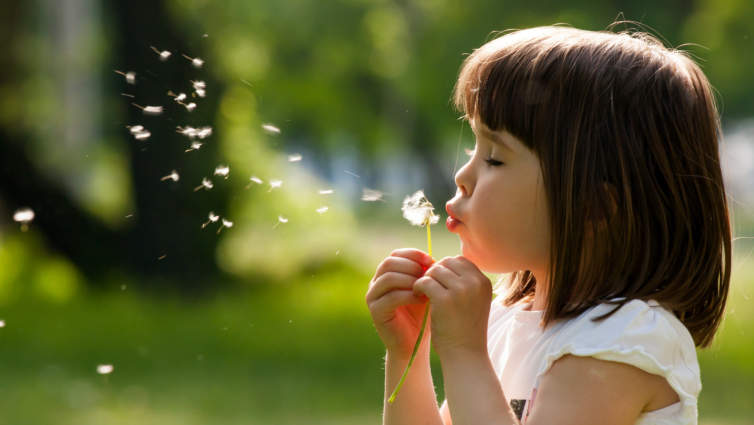
Enjoy your day!

Slide 33
Lesson 3
Stay positive and have a nice day!

