Slide 1
WARM UP

Slide 3
It’s time to learn …

Slide 4
Thursday, 3rd ,October, 2024 Unit 2: WHAT I CAN DO. Period 16: Lesson 1.1( Page 20)

Slide 5
New words
dance,
sing,
play the keyboard, paint,
draw,
act

Slide 6
Click the icon to hear the sound.

Slide 7
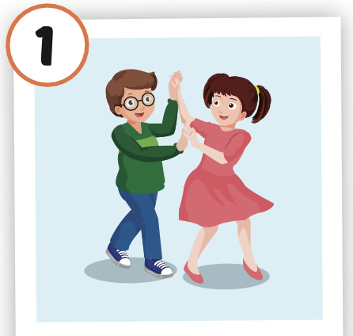
Click the picture to hear the sound.
dance
/ˈdæns/
nhảy múa

Slide 8
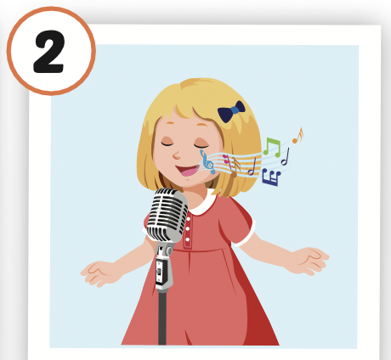
Click the picture to hear the sound.
sing
/sɪŋ/
hát

Slide 9
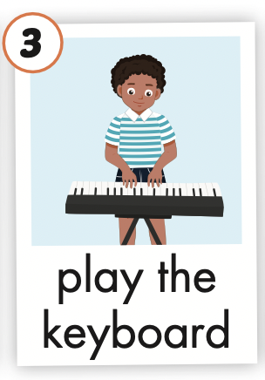
Click the picture to hear the sound.
play the keyboard
/pleɪ ðə ˈkiːbɔːrd/
chơi đàn phím

Slide 10
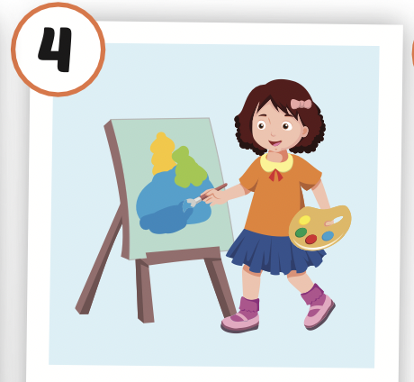
Click the picture to hear the sound.
paint
/peɪnt/
vẽ, sơn

Slide 11
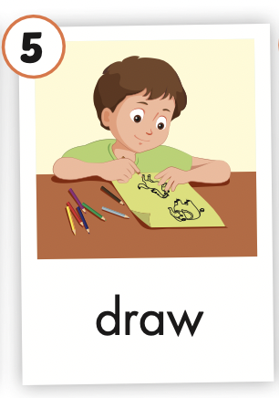
Click the picture to hear the sound.
draw
/drɑː/
vẽ

Slide 12
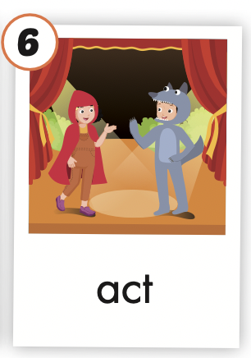
Click the picture to hear the sound.
act
/ækt/
diễn xuất

Slide 13
Click the icon to hear the sound.

Slide 14
LISTEN AND CHOOSE

Slide 15
A
C
B

Slide 16
A
C
B

Slide 17
A
C
B

Slide 18
A
C
B

Slide 19
Structures
I can dance.
I can't draw.

Slide 20
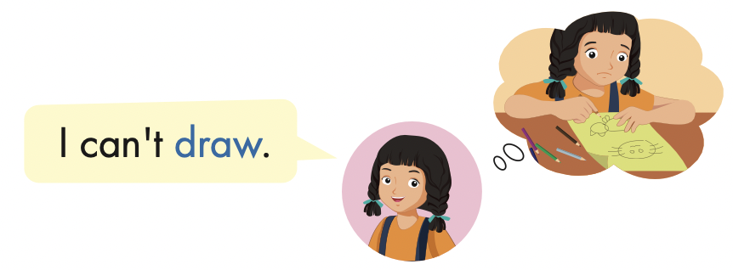

Slide 21
I can act.

Slide 22
I can’t draw.

Slide 23
I can’t play the keyboard.

Slide 24
I can sing.

Slide 29
LET’S PLAY!
WHAT’S MISSING?

Slide 36
WRAP-UP

Slide 37
Today’s lesson
Vocabularies
dance,
sing,
play the keyboard, paint,
draw,
act
Structures/ Sentence patterns
I can dance.
I can't draw.

Slide 38
Homework
Practice the vocabularies and structure; and make sentences using them.
Do the exercises in Tiếng Anh 4 i-Learn Smart Start WB (page 12)
Do the exercises in Tiếng Anh 4 i-Learn Smart Start Notebook (page 10)
Prepare the next lesson (page 21 SB)
Play the consolidation games in Tiếng Anh 4 i-Learn Smart Start DHA App on www.eduhome.com.vn

Slide 39
Enjoy your day!

