Slide 1

Unit 7: MY FAMILY
Lesson 1.3
Page 94

Slide 2
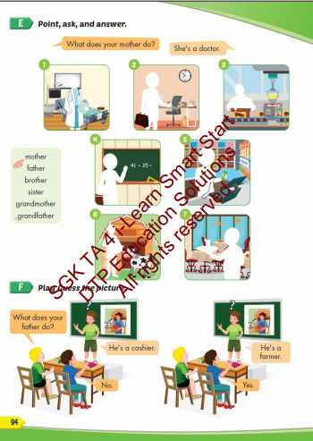
Lesson Outline
Warm-up
Practice
Speaking
Consolidation
Wrap-up

Slide 3
Objectives
By the end of this lesson, students will be able to talk about what job their family members do.
Vocabulary: cashier, doctor, office worker, factory worker, farmer, waiter.
Structure: What does your mother do?
She's a doctor.
What does your father do?
He's a farmer.

Slide 4

WARM UP

Slide 5

1. She’s a__________
D
A. doctor
B. cashier
D. factory
worker
C. waiter

Slide 6

2. He’s a__________
C
A. cashier
B. doctor
C. farmer
D. waiter

Slide 7

3. She’s a__________
A
A. cashier
B. doctor
C. waiter
D. farmer

Slide 8
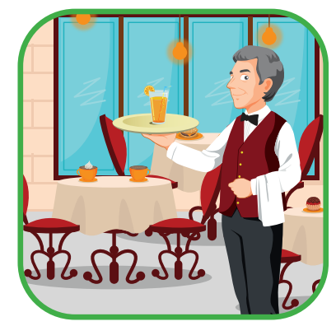
4. He’s a__________
C
A. cashier
B. doctor
D. factory
worker
C. waiter

Slide 9

Practice

Slide 10

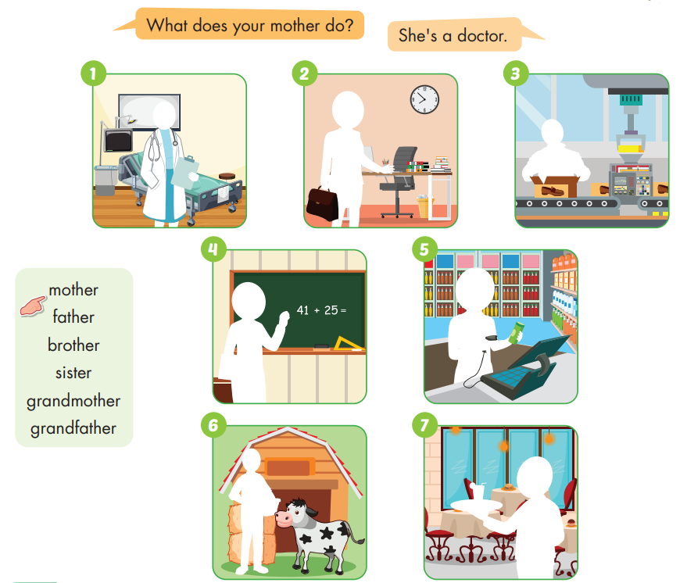

Slide 11
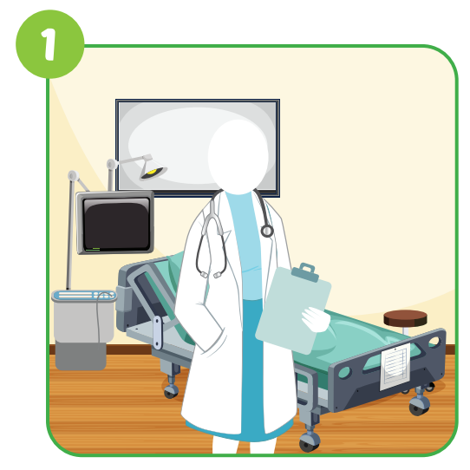
What does your mother do?
She's a doctor.

Slide 12
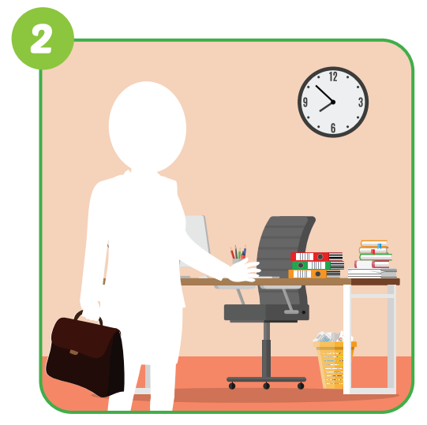
What does your mother do?
She's a
office worker.

Slide 13
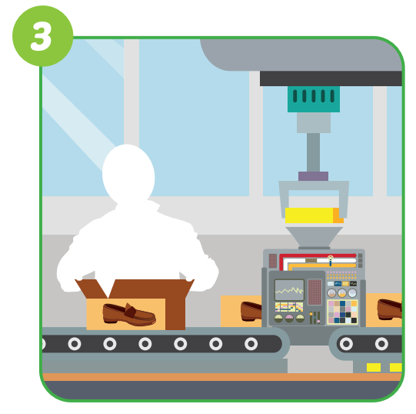
What does your brother do?
He's a
factory worker.

Slide 14
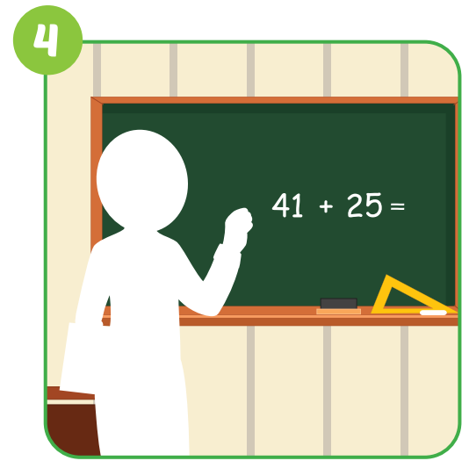
What does your grandmother do?
She's a teacher.

Slide 15

What does your sister do?
She's a cashier.

Slide 16
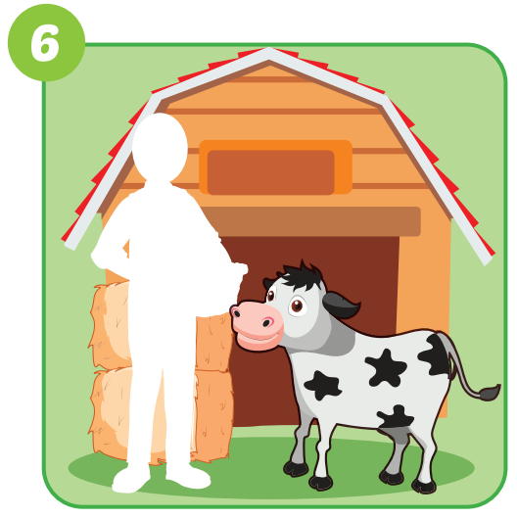
What does your grandfather do?
He's a farmer.

Slide 17
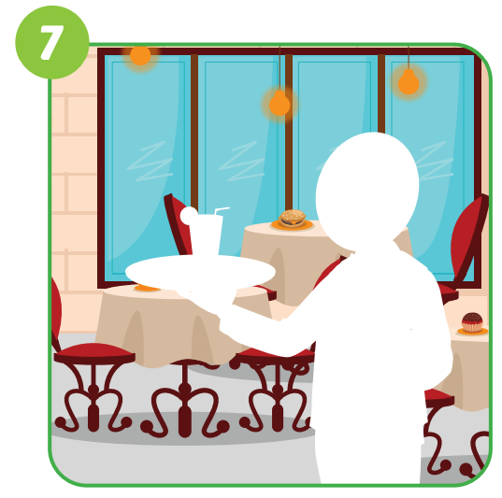
What does your father do?
He's a waiter.

Slide 18

Speaking

Slide 19

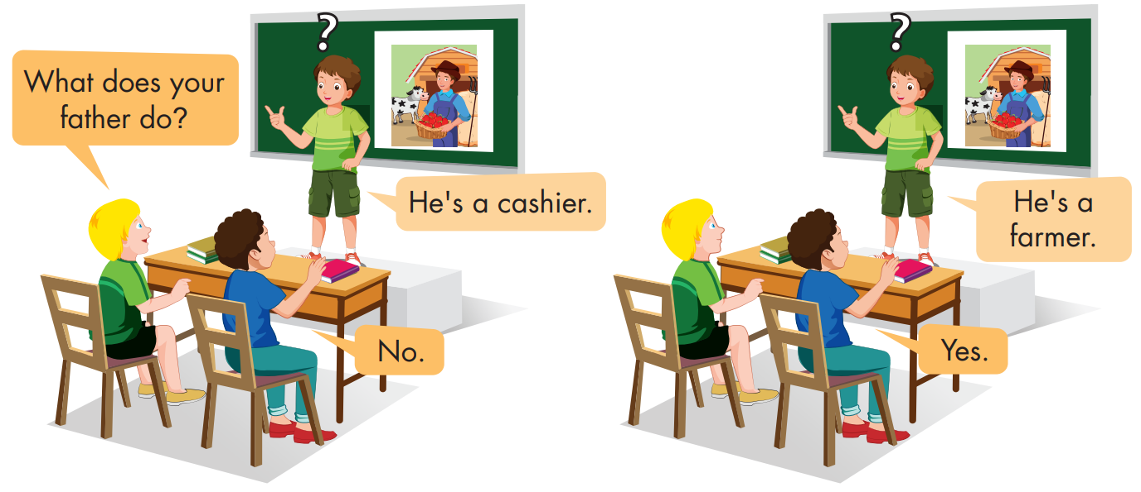

Slide 20
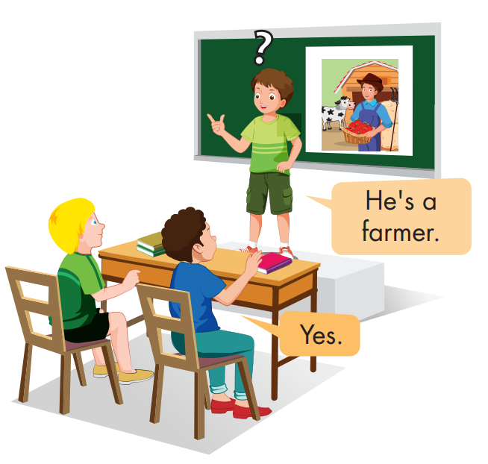



Slide 21



Slide 22

CONSOLIDATION

Slide 23
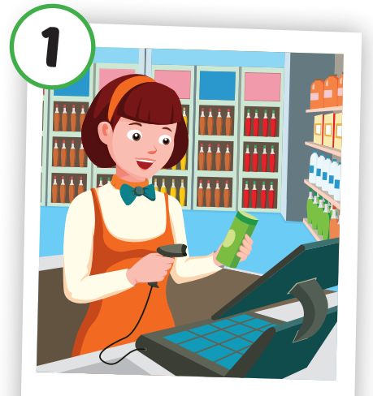

Choose a letter to fill in.
i
Cash er
_ _ _ _ _ _ _
a
b
c
d
i
y
g
e
f
j
k
l
m

Slide 24
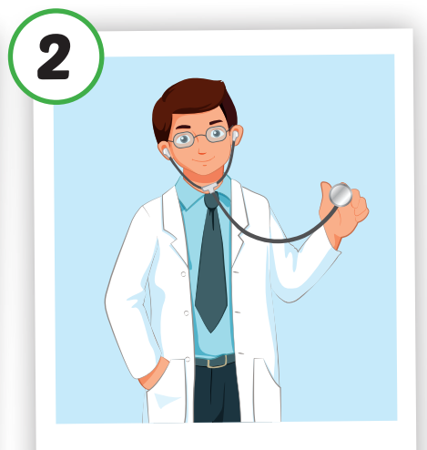
Choose a letter to fill in.
o
D ctor
_ _ _ _ _ _
a
b
c
d
e
k
g
l
i
j
w
o
m

Slide 25

Choose a letter to fill in.
w
Office orker
__ _ _ _ _ _
a
b
c
d
k
f
g
h
u
j
w
l
m

Slide 26
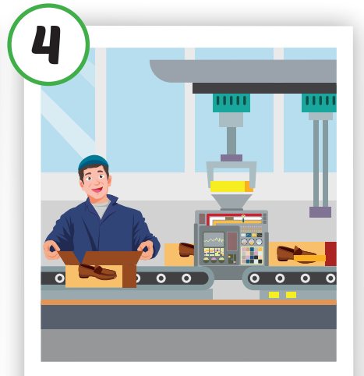
Choose a letter to fill in.
c
Fa tory worker
_ _ _ _ _ _ _
n
b
o
d
e
f
g
h
i
j
k
l
c

Slide 27
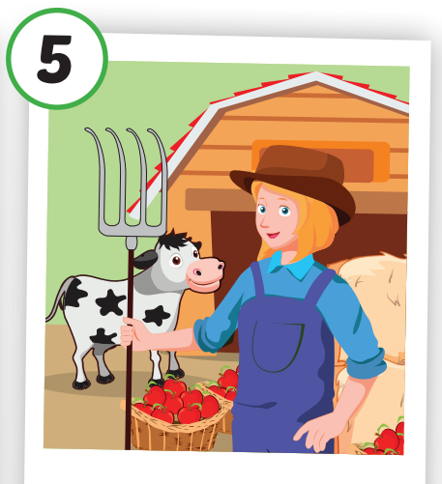
Choose a letter to fill in.
Far er
m
_ _ _ _ _ _
a
b
c
d
k
f
g
h
n
j
m
l
i

Slide 28
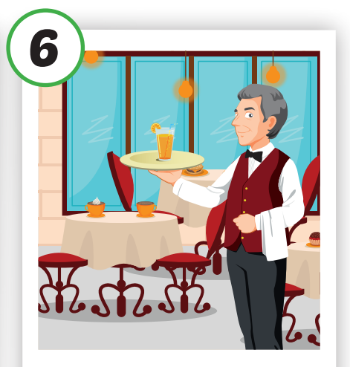
Choose a letter to fill in.
a
W iter
__ _ _ _ _ _
n
b
c
d
o
f
g
h
i
j
k
l
a

Slide 29

WRAP-UP

Slide 30
Today’s lesson
Vocabularies
cashier, doctor, office worker, factory worker, farmer, waiter.
Structures/ Sentence patterns
What does your father do? He's a doctor.
What does your mother do? She's an office worker.

Slide 31
Homework
Practice the vocabularies and structure; and make sentences using them.
Do the exercises in Tiếng Anh 4 i-Learn Smart Start WB (page 63)
Prepare the next lesson (page 95 SB)
Play the consolidation games in Tiếng Anh 4 i-Learn Smart Start DHA App on www.eduhome.com.vn

Slide 32

Enjoy your day!

Slide 33

Have a nice day!

