Slide 1
Unit 7: MY FAMILY
Lesson 1.2
Page 93

Slide 2
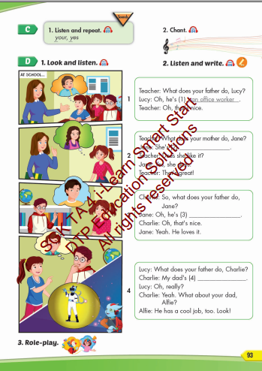
Lesson Outline
Warm-up
Listening
Consolidation
Wrap-up

Slide 3
Objectives
By the end of this lesson, students will be able to talk about what job their family members do.
Vocabulary: your, yes
Phonics: /j/
Structure: What does your father do?
He's a doctor.
What does your mother do?
She's an office worker.

Slide 4
WARM UP

Slide 5
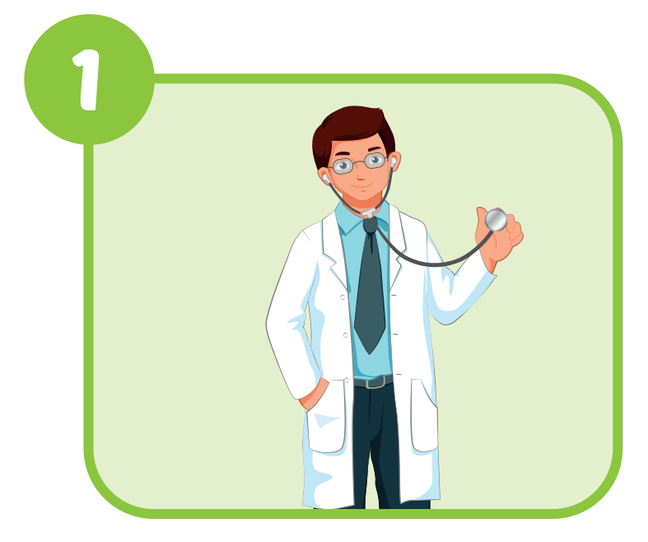
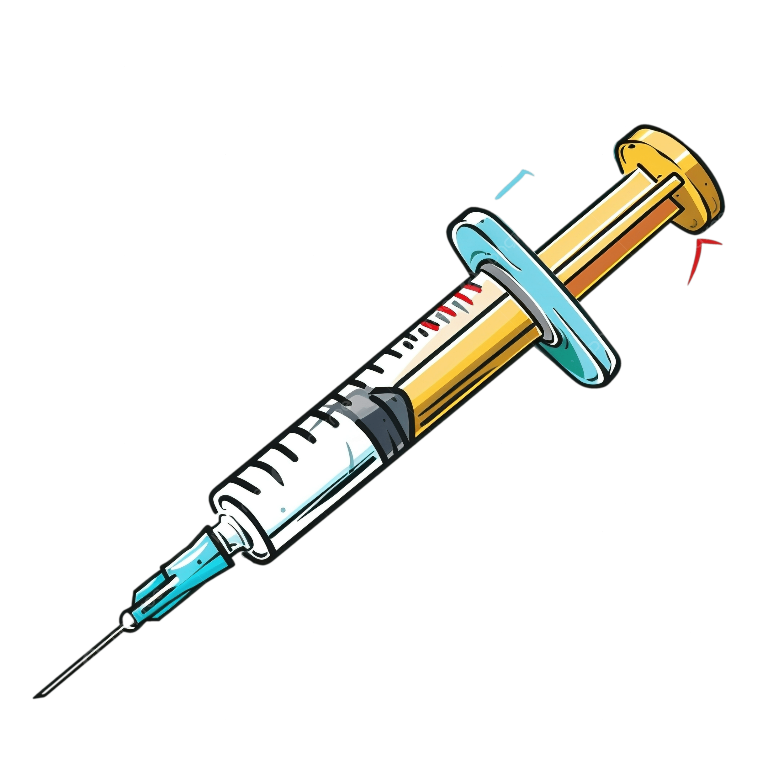
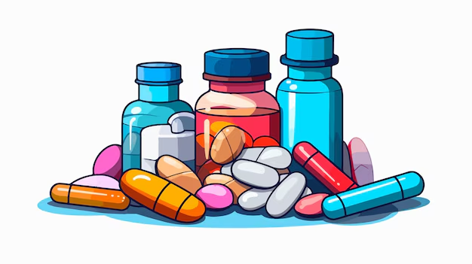
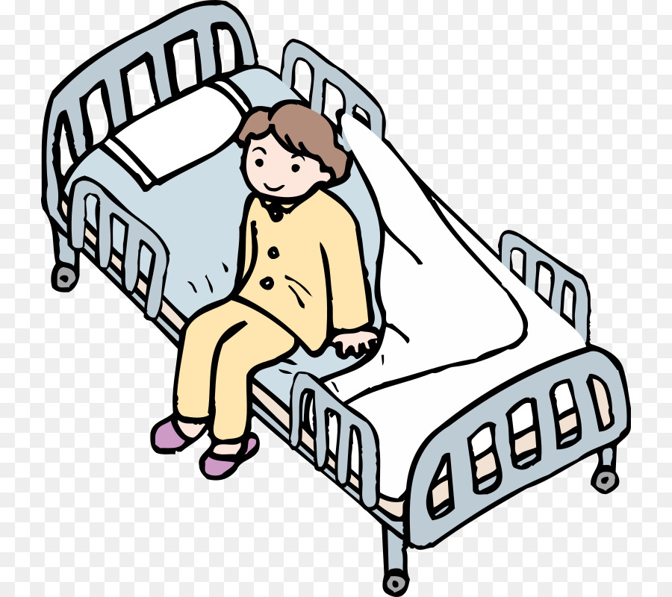
doctor

Slide 6
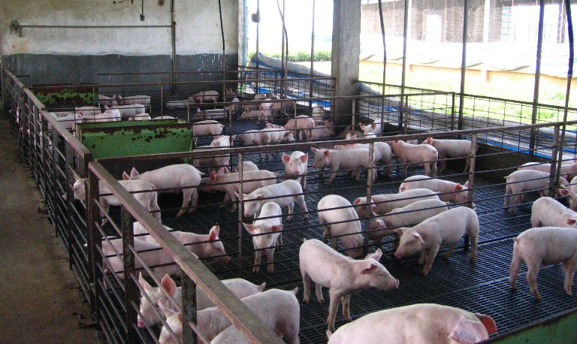
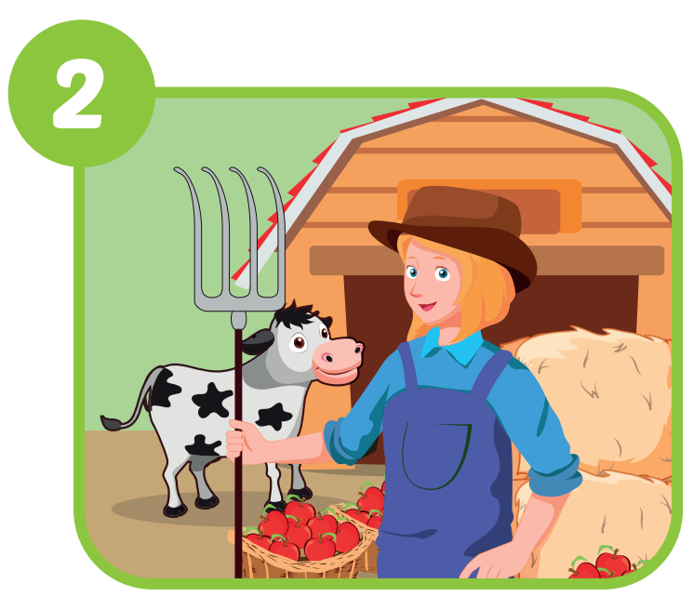
farmer

Slide 7
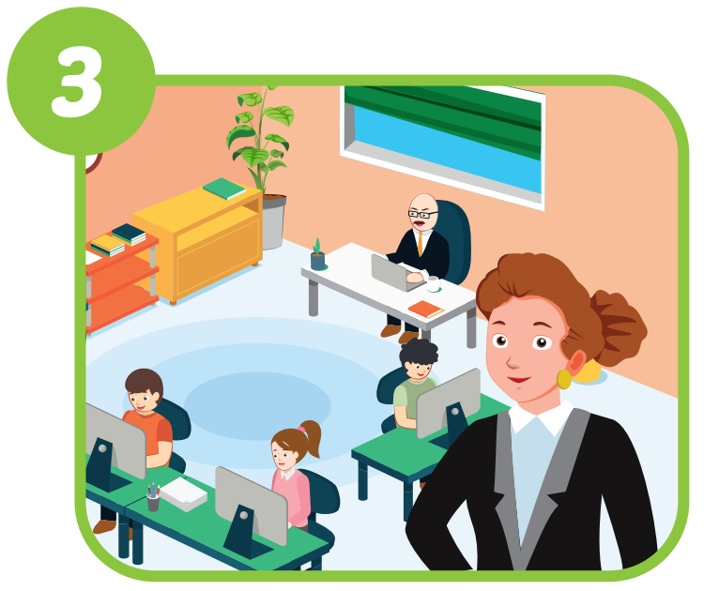
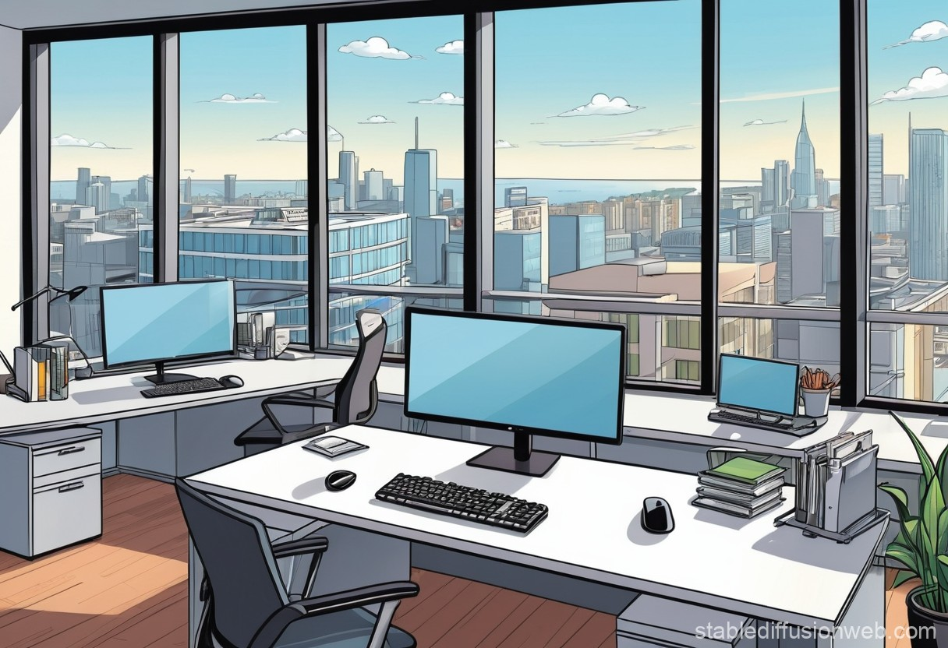
office
worker

Slide 8
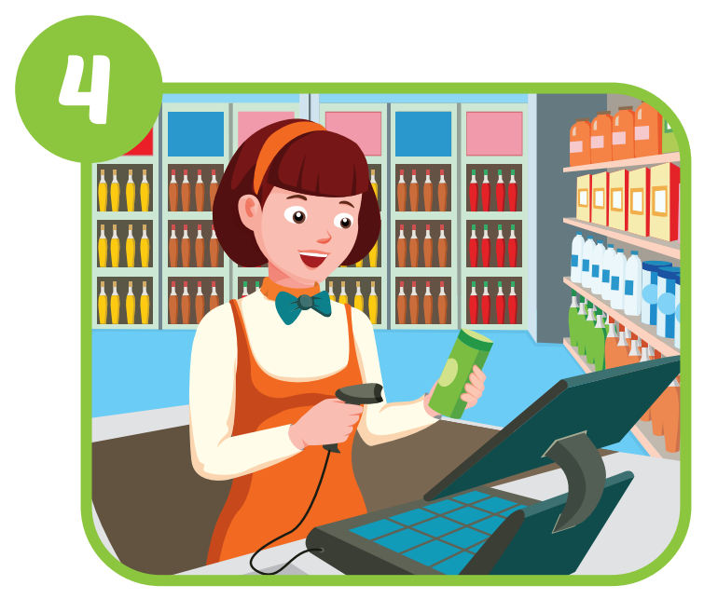
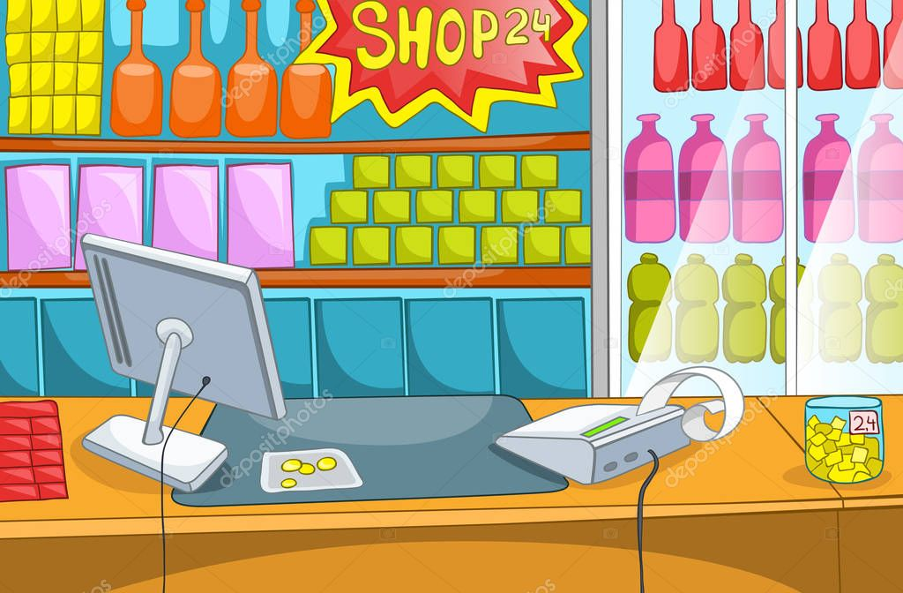
cashier

Slide 9
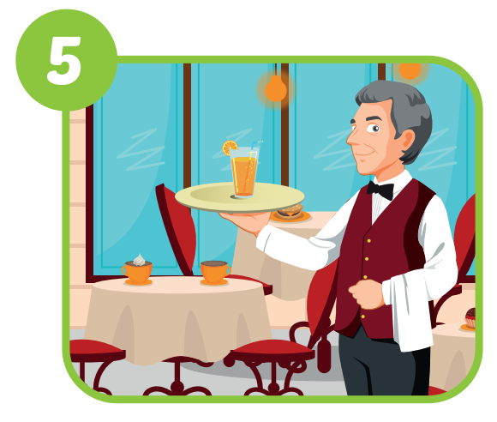
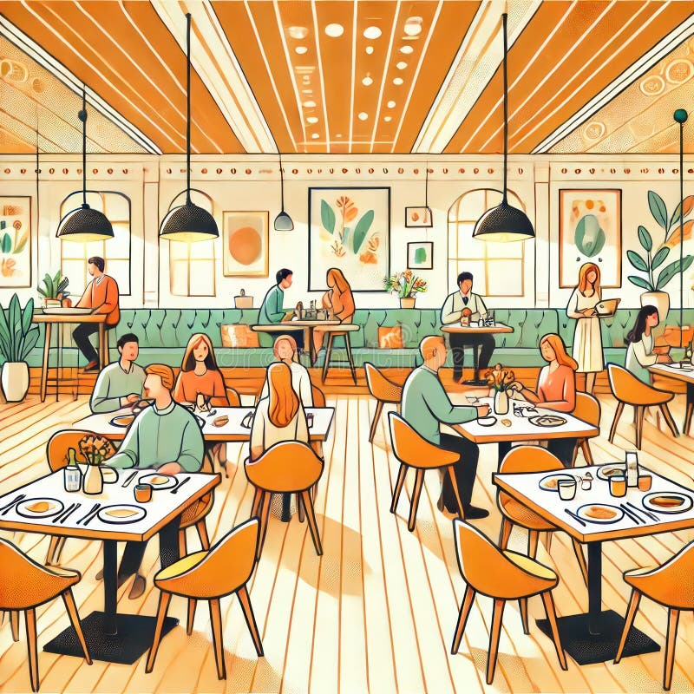
waiter

Slide 10
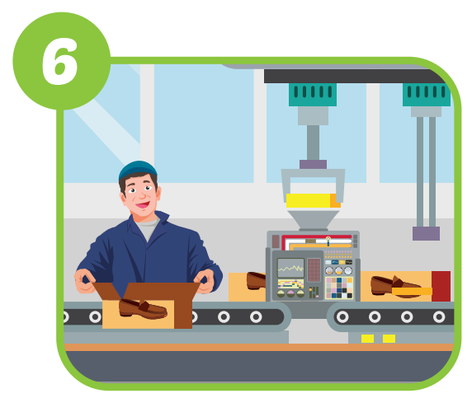
cyratof
korwre
factory
worker

Slide 11
Family
Grandmother
Grandfather
Father
Mother
Brother
Sister
Aunt
Uncle

Slide 12
Family
Grandmother
Grandfather
Father
Mother
Brother
Sister
Aunt
Uncle
Câu hỏi về nghề nghiệp của ai đó
What does + S (your + member of family) + do?
He’s/ She’s ………….

Slide 13
Family
Grandmother
Grandfather
Father
Mother
Brother
Sister
Aunt
Uncle
Câu hỏi về nghề nghiệp của ai đó
What does + S (your + member of family) + do?
He’s/ She’s + a/an + job

Slide 14
An
U, E, O, A, I
Ex: An office worker
A
Ex: A famer

Slide 15
Family
Grandmother
Grandfather
Father
Mother
Brother
Sister
Aunt
Uncle
Câu hỏi về nghề nghiệp của ai đó
What does + S (your + member of family) + do?
He’s/ She’s + a/an + job

Slide 16
Click each English word to hear the sound.
your
yes
/jʊr/
của bạn
/jes/
có

Slide 17
Click the earphone to hear the sound.
Is the father a waiter?
Yes, he is.
Is the mother a cashier?
Yes, she is.

Slide 18
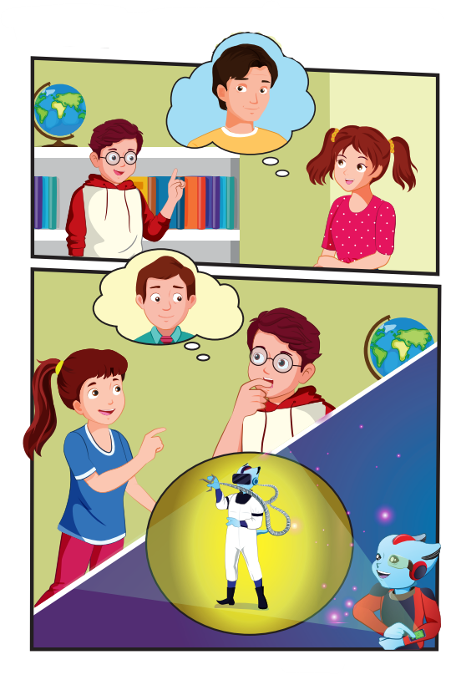
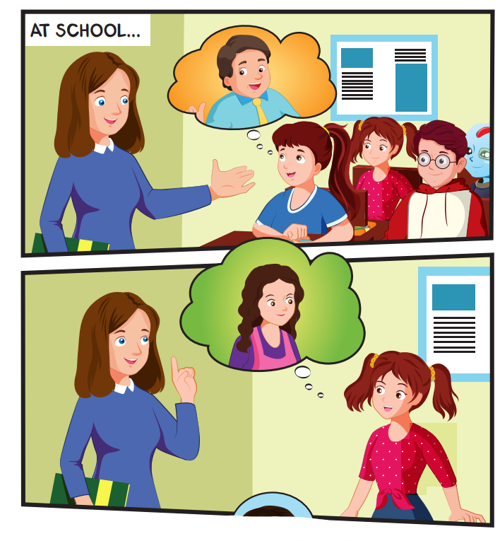
Click each English word to hear the sound.

Slide 19
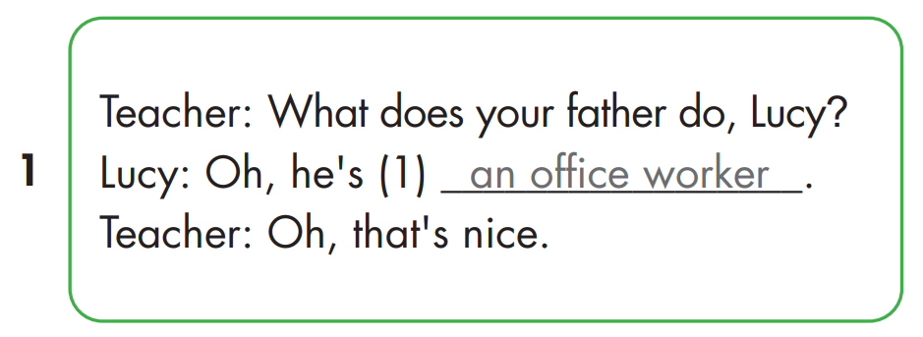

Slide 20
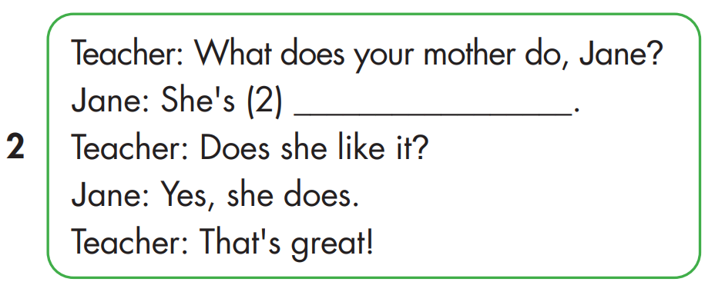
a factory worker

Slide 21
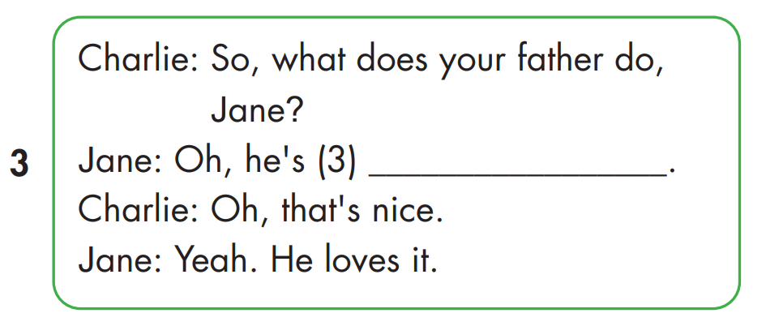
a farmer

Slide 22
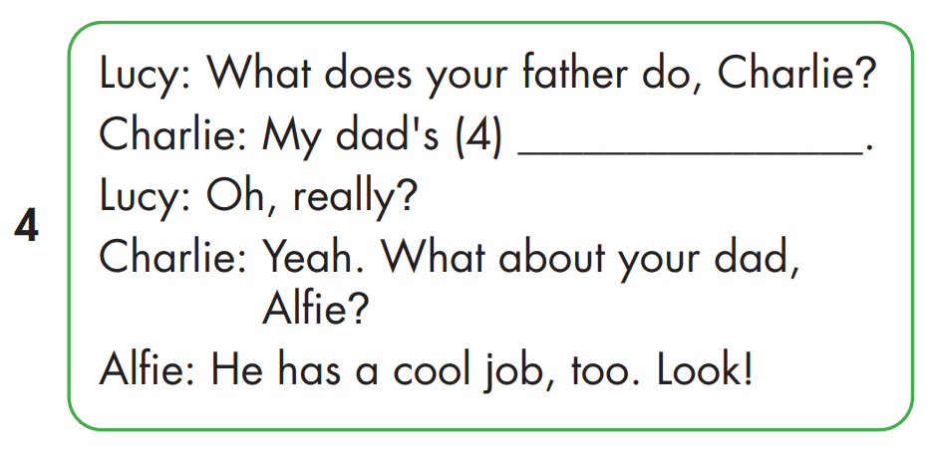
a doctor

Slide 23
Practice

Slide 24
What does your father do?
He's a doctor.
She's an
office worker.
What does your mother do?

Slide 25
What does your father do?
He's a farmer.
She's a cashier.
What does your mother do?

Slide 26
What does your father do?
He's a waiter.
She's a
factory worker.
What does your mother do?

Slide 27
CONSOLIDATION

Slide 28
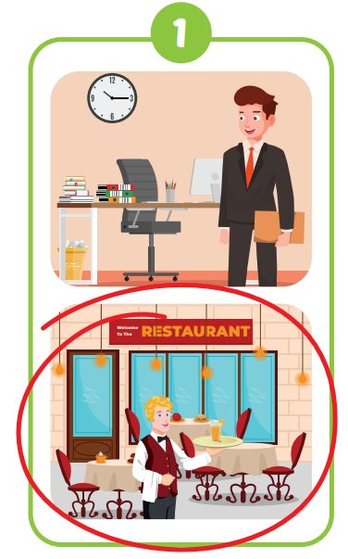
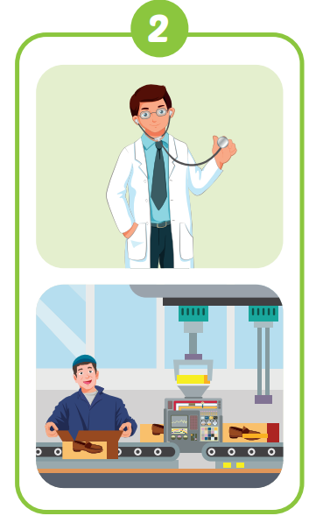

Slide 29
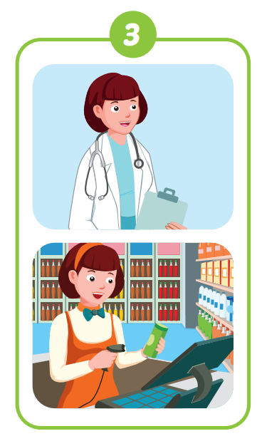
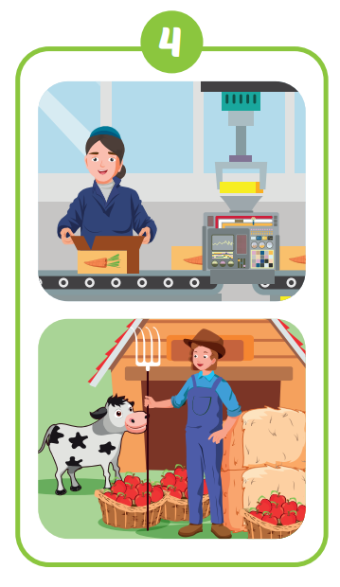

Slide 31
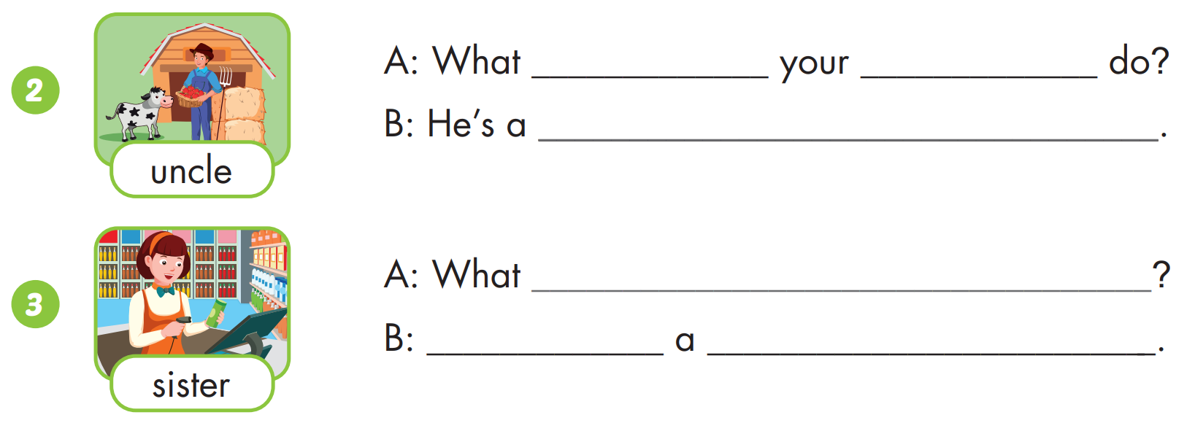
does
uncle
farmer
does your sister do
She’s
cashier

Slide 32
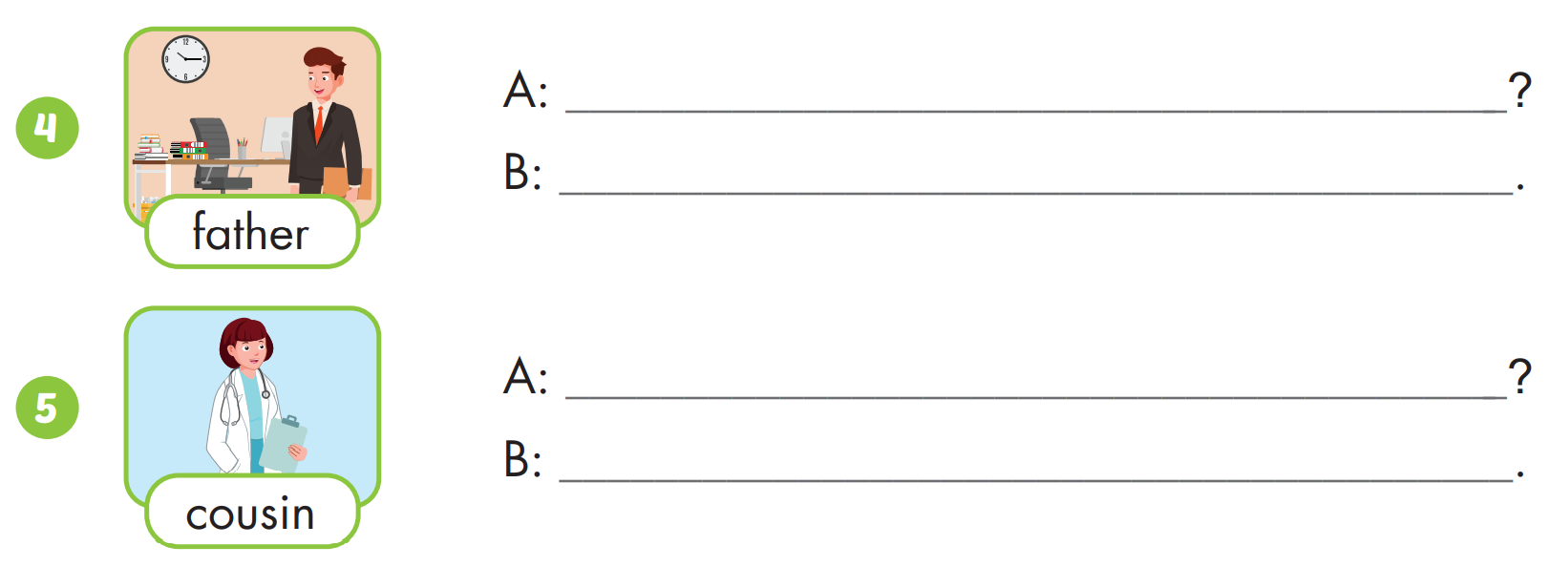
What does your father do
He’s an office worker
What does your cousin do
She’s a doctor

Slide 33
WRAP-UP

Slide 34
Today’s lesson
Vocabularies
your, yes
Structures/ Sentence patterns
What does your father do?
He's a doctor.
What does your mother do?
She's an office worker.

Slide 35
Homework
Practice the vocabularies and structure; and make sentences using them.
Do the exercises in Tiếng Anh 4 i-Learn Smart Start WB (page 63)
Do the exercises in Tiếng Anh 4 i-Learn Smart Start Notebook (page 40)
Prepare the next lesson (page 94 SB)
Play the consolidation games in Tiếng Anh 4 i-Learn Smart Start DHA App on www.eduhome.com.vn

Slide 36
Have a nice day!

