Slide 1

Unit 3: MY FRIENDS AND I
Lesson 1.1
Page 34

Slide 2
Lesson Outline
Warm-up
Vocabulary
Structure
Consolidation
Wrap-up

Slide 3
Objectives
By the end of this lesson, students will be able to point out and say different adverbs.
Vocabulary: slowly, fast, badly, well, hard.
Structure: Tom kicks the ball hard.

Slide 4

WARM-UP

Slide 5
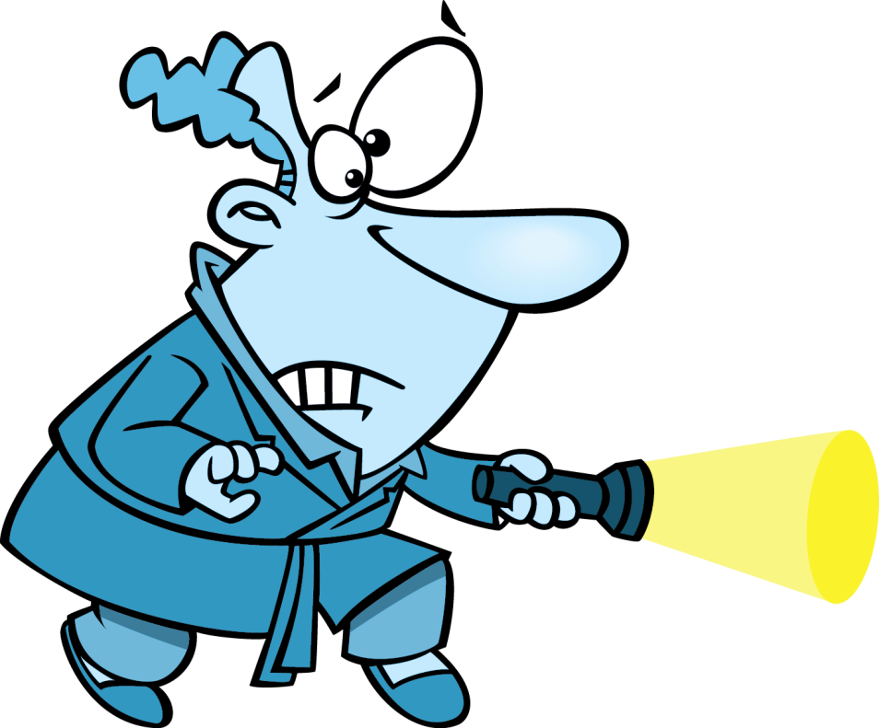

GUESS
AND
ACT

Slide 6
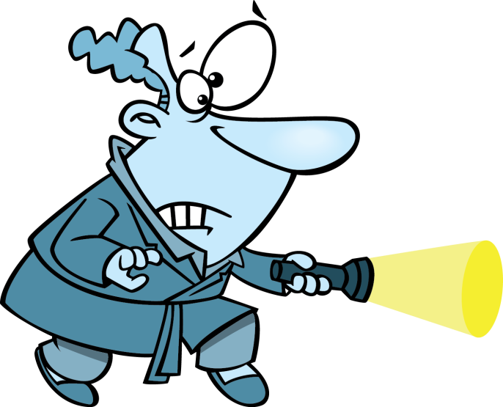
Click on the man with a torch and guess the hidden verb
walk
CHECK

Slide 7
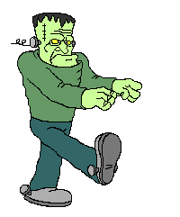

WALK
Walk like Frankenstein around the classroom.
CHECK

Slide 8
Click on the man with a torch and guess the hidden verb
cook
CHECK

Slide 9
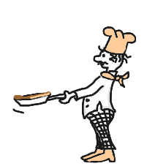
COOK
Act like cooking a pancake
CHECK

Slide 10
Click on the man with a torch and guess the hidden verb
smile
CHECK

Slide 11

SMILE
Smile to your classmates
CHECK

Slide 12
Click on the man with a torch and guess the hidden verb
drink
CHECK

Slide 13

DRINK
Mime the action
CHECK

Slide 14
Click on the man with a torch and guess the hidden verb
sing
CHECK

Slide 15

SING
Sing a song in English
EXIT
CHECK

Slide 16

It’s time to learn …

Slide 17
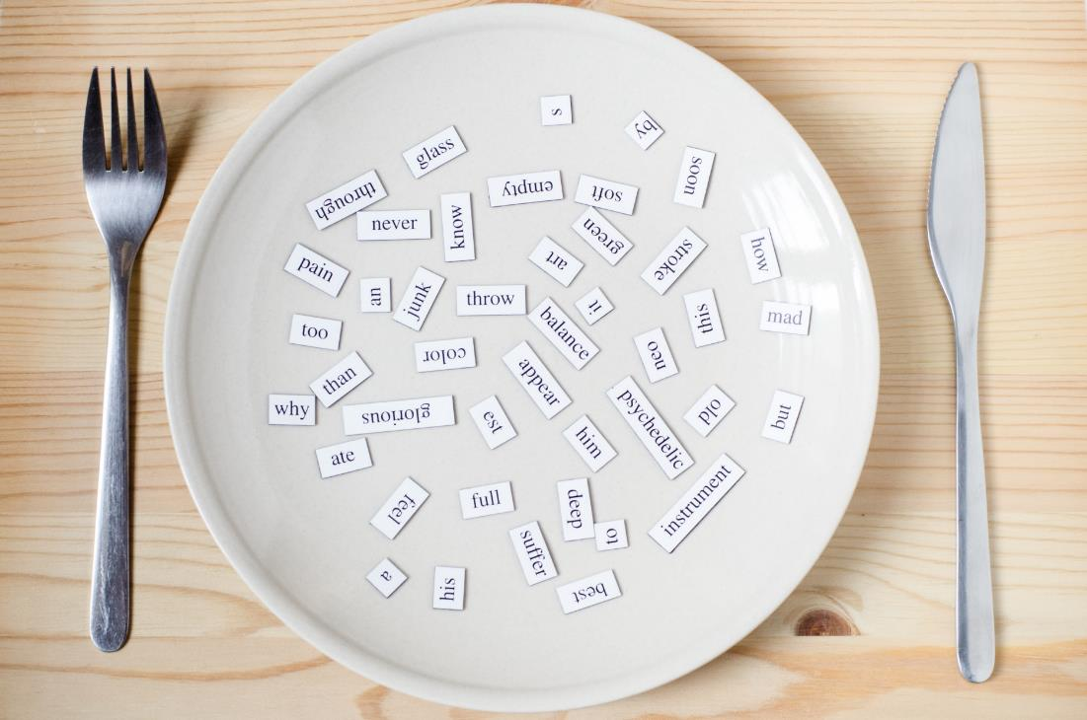
New words
Slowly,
Fast,
Badly,
Well,
Hard

Slide 18

Presentation

Slide 19


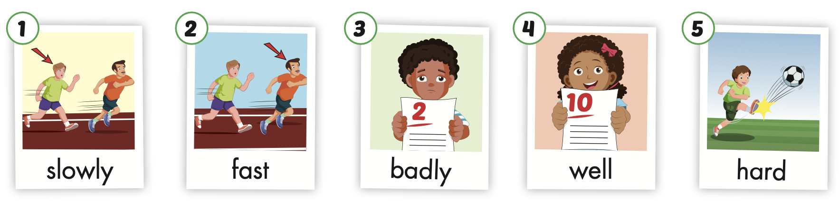
/ˈsloʊli/
chậm chạp
/fæst/
nhanh
/ˈbædli/
tồi, dở
/wel/
tốt, giỏi
/hɑːrd/
mạnh
Notes:
Click vào hình A. 1. Listen and point. Repeat để cho cả audio full chạy

Slide 20
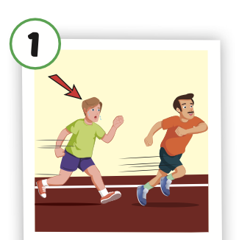
slowly
/ˈsloʊli/
chậm chạp

Slide 21
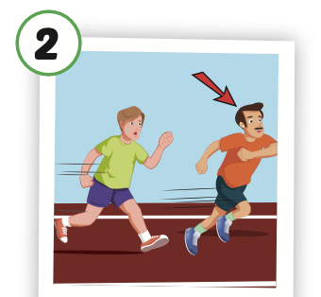
fast
/fæst/
nhanh

Slide 22
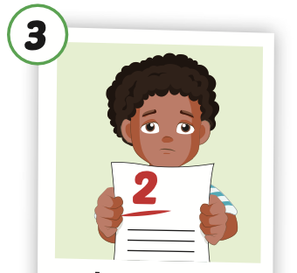
badly
/ˈbædli/
tồi, dở

Slide 23
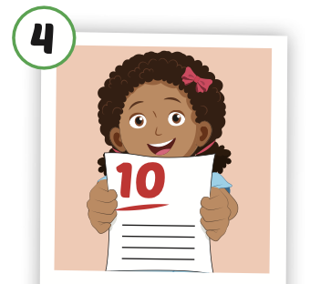
well
/wel/
tốt, giỏi

Slide 24
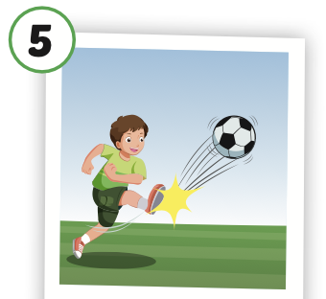
hard
/hɑːrd/
mạnh

Slide 25
Practice

Slide 26
Listen and choose

Slide 27

Listen and choose
slowly
fast
badly
A
B
C

Slide 28
Listen and choose
well
fast
badly
A
B
C

Slide 29
Listen and choose
well
fast
hard
A
B
C

Slide 30
Listen and choose
well
fast
badly
A
B
C

Slide 31


Slide 32
Look and say.

Slide 33
Structure
Tom kicks the ball hard.

Slide 34
Presentation

Slide 35
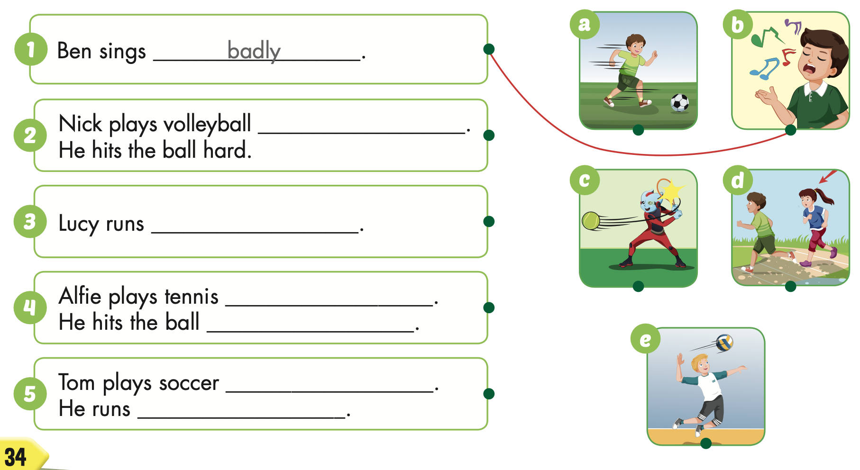

Structure
Ben sings badly.

Slide 36

Practice

Slide 37

well
slowly
well
hard
well
fast

Slide 38

Production

Slide 39

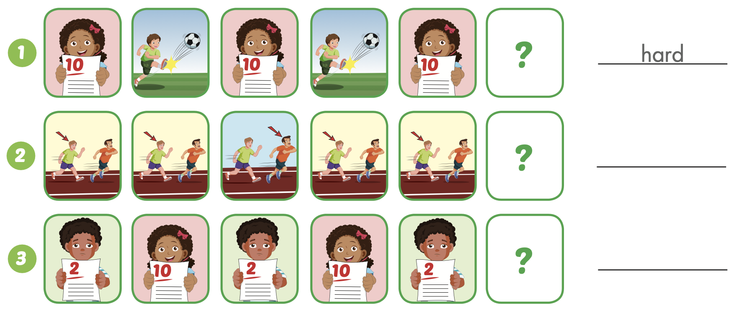
Extra Practice
WB, page 22
fast
well

Slide 40
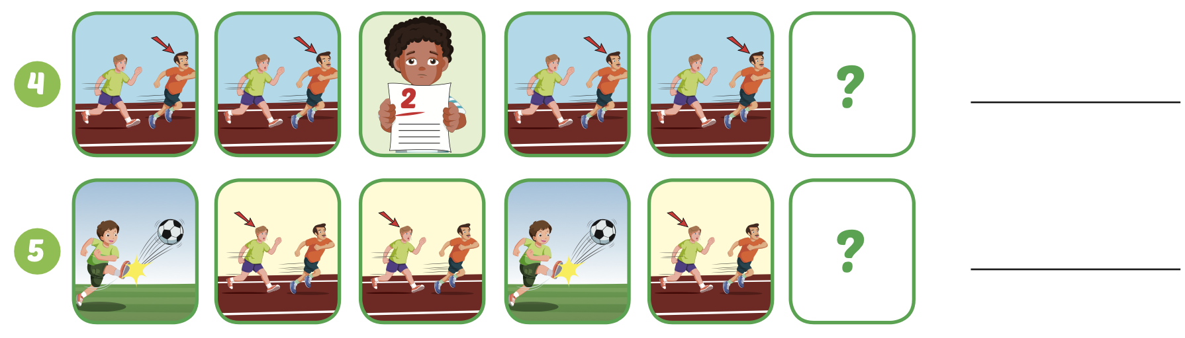
Extra Practice
WB, page 22
badly
slowly

Slide 41

WRAP-UP

Slide 42
Today’s lesson
Vocabularies
slowly,
fast,
badly,
well,
hard.
Structures/ Sentence patterns
Tom kicks the ball hard.

Slide 43
Homework
Practice the vocabularies and structure, and make sentences using them.
Do the exercises in Tiếng Anh 5 i-Learn Smart Start WB (page 22).
Do the exercises in Tiếng Anh 5 i-Learn Smart Start Notebook.
Prepare the next lesson (page 35 SB).
Play the consolidation games in Tiếng Anh 5 i-Learn Smart Start DHA App on www.eduhome.com.vn

Slide 44

Enjoy your day!

Slide 45

Lesson 3
Stay positive and have a nice day!

