Slide 1

Unit 7: JOBS
Lesson 3.1
Page 98

Slide 2
Lesson Outline
Warm-up
Vocabulary
Structure
Consolidation
Wrap-up

Slide 3
Objectives
By the end of this lesson, students will be able to recognize the vocabulary and get to know the structure of asking someone’s future job.
Vocabulary: writer, piano player, zookeeper, baker, chef, artist
Structure: Will you be a baker in the future?
- Yes, I will. I love baking. / No, I won’t. I don’t like baking

Slide 4

WARM-UP

Slide 5


Slide 6

What would you like to be when you grow up?
I’d like to be ____?
A. a pilot
B. a nurse
C. a designer
1
check

Slide 7

What would you like to be when you grow up?
I’d like to be ____?
A. a scientist
B. a soccer player
C. a singer
2
check

Slide 8

What would you like to be when you grow up?
I’d like to be ____?
A. a police officer
B. a tour guide
C. a driver
3
check

Slide 9

He likes acting. I think he’ll
be _______.
A. a actor
B. a singer
C. an actor
4
check

Slide 10

She likes helping sick people. I think she’ll be _______.
A. a nurse
B. a business person
C. a teacher
5
check

Slide 11

You like singing. I think you’ll
be _______.
A. a driver
B. a singer
C. a farmer
6
check

Slide 12

It’s time to learn …

Slide 13
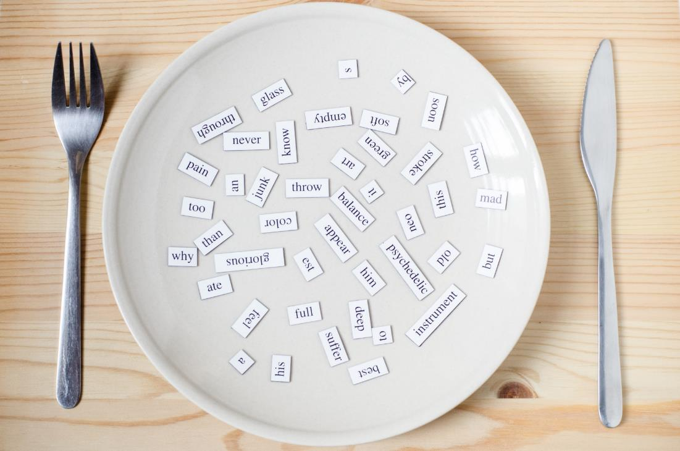
New words
writer,
piano player,
zookeeper,
baker,
chef,
artist.

Slide 14

Presentation

Slide 15

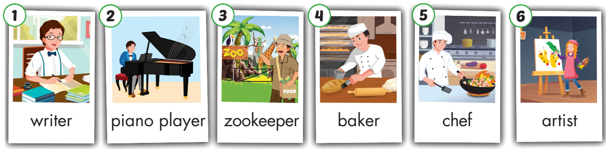
← Click on the title to hear the sound.
/piˈænoʊ ˈpleɪər/
nhạc sĩ dương cầm
/ˈzuːkiːpər /
nhân viên sở thú
/ˈraɪtər/
nhà văn
/ˈbeɪkər/
thợ làm bánh
/ʃef/
đầu bếp,
bếp trưởng
/ˈɑːrtɪst/
họa sĩ

Slide 16
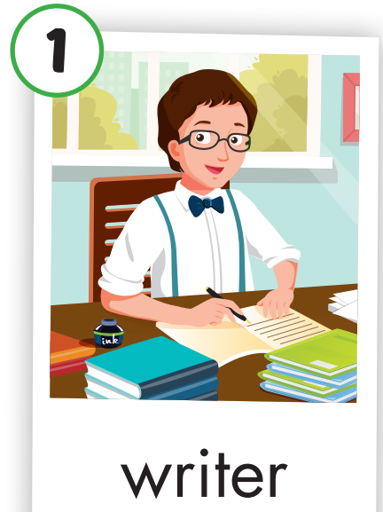
Click on the picture to hear the sound.
writer
/ ˈraɪtər /
nhà văn

Slide 17
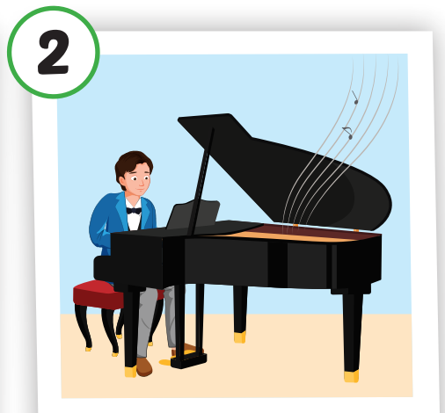
Click on the picture to hear the sound.
piano player
/ piˈænoʊ ˈpleɪər /
nhạc sĩ dương cầm

Slide 18
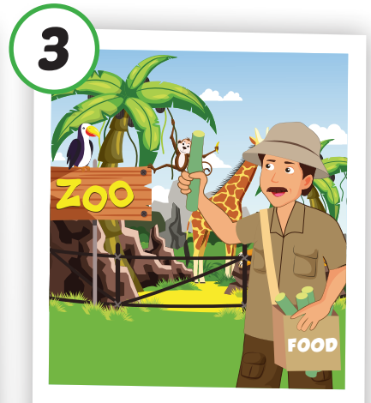
Click on the picture to hear the sound.
zookeeper
/ ˈzuːkiːpər /
nhân viên sở thú

Slide 19
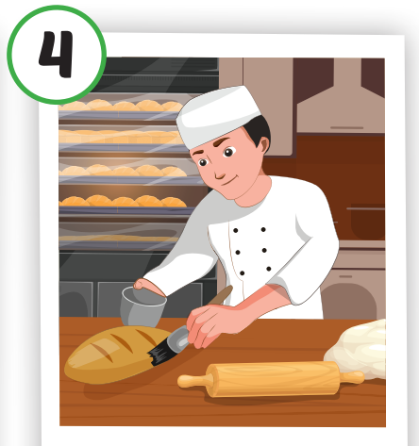
Click on the picture to hear the sound.
baker
/ ˈbeɪkər /
thợ làm bánh

Slide 20
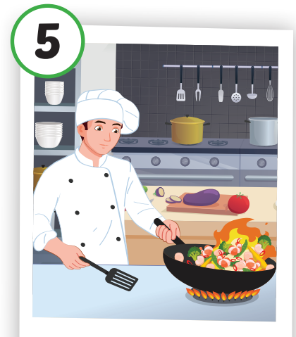
Click on the picture to hear the sound.
chef
/ ʃef /
đầu bếp, bếp trưởng

Slide 21
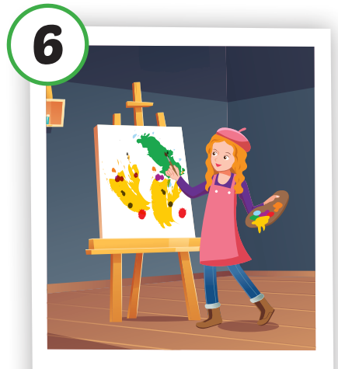
Click on the picture to hear the sound.
artist
/ ˈɑːrtɪst /
họa sĩ

Slide 22
Practice

Slide 23
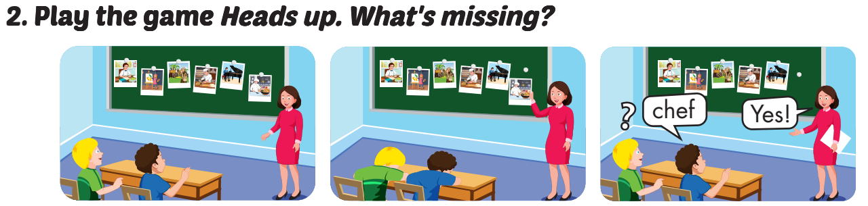

Slide 24
Click to make the picture disappear and reappear.

Slide 25
Structure
Will you be a baker in the future?
Yes, I will. I love baking.
No, I won’t. I don’t like baking.

Slide 26
Presentation

Slide 27
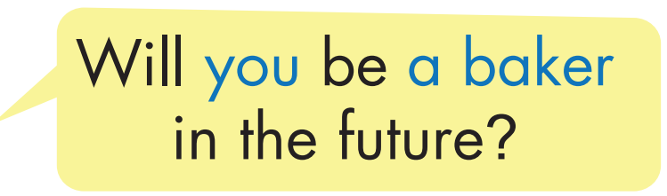
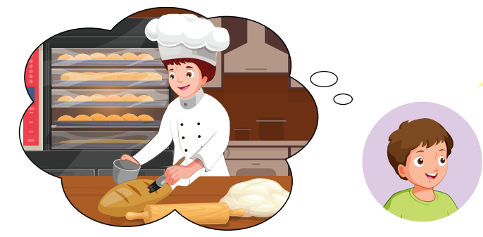
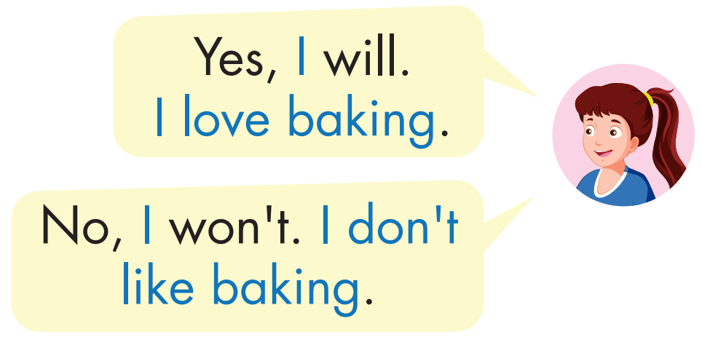
Structure
Click on the picture to hear the sound.

Slide 28

Practice

Slide 29

Click on the picture below to hear the sound.

Slide 30

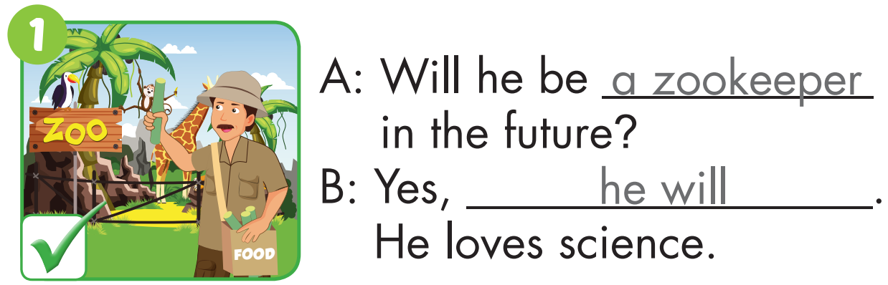
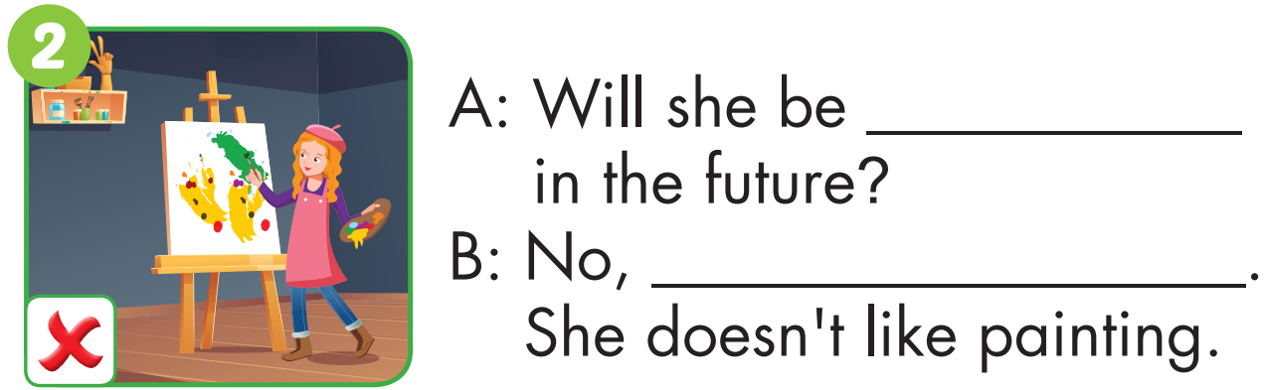
an artist
she won’t

Slide 31
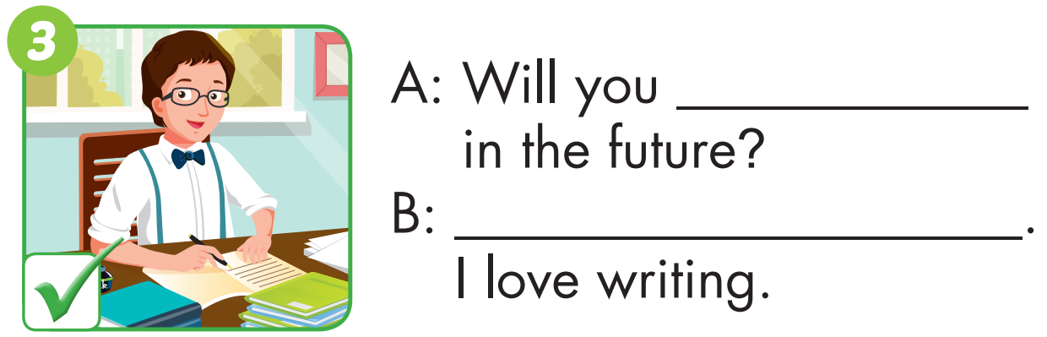
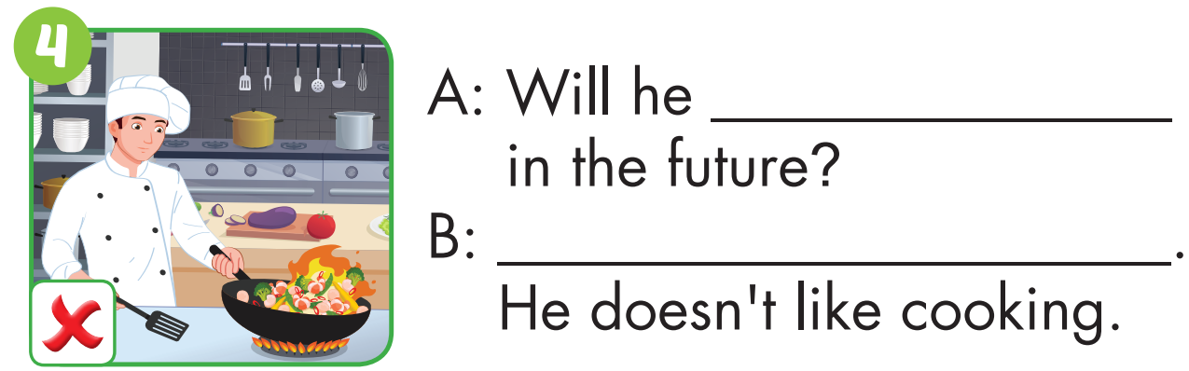
be a writer
Yes, I will
be a chef
No, he won’t

Slide 32
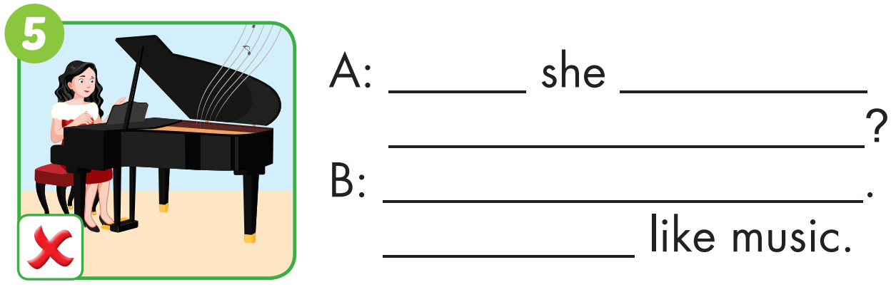
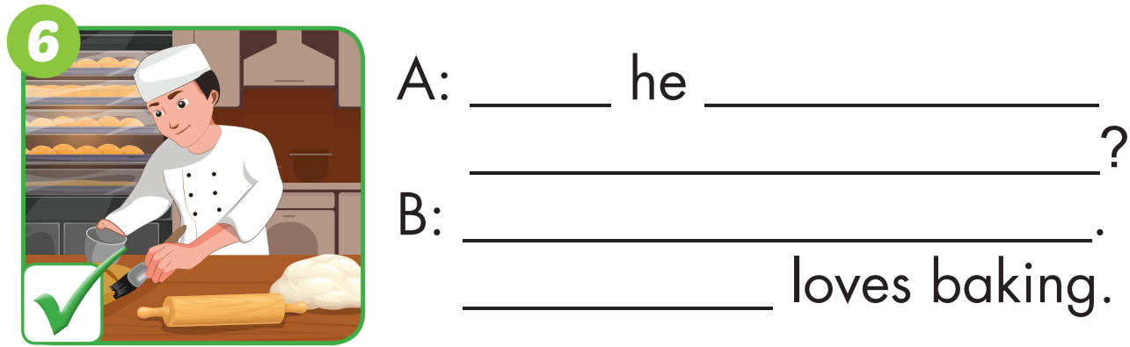
Will
be a piano
player in the future
No, she won’t
She doesn’t
Will
be a baker
in the future
Yes, he will
He

Slide 33

Production

Slide 34


Look, ask and answer.
Will you be a piano player in the future?
Will you be a writer in the future?
Yes, I will.
I love writing.
No, I won’t.
I don’t like music.

Slide 35
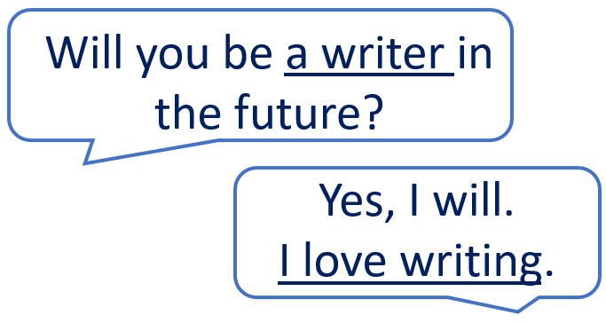
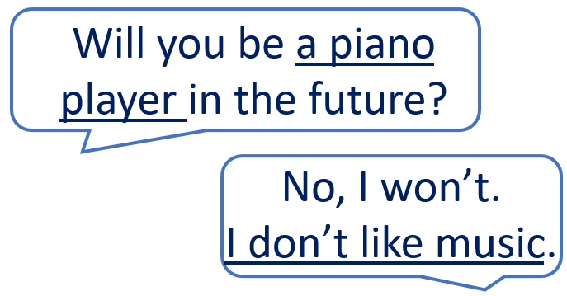

Slide 36

CONSOLIDATION

Slide 37

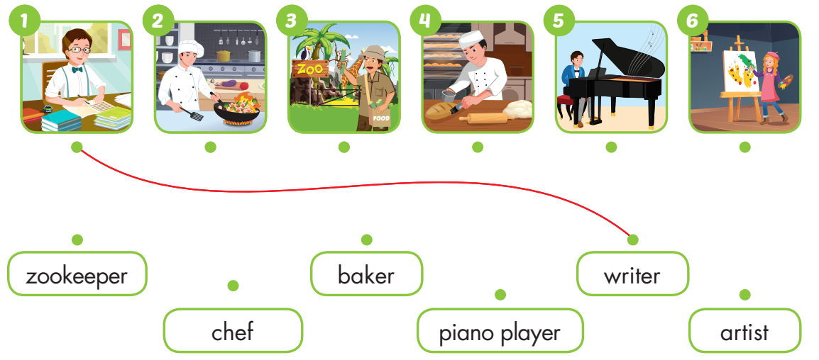
Extra Practice
WB, page 66

Slide 38

WRAP-UP

Slide 39
Today’s lesson
Vocabularies
writer, piano player, zookeeper, baker, chef, artist
Structures/ Sentence patterns
Will you be a baker in the future?
- Yes, I will. I love baking. /
- No, I won’t. I don’t like baking

Slide 40
Homework
Practice the vocabulary and structure, and make sentences using them.
Do the exercises in Tiếng Anh 5 i-Learn Smart Start WB (page 66).
Do the exercises in Tiếng Anh 5 i-Learn Smart Start Notebook.
Prepare for the next lesson (page 99 SB).
Play the consolidation games in Tiếng Anh 5 i-Learn Smart Start DHA App on www.eduhome.com.vn

Slide 41

Enjoy your day!

Slide 42

Lesson 3
Stay positive and have a nice day!

