Slide 1

Unit 2
WHAT I CAN DO
LESSON 3.1 - PAGE 26

Slide 2
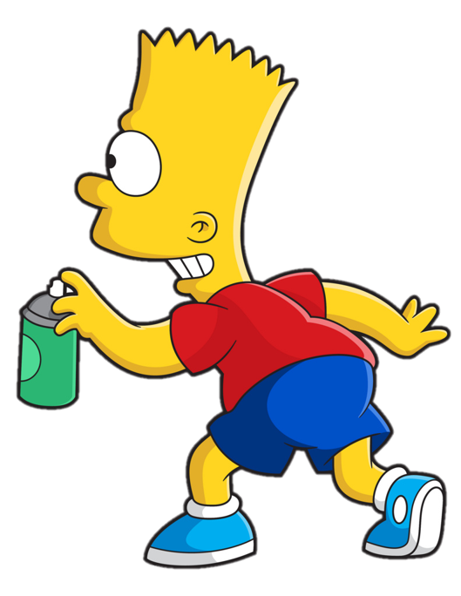


Slide 3












> Someone has deleted some words.
> Guess the deleted word within the time limit (12 seconds).

Slide 4
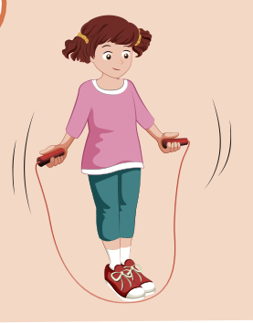

Y
Can she jump rope?
CHECK
Notes:
4

Slide 5
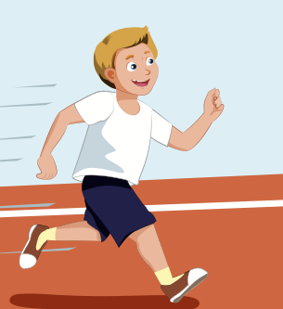
Can he run?
CHECK
Notes:
5

Slide 6
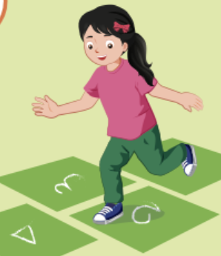
Can she hop?
CHECK
Notes:
6

Slide 7
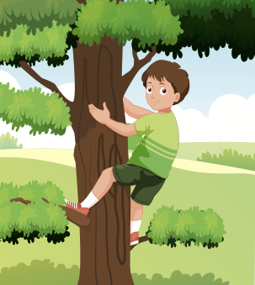
Y
Can he climb a tree?
CHECK
Notes:
7

Slide 8
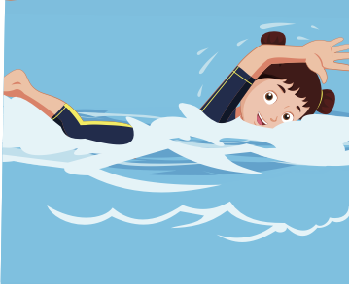
Y
Can she swim?
CHECK
Notes:
8

Slide 9

New words
play the guitar, play the piano, drive a car,
ride a bike,
do gymnastics, play the drums.

Slide 10


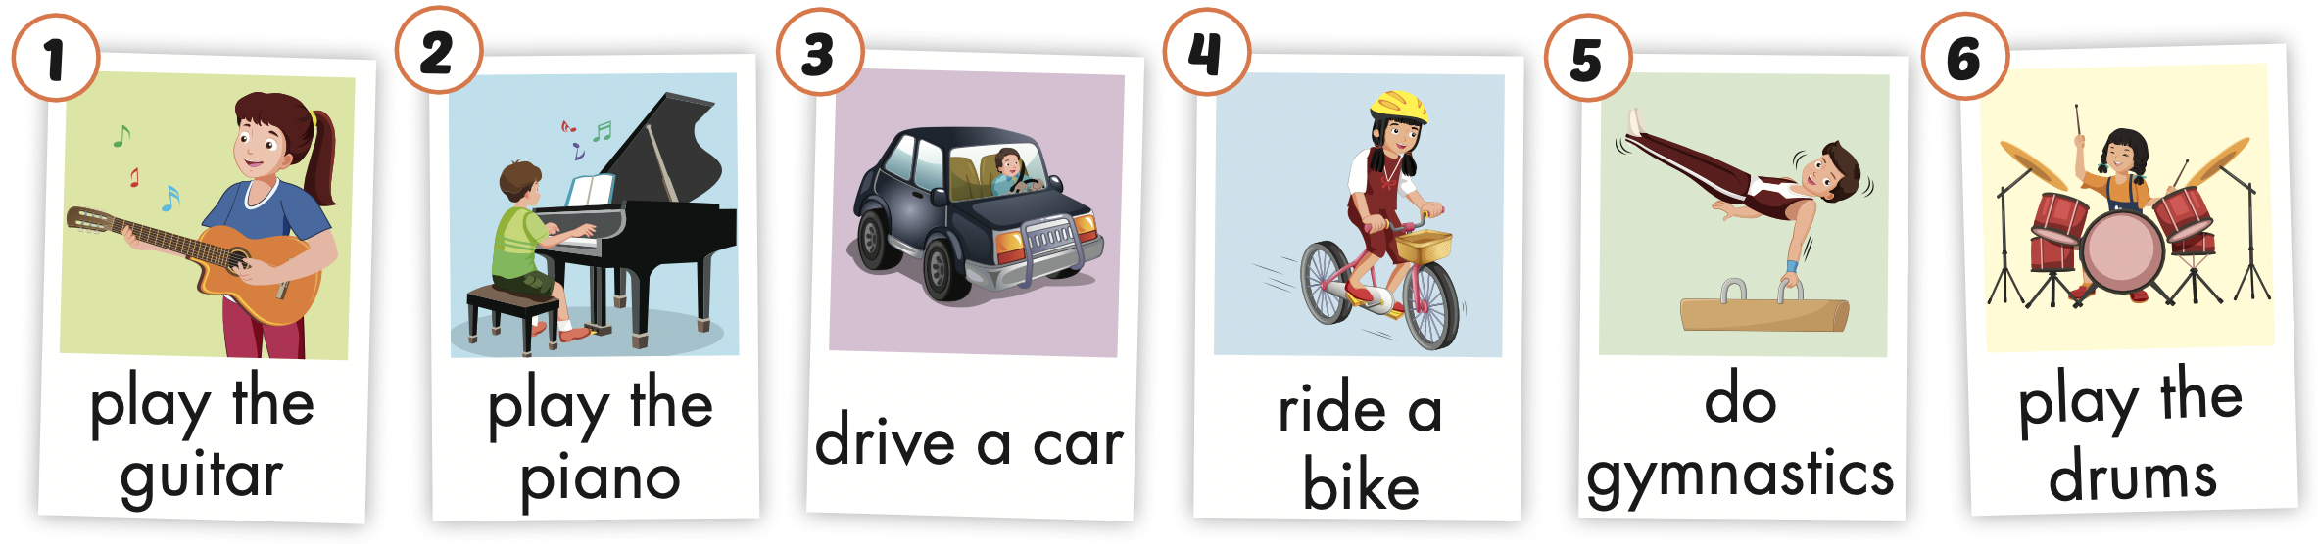
Click the icon to hear the sound.

Slide 11
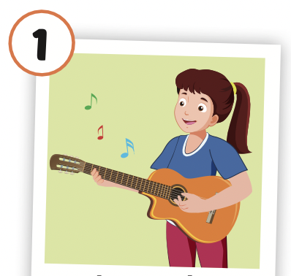
Click the picture to hear the sound.
play the guitar
/pleɪ ðə ɡɪˈtɑːr/
chơi đàn ghi-ta

Slide 12
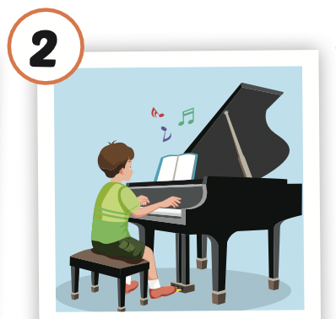
Click the picture to hear the sound.
play the piano
/pleɪ ðə piˈænoʊ/
chơi dương cầm/ đàn pi-a-nô

Slide 13
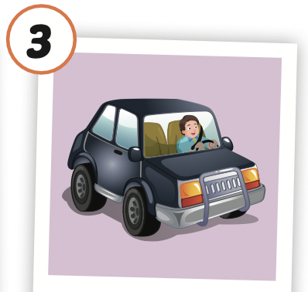
Click the picture to hear the sound.
drive a car
/draɪv ə kɑːr/
lái xe (4 bánh)

Slide 14
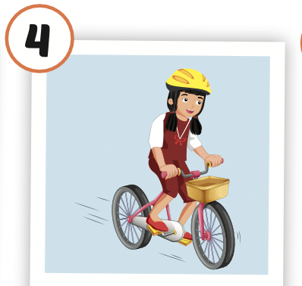
Click the picture to hear the sound.
ride a bike
/raɪd ə baɪk /
cưỡi xe đạp

Slide 15
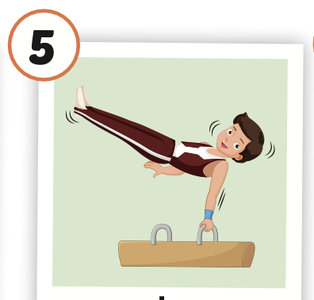
Click the picture to hear the sound.
do gymnastics
/duː dʒɪmˈnæstɪks/
tập thể dục dụng cụ

Slide 16
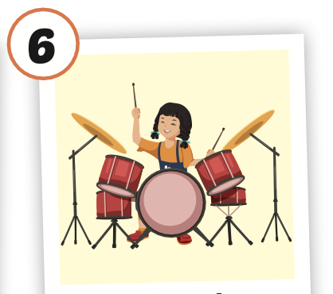
Click the picture to hear the sound.
play the drums
/pleɪ ðə drʌmz/
chơi trống

Slide 17
Click the icon to hear the sound.

Slide 18



LISTEN AND CHOOSE

Slide 23
Structures
What can you do?
- I can play the piano.
What can your mom do?
- She can drive a car.
What can your friends do?
- They can ride bikes.

Slide 24

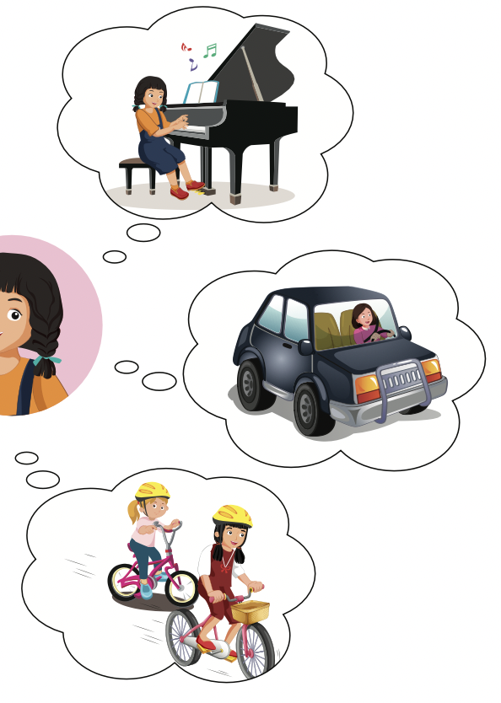
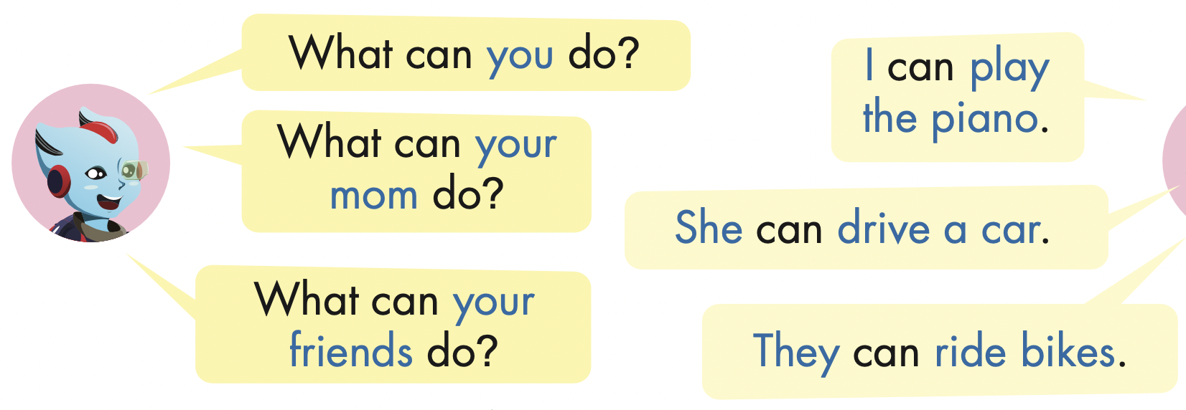
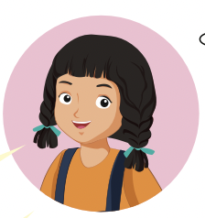

Slide 25
What can your brother do?
He can do gymnastics.

Slide 26
What can your sister do?
She can ride a bike.

Slide 27
What can your father do?
He can drive a car.

Slide 28
What can your friend do?
She can play the guitar.

Slide 29
Tuesday, October 14th 2025
Unit 2 – Lesson 3.1
play the guitar,
play the piano,
drive a car,
ride a bike,
do gymnastics,
play the drums.
- What can you do?
- I can play the piano.
- What can your mom do?
- She can drive a car.
- What can your friends do?
- They can ride bikes.

Slide 30
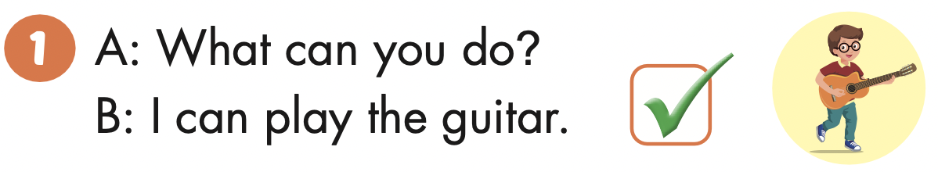

Slide 31
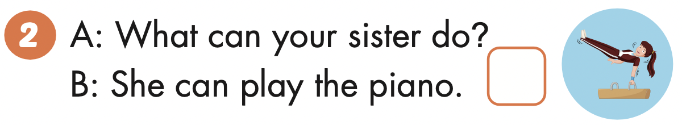

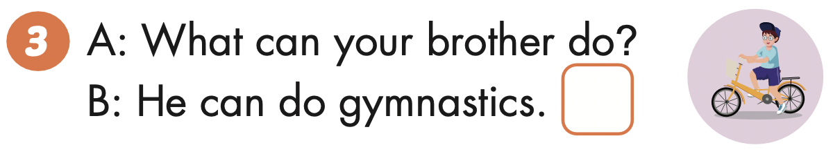

Slide 32
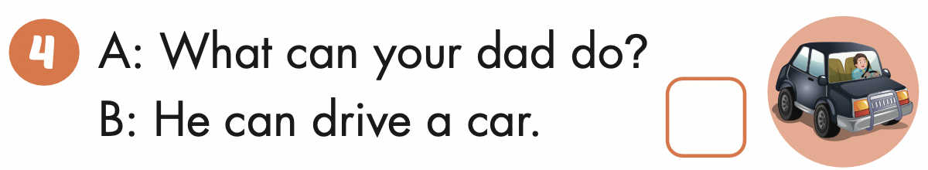

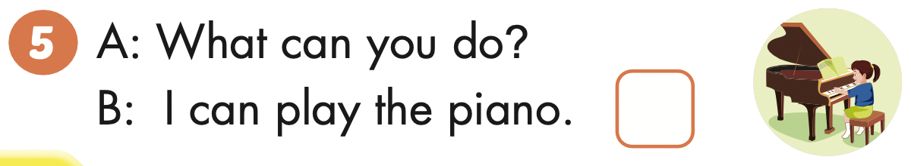

Slide 33
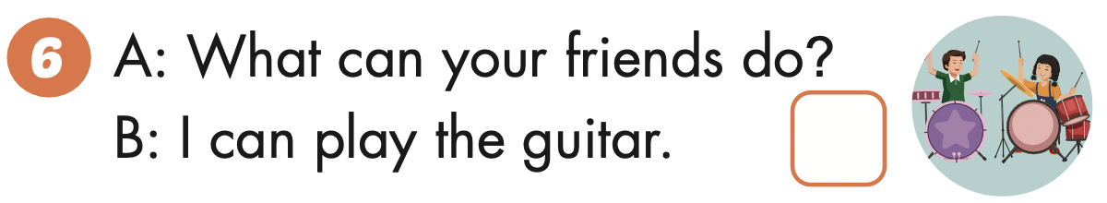

Slide 34

Read and write

Slide 35

Next
CHECK
What can your mom do?
She can play the piano.
…………….………………….

Slide 36
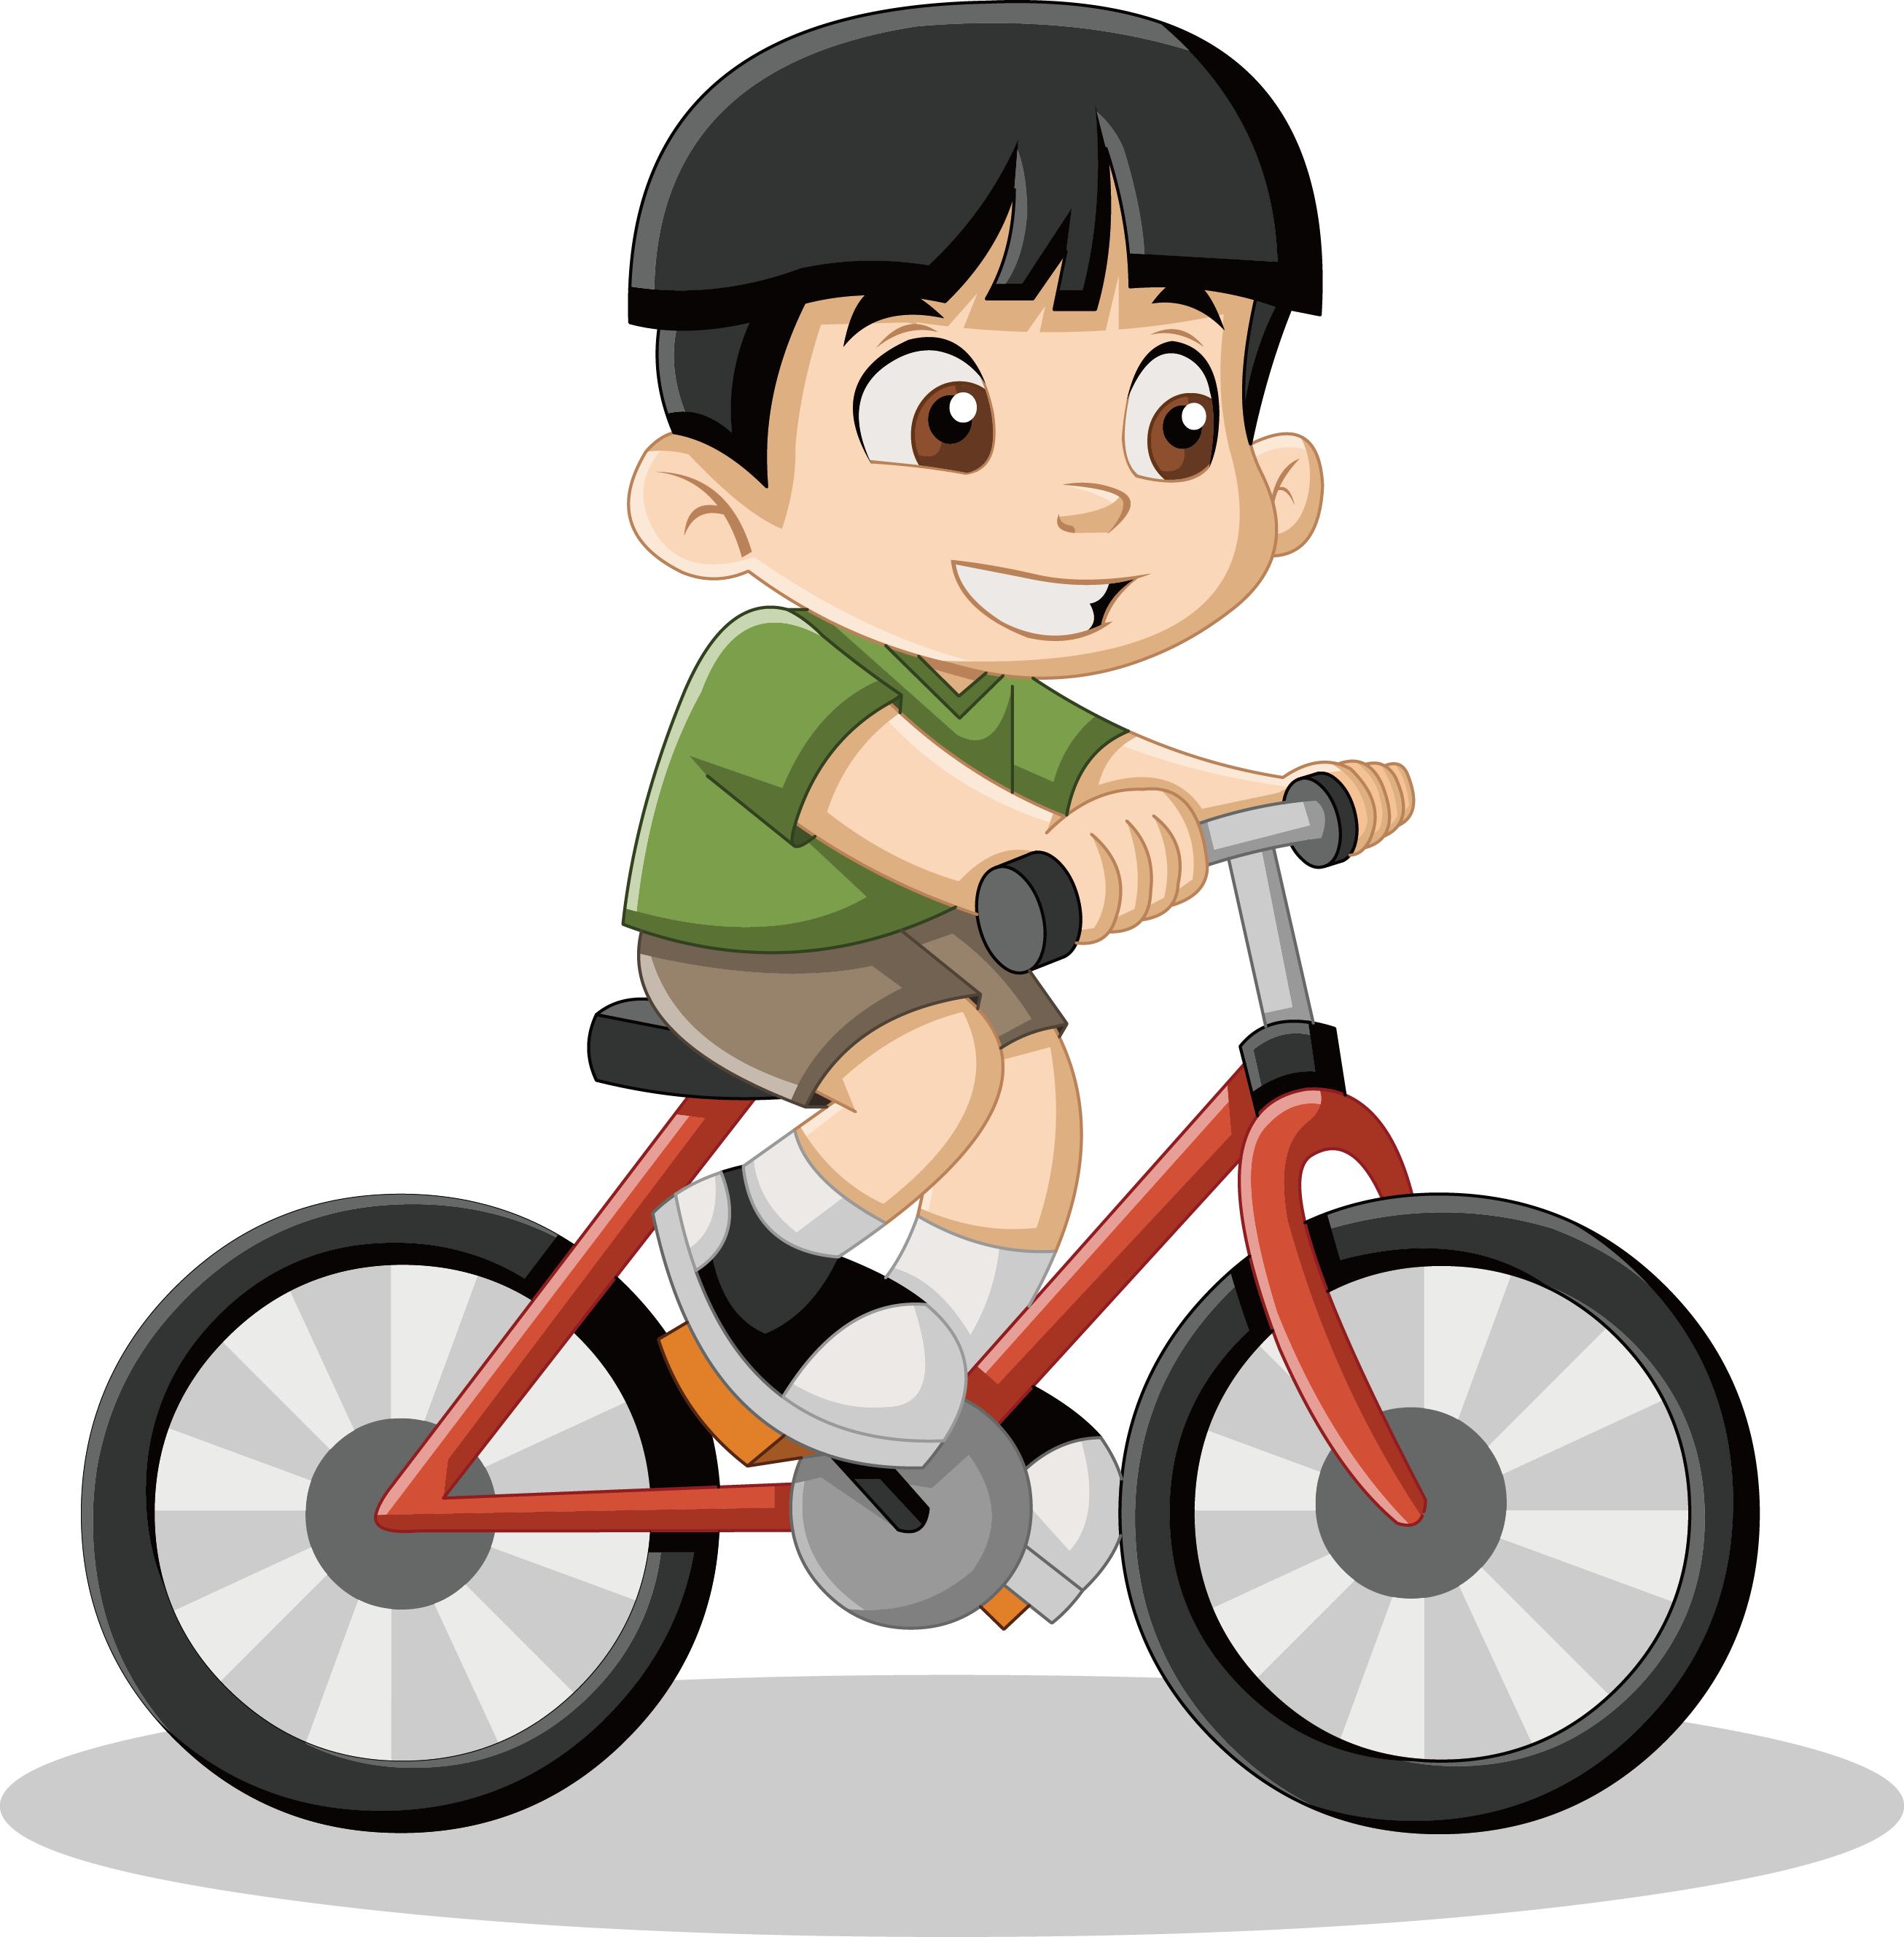
Next
CHECK
What can your friend do?
He can ride a bike.
…………….………………….

Slide 37

Next
CHECK
What can you and your sister do?
We can swim.
…………….………………….

Slide 38

Next
CHECK
What can your brother do?
He can play the drums.
…………….………………….

Slide 39

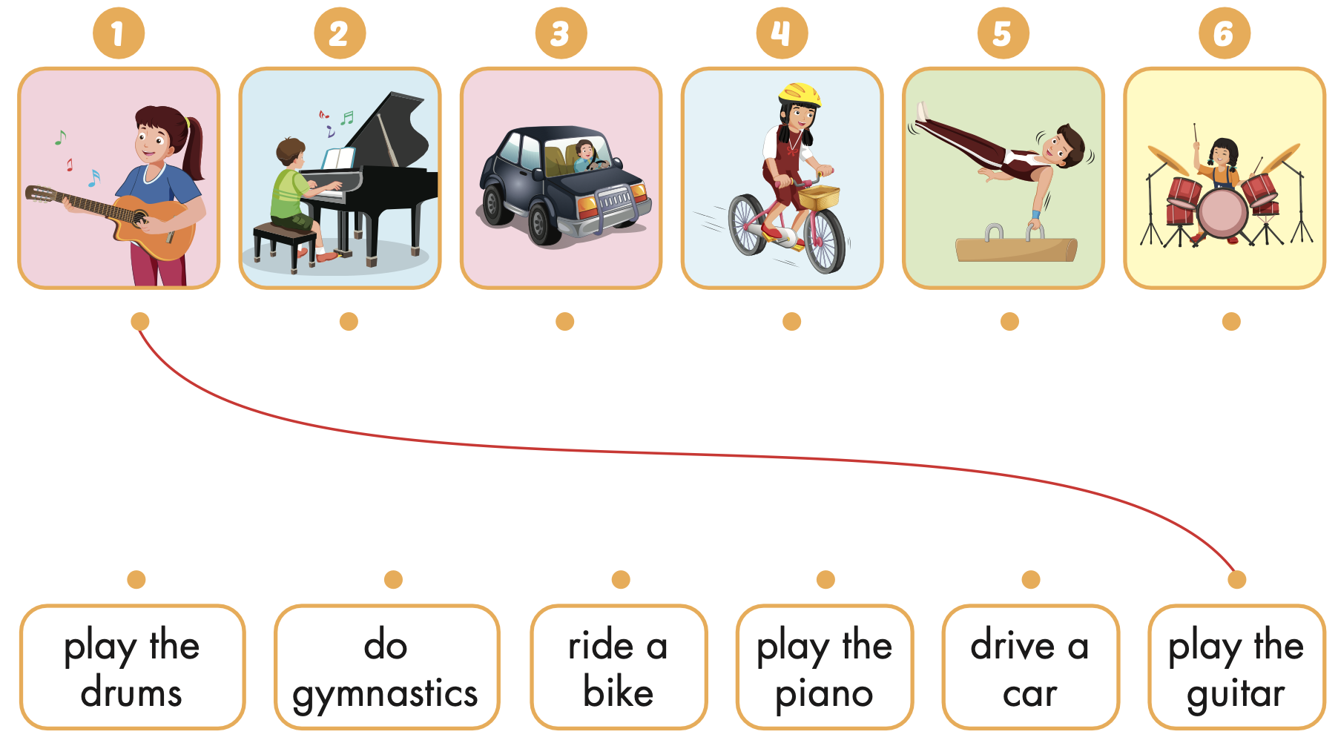





Extra Practice
WB, page 16

