Slide 1
Unit 4: Culture & Ethnic groups
Lesson 1. Getting started & vocabulary
Page: 54

Slide 2
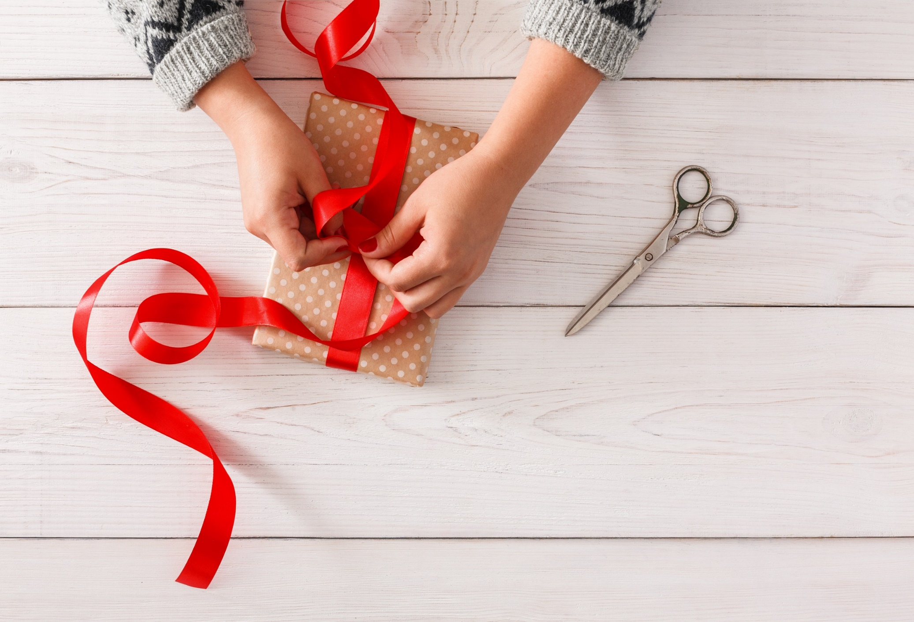
WRAP-UP

Slide 3
Today’s lesson
Vocabulary
learn and practise vocabulary for Customs
Pronunciation
practise the sounds /s/, /ʃ/ and /z/

Slide 4
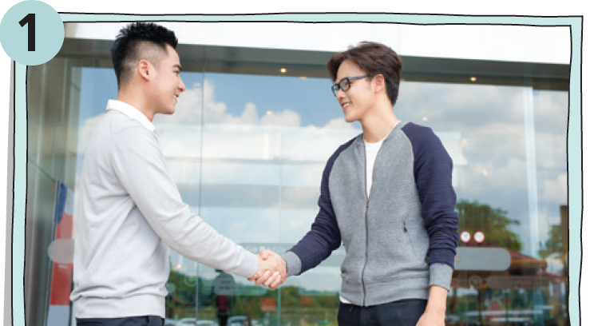
What is happening in each picture?
They are talking and shaking hands.

Slide 5
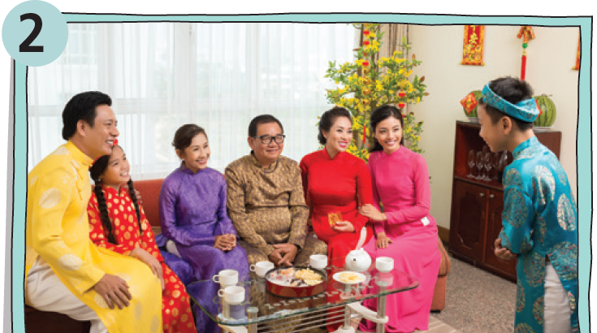
What is happening in each picture?
The boy is showing his respect to older people.

Slide 6
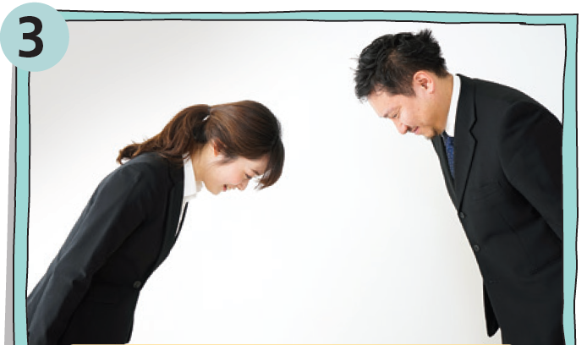
What is happening in each picture?
They are greeting each other.

Slide 7
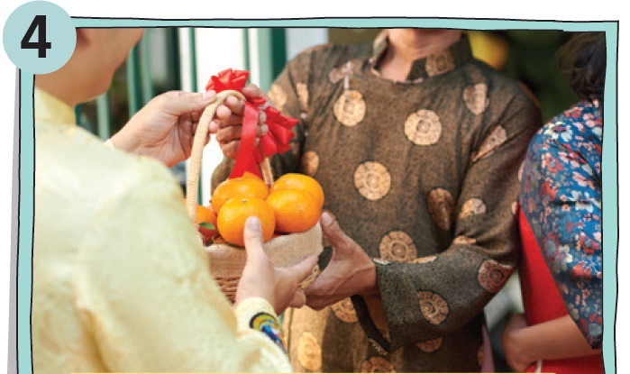
What is happening in each picture?
A woman is giving some fruits to her friend.

Slide 8
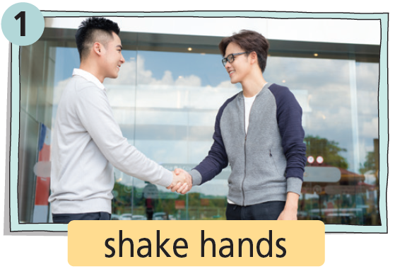
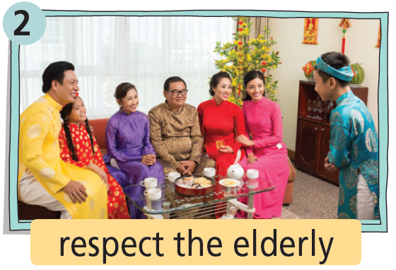
VOCABULARY

Slide 9
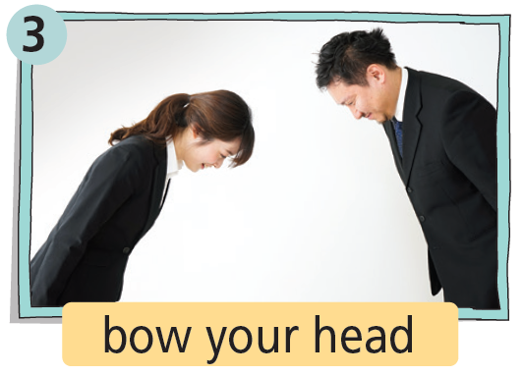
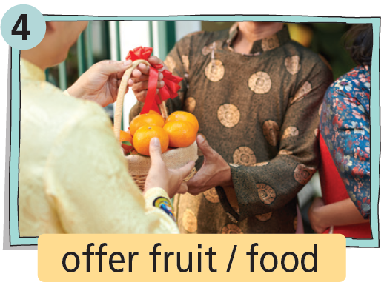
VOCABULARY

Slide 10
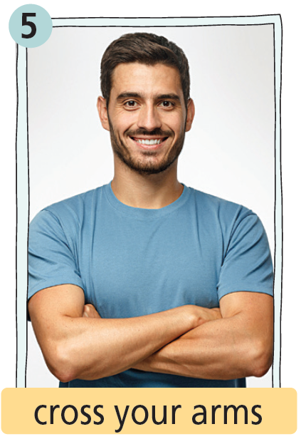
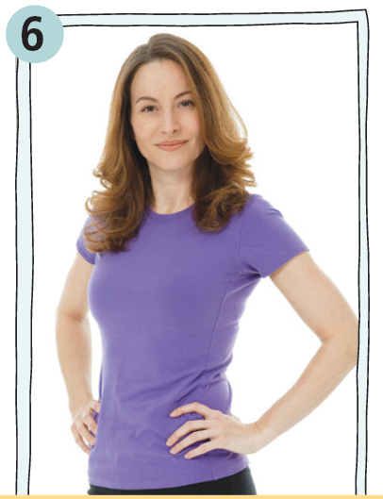
VOCABULARY

Slide 11
VOCABULARY
Practise saying them with a partner.
1. shake hands /ʃeɪk hændz/ (phr):
bắt tay
2. respect the elderly /rɪˈspekt ði ˈeldəli/ (phr):
tôn trọng người lớn tuổi
3. bow your head /baʊ jɔː hed/ (phr):
cúi chào
4. offer fruit / food /ˈɒfə fruːt/ /ˈɒfə fuːd/ (phr):
tặng trái cây/ thức ăn
5. cross your arms /krɒs jɔː ɑːmz/ (phr):
khoanh tay
6. stand with hands on hips
/stænd wɪð hændz ɒn hɪps/ (phr):
đứng chống nạnh

Slide 12
Pronunciation /s/ - /ʃ/ - /z/
Listen and put the words into the correct columns.
Practise saying them with a partner.

Slide 14
Extra practice
Listen again and decide if the following statements are R (right) or W (wrong).
1. In Japan, people say hello by bowing their heads.
2. In Vietnam, it is polite to stand with hands on hips.
3. Offering fruit or food to the host is a way to show your respect for him/her.
R
W
R

Slide 15
Which of the customs in Exercise 1 people should/ shouldn’t do in your country?
should/shouldn’t + bare infinitive
Suggested Answer Key In my country, people should shake hands, respect the elderly, bow their heads and offer fruit or food. They shouldn’t cross their arms or stand with their hands on their hips.

Slide 16
Audioscript
Speaker A
People from different places have different customs, from the way they greet each other to their body language. When I was on holiday in Japan, I found out that most people there don’t greet each other the same way we do in my country. They say hello by bowing their heads.
Speaker B
I love travelling and I know that it’s important to follow the customs of the local people. Last summer, I was on holiday in Việt Nam. One day, I was standing with my hands on my hips when I remembered that was not polite, so I stopped myself.
Speaker C
I always like to bring a gift when a friend invites me to their home. No matter where you’re from, one way to show your respect for hosts is to bring a small gift. Offering fruit or food to the host is a popular gift-giving custom all over the world!

Slide 17
CONSOLIDATION

Slide 18
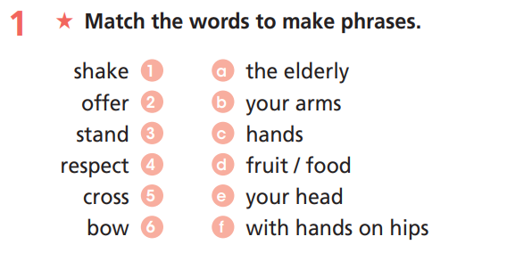
Extra practice (WB, Ex. 1, p. 30)

Slide 19
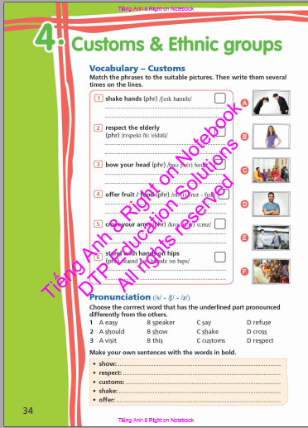
Homework
learn by heart the vocabularies and
make sentences using them.
- do the exercises on page 30, WB.
do the exercises in Tiếng Anh 8
Right on! Notebook (page 34)
prepare for the next lesson:
Lesson 4a - Reading (page 55, SB)

Slide 20
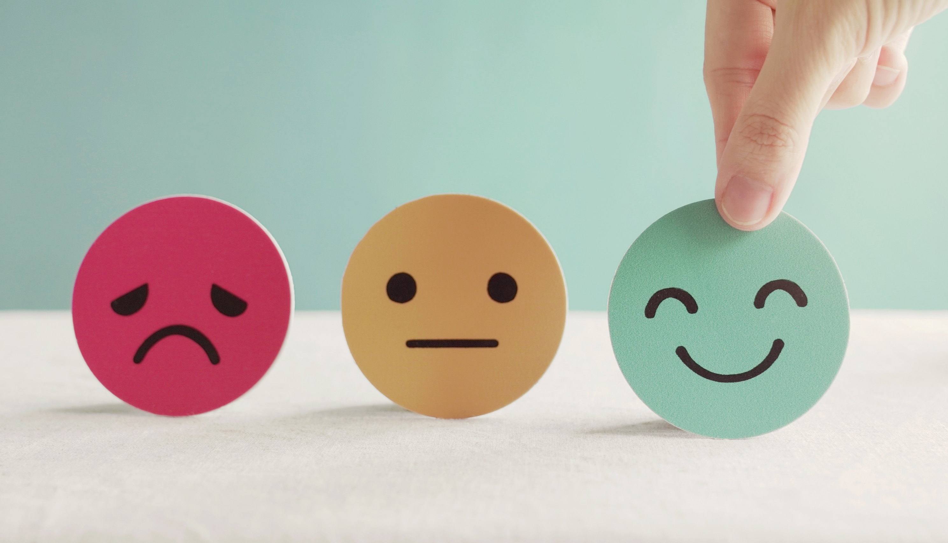
Lesson 3
Stay positive and have a nice day!

