Slide 1
Teacher: Vu Thi Lua

Slide 2
Thursday December 12nd 2024 Unit4 ACTIVITIES
CULTURE 1.1( page 57)

Slide 3
TABLE OF CONTENTS
01
02
03
Warm up
Vocabulary
04
Structure
Consolidation
05
Wrap- up

Slide 4
01
WARM UP

Slide 6
02
VOCABULARY
++

Slide 7
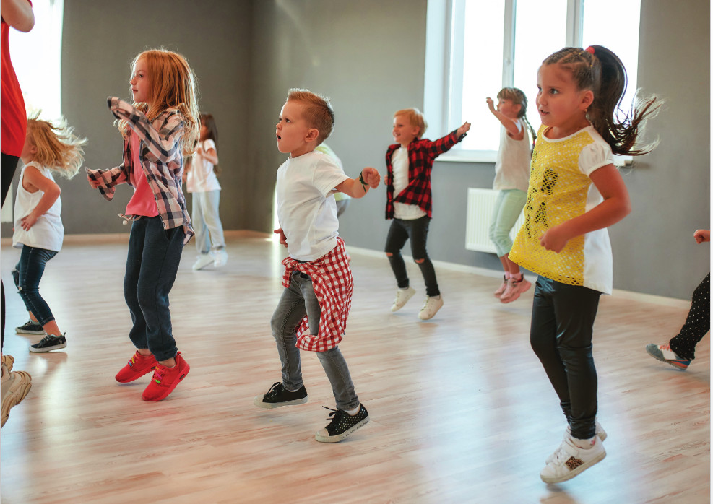
studio

Slide 8
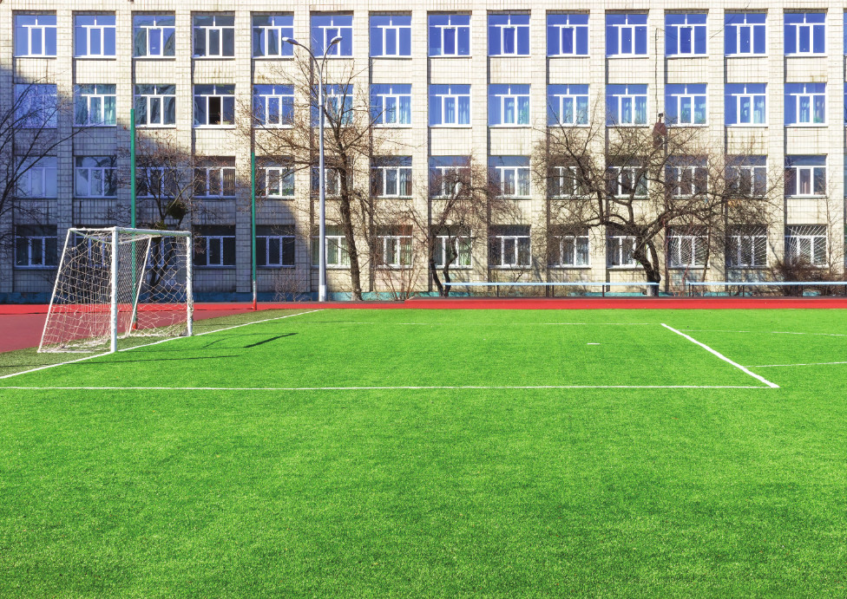
soccer field

Slide 9
arcade

Slide 10
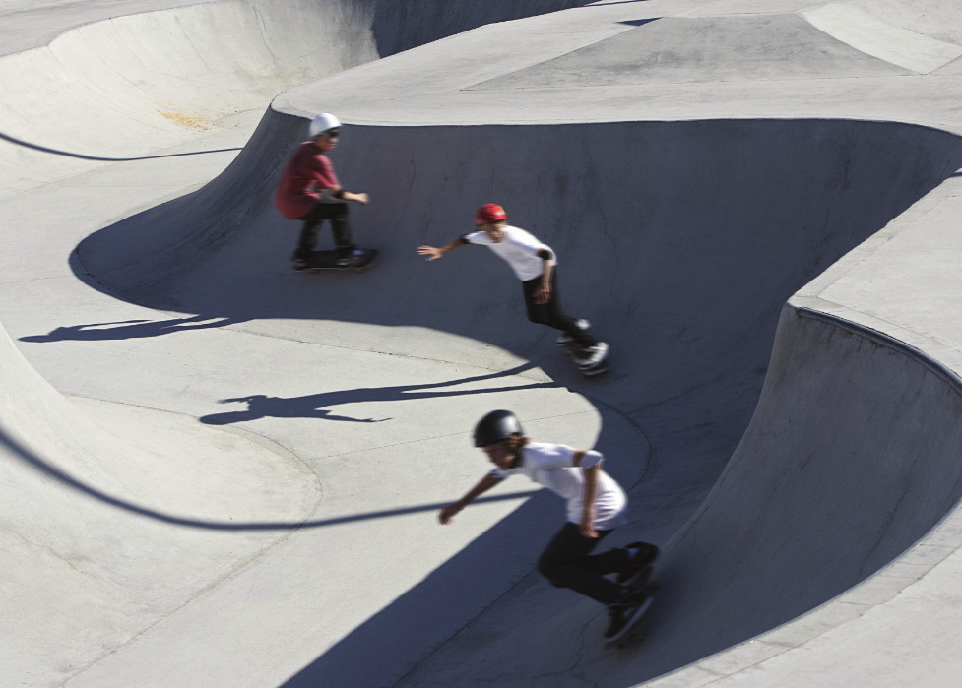
skate park

Slide 11
coffee shop

Slide 12
A. 1.Listen and point. Repeat.
1
2
3
studio
soccer field
arcade
4
5
skate park
coffee shop

Slide 13
2. Play Heads up. What’s missing ?

Slide 15
Answer the question
I want to play football. Where can I go ?
soccer field
CHECK

Slide 16
I want to drink juice. Where can I go ?
coffee shop
CHECK

Slide 17
I want to play game. Where can I go ?
arcade
CHECK

Slide 18
I want to play skating. Where can I go ?
skate park
CHECK

Slide 19
I want to dance. Where can I go ?
studio
CHECK

Slide 20
03 STRUCTURE
++
++

Slide 21
B. 1.Listen and practice.
What’s she doing ?
She’s dancing at the studio.
They’re playing soccer at the soccer field.
What are they
doing ?

Slide 22
What +is + she/he +doing ?
He’s/ She’s + V-ing

Slide 23
What + are + you/we/they + doing ?
We/You/They +’re + V-ing
I +am + V-ing

Slide 24
PLAY

Slide 25
Ms Huyền Phạm
0936.082.789

Slide 26
B. reading book
A. dancing
C. skating
He’s …. at the coffee shop.

Slide 27
B. arcade
A. skate park
C. studio
They’re dancing at the…….

Slide 28
B. Who
What
C. Would
…is he doing ?
He’s reading.

Slide 29
B. He’s playing
arcade at the
video games.
He’s video
games at the
playing arcade.
C. He’s playing
video games
at the arcade.
at / video/ the/
games/ playing/ arcade./ He’s

Slide 30
B
C
A
They’re skating at the…

Slide 31
B. is
A. are
C. am
She…dancing at the studio.

Slide 32
B. skating
C. talking with friends
A. dancing
She’s…..at the coffee shop.

Slide 33
B. What’s she doing ?
A. What are they doing ?
C. What’s he doing ?
They’re playing soccer at the soccer field.

Slide 34
EXIT

Slide 35
04 CONSOLIDATION

Slide 36
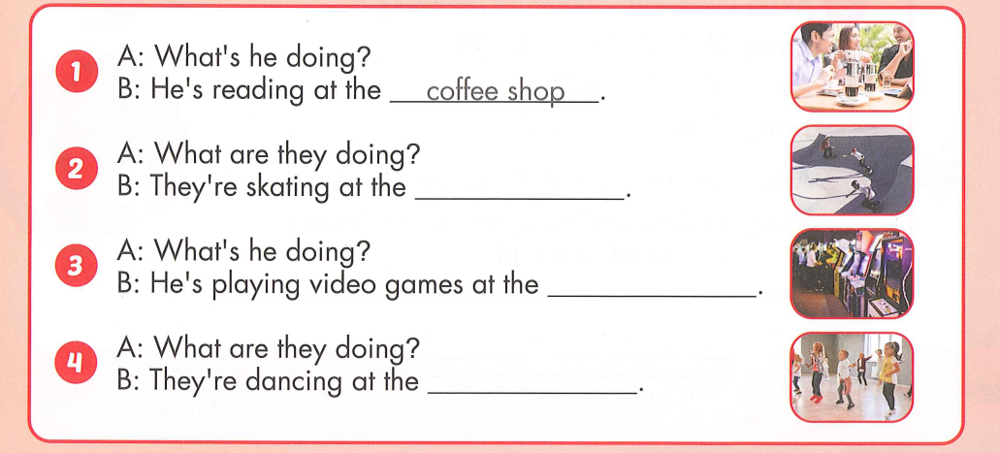
2. Look and write. Practice.
skate park
arcade
studio

Slide 37
05 WRAP- UP
++
++

Slide 38
Today’s lesson
Vocabularies
studio, soccer field, arcade, skate park, coffee shop.
Structures/ Sentence patterns
What is she doing?
She’s dancing at the studio.
What are they doing?
They are playing soccer at the soccer field.

Slide 39
Homework
Practice the vocabulary and structure, and make sentences using them.
Do the exercises in Tiếng Anh 4 i-Learn Smart Start WB (page 38)
Prepare the next lesson (page 58 SB)

Slide 40
GOOD BYE SEE YOU AGAIN

