Slide 1





Slide 2


Our school facilities
6
Lesson 1 – Period 2

Slide 3
Table of contents
Warm-up
Guessing game
01
02
03
Activity 6
Let’s play.
04
Activity 4
Listen and number.
Game
05
Activity 5
Look, complete
and read.

Slide 4
01
Warm-up
Guessing game

Slide 5

school
Remove

Slide 6

city
Remove

Slide 7

village
Remove

Slide 8

mountains
Remove

Slide 9
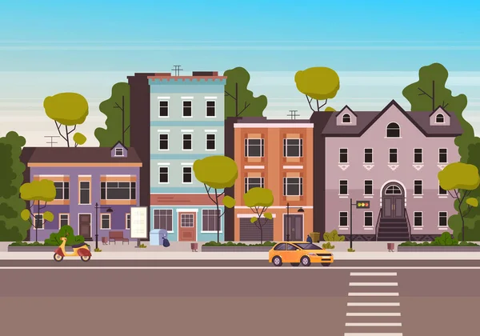
town
Remove

Slide 10
02
Activity 4
Listen and number.

Slide 11
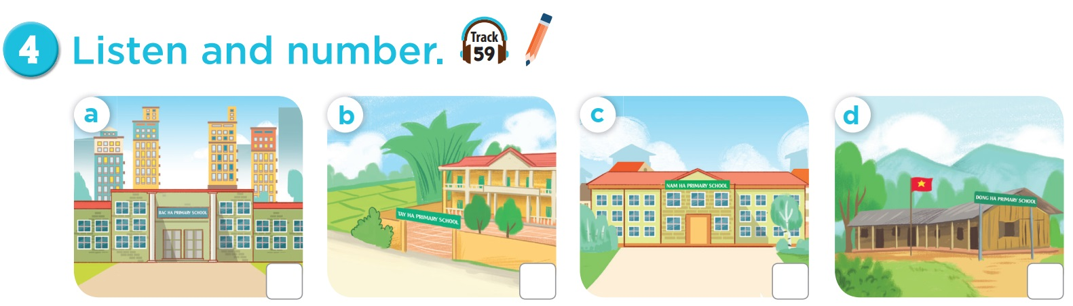

3
4
1
2

Slide 12
03
Activity 5
Look, complete and read.

Slide 13
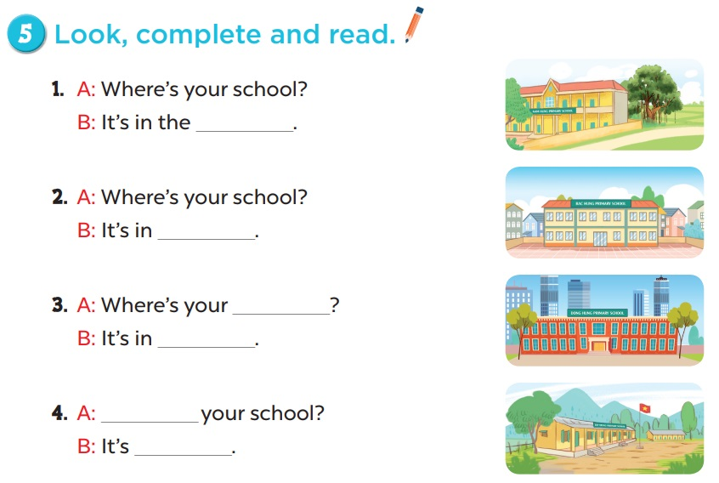

Slide 14

A: Where’s your school?
B: It’s in the ______.
village

Slide 15



Congratulations

Slide 16

A: Where’s your school?
B: It’s in _______.
the town
Notes:
Câu này yêu cầu học sinh đọc câu hỏi và sau đó có thể cho nó chọn một đứa khác để trả lời.

Slide 17
CongratulationS!

Slide 18

school
A: Where’s your _______?
B: It’s in _______.
the city
Notes:
Câu này có thể hỏi học sinh là What is it? trước. Và sau đó yêu cầu chúng nó đánh vần ạ.

Slide 19
CongratulationS!

Slide 20
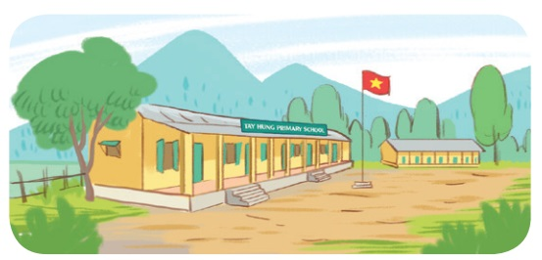
A: ______ your school?
B: It’s ______________.
Where’s
in the mountains

Slide 21
Congratulation

Slide 22
04
Activity 6
Let’s play.

Slide 23
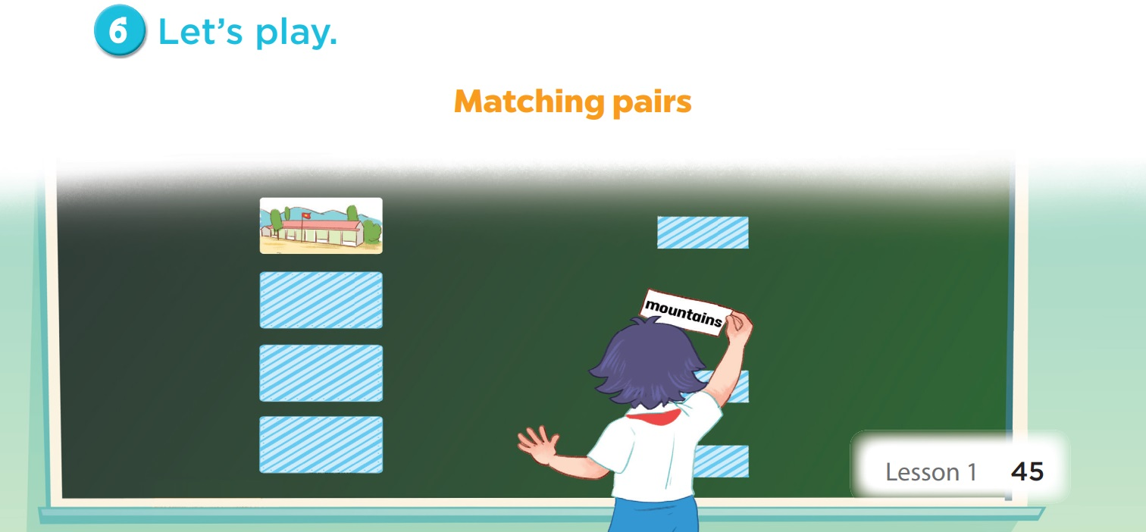

Slide 24
05
Game

Slide 25


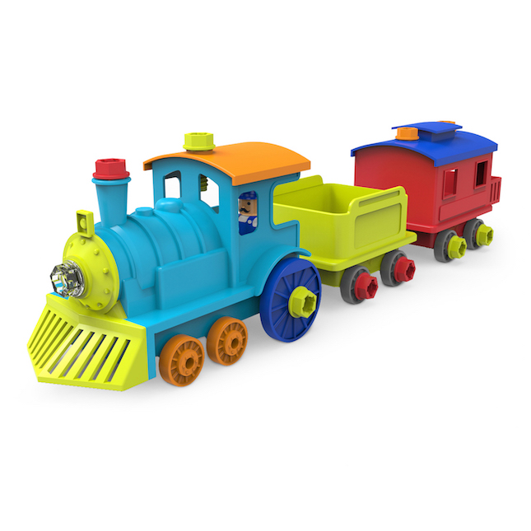


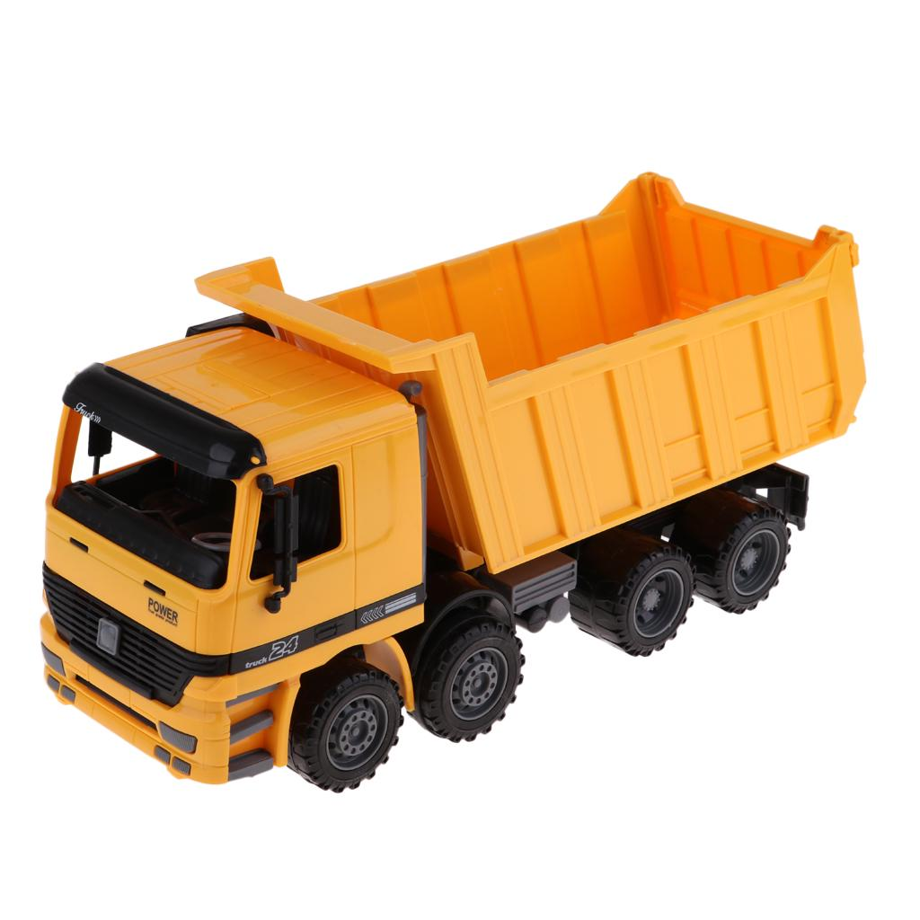
1
2
3
5
school
mountains
4
city
6
7
8
10
town
village
9

Slide 26

Website: hoclieu.vn
Fanpage: facebook.com/www.tienganhglobalsucces.vn

