Slide 2





Slide 3
Unit 4: In the countryside
Lesson 2 – Period 2

Slide 4

TABLE OF CONTENTS
Warm-up and Review
2.Activity 3: Listen and chant.
3.Activity 4: Listen and circle.
4.Activity 5: Look and write.
5.Fun corner & Wrap-up

Slide 5

01
Warm up and Review

Slide 6




Game: WHAT’S THE PICTURE?
road
Notes:
Click the shapes to see pieces of the picture for pupils to guess
Click the camera to see the picture
Click the word to hear the sound

Slide 7


rainbow
Notes:
Click the shapes to see pieces of the picture for pupils to guess
Click the camera to see the picture
Click the word to hear the sound

Slide 8



river
Notes:
Click the shapes to see pieces of the picture for pupils to guess
Click the camera to see the picture
Click the word to hear the sound

Slide 9
02
Activity 3
Listen and chant.

Slide 10



3. Listen and chant.
There’s a rainbow.
There’s a river.
There’s a road.

Slide 11
3. Listen and chant.
R, r, road.
There’s a road.
R, r, river.
There’s a river.
R, r, rainbow.
There’s a rainbow.

Slide 12

GROUPWORK

Slide 13
03
Activity 4
Listen and tick.

Slide 14


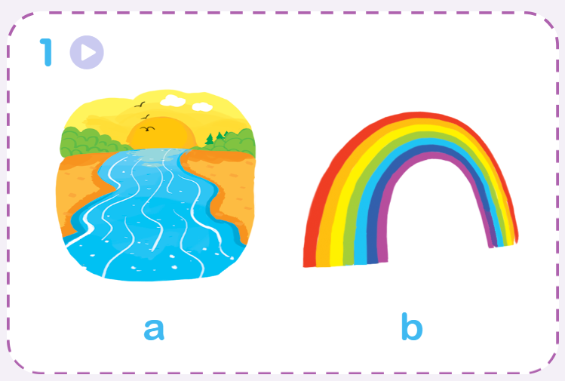
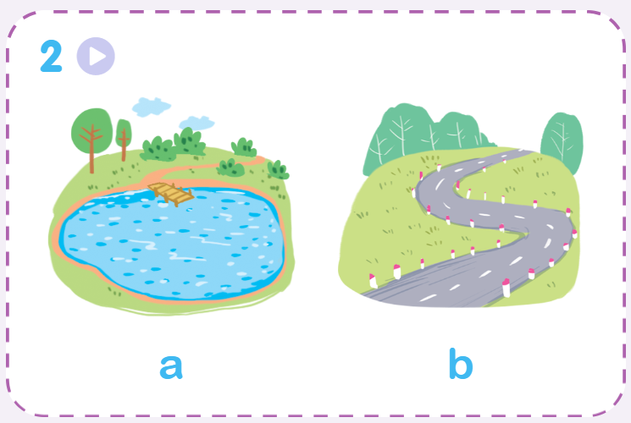
Listen and circle.

Slide 15


Listen and circle.
1.
a
b

Slide 16


Listen and circle.
2.
a
b

Slide 17
04
Activity 5
Look and write.

Slide 18







Look and write.

Slide 19
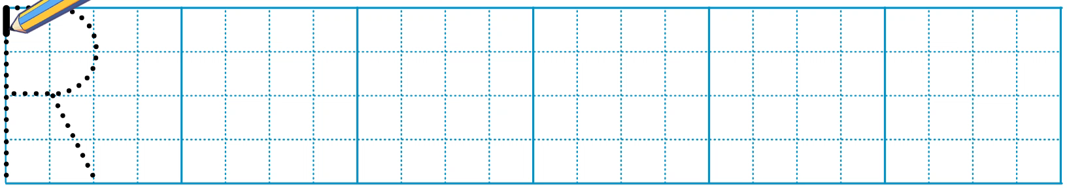
Look and write.

Slide 20
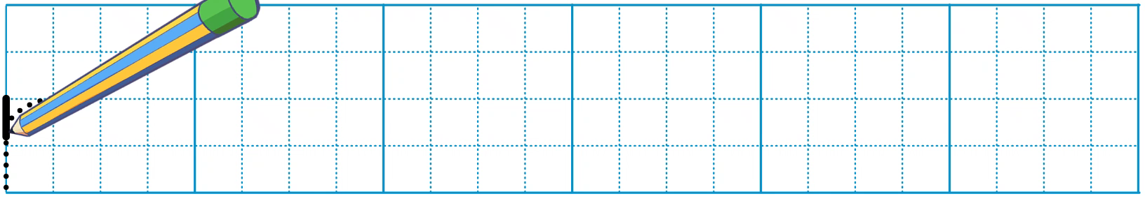
Look and write.

Slide 21
Look and write.
_oad
r

Slide 22
Look and write.
r
_iver

Slide 23
Look and write.
r
_ainbow

Slide 24
05
Fun corner and Wrap-up

Slide 25



Game: PELMANISM
river
ruler
road
Notes:
Click the penguins and hot-air balloons to see the pictures and words
Click the pictures or words to remove them

Slide 26


rainbow
river
road
Notes:
Click the penguins and hot-air balloons to see the pictures and words
Click the pictures or words to remove them

Slide 27


Slide 28

Goodbye! See you again!

Slide 29
Website: hoclieu.vn
Fanpage: https://www.facebook.com/tienganhglobalsuccess.vn/

